Slide 1

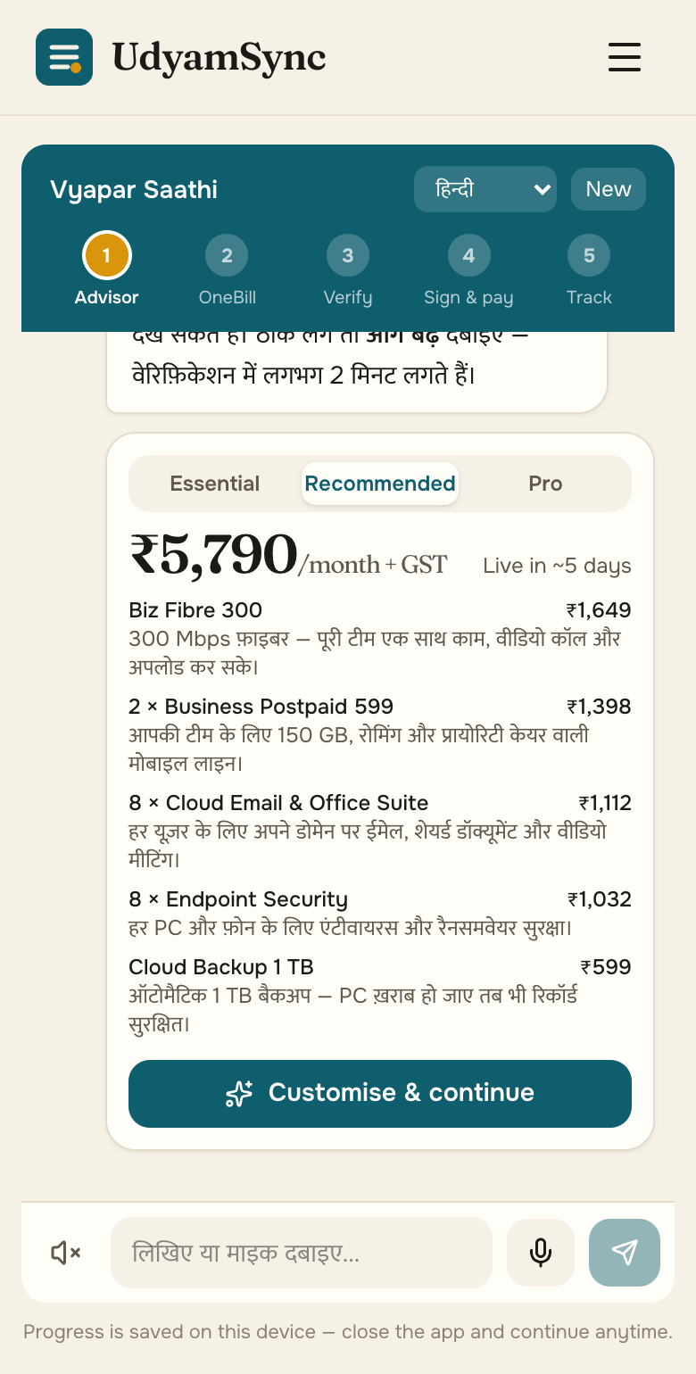
TEAM SOFTMAX
Accel UdyamSync
A small business goes online in one sitting: discover, price, verify and track on a phone, in its own language.
Working prototype · 65 tests · 12/12 KYC verdicts right · 3 + 7 GenAI languages
▶ Watch the demo (2:27)
GitHub: ac265640/UdyamSync
Live showcase: ac265640.github.io/UdyamSync · Airtel SYNC 2026 · Enterprise Track A
Notes:
Team Softmax — Accel UdyamSync. Demo video and code are linked on this slide.

Slide 2
93 of every 100 interested businesses never get switched on
Accel’s own data, 5,000 SMB leads in Apr–Jun 2026: demand is there; the journey loses them.
17.6 days
3 calls
from lead to live
customers chase their order
₹15,053
9.6% vs 2.0%
spent to win one customer
activation with vs without GSTIN
Where they leave → what UdyamSync removes
827 no time for a visit, or never scheduled
1,006 price, complex or slow quote
273 documents, paperwork, absent signatory
56 activations that broke catalogue rules
→ Self-serve advisor
→ OneBill, instant
→ Smart KYC + e-sign link
→ Rules engine blocks them

Slide 3
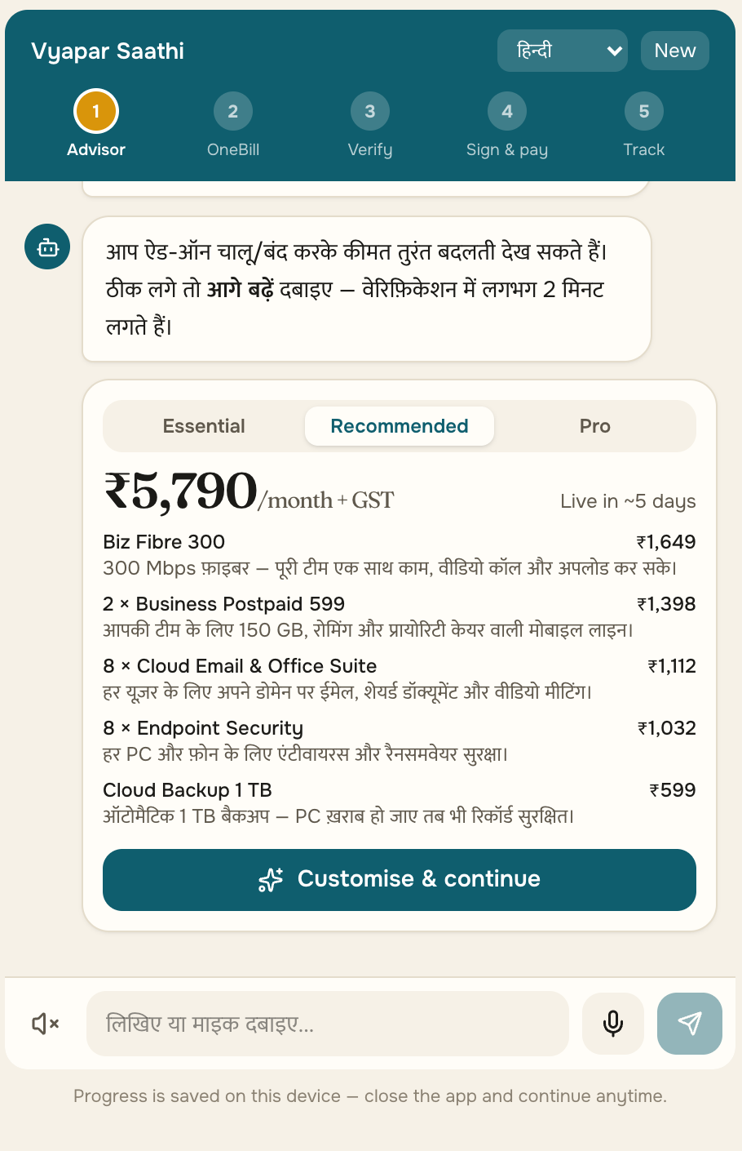
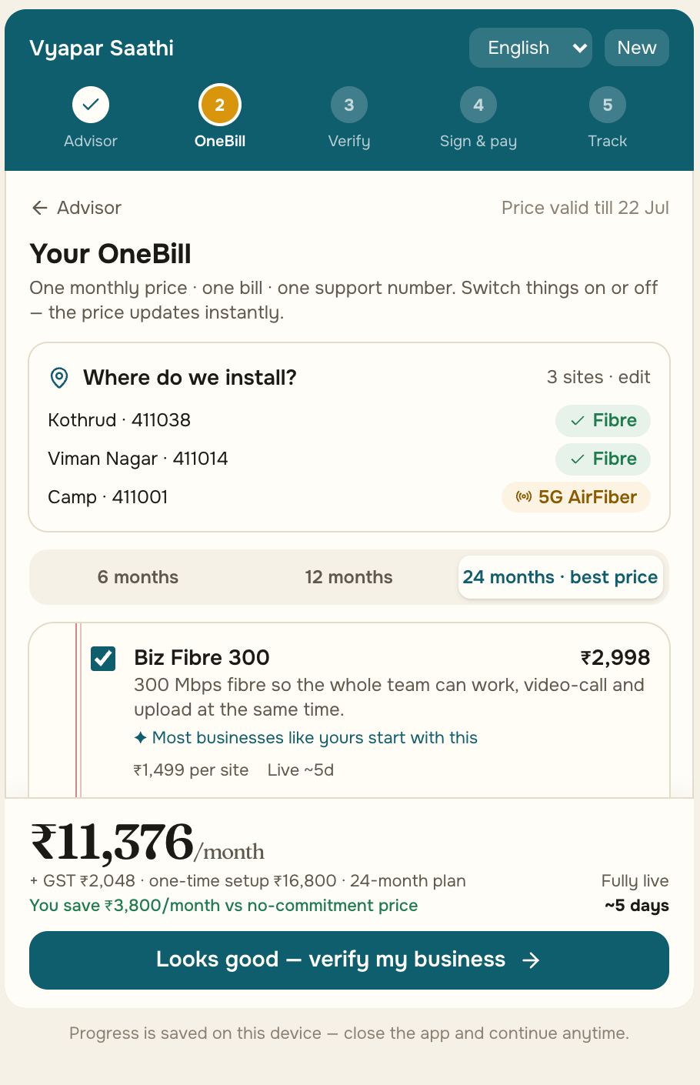
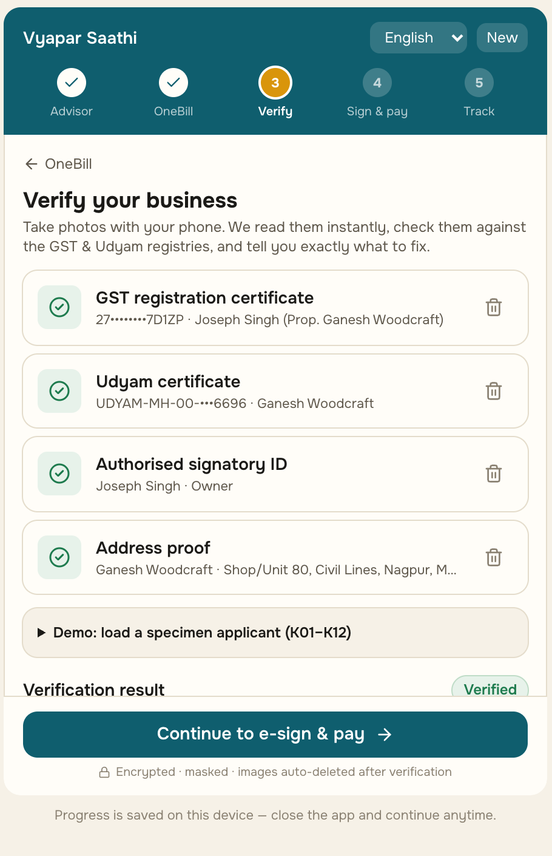
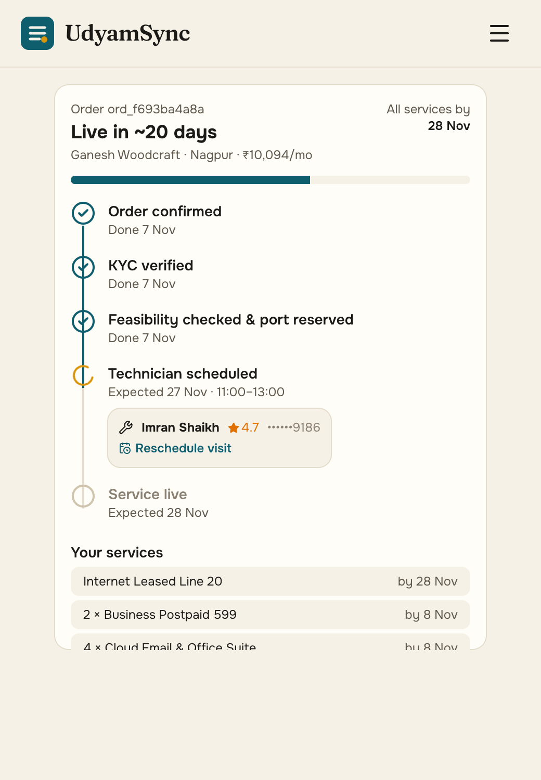
Built and live: hello to a verified order in one sitting
Every screen is the working prototype (mobile-first web); the same flow runs in a WhatsApp-style chat and on a partner tablet.
1 Discover
2 OneBill
3 Verify
4 Sign & track
Hindi voice or text; a GSTIN fills in the business from the registry.
One monthly price; add-ons re-price live; fibre or 5G AirFiber per branch pincode.
Consent first; documents read on our server and checked against GST and Udyam.
E-sign, UPI AutoPay, then an ETA per product: this order has a leased line (21 days).
65 automated tests
30/30 internal evals
12/12 KYC verdicts right
3 + 7 languages*
3/3 stretch goals
* 3 built in (Hindi, Marathi, English; work offline) + 7 via the optional GenAI layer (Gemini / Groq)

Slide 4
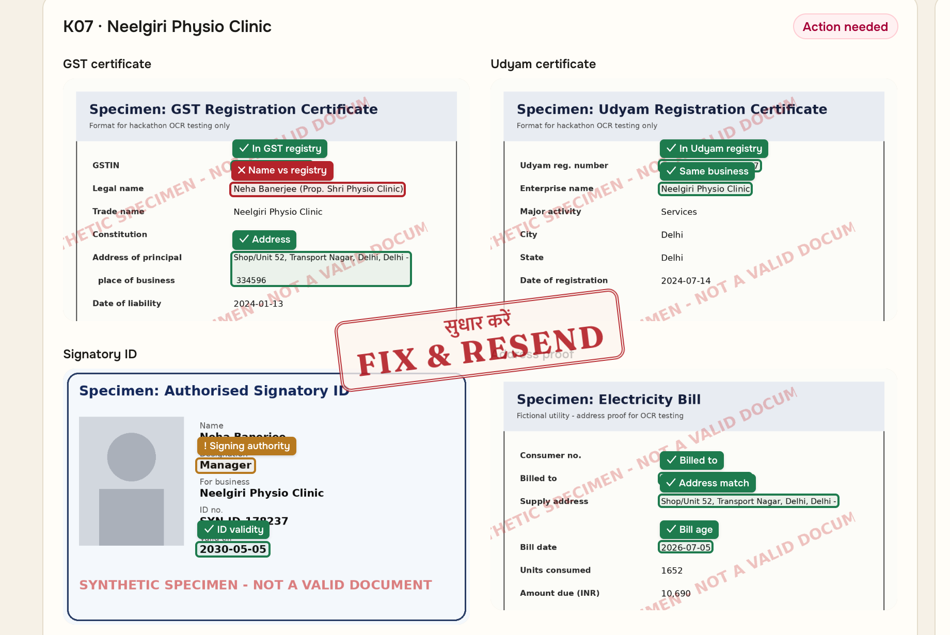
Smart KYC: all 12 specimen applicants judged correctly
Live KYC Inspector: on-server OCR + 20+ registry checks. 7 applicants had a planted problem, 5 were clean.
7 planted problems, all caught
K01
Cancelled GSTIN + blank Udyam number
K02
7° tilted scan, auto-straightened
K04
Blurred GST certificate
K05
Udyam certificate missing
K06
GSTIN typo: checksum fails, fix suggested
K07
Business name edited vs registry
K11
Utility bill 257 days old (limit 90)
5 clean
K03, K08–K10, K12 passed as clean
DPDP Act by design
Consent per purpose before upload · Aadhaar number never collected · OCR on our own server · images purged 30 days after verification · full 1-page privacy note filed separately

Slide 5
Digital fit × volume decides who goes self-serve
Bundles: the advisor’s live pick for a typical business in each segment (prices ex-GST). Conversion and payback: smb_leads.csv.
Segment · share of base | Recommended bundle (typical business) | Price / mo | Contract | Conv. today | Payback* | Channel
Professional offices · 25% Clinic, CA firm, 14 staff | Biz Fibre 300 + 4 business SIMs + cloud email and endpoint security, 14 seats | ₹8,197 | 12 mo, no setup fee | 11.1% | 1.6 → 0.6 mo | Self-serve web
Micro retail & services · 55% Kirana, salon, pharmacy | Biz Fibre 100 + 2 business SIMs + WhatsApp Business (entry ₹1,448: fibre + SIM) | ₹3,046 | 12 mo, no setup fee | 4.1% | 8.1 → 1.6 mo | WhatsApp + partner
Small multi-site · 15% Restaurant chain, 5 outlets | Fibre 300 + SIM per outlet, 20 cloud CCTV, 4G/5G failover per site, one bill | ₹16,965 | 24 mo, ₹21,750 setup | 11.0% | 0.6 mo | Field sales
Small manufacturers · 5% Auto-parts unit, 85 staff | 20 Mbps leased line + 9 SIMs + email and security, 29 seats; IoT in Pro tier | ₹19,887 | 24 mo, ₹5,000 setup | 12.8% | 1.0 mo | Field sales
* Payback = acquisition cost ÷ monthly bundle revenue (revenue, not margin). Today’s cost per segment → UdyamSync blended ₹3,964, shown for the self-serve segments.
Self-serve where it fits
Kirana: volume, not margin
Field sales where it pays
Offices and kirana are 80% of the base, single-site, with needs a 3-question advisor can price. Offices lead: 86% have a GSTIN, so KYC is instant.
Worst conversion (4.1%) and payback (8.1 mo) today, so only the cheapest channel works: WhatsApp, Essential tier, partner-assisted KYC.
Chains and factories convert well and pay back fastest, but need surveys, SD-WAN and leased lines. The advisor qualifies; a rep closes.

Slide 6
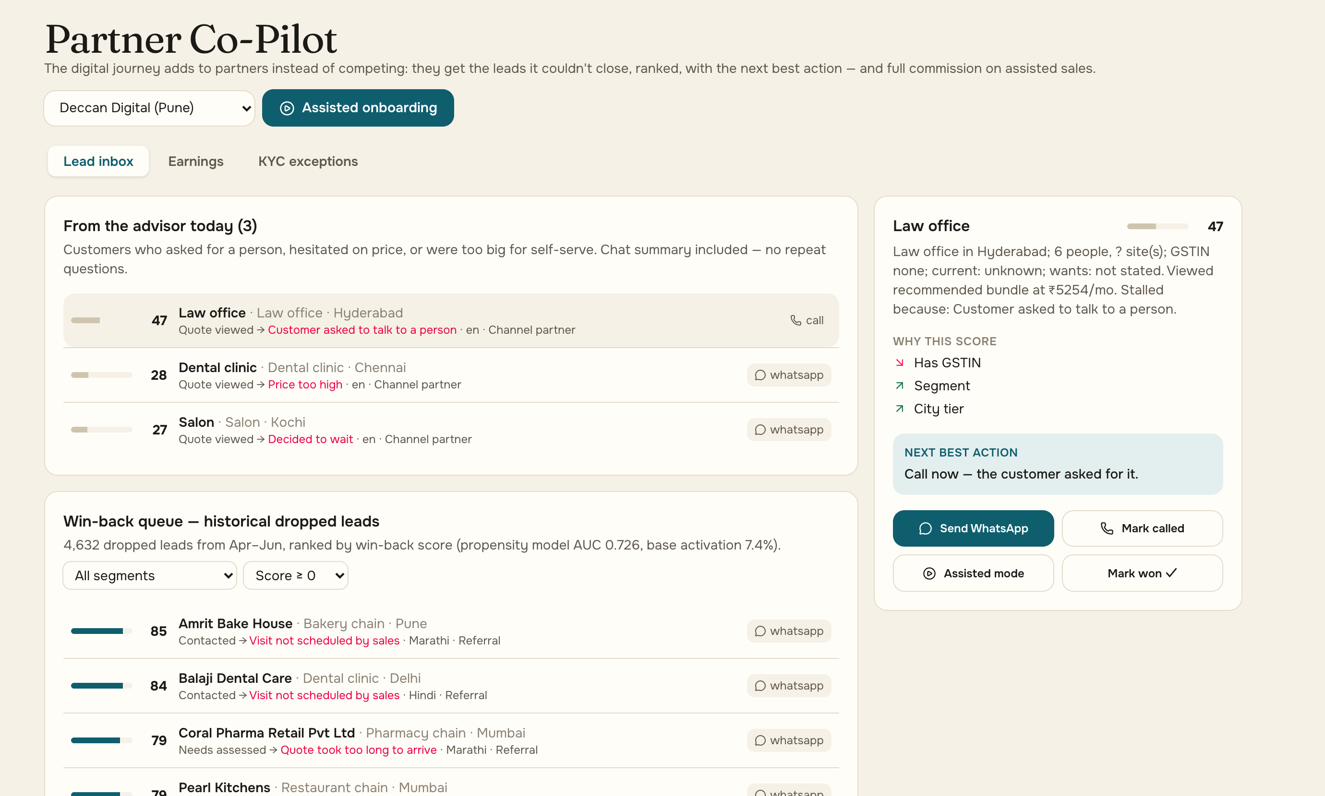
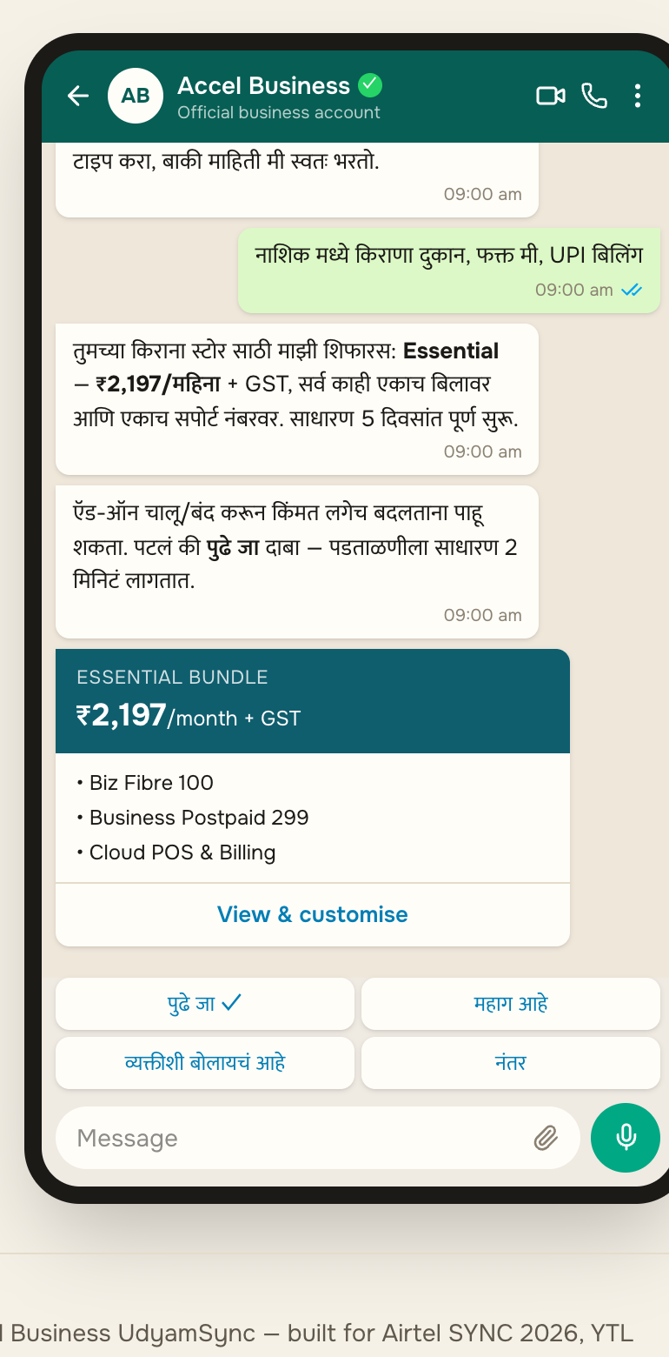
The app adds to the field force and partners; it never competes
Live Partner Co-Pilot: leads the advisor can’t close go to the local partner (with the owner’s consent), ranked, with the chat summary.
Who does what
1
Advisor (web, voice, chat)
Self-serve for offices and kirana: discovery, quote, KYC, e-sign, tracking
2
Channel partners
Get every consented stalled lead in their area, plus commission on digital sales there
3
Field sales
Multi-site and factory deals only; the advisor qualifies and books the survey
WhatsApp-style chat (mock); production uses the WhatsApp Business API
Why partners and reps say yes
827 leads drop today because no visit happened. These become warm, pre-qualified calls: fewer wasted visits, more closes, credit kept.
4,632 dropped leads ranked by a win-back score: propensity model (AUC 0.73) × how recoverable the drop reason is
Assisted mode on a tablet; KYC exceptions fixed with the owner

Slide 7
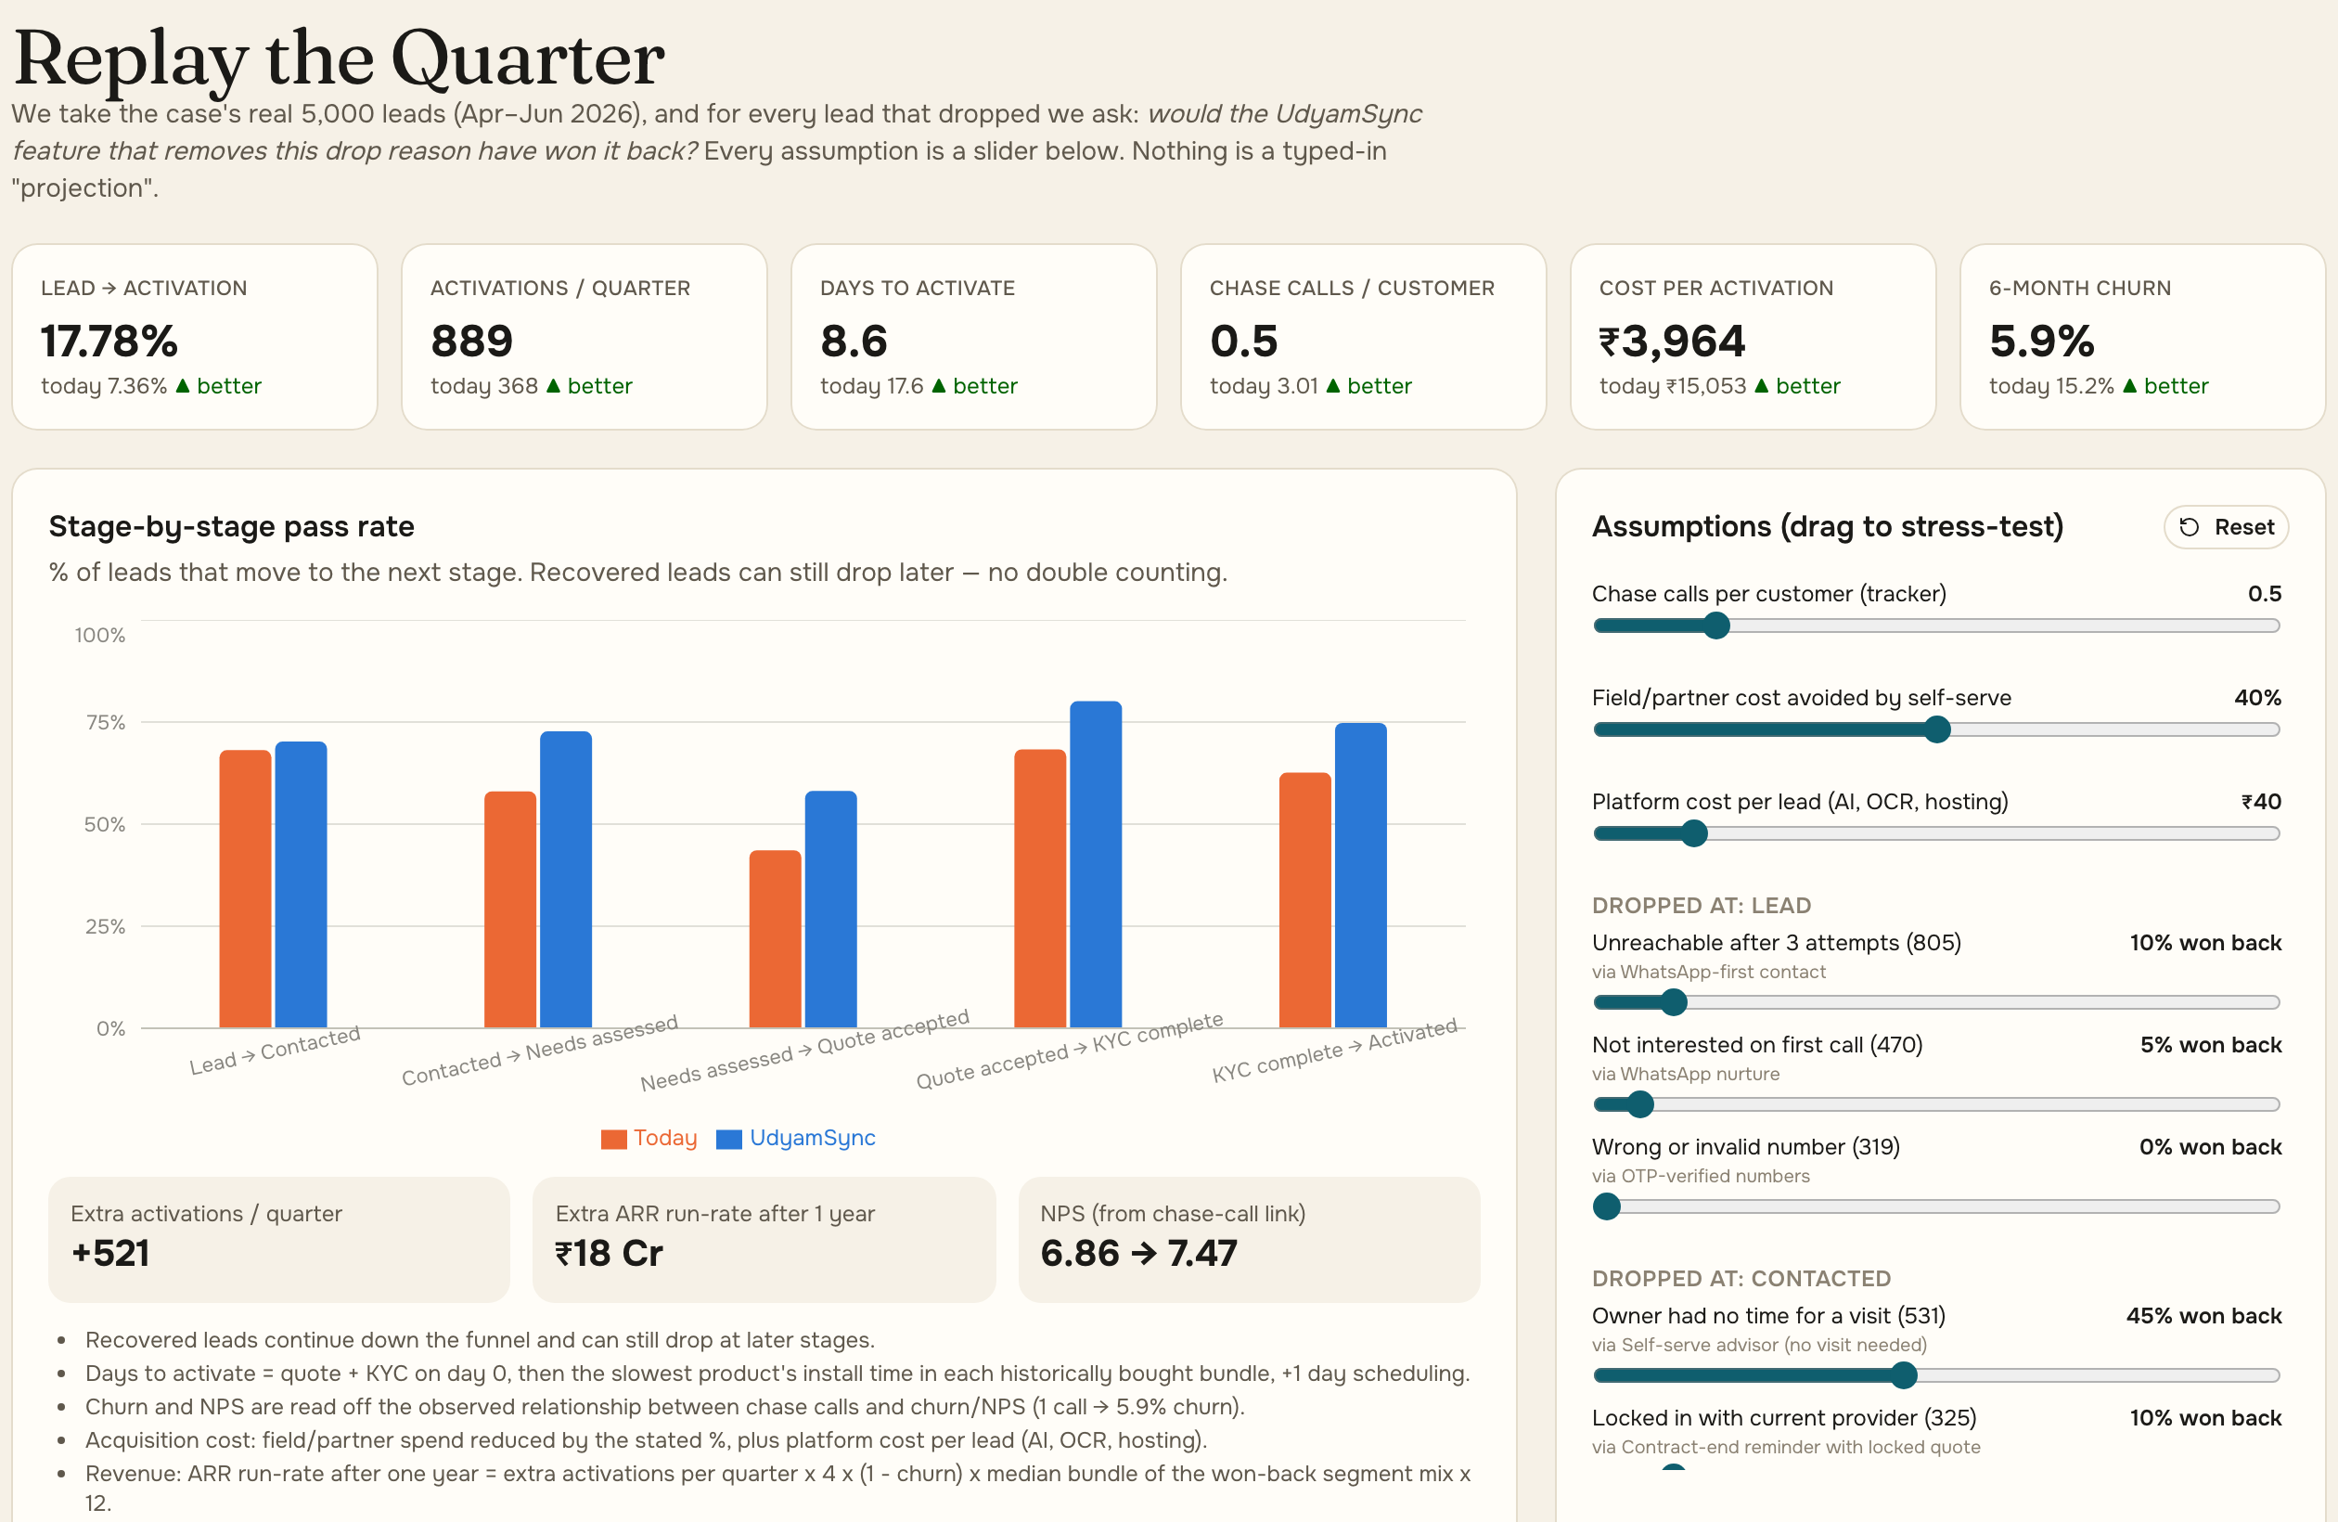
Five metrics, conservative targets: same 5,000 leads replayed
Live Insights screen: each drop reason is won back only by the feature that removes it, at cautious 10–50% rates (all adjustable).
Metric | Today | Replayed | Pilot target
Lead → activation | 7.36% | 17.8% | ≥ 12%
Days lead → live | 17.6 | 8.6 | ≤ 12
Cost per activation | ₹15,053 | ₹3,964 | ≤ ₹7,500
Chase calls / customer | 3.0 | 0.5 | ≤ 1.0
6-month churn | 15.2% | 5.9% | ≤ 11%
Targets sit well under the replay, so the pilot is judged on a margin of safety, not on our own model.
Days: quote, KYC and e-sign happen in one sitting, so only install time is left, and it depends on the product: AirFiber 2 days, fibre 5, leased line 21–30.
Churn: 1 call → 5.9%, 5 calls → 27.9% is a correlation. If only half of it is causal, churn still falls to about 10.6%.
Cost: field spend −40% on self-served leads, plus about ₹40 platform cost per lead (AI, OCR, hosting).
+521
≈ ₹18 Cr
56 → 0
activations a quarter (2.4×)
ARR run-rate after year 1
rule-breaking sales
₹18 Cr = 521 × 4 qtrs × 94% kept × ₹7,771 avg bundle × 12

Slide 8
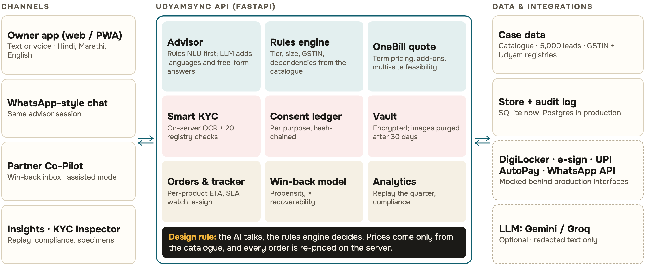
Architecture: the AI talks, the rules engine decides
Full diagram + data flows (PDF) ↗
Mocks sit behind production interfaces, so the pilot swaps adapters, not logic.

Slide 9
Rollout in three gates, and the risks that could stop it
Each phase starts only when the previous one meets the pilot targets on slide 7.
0–90 days Pilot: Pune + Jaipur
Risk | How we handle it
Technician capacity | Faster sales can swamp install crews: city launches are gated on crew capacity, the SLA watch flags installs at risk of passing 21 days, and AirFiber (2 days) covers fibre backlogs.
Field force pushback | Reps keep credit for advisor-qualified leads in their territory and focus on high-value multi-site and factory deals.
Partner pushback | Stalled leads and commission flow to them; assisted mode makes them faster, not redundant.
Payment / AutoPay failure | UPI mandate retry, then card or net-banking mandate; the order is held, not cancelled, with WhatsApp reminders.
Wrong AI answer | Prices only from the catalogue; internal 30-scenario eval in CI (the judges’ scenarios will differ).
Document fraud | Registry cross-checks, tamper and name-match flags, human exception queue.
Offices on web, kirana on WhatsApp, 20 partners. Real DigiLocker and e-sign; compliance sign-off on KYC retention first.
3–6 months 6 cities
GSP registry APIs, NPCI AutoPay, WhatsApp Business API. Field reps get advisor-qualified leads.
6–12 months All tier 1–2 cities
Multi-site and factory deals run through the Co-Pilot; LLM on an enterprise no-training tier.

Slide 10
Everything the brief asked for, answered
Key questions, build challenge and the four deliverables from the case, each mapped to where it is shown.
The brief asks | Our answer | Where
Q1 Segments and bundles | ✓ Digital fit × volume; 4 bundles with products, price, contract | Slide 5
Q2 Discovery without a salesperson | ✓ Advisor: 3 languages built in + 7 via GenAI, voice or text, GSTIN pre-fill | Slide 3, video
Q3 Near-instant, DPDP-compliant KYC | ✓ Registry lookup, on-server OCR, DigiLocker, e-sign; consent per purpose | Slide 4, privacy note
Q4 Role of field force and partners | ✓ Partners get consented stalled leads + commission; reps keep big deals | Slide 6
Q5 Metrics and targets | ✓ 5 metrics: today, replayed, conservative pilot target | Slide 7
Build: advisor, quote, KYC, tracker | ✓ All 4 built; stretch: voice, WhatsApp-style chat, partner view, propensity | Slide 3, video
Deliverables 1–4 | ✓ Video 2:27 + code · architecture PDF · this 10-slide case · 1-page privacy note | Links below
▶ Watch the demo (2:27)
GitHub repository
Team Softmax
Live showcase:
ac265640.github.io/UdyamSync
github.com/ac265640/UdyamSync
Architecture (PDF)
Privacy note (PDF)

