Slide 1

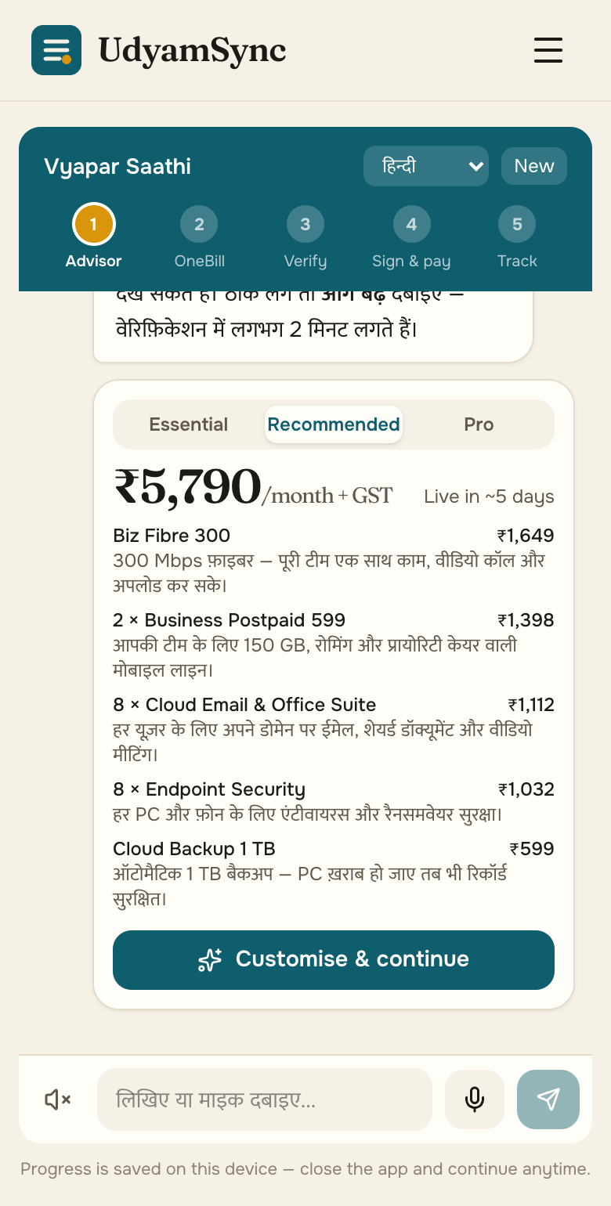
TEAM SOFTMAX
Accel UdyamSync
A small business goes online in one sitting: discover, price, verify and track on a phone, in its own language.
Working prototype · 65 tests · 12/12 KYC traps caught · 10 languages · ₹0 to run
▶ Watch the demo (2:27)
GitHub: ac265640/UdyamSync
Live showcase: ac265640.github.io/UdyamSync · Airtel SYNC 2026 · Enterprise Track A
Notes:
Team Softmax — Accel UdyamSync. Demo video and code are linked on this slide.

Slide 2
93 of every 100 interested businesses never get switched on
Accel’s own data, 5,000 SMB leads in Apr–Jun 2026: demand is there; the journey loses them.
17.6 days
3 calls
from lead to live
customers chase their order
₹15,053
9.6% vs 2.0%
spent to win one customer
activation with vs without GSTIN
Where they leave → what UdyamSync removes
827 no time for a visit, or never scheduled
1,006 price, complex or slow quote
273 documents, paperwork, absent signatory
56 activations that broke catalogue rules
→ Self-serve advisor
→ OneBill, instant
→ Smart KYC + e-sign link
→ Rules engine blocks them

Slide 3
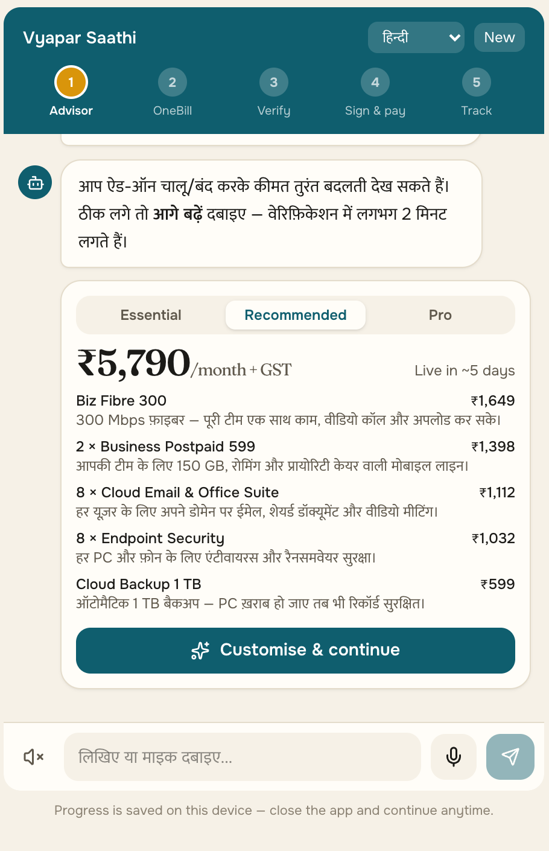
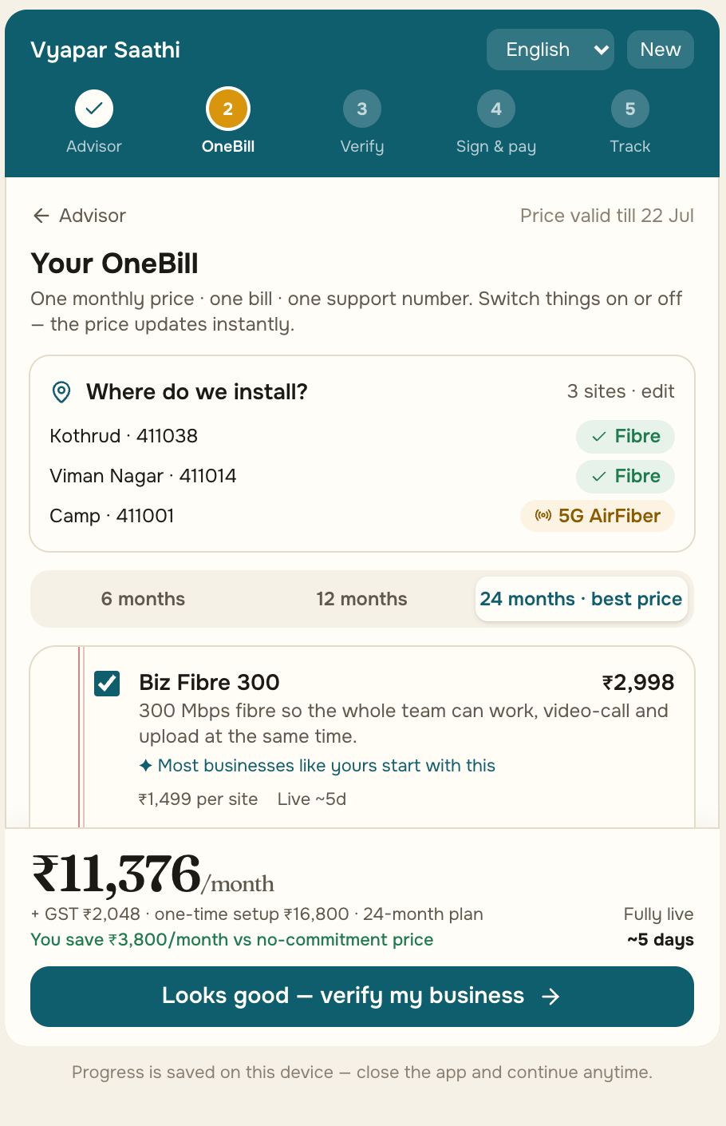
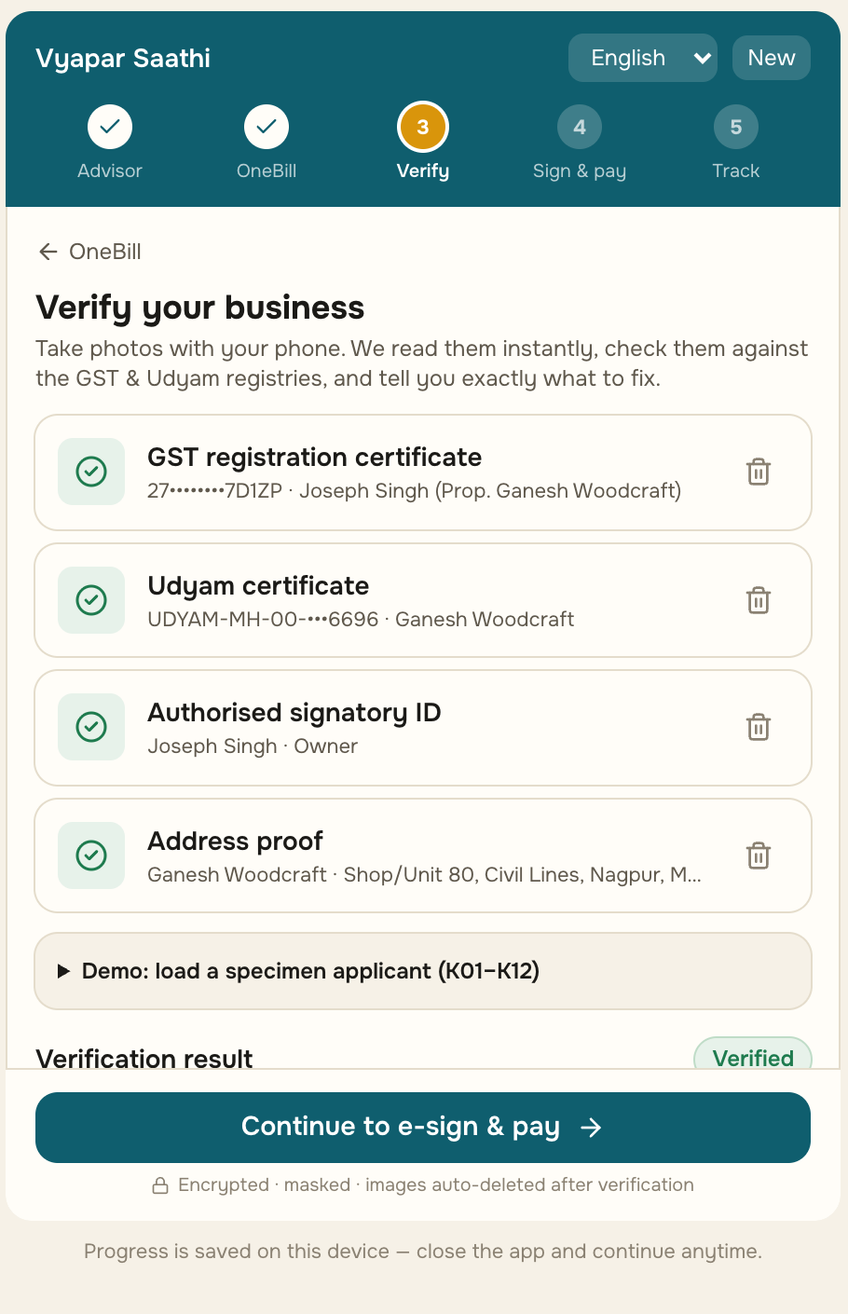
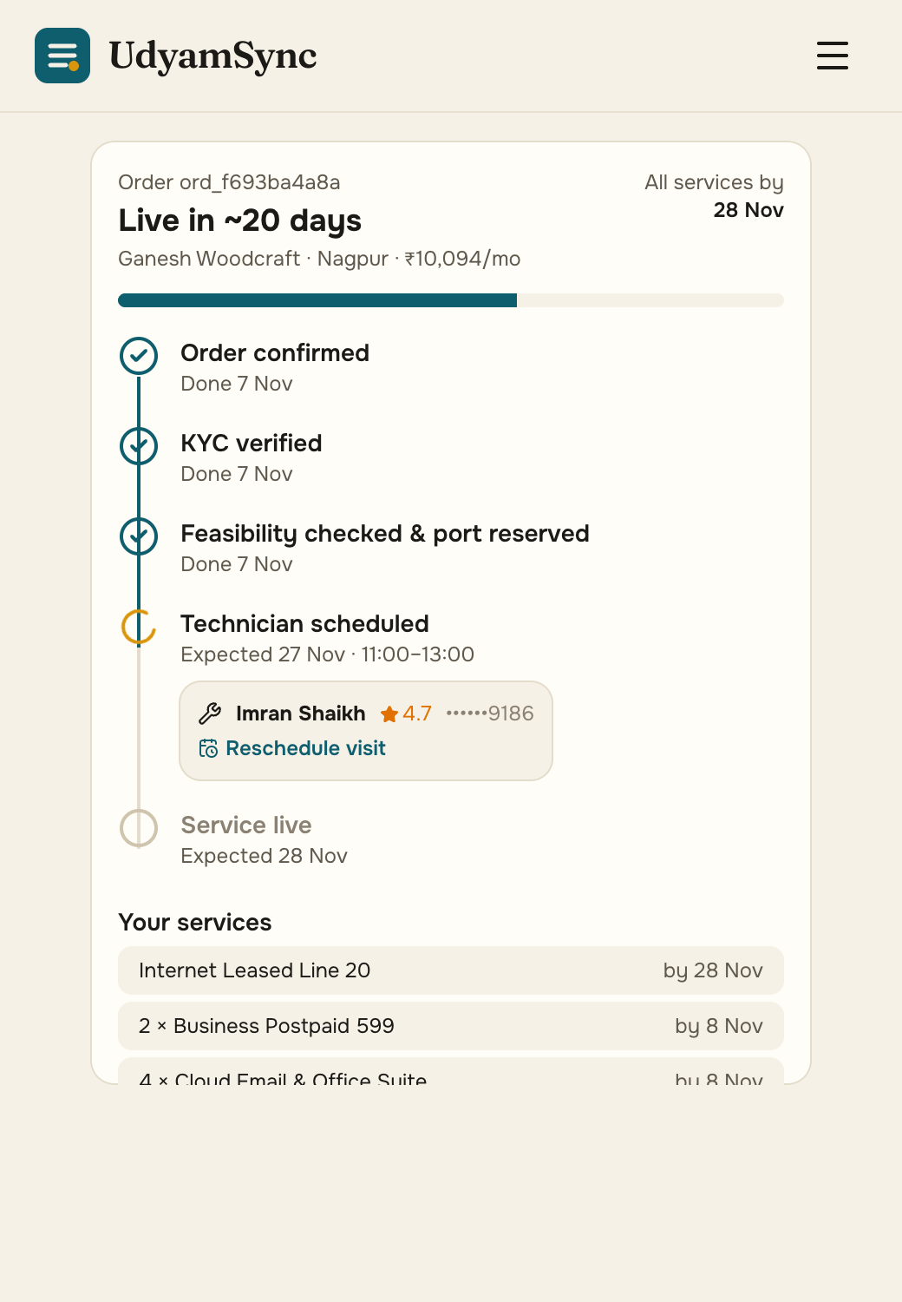
Built and live: hello to a verified order in one sitting
Every screen below is the working prototype (owner app, mobile-first web; the same flow runs in WhatsApp and on a partner’s tablet).
1 Discover
2 OneBill
3 Verify
4 Sign & track
Hindi voice or text; a GSTIN auto-fills the business from the registry.
One monthly price; add-ons re-price live; fibre or 5G AirFiber per branch pincode.
Consent first; documents read on our server and checked against GST and Udyam.
Aadhaar e-sign, slide-to-pay UPI AutoPay, 5-stage tracker with WhatsApp updates.
65 automated tests
30/30 advisor scenarios
12/12 KYC traps caught
10 languages + voice
₹0 to run (free tiers)

Slide 4
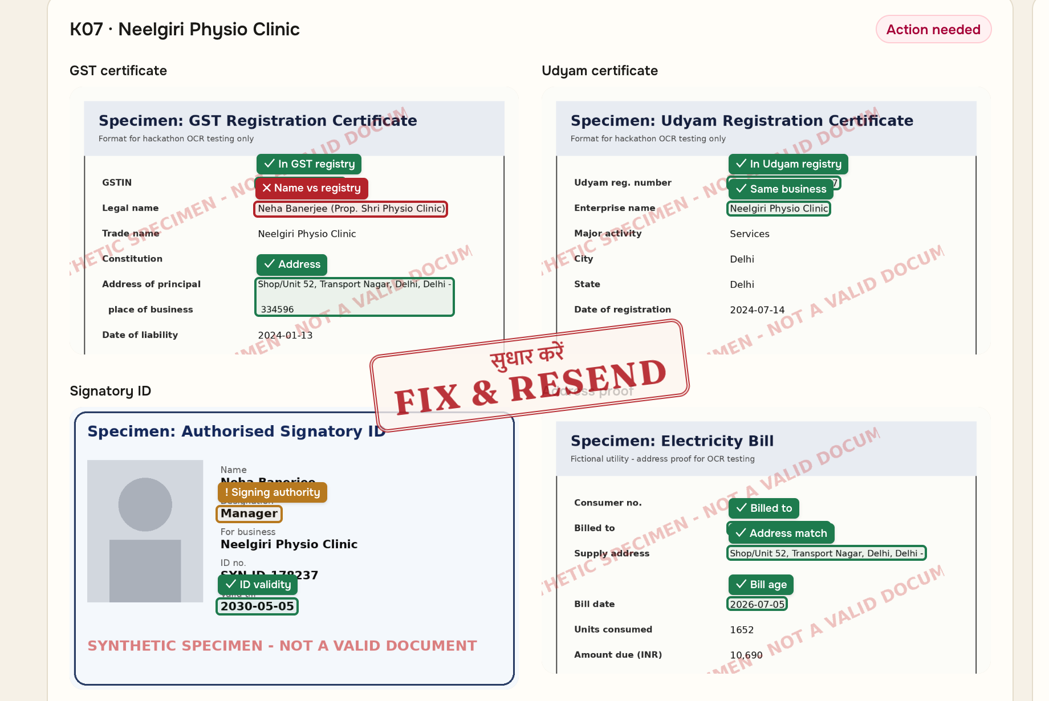
Smart KYC catches every planted problem, and shows where
Live KYC Inspector: 12 specimen applicants, on-server OCR + 20+ registry checks; boxes mark where each finding was read.
Caught in the case’s specimens
K01
Cancelled GSTIN + blank Udyam number
K02
7° tilted scan, auto-straightened
K04
Blurred GST certificate
K05
Udyam certificate missing
K06
GSTIN typo: checksum fails, fix suggested
K07
Business name edited vs registry
K11
Utility bill 257 days old (limit 90)
DPDP Act by design
Consent per purpose, hash-chained · no Aadhaar number ever stored · OCR on our own server · encrypted, purged 30 days after verification · “My Data”: view, export, erase

Slide 5
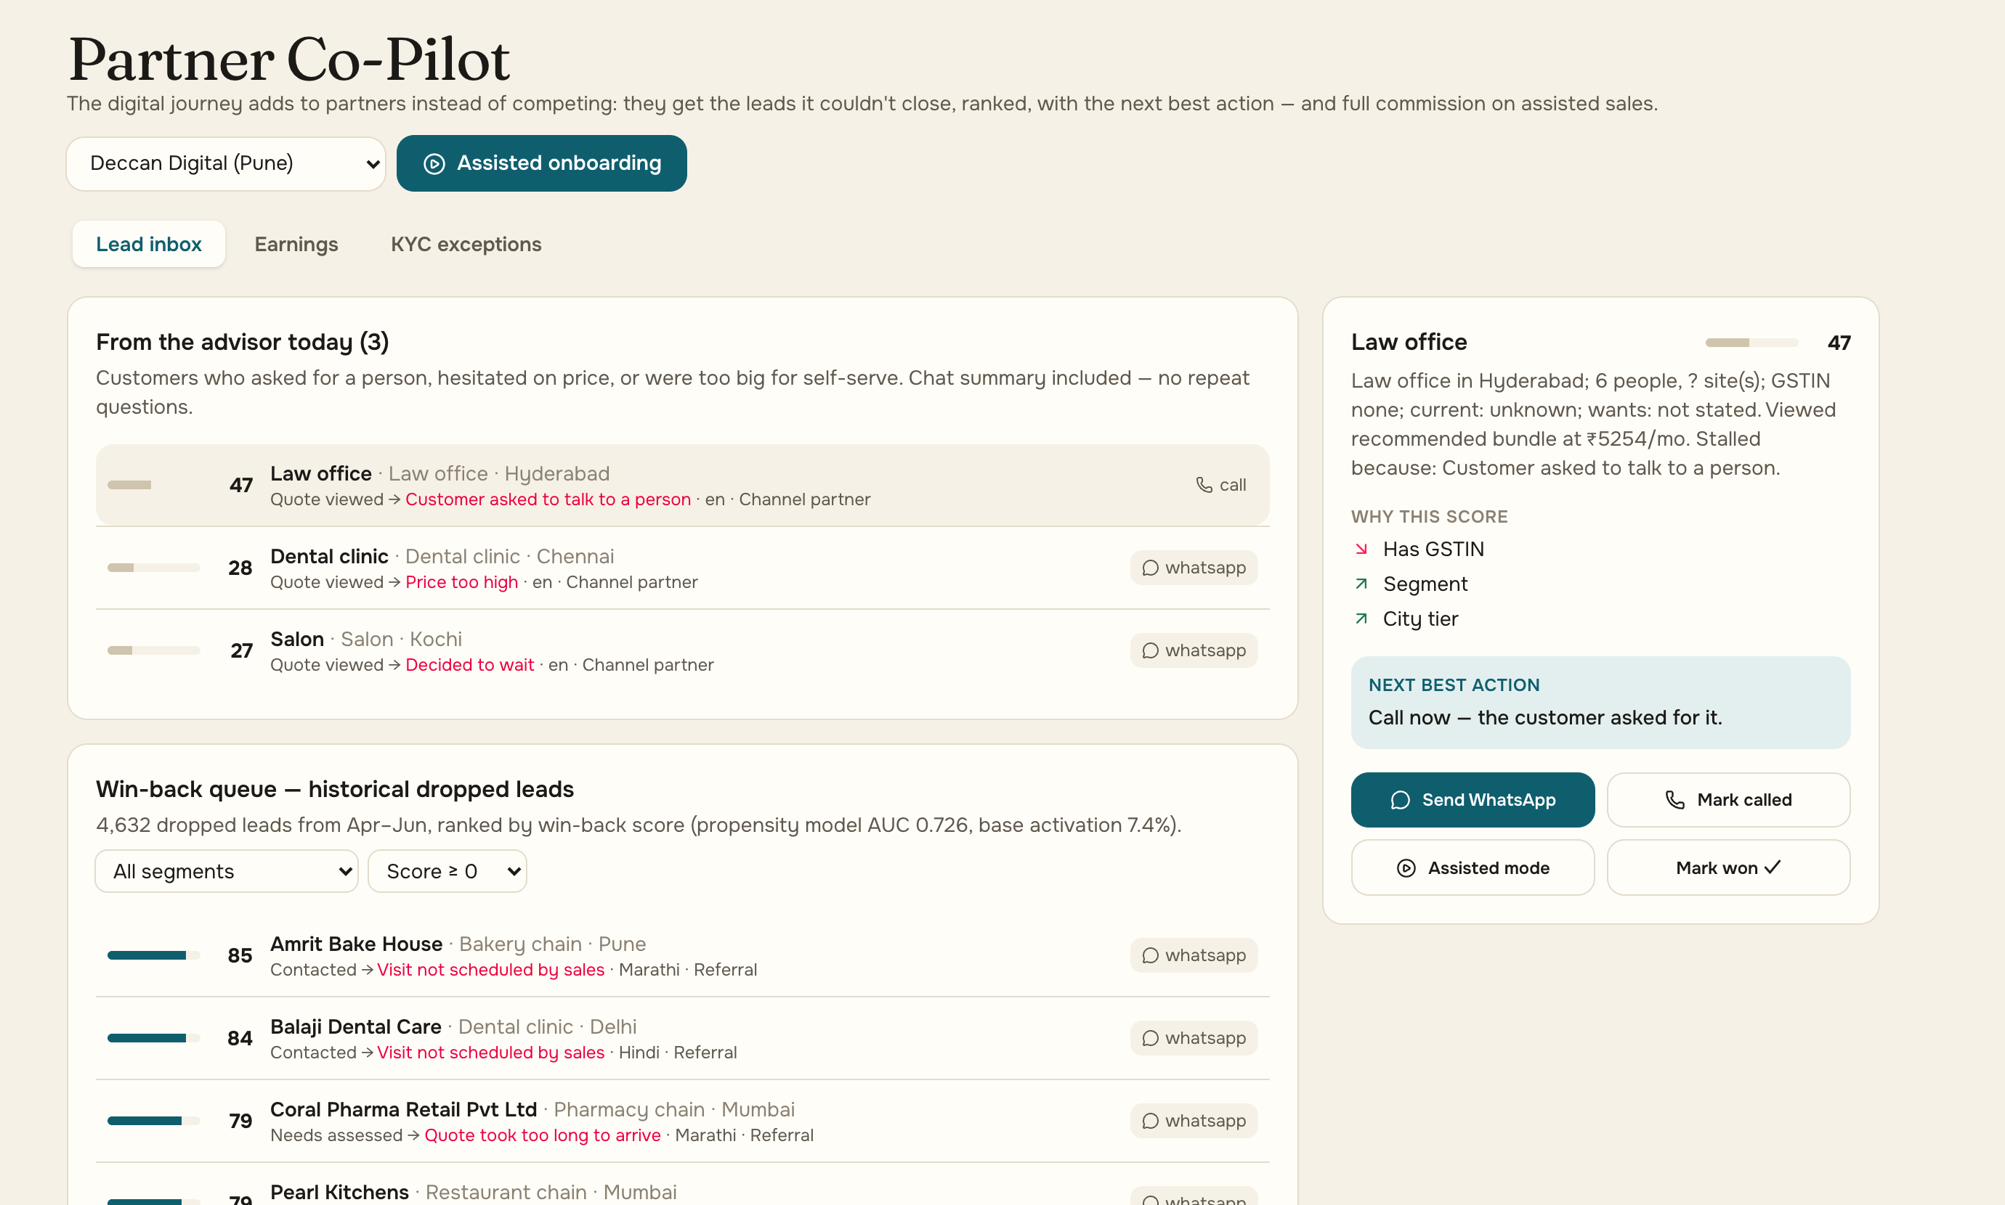
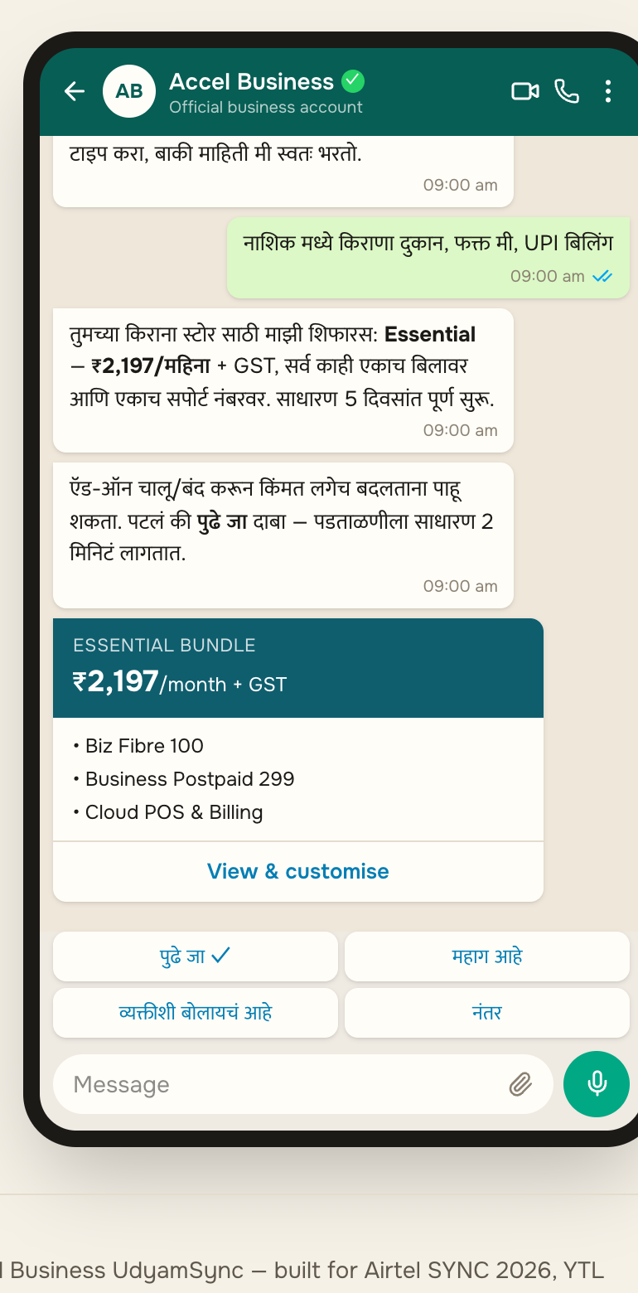
Partners stay in the deal. Offices first, kirana at scale
Segment order comes from the case economics; bundles are priced live by the prototype’s rules engine.
# | Segment | Conv. | Bundle/mo | Payback
1 | Professional offices | 11.1% | ₹6,575 | 1.6 mo
2 | Micro retail (54% of leads) | 4.1% | ₹2,470 | 8.1 mo
3 | Multi-site chains | 11.0% | ₹28,080 | 0.6 mo
4 | Manufacturers | 12.8% | ₹15,910 | 1.0 mo
Priced live by the engine
₹2,197 /mo Kirana, Nashik · WhatsApp, Marathi
₹5,790 /mo Dental clinic, Pune · Hindi voice
Every lead the advisor can’t close reaches a partner with the chat summary, a win-back score (model AUC 0.73) and the next best action
Assisted mode on a tablet; commission credited automatically, so the app never takes their customer
₹11,376 /mo 3 restaurants, Pune · 3 branches
Micro retail is reached on WhatsApp at near-zero cost to serve; field sales focus on multi-site and manufacturing.

Slide 6
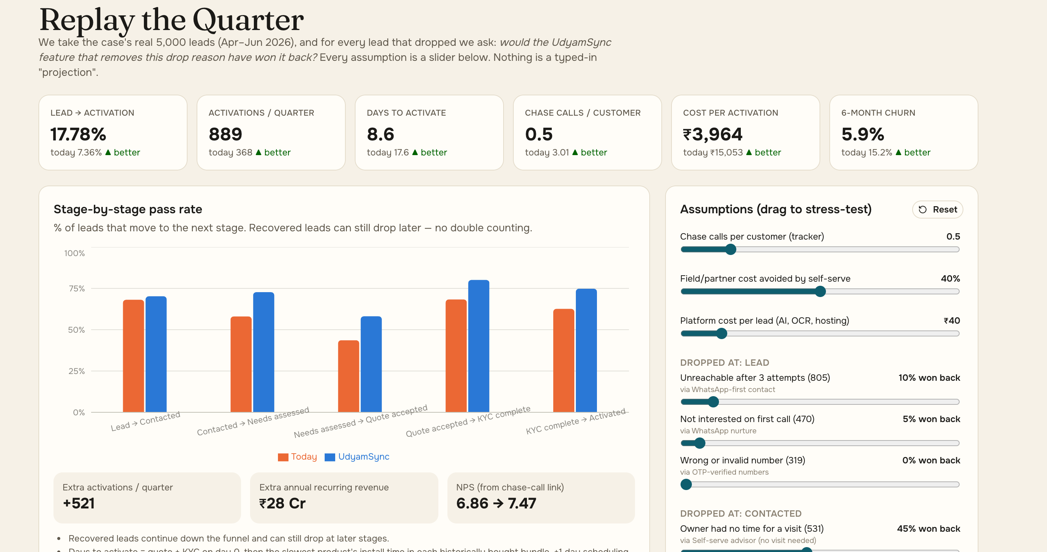
Replay the quarter: same 5,000 leads, 2.4× the activations
Live Insights screen: each drop reason is won back only by the feature that removes it, at cautious 10–50% rates.
Metric that matters | Today | Replayed | Pilot target
Lead → activation | 7.36% | 17.8% | ≥ 15%
Days lead → live | 17.6 | 8.6 | ≤ 9
Cost per activation | ₹15,053 | ₹3,964 | ≤ ₹5,000
Chase calls / customer | 3.0 | 0.5 | ≤ 0.5
6-month churn | 15.2% | 5.9% | ≤ 8%
Churn follows chase calls in the data (1 call → 5.9%, 5 calls → 27.9%); the tracker removes the calls.
Platform cost ≈ ₹40 per lead (AI, OCR, hosting); field effort shifts to leads the advisor hands over.
Compliance re-run: all 56 historical rule breaches are blocked at quote time.
+521
≈ ₹28 Cr
56 → 0
activations every quarter
new annual recurring revenue
rule-breaking sales

Slide 7
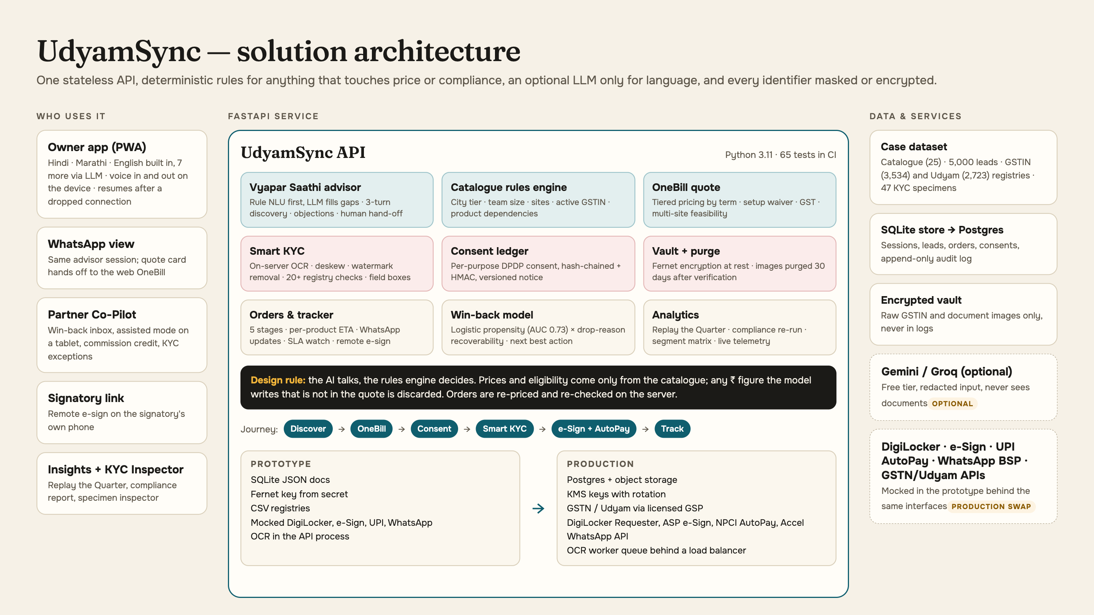
Engineered to ship: architecture, rollout, risks
The AI talks, the rules engine decides. Mocks sit behind production interfaces, so the pilot swaps adapters, not logic.
Rollout
0–90 days Pune + Jaipur pilot: offices on web, 20 partners, real DigiLocker and e-sign
3–6 months 6 cities; kirana on WhatsApp; GSP registry APIs, NPCI AutoPay
6–12 months All tier 1–2 cities; multi-site and factories via the Co-Pilot
Risks, handled
Wrong AI answer → prices only from the catalogue; 30-scenario eval in CI
Partner pushback → leads and commission flow to them
Document fraud → registry checks + human exception queue
▶ Watch the demo (2:27)
GitHub repository
Live showcase
Team Softmax
FastAPI · React · GSAP · RapidOCR · scikit-learn
github.com/ac265640/UdyamSync · ac265640.github.io/UdyamSync

