Slide 1
Security for Operating Systems: Cryptography, Authentication, and Protecting OS Resources CS 111 Operating Systems Peter Reiher

Slide 2
Outline
Basic concepts in computer security
Design principles for security
Important security tools for operating systems
Access control
Cryptography and operating systems
Authentication and operating systems
Protecting operating system resources

Slide 3
Cryptography
Much of computer security is about keeping secrets
One method of doing so is to make it hard for others to read the secrets
While (usually) making it simple for authorized parties to read them
That’s what cryptography is all about

Slide 4
What Is Encryption?
Encryption is the process of hiding information in plain sight
Transform the secret data into something else
Even if the attacker can see the transformed data, he can’t understand the underlying secret
Usually, someone you want to understand it can

Slide 5
Cryptography Terminology
Typically described in terms of sending a message
Though it’s used for many other purposes
The sender is S
The receiver is R
Encryption is the process of making message unreadable/unalterable by anyone but R
Decryption is the process of making the encrypted message readable by R
A system performing these transformations is a cryptosystem
Rules for transformation sometimes called a cipher

Slide 6
Plaintext and Ciphertext
Plaintext is the original form of the message (often referred to as P)
Transfer $100 to my savings account
Ciphertext is the encrypted form of the message (often referred to as C)
Sqzmredq #099 sn lx rzuhmfr zbbntms

Slide 7
Cryptographic Keys
Most cryptographic algorithms use a key to perform encryption and decryption
Referred to as K
The key is a secret
Without the key, decryption is hard
With the key, decryption is easy
Reduces the secrecy problem from your (long) message to the (short) key
But there’s still a secret

Slide 8
More Terminology
The encryption algorithm is referred to as E()
C = E(K,P)
The decryption algorithm is referred to as D()
The decryption algorithm also has a key
The combination of the two algorithms are often called a cryptosystem

Slide 9
Symmetric and Asymmetric Cryptosystems
Symmetric cryptosystems use the same keys for E and D :
P = D(K, C)
Expanding, P = D(K, E(K,P))
Asymmetric cryptosystems use different keys for E and D:
C = E(K_{E},P)
P = D(K_{D},C)
Expanding, P = D(K_{D} , E(K_{E} ,P))

Slide 10
Desirable Characteristics of Keyed Cryptosystems
If you change only the key, a given plaintext encrypts to a different ciphertext
Same applies to decryption
Changes in the key ideally should cause unpredictable changes in the ciphertext
Decryption should be hard without knowing the key
The less a given key is used, the better (in security terms)

Slide 11
Cryptography and Operating Systems
What does cryptography have to offer operating systems?
Which hard security problems in operating systems can we solve with cryptography?
Where doesn’t it help?

Slide 12
Cryptography and Secrecy
Pretty obvious for networks
Only those knowing the proper keys can decrypt an encrypted message
Thus preserving secrecy
Used cleverly, it can provide other forms of secrecy
Clear where we’d use this for distributed systems
Where does it make sense in a single machine?

Slide 13
Cryptography and Authentication
How can I prove to you that I created a piece of data?
What if I give you the data in encrypted form?
Using a key only you and I know
Then only you or I could have created it
Unless one of us told someone else the key . . .
Or one of us is trying to screw the other

Slide 14
Cryptography and Integrity
Changing one bit of a piece of ciphertext completely garbles it
For many forms of cryptography
If a checksum is part of encrypted data, that’s detectable
If you don’t need secrecy, can get the same effect
By encrypting only the checksum

Slide 15
Symmetric Cryptosystems
C = E(K,P)
P = D(K,C)
E() and D() are not necessarily the same operations

Slide 16
Advantages of Symmetric Cryptosystems
Encryption and authentication performed in a single operation
Well-known (and trusted) ones perform much faster than asymmetric key systems
No centralized authority required
Though key servers help a lot

Slide 17
Disadvantages of Symmetric Cryptosystems
Encryption and authentication performed in a single operation
Makes signature more difficult
Non-repudiation hard without servers
Key distribution can be a problem
Scaling
Especially for Internet use

Slide 18
Some Popular Symmetric Ciphers
The Data Encryption Standard (DES)
The old US encryption standard
Still fairly widely used, due to legacy
Weak by modern standards
The Advanced Encryption Standard (AES)
The current US encryption standard
Probably the most widely used cipher
Blowfish
There are many, many others

Slide 19
Symmetric Ciphers and Brute Force Attacks
If your symmetric cipher has no flaws, how can attackers crack it?
Brute force – try every possible key until one works
The cost of brute force attacks depends on key length
Assuming random choice of key
For N possible keys, attack must try N/2 keys, on average, before finding the right one

Slide 20
How Long Are the Keys?
DES used 56 bit keys
Brute force attacks on that require a lot of time and resources
But they are demonstrably possible
Attackers can thus crack DES, if they really care
AES uses either 128 bit or 256 bit keys
Even the shorter key length is beyond the powers of brute force today
2¹²⁷ decryption attempts is still a lot, by any standard

Slide 21
Asymmetric Cryptosystems
Often called public key cryptography
Or PK, for short
The encrypter and decrypter have different keys
C = E(K_{E},P)
P = D(K_{D},C)
Often works the other way, too
C’ = E(K_{D},P)
P = D(K_{E},C’)

Slide 22
Using Public Key Cryptography
Keys are created in pairs
One key is kept secret by the owner
The other is made public to the world
Hence the name
If you want to send an encrypted message to someone, encrypt with his public key
Only he has private key to decrypt

Slide 23
Authentication With Public Keys
If I want to “sign” a message, encrypt it with my private key
Only I know private key, so no one else could create that message
Everyone knows my public key, so everyone can check my claim directly
Much better than with symmetric crypto
The receiver could not have created the message
Only the sender could have

Slide 24
PK Key Management
To communicate via shared key cryptography, key must be distributed
In trusted fashion
To communicate via public key cryptography, need to find out each other’s public key
“Simply publish public keys”
Not really that simple, for most cases

Slide 25
Issues With PK Key Distribution
Security of public key cryptography depends on using the right public key
If I am fooled into using wrong one, that key’s owner reads my message
Need high assurance that a given key belongs to a particular person
Either a key distribution infrastructure
Or use of certificates
Both are problematic, at high scale and in the real world

Slide 26
The Nature of PK Algorithms
Usually based on some problem in mathematics
Like factoring extremely large numbers
Security less dependent on brute force
More on the complexity of the underlying problem

Slide 27
Choosing Keys for Asymmetric Ciphers
For symmetric ciphers, the key can be any random number of the right size
You can’t do that for asymmetric ciphers
Only some public/private key pairs “work”
Generally, finding a usable pair takes a fair amount of time
E.g., for RSA you perform operations on 100-200 digit prime numbers to get keys
You thus tend to use one public/private key pair for a long time
Issues of PK key distribution and typical usage also suggest long lifetimes for these keys

Slide 28
Example Public Key Ciphers
RSA
The most popular public key algorithm
Used on pretty much everyone’s computer, nowadays
Elliptic curve cryptography
An alternative to RSA
Tends to have better performance
Not as widely used or studied

Slide 29
Security of PK Systems
Based on solving the underlying problem
E.g., for RSA, factoring large numbers
In 2009, a 768 bit RSA key was successfully factored
Research on integer factorization suggests keys up to 2048 bits may be insecure
In 2013, Google went from 1024 to 2048 bit keys
Size will keep increasing
The longer the key, the more expensive the encryption and decryption

Slide 30
Combined Use of Symmetric and Asymmetric Cryptography
Very common to use both in a single session
Asymmetric cryptography essentially used to “bootstrap” symmetric crypto
Use RSA (or another PK algorithm) to authenticate and establish a session key
Use DES or AES with session key for the rest of the transmission

Slide 31


For Example,
Alice wants to share K_{S} only with Bob
Bob wants to be sure it’s Alice’s key
Only Bob can decrypt it
Alice
Bob
K_{EA}
K_{DA}
Only Alice could have created it
K_{EB}
K_{DB}
K_{DB}
K_{DA}
C=E(K_{S},K_{DB})
K_{S}=D(C,K_{EB})
C=D(M,K_{DA})
M
K_{S}
M=E(C,K_{EA})

Slide 32
Authentication for Operating Systems
What is authentication?
How does the problem apply to operating systems?
Techniques for authentication in operating systems

Slide 33
What Is Authentication?
Determining the identity of some entity
Process
Machine
Human user
Requires notion of identity
One implication is we need some defined name space
And some degree of proof of identity

Slide 34
Where Do We Use Authentication in the OS?
Typically users authenticate themselves to the system
Their identity tends to be tied to the processes they create
OS can keep track of this easily
Once authenticated, users (and their processes) typically need not authenticate again
One authentication per session, usually
Distributed systems greatly complicate things

Slide 35
Authentication Mechanisms
Something you know
E.g., passwords
Something you have
E.g., smart cards or tokens
Something you are
Biometrics
Somewhere you are
Usually identifying a role

Slide 36
Passwords
Authentication by what you know
One of the oldest and most commonly used security mechanisms
Authenticate the user by requiring him to produce a secret
Usually known only to him and to the authenticator

Slide 37
Problems With Passwords
They have to be unguessable
Yet easy for people to remember
If sent over the network, susceptible to password sniffers
Unless fairly long, brute force attacks often work on them

Slide 38
Handling Passwords
The OS must be able to check passwords when users log in
So must the OS store passwords?
Not really
It can store an encrypted version
Encrypt the offered password
Using a one-way function
E.g., a secure hash algorithm like SHA1
And compare it to the stored version

Slide 39
Is Encrypting the Password File Enough?
What if an attacker gets a copy of your password file?
No problem, the passwords are encrypted
Right?
Yes, but . . .

Slide 40


Dictionary Attacks
Harpo 2st6’sG0
Zeppo G>I5{as3
Chico w*-;sddw
Karl sY(34,ee
Groucho We6/d02,
Gummo 3(;wbnP]
Dictionary
sY(34,ee
aardvark
Now you can hack the Communist Manifesto!
340jafg;
aardwolf
sY(34,ee
K]ds+3a,
abaca
abaca is Karl Marx’s password!
Rats!!!!

Slide 41
Salted Passwords
A technique to combat dictionary attacks
Combine the plaintext password with a random number
Then run it through the one-way function
The random number need not be secret
It just has to be different for different users
You store the salt integer with the password
Generally in plaintext

Slide 42

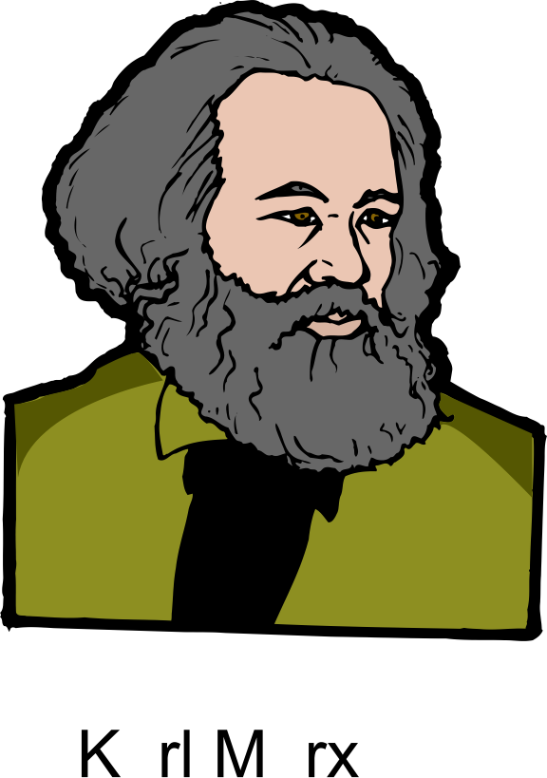
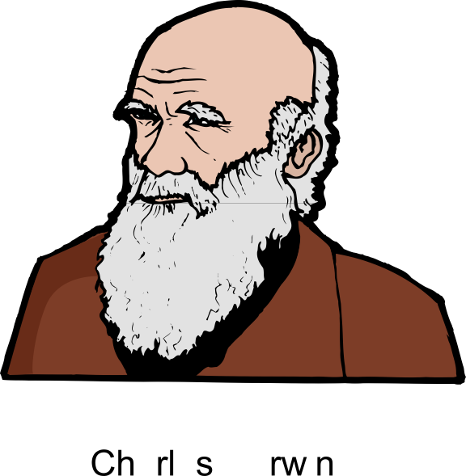

Did It Fix Our Problem?
Karl Marx
Charles Darwin
Karl Marx
Charles Darwin
beard
beard
D0Cls6&
aardvark 340jafg;
aardwolf K[ds+3a,
abaca sY(34,ee
. . .
beard ^*eP61a-
)#4,doa8

Slide 43
Are My Passwords Safe Now?
If I salt and encrypt them, am I OK?
Depends on the quality of the passwords chosen
Attacker can still perform dictionary attacks on an individual password, with its salt
If the password isn’t in the dictionary, no problem
If it is, the attack succeeds
Which is why password choice is important

Slide 44
Password Selection
Generally, long passwords chosen from large character sets are good
Short passwords chosen from small character sets are bad
How long?
A matter of time
Moore’s law forces us to make them ever longer
What’s a large character set?
Upper and lower case letters, plus numbers, plus symbols (like ^ and @)

Slide 45
Authentication Devices
Authentication by what you have
A smart card or other hardware device that is readable by the computer
Safest if device has some computing capability
Rather than just data storage
Authenticate by providing the device to the computer
More challenging when done remotely, of course

Slide 46

Authentication With Smart Cards
Authentication verified!
challenge
challenge
E(challenge)
E(challenge)
How can the server be sure of the remote user’s identity?
By proper use of cryptography

Slide 47
Problems With Authentication Devices
If lost or stolen, you can’t authenticate yourself
And maybe someone else can
Often combined with passwords to avoid this problem
Unless cleverly done, susceptible to sniffing attacks
Requires special hardware
There have been successful attacks on some smart cards

Slide 48
Biometric Authentication
Authentication based on who you are
Things like fingerprints, voice patterns, retinal patterns, etc.
To authenticate, allow the system to measure the appropriate physical characteristics
Biometric measurement converted to binary and compared to stored values
With some level of match required

Slide 49
Problems With Biometrics
Requires very special hardware
May not be as foolproof as you think
Many physical characteristics vary too much for practical use
Day to day or over long periods of time
Generally not helpful for authenticating programs or roles
What happens when it’s cracked?
You only have two retinas, after all

Slide 50
Characterizing Biometric Accuracy
How many false positives?
Match made when it shouldn’t have been
Versus how many false negatives?
Match not made when it should have been
False Positive Rate
False Negative Rate
The Crossover Error Rate (CER)
Generally, the higher the CER is, the better the system
Errors
Retinal scans: 1:10,000,000+
Fingerprint readers: 1:500
Sensitivity

Slide 51
Protecting Operating Systems Resources
How do we use these various tools to protect actual OS resources?
Memory?
Files?
Devices?
IPC?
Secure booting

Slide 52
Protecting Memory
Most modern operating systems provide strong memory protection
Usually hardware-based
Most commonly through use of page tables and paging hardware
Each process can only access page frames mapped in its own page table
Reduces issue to OS’ proper use of page tables for processes

Slide 53
Protecting Files
We’ve already discussed this
Most file systems have a built-in access control model
The OS must enforce it
All file access done through system calls
Which gives the OS a chance to enforce the access control policy
Typically checked on open
Issue of complete mediation . . .

Slide 54
A File Data Vulnerability
What if someone bypasses the operating system?
Directly accessing the disk as a device
The OS typically won’t allow that to happen
If it’s still in control . . .
But there can be flaws or misconfigurations
Or the disk can be moved to another machine
Which may not enforce the access permissions it specifies

Slide 55
Full Disk Encryption
FDE
A solution to this problem
Encrypt everything you put on the disk
Decrypt data moved from the disk to memory
Can be done in hardware
Typically in the disk drive or controller
Or software
Typically by the operating system
Various options for storing the key

Slide 56
Protecting Devices
Most devices are treated as files
So the file protection model applies
In some cases, some parts of the devices are memory mapped into processes
Memory protections apply, here
But potential issues if you map them into more than one process
Non-OS controlled bus interfaces can also cause problems (e.g., Firewire)

Slide 57
Protecting IPC
IPC channels are often also treated like files
So the same protection model and mechanisms apply
Even shared memory is handled this way
But especially important to remember that you don’t get complete mediation here
And granularity of protection is the segment, not the word or page or block

Slide 58
Secure Boot
Our OS-based protection mechanisms rely on one fundamental assumption
We are running an OS that properly implements them
What if we aren’t running the OS that we think we are?
Then all bets are off
The false OS can do whatever it wants
So we need to be sure we’ve booted what we wanted to boot

Slide 59
The Bootstrap Process
When a computer is powered on, the OS is not usually resident in memory
It gets put there by a bootstrap loader
The bootstrap program is usually very short
Located in an easily defined place
Hardware finds it, loads it, runs it
Bootstrap then takes care of initializing the OS

Slide 60
Booting and Security
Most systems make it hard to change bootstrap loader
But it must have enough flexibility to load different OSes
From different places on machine
Malware likes to corrupt the bootstrap
Trusted computing platforms can help secure bootstrapping

Slide 61
Approaches to Bootstrap Security
TPM – an industry standard
A hardware-assisted method to guarantee that the right bootstrap was loaded
And, from that, guarantee that the right OS was booted
And possibly build up further security from that
SecureBoot – a Microsoft technology
Built into the boot hardware and SW
Essentially, only allows booting of particular OS versions

Slide 62
Conclusion
This scratches the surface of security issues for the OS
Ideally, OS design and implementation should consider security from start to finish
Ongoing research looks at improving OS security
E.g., by proving security properties of the kernel
Since the OS is the foundation of the other software, its security is crucial

