Slide 1
Multimedia networking: outline
7.1 multimedia networking applications
7.2 streaming stored video
7.3 voice-over-IP
7.4 protocols for real-time conversational applications
7.5 network support for multimedia
Multmedia Networking
7-<number>

Slide 2
Multimedia: audio
analog audio signal sampled at constant rate
  telephone: 8,000 samples/sec
  CD music: 44,100 samples/sec
each sample quantized, i.e., rounded
  e.g., 2⁸=256 possible quantized values
  each quantized value represented by bits, e.g., 8 bits for 256 values
quantization error
quantized value of
analog value
analog
signal
audio signal amplitude
time
sampling rate
(N sample/sec)
Multmedia Networking
7-<number>

Slide 3
Multimedia: audio
example: 8,000 samples/sec, 256 quantized values: 64,000 bps
receiver converts bits back to analog signal:
  some quality reduction
example rates
CD: 1.411 Mbps
MP3: 96, 128, 160 kbps
Internet telephony: 5.3 kbps and up
quantization error
quantized value of
analog value
analog
signal
audio signal amplitude
time
sampling rate
(N sample/sec)
Multmedia Networking
7-<number>

Slide 4

Multimedia: video
spatial coding example: instead of sending N values of same color (all purple), send only two values: color value (purple) and number of repeated values (N)
video: sequence of images displayed at constant rate
  e.g. 24 images/sec
digital image: array of pixels
  each pixel represented by bits
coding: use redundancy within and between images to decrease # bits used to encode image
  spatial (within image)
  temporal (from one image to next)
……………………...…
……………………...…
frame i
temporal coding example: instead of sending complete frame at i+1, send only differences from frame i
frame i+1
Multmedia Networking
7-<number>

Slide 5
Multimedia: video
spatial coding example: instead of sending N values of same color (all purple), send only two values: color value (purple) and number of repeated values (N)
CBR: (constant bit rate): video encoding rate fixed
VBR: (variable bit rate): video encoding rate changes as amount of spatial, temporal coding changes
examples:
  MPEG 1 (CD-ROM) 1.5 Mbps
  MPEG2 (DVD) 3-6 Mbps
  MPEG4 (often used in Internet, < 1 Mbps)
……………………...…
……………………...…
frame i
temporal coding example: instead of sending complete frame at i+1, send only differences from frame i
frame i+1
Multmedia Networking
7-<number>

Slide 6
Multimedia networking: 3 application types
streaming, stored audio, video
  streaming: can begin playout before downloading entire file
  stored (at server): can transmit faster than audio/video will be rendered (implies storing/buffering at client)
  e.g., YouTube, Netflix, Hulu
conversational voice/video over IP
  interactive nature of human-to-human conversation limits delay tolerance
  e.g., Skype
streaming live audio, video
  e.g., live sporting event (futbol)
Multmedia Networking
7-<number>

Slide 7
Multimedia networking: outline
7.1 multimedia networking applications
7.2 streaming stored video
7.3 voice-over-IP
7.4 protocols for real-time conversational applications
7.5 network support for multimedia
Multmedia Networking
7-<number>

Slide 8


Streaming stored video:
Cumulative data
2. video
sent
video
recorded (e.g., 30 frames/sec)
3. video received,
played out at client
(30 frames/sec)
network delay
(fixed in this example)
time
streaming: at this time, client
playing out early part of video,
while server still sending later
part of video
Multmedia Networking
7-<number>

Slide 9
Streaming stored video: challenges
continuous playout constraint: once client playout begins, playback must match original timing
  … but network delays are variable (jitter), so will need client-side buffer to match playout requirements
other challenges:
  client interactivity: pause, fast-forward, rewind, jump through video
  video packets may be lost, retransmitted
Multmedia Networking
7-<number>

Slide 10
Streaming stored video: revisited
constant bit
rate video
transmission
client video
reception
constant bit
rate video
playout at client
Cumulative data
variable
network
delay
buffered
video
client playout
delay
time
client-side buffering and playout delay: compensate for network-added delay, delay jitter
Multmedia Networking
7-<number>

Slide 11
Streaming multimedia: UDP
server sends at rate appropriate for client
  often: send rate = encoding rate = constant rate
  transmission rate can be oblivious to congestion levels
short playout delay (2-5 seconds) to remove network jitter
error recovery: application-level, time-permitting
Multmedia Networking
7-<number>

Slide 12
Streaming multimedia: HTTP
multimedia file retrieved via HTTP GET
send at maximum possible rate under TCP
fill rate fluctuates due to TCP congestion control, retransmissions (in-order delivery)
larger playout delay: smooth TCP delivery rate
HTTP/TCP passes more easily through firewalls
_x0013_
variable rate, x(t)
_x0013_
_x0013_
video
file
TCP send buffer
TCP receive buffer
application playout buffer
server
client
Multmedia Networking
7-<number>

Slide 13
Streaming multimedia: DASH
DASH: Dynamic, Adaptive Streaming over HTTP
server:
  divides video file into multiple chunks
  each chunk stored, encoded at different rates
  manifest file: provides URLs for different chunks
client:
  periodically measures server-to-client bandwidth
  consulting manifest, requests one chunk at a time
    chooses maximum coding rate sustainable given current bandwidth
    can choose different coding rates at different points in time (depending on available bandwidth at time)
Multmedia Networking
7-<number>

Slide 14
Streaming multimedia: DASH
DASH: Dynamic, Adaptive Streaming over HTTP
“intelligence” at client: client determines
  when to request chunk (so that buffer starvation, or overflow does not occur)
  what encoding rate to request (higher quality when more bandwidth available)
  where to request chunk (can request from URL server that is “close” to client or has high available bandwidth)
Multmedia Networking
7-<number>

Slide 15
Multimedia networking: outline
7.1 multimedia networking applications
7.2 streaming stored video
7.3 voice-over-IP
7.4 protocols for real-time conversational applications
7.5 network support for multimedia
Multmedia Networking
7-<number>

Slide 16
Voice-over-IP (VoIP)
VoIP end-end-delay requirement: needed to maintain “conversational” aspect
  higher delays noticeable, impair interactivity
  < 150 msec: good
  > 400 msec bad
  includes application-level (packetization,playout), network delays
session initialization: how does callee advertise IP address, port number, encoding algorithms?
value-added services: call forwarding, screening, recording
emergency services: 911
Multmedia Networking
7-<number>

Slide 17
VoIP characteristics
speaker’s audio: alternating talk spurts, silent periods.
  64 kbps during talk spurt
  pkts generated only during talk spurts
  20 msec chunks at 8 Kbytes/sec: 160 bytes of data
application-layer header added to each chunk
chunk+header encapsulated into UDP or TCP segment
application sends segment into socket every 20 msec during talkspurt
Multmedia Networking
7-<number>

Slide 18
VoIP: packet loss, delay
network loss: IP datagram lost due to network congestion (router buffer overflow)
delay loss: IP datagram arrives too late for playout at receiver
  delays: processing, queueing in network; end-system (sender, receiver) delays
  typical maximum tolerable delay: 400 ms
loss tolerance: depending on voice encoding, loss concealment, packet loss rates between 1% and 10% can be tolerated
Multmedia Networking
7-<number>

Slide 19
Delay jitter
constant bit
rate
transmission
client
reception
constant bit
rate playout
at client
Cumulative data
variable
network
delay
(jitter)
buffered
data
client playout
delay
time
end-to-end delays of two consecutive packets: difference can be more or less than 20 msec (transmission time difference)
Multmedia Networking
7-<number>

Slide 20
VoIP: fixed playout delay
receiver attempts to playout each chunk exactly q msecs after chunk was generated.
  chunk has time stamp t: play out chunk at t+q
  chunk arrives after t+q: data arrives too late for playout: data “lost”
tradeoff in choosing q:
  large q: less packet loss
  small q: better interactive experience
Multmedia Networking
7-<number>

Slide 21
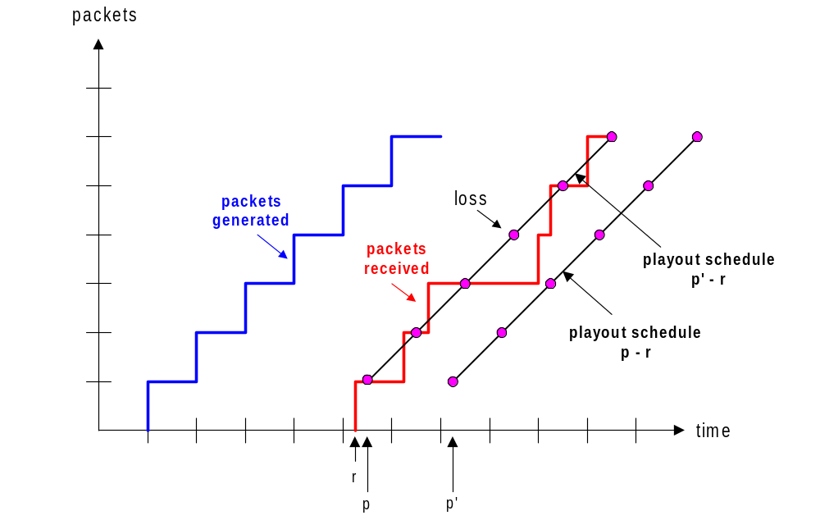
VoIP: fixed playout delay
sender generates packets every 20 msec during talk spurt.
first packet received at time r
first playout schedule: begins at p
second playout schedule: begins at p’
Multmedia Networking
5-<number>

Slide 22
Adaptive playout delay (1)
goal: low playout delay, low late loss rate
approach: adaptive playout delay adjustment:
  estimate network delay, adjust playout delay at beginning of each talk spurt
  silent periods compressed and elongated
  chunks still played out every 20 msec during talk spurt
adaptively estimate packet delay: (EWMA - exponentially weighted moving average, recall TCP RTT estimate):
d_{i} = (1−α)d_{i-1} + α (r_{i} – t_{i})
delay estimate after ith packet
small constant, e.g. 0.1
time received -
time sent (timestamp)
measured delay of ith packet
Multmedia Networking
7-<number>

Slide 23
Adaptive playout delay (2)
also useful to estimate average deviation of delay, v_{i} :
v_{i} = (1−β)v_{i-1} + β |r_{i} – t_{i} – d_{i}|
estimates d_{i}, v_{i} calculated for every received packet, but used only at start of talk spurt
for first packet in talk spurt, playout time is:
remaining packets in talkspurt are played out periodically
playout-time_{i} = t_{i} + d_{i} + Kv_{i}
Multmedia Networking
5-<number>

Slide 24
VoiP: recovery from packet loss (1)
Challenge: recover from packet loss given small tolerable delay between original transmission and playout
each ACK/NAK takes ~ one RTT
alternative: Forward Error Correction (FEC)
  send enough bits to allow recovery without retransmission (recall two-dimensional parity in Ch. 5)
simple FEC
for every group of n chunks, create redundant chunk by exclusive OR-ing n original chunks
send n+1 chunks, increasing bandwidth by factor 1/n
can reconstruct original n chunks if at most one lost chunk from n+1 chunks, with playout delay
Multmedia Networking
7-<number>

Slide 25
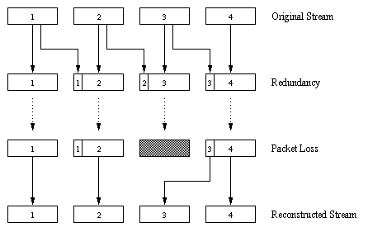
VoiP: recovery from packet loss (2)
another FEC scheme:
“piggyback lower
quality stream”
send lower resolution
audio stream as
redundant information
e.g., nominal
stream PCM at 64 kbps
and redundant stream
GSM at 13 kbps
non-consecutive loss: receiver can conceal loss
generalization: can also append (n-1)st and (n-2)nd low-bit rate
chunk
Multmedia Networking
7-<number>

Slide 26
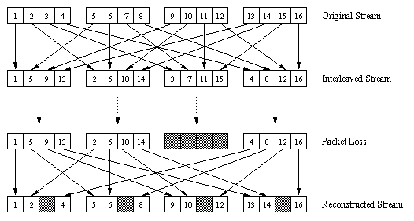
VoiP: recovery from packet loss (3)
interleaving to conceal loss:
audio chunks divided into smaller units, e.g. four 5 msec units per 20 msec audio chunk
packet contains small units from different chunks
if packet lost, still have most of every original chunk
no redundancy overhead, but increases playout delay
Multmedia Networking
7-<number>

Slide 27
Multimedia networking: outline
7.1 multimedia networking applications
7.2 streaming stored video
7.3 voice-over-IP
7.4 protocols for real-time conversational applications: RTP, SIP
7.5 network support for multimedia
Multmedia Networking
7-<number>

Slide 28
Real-Time Protocol (RTP)
RTP specifies packet structure for packets carrying audio, video data
RFC 3550
RTP packet provides
  payload type identification
  packet sequence numbering
  time stamping
RTP runs in end systems
RTP packets encapsulated in UDP segments
interoperability: if two VoIP applications run RTP, they may be able to work together
Multmedia Networking
7-<number>

Slide 29
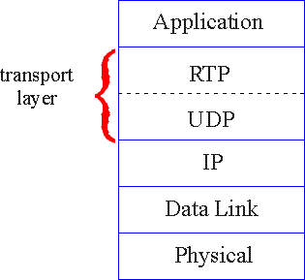
RTP runs on top of UDP
RTP libraries provide transport-layer interface
that extends UDP:
  port numbers, IP addresses
  payload type identification
  packet sequence numbering
  time-stamping
Multmedia Networking
5-<number>

Slide 30
RTP example
example: sending 64 kbps PCM-encoded voice over RTP
application collects encoded data in chunks, e.g., every 20 msec = 160 bytes in a chunk
audio chunk + RTP header form RTP packet, which is encapsulated in UDP segment
RTP header indicates type of audio encoding in each packet
  sender can change encoding during conference
RTP header also contains sequence numbers, timestamps
Multmedia Networking
7-<number>

Slide 31
Real-Time Control Protocol (RTCP)
works in conjunction with RTP
each participant in RTP session periodically sends RTCP control packets to all other participants
each RTCP packet contains sender and/or receiver reports
  report statistics useful to application: # packets sent, # packets lost, interarrival jitter
feedback used to control performance
  sender may modify its transmissions based on feedback
Multmedia Networking
7-<number>

Slide 32

RTCP: multiple multicast senders
sender
RTP
RTCP
RTCP
RTCP
receivers
each RTP session: typically a single multicast address; all RTP /RTCP packets belonging to session use multicast address
RTP, RTCP packets distinguished from each other via distinct port numbers
to limit traffic, each participant reduces RTCP traffic as number of conference participants increases
Multmedia Networking
5-<number>

Slide 33
SIP: Session Initiation Protocol [RFC 3261]
long-term vision:
all telephone calls, video conference calls take place over Internet
people identified by names or e-mail addresses, rather than by phone numbers
can reach callee (if callee so desires), no matter where callee roams, no matter what IP device callee is currently using
Multmedia Networking
7-<number>

Slide 34
SIP services
SIP provides mechanisms for call setup:
  for caller to let callee know she wants to establish a call
  so caller, callee can agree on media type, encoding
  to end call
determine current IP address of callee:
  maps mnemonic identifier to current IP address
call management:
  add new media streams during call
  change encoding during call
  invite others
  transfer, hold calls
Multmedia Networking
7-<number>

Slide 35
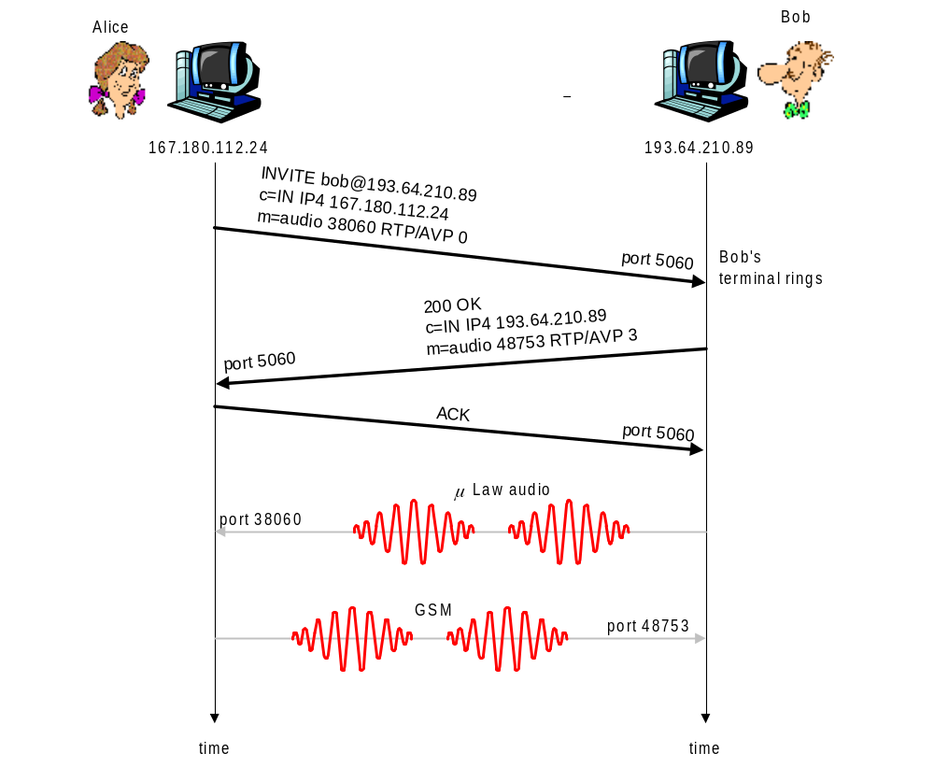
Example: setting up call to known IP address
Alice’s SIP invite message indicates her port number, IP address, encoding she prefers to receive (PCM μlaw)
Bob’s 200 OK message indicates his port number, IP address, preferred encoding (GSM)
SIP messages can be sent over TCP or UDP; here sent over RTP/UDP
default SIP port number is 5060
Multmedia Networking
5-<number>

Slide 36
SIP example: jim@umass.edu calls keith@poly.edu
Poly SIP
registrar
2. UMass proxy forwards request
to Poly registrar server
2
3
3. Poly server returns redirect response,
indicating that it should try keith@eurecom.fr
UMass SIP proxy
4. Umass proxy forwards request
to Eurecom registrar server
Eurecom SIP
registrar
4
7
1. Jim sends INVITE
message to UMass SIP proxy.
6-8. SIP response returned to Jim
5. eurecom registrar forwards INVITE to 197.87.54.21, which is running keith’s SIP client
8
5
6
1
9
128.119.40.186
9. Data flows between clients
197.87.54.21
Multmedia Networking
7-<number>

Slide 37
Multimedia networking: outline
7.1 multimedia networking applications
7.2 streaming stored video
7.3 voice-over-IP
7.4 protocols for real-time conversational applications
7.5 network support for multimedia
Multmedia Networking
7-<number>

Slide 38
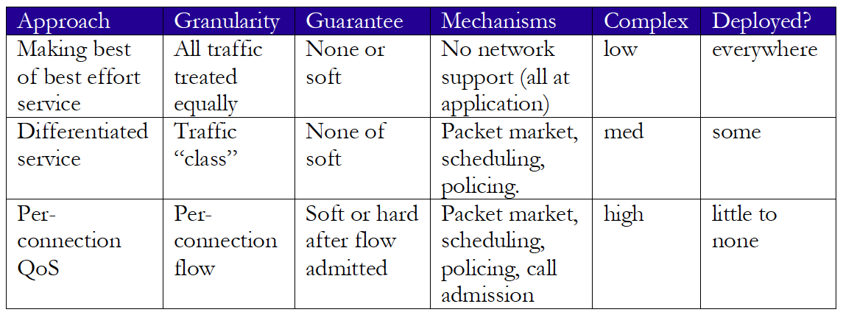
Network support for multimedia
Multmedia Networking
7-<number>

Slide 39
Dimensioning best effort networks
approach: deploy enough link capacity so that congestion doesn’t occur, multimedia traffic flows without delay or loss
  low complexity of network mechanisms (use current “best effort” network)
  high bandwidth costs
challenges:
  network dimensioning: how much bandwidth is “enough?”
  estimating network traffic demand: needed to determine how much bandwidth is “enough” (for that much traffic)
Multmedia Networking
7-<number>

Slide 40
Providing multiple classes of service
H1
H3
R1
R2
H4
H2
R1 output
interface
queue
1.5 Mbps link
Multmedia Networking
7-<number>

Slide 41

Scenario 1: mixed HTTP and VoIP
example: 1Mbps VoIP, HTTP share 1.5 Mbps link.
  HTTP bursts can congest router, cause audio loss
  want to give priority to audio over HTTP
R1
R2
Principle 1
packet marking needed for router to distinguish between different classes; and new router policy to treat packets accordingly
Multmedia Networking
7-<number>

Slide 42
Principles for QOS guarantees (more)
what if applications misbehave (VoIP sends higher than declared rate)
  policing: force source adherence to bandwidth allocations
marking, policing at network edge
1 Mbps
phone
R1
R2
1.5 Mbps link
packet marking and policing
Principle 2
provide protection (isolation) for one class from others
Multmedia Networking
7-<number>

Slide 43
Principles for QOS guarantees (more)
allocating fixed (non-sharable) bandwidth to flow: inefficient use of bandwidth if flows doesn’t use its allocation
1 Mbps
phone
1 Mbps logical link
R1
R2
1.5 Mbps link
0.5 Mbps logical link
Principle 3
while providing isolation, it is desirable to use
resources as efficiently as possible
Multmedia Networking
7-<number>

Slide 44
Per-connection QOS guarantees
basic fact of life: can not support traffic demands beyond link capacity
1 Mbps
phone
R1
R2
1 Mbps
phone
1.5 Mbps link
Principle 4
call admission: flow declares its needs, network may
block call (e.g., busy signal) if it cannot meet needs
Multmedia Networking
7-<number>

