Slide 1

Exploring the Power of Large Language Models:
News Intention Detection using
Adaptive Learning Prompting
Master’s Thesis
Alberto Caballero Hinojosa
Master in Language Technologies
Directed by
Prof. Dr. D. Álvaro Rodrigo Yuste
Prof. Dr. D. Roberto Centeno Sánchez
September 2023

Slide 2
Index
INTRODUCTION
STATE-OF-THE-ART
TASK DEFINITION
HYPOTHESIS
DATASET CREATION
PROPOSAL
EVALUATION
DISCUSSION
CONCLUSIONS
FUTURE WORK

Slide 3
1.INTRODUCTION
News Screening: from Veracity to Intention
Informed
Decision-Making
-Strengthening Democracy
-Public Safety
Beyond Dichotomy
(True vs False)
- Complexity
- Subjectivity
Intention’s Value
-Power of Narratives
-Bias Recognition
-Media Accountability
Low-resource scenarios
Lack of reference datasets
Compute limitations
Flexibility (scope adjustment)
Limiting Factors:

Slide 4
2. STATE-OF-THE-ART
VERACITY
INTENTION
Approaches:
Neural Networks (CNN, RNN,Transformers)[1] ：
High-Quality Training Data
Balanced Distribution
Pre-processing
Multimodal [2]:
Data Fusion,Feature Extaction, Modality Alignment
Different Datasets:
LIAR (No Intentions, Simplistic Narrative)
Fakenewsnet (Limited Multimodal Data, No Intentions)
Relatively Unchartered:
Opinion Mining for Fake news Detection [3]
Stance Detection towards an entity[4]
Media Intention:
User’s Perpective [5]
No specific Dataset
[1]-Qazi, M., Khan, M. U., and Ali, M. (2020). Detection of fake news using transformer model. In 2020 3rd international conference on computing, mathematics and engineering technologies (iCoMET), pages 1–6.
[2]-Comito, C., Caroprese, L. & Zumpano, E. Multimodal fake news detection on social media: a survey of deep learning techniques. Soc. Netw. Anal. Min. 13, 101 (2023). https://doi.org/10.1007/s13278-023-01104
[3]-Liu, B. (2015). Sentiment analysis: Mining opinions, sentiments, and emotions.
[4]-Mohammad et al., 2016] Mohammad, S., Kiritchenko, S., Sobhani, P., Zhu, X., and Cherry, C. (2016). Semeval-2016 task 6: Detecting stance in tweets.
[5]-Guo, Z., Zhang, Q., An, X., Zhang, Q., JÃ¸sang, A., Kaplan, L. M and Cho, J. H. (2023). Uncertainty-aware reward-based deep reinforcement learning for intent analysis of social media information.

Slide 5
3. TASK DEFINITION
Objective:
Identify intentions behind political news articles
Significance:
Critical for media literacy and combating mis and disinformation
Challenges:
Lack of previous work on the topic
No specific dataset with political news intentions
Addressing biases and hidden narratives in news content (subjectivity)

Slide 6
4. HYPOTHESIS
LLMs can significantly improve the accuracy of news intention identification
Iterative prompt engineering can enhance the precision and recall of news intention identification
The "Adaptive Learning Prompting" strategy will significantly improve news intention identification performance

Slide 7
5.DATASET CREATION
Table 5 Labels Definitions
Type | Description | Label
Reputation Impact (Influence the reputation of a political actor or institution) | Spreading information with the intent to directly impact and alter the reputation of a specific political actor, institution, or individual, aiming to influence public perception either positively or negatively. | A
Associative Manipulation (Manipulate voting intentions or discourage participation) | Disseminating information that indirectly associates a political actor, institution, or individual with positive or negative events or actions conducted by a third party, with the goal of manipulating voting intentions or public support. | B
Electoral Legitimacy Concerns (Undermine the legitimacy of the electoral process) | Spreading information to raise concerns or doubts about the integrity and fairness of the electoral process, aiming to influence public trust and confidence in elections, either positively or negatively. | C
Fear and Uncertainty Propagation (Generate uncertainty, fear, or incite violence) | Generating uncertainty, fear, and anxiety by spreading information, whether true or false, related to future events or situations, using fear-mongering tactics or calls for violence to create an atmosphere of unrest, regardless of whether the intent is positive or negative. | D
FakeNewsNet [6]
Fake News Dataset
(336 fake-447real)
Data reduction
( 133 fake-118 real)
Labels
4 Intentions
Narratives build Reality [7]
Labelling Process
Two Annotators
36% Discrepancy
[6]-Shu, K., Mahudeswaran, D., Wang, S., Lee, D., and Liu, H. (2018).Fakenewsnet: A data repository with news content, social context, and spatiotemporal information for studying fake news on social media.
[7]-Shenhav, S. R. (2006). Political narratives and political reality. In_x0002_ternational Political Science Review / Revue Internationale de Science Politique.

Slide 8
6.1 PROPOSAL: High-level Concept
Adaptive-Learning Model:
Adaptive
Dynamic Evolution: This model continually evolves and improves its performance over time
No Initial Examples: It begins its process without any initial training examples
Learning
Misclassified News Integration: Misclassified news items are reintroduced into the learning process with their labels corrected, allowing the model to learn from its mistakes
Progressive Refinement: Through continuous adaptation, it gradually enhances its ability to understand and classify complex intention categories

Slide 9
6.2 PROPOSAL: Paradigm Comparison
Fine-Tuning | Prompting
Resource Intensive Complex Process/Expertise: Hyperparameter and Deep Learning Deeper LLM adjustment for Specific Tasks: Learnable Parameters | Textual Prompts as Intructions: In Context Learning (ICL) Experimentation Required Relies on Natural Language Understanding (NLU)

Slide 10
6.3 PROPOSAL: Analysis Models
Table 6.3 Models Specifications
Baseline | Zero-Shot | Few-Shot | Adaptive-Learning
"bert-uncased" | "gpt-3.5-turbo model"
10-fold Cross-Validation | Labels Definitions
Ensemble (Majority Voting) | - | 8 Examples (2 per label outside original dataset) | Re-feeding misclassified Labels into the Prompt properly labeled as Reference
Model Variants
Pre-trained LLM
Validation
Techniques
Model
Strategies

Slide 11
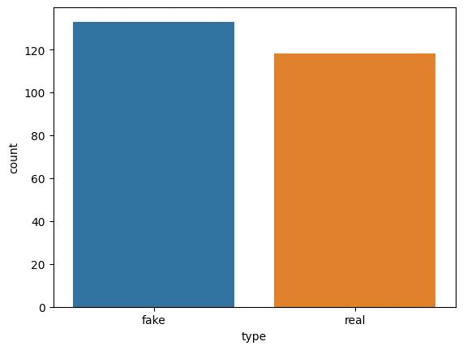
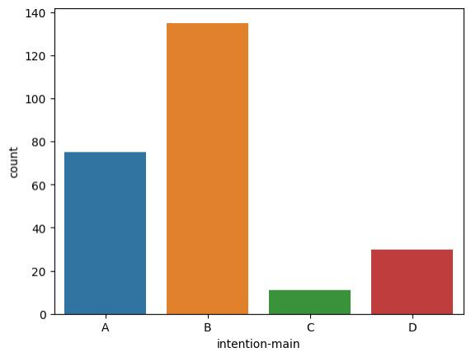
6.4 PROPOSAL: Dataset Description
Figure 6.4-a Fake Vs Real News Distribution
Figure 6.4-b News Intention Distribution
Similar distribution
Slight majority of fake news ,133 fake news and 118 real
Imbalanced distribution
Label B represents 52,4 % of the news articles in the dataset.
Label C accounts for only 6% of the news

Slide 12
5. EVALUATION
Customized Dataset- 251 News
151 Training Samples:
Used to fine-tune the Baseline Model (BERT)
100 Testing Samples:
Run the different testing experiments
Static (Overall Performance) | Dynamic （Performance Evolution)
Multiclass Classification F1-Score Imbalanced Dataset Harmonic Mean of Precision and Recall | Test Learning Hypothesis Batches (10) Regression: F1-Score Slope-Testing (Learning Progression)

Slide 13
5.1 EVALUATION: Static Results
Table 5.1 Model Performance: Static
 | Fine-Tuning |  |  | Prompt-Engineering
 | Baseline Model |  |  | Zero-Show |  |  | Few-Shot |  |  | Adaptive-Learning
Label | Precision | Recall | F1-Score | Precision | Recall | F1-Score | Precision | Recall | F1-Score | Precision | Recall | F1-Score
A | 0.4 | 0.2 | 0.27 | 0.33 | 0.77 | 0.46 | 0.37 | 0.87 | 0.51 | 0.49 | 0.57 | 0.52
B | 0.53 | 0.87 | 0.66 | 0.73 | 0.21 | 0.33 | 0.69 | 0.17 | 0.28 | 0.61 | 0.54 | 0.57
C | 0 | 0 | 0 | 0.44 | 0.67 | 0.53 | 0.5 | 0.67 | 0.57 | 0.5 | 0.5 | 0.5
D | 0 | 0 | 0 | 0.29 | 0.17 | 0.21 | 0.38 | 0.25 | 0.3 | 0.46 | 0.5 | 0.48
Accuracy | 0.51 |  |  | 0.4 |  |  | 0.42 |  |  | 0.54
Macro avg | 0.23 | 0.27 | 0.23 | 0.45 | 0.45 | 0.38 | 0.48 | 0.49 | 0.42 | 0.51 | 0.53 | 0.52
Weighted avg | 0.4 | 0.51 | 0.41 | 0.54 | 0.4 | 0.37 | 0.54 | 0.42 | 0.37 | 0.55 | 0.54 | 0.54
The fine-tuned model is highly influenced by class imbalance, leaning towards the majority class B (Associative Manipulation)
Prompted models offer a more balanced across-label performance
Adaptive-learning outperforms the baseline in all reference metrics (accuracy and F1-score)

Slide 14
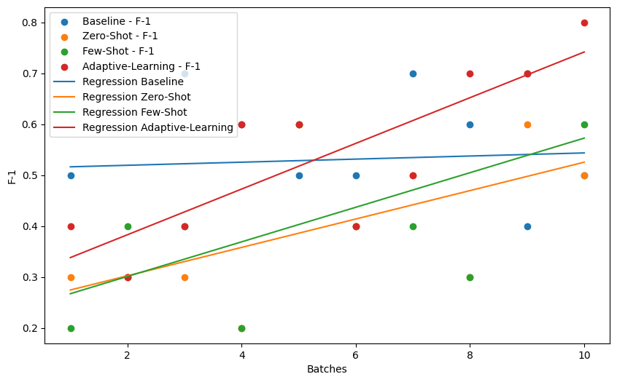
5.2 EVALUATION: Dynamic Results
Perform Evolution over 10 Batches of 10 Inputs
Baseline Model displays the flatter Regression-line
Zero and Few-Shot Models display a not statistically significant slope
Adaptive-Learning statistically significant Slope (0.448, p-value=0.0033)
This model learns to 'reason' from these examples to boost performance over batches
Figure 5.2 Model Perfomance: Dynamic (F1-Score "Micro")

Slide 15
6.DISCUSSION
LLMs can be effectively used for News Intention Detection through different approaches, including fine-tuning and prompting
Prompting offers a more balanced Intention Classification across labels with similar or superior performances (R1-score Macro) in the context of this work
Adaptive-Learning Prompting outperforms all models in all metrics (Accuracy, R1-score), proving that it can be effectively implemented even in situations with no previous learning examples

Slide 16
7. CONCLUSIONS
Technical Industry Social
1）High-Value Examples for LLMs Prompting: - Boosting Performance [8] - Effectively Steering the LLM | 4）Media Platforms Auditing: - Bias Detection - Informed Audiences - Stengthening Democratic Processes | 7）Broader Presence of AI: Integration in daily life
2）Reasoning Abilities of LLMs [9] : Prompting as Instructions functional even under low-resource scenarios | 5）LLMs applied to other Tasks: Conversational Systems, Sentiment Analysis, Information Verification, etc | 8）Future Questions: - Auditing of AI (XAI)[12] - Ethical Use of AI
3）Modular Systems [10]: LLM-based Interface | 6）Democratization of LLMs - Open-Souces LLMs[11] - Distributed Networks (Petals) | 9) Bridging Informational Gap: -Navigate digital landscape -Empowering citizens - Better decision-making
[8]-Brown, T., Mann, B., Ryder, N., Subbiah, M., Kaplan, J. D., Dha_x0002_riwal, P., and Amodei, D. (2020). Language models are few-shot learners. Advances in neural information processing systems,
[9]-Yu, F., Zhang, H., and Wang, B. (2023). Nature language reasoning, a survey.
[10]-https://www.langchain.com/
[11[-https://huggingface.co/spaces/HuggingFaceH4/open_llm_leaderboard
[12]-Datta, T. and Dickerson, J. P. (2023). Who’s thinking? a push for human-centered evaluation of llms using the xai playbook. arXiv preprint arXiv:2303.06223.

Slide 17
8. FUTURE WORK
Multitask Learning
Integrative Analysis (Veracity- Intention)
Increase Inputs range
Users social profile
News dissemination (Graph-Analysis)
Modular LLM-based Systems:
Augmented Retrieval-Knowledge Base:
Semantic Search,Knowledge Graphs
Managing and Reflective Modules:
Graph-of-Thoughts (GoT)[13]
[13]-Besta, M., Blach, N., Kubíček, A.,. (2023). Graph of Thoughts: Solving Elaborate Problems with Large Language Models.

Slide 18
Q&A

