Slide 1
Containerized apps with docker
{
“author”: “Alexi Caballero Esteban”,
“date”: “Fri Apr 05 2024 14:00:00 GMT-0500 (Colombia Standard Time)”,
“audience”: “Cloud COP”
}

Slide 2




Container
A container is an isolated environment for your code. This means that a container has no knowledge of your operating system, or your files.
It runs on the environment provided to you by Docker.
Containers have everything that your code needs in order to run, down to a base operating system.
Containers are technologies that allow the packaging and isolation of applications with their entire runtime environment

Slide 3




Containerization
Containerization is an approach to software development in which an application or service, its dependencies, and its configuration (abstracted as deployment manifest files) are packaged together as a container image.
The containerized application can be tested as a unit and deployed as a container image instance to the host operating system (OS).
Code
Image
Container

Slide 4



DOcker
Docker is an open-source project for automating the deployment of applications as portable, self-sufficient containers that can run on the cloud or on-premises
Docker allows you to separate your applications from your infrastructure so you can deliver software quickly, you can manage your infrastructure in the same ways you manage your applications. By taking advantage of Docker’s methodologies for shipping, testing, and deploying code quickly, you can significantly reduce the delay between writing code and running it in production.
Virtual Machines
Docker Containers
App 1
App 2
App 3
Host Operating System
Container Engine
App 1
App 2
App 3
bins/libs
bins/libs
bins/libs
bins/libs
bins/libs
bins/libs
Guest OS
Guest OS
Guest OS
Hypervisor
Host Operating System
Infrastructure
Infrastructure

Slide 5
Docker terminology
Image: A package with all the dependencies and information needed to create a container.
Dockerfile: A text file that contains instructions for building a Docker image.
Build: The action of building a container image based on the information and context provided by its Dockerfile.
Container: An instance of a Docker image. A container represents the execution of a single application, process, or service.
Volume: Offer a writable filesystem that the container can use.
Tag: A mark or label you can apply to images so that different images or versions of the same image.
Repository: A collection of related Docker images, labeled with a tag that indicates the image version.
Registry: A service that provides access to repositories.
Docker hub: A public registry to upload images and work with them.
Compose: A command-line tool and YAML file format with metadata for defining and running multi-container applications.
Cluster: A collection of Docker hosts exposed as if it were a single virtual Docker host, so that the application can scale to multiple instances of the services spread across multiple hosts within the cluster.
Orchestrator: A tool that simplifies the management of clusters and Docker hosts.

Slide 6
CODE

Slide 7
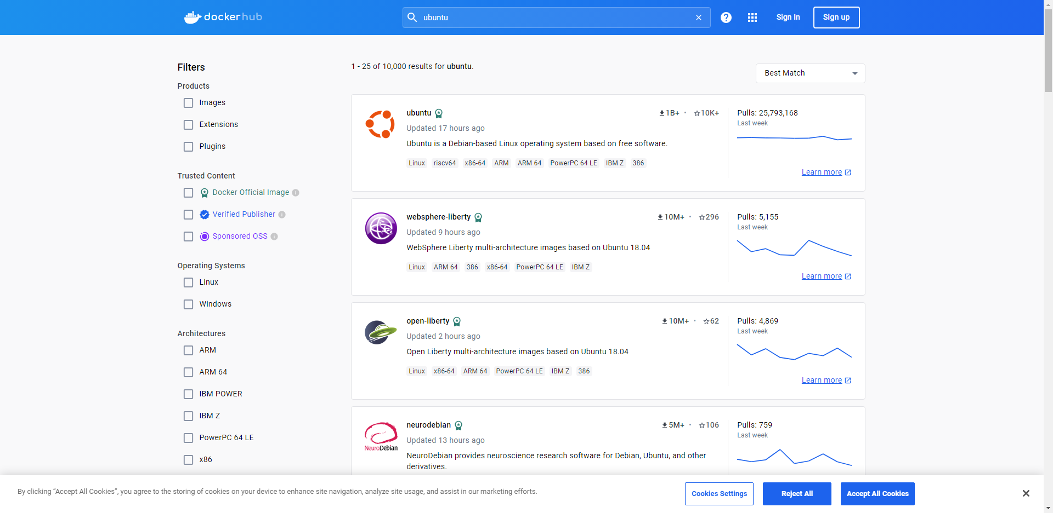
Image

Slide 8
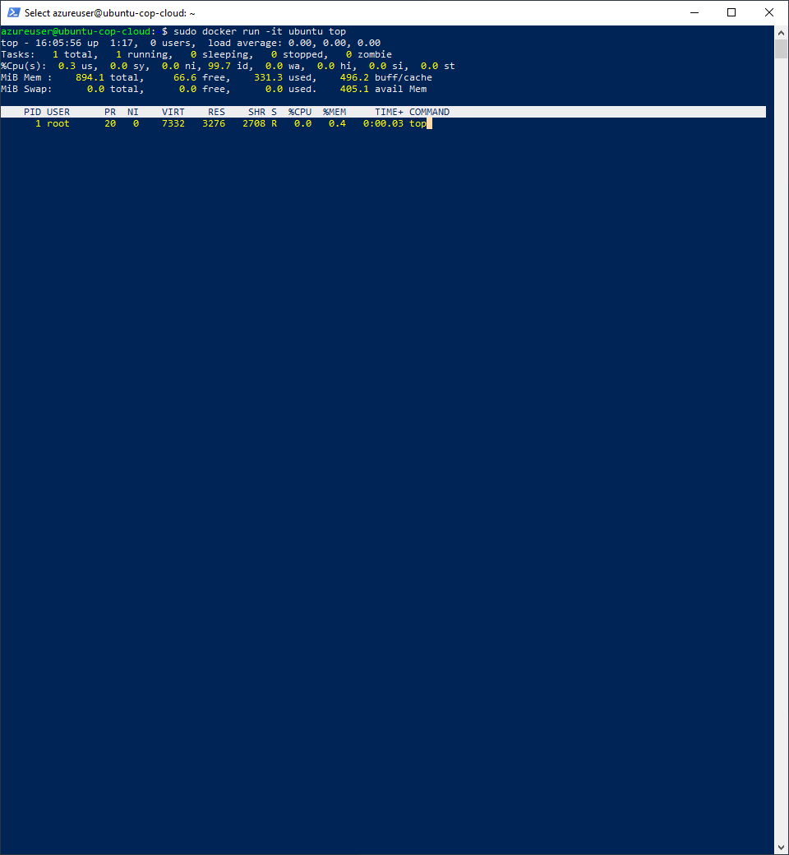
Lab 1 – Running the first container
sudo docker run -it ubuntu top
Use the docker run command to run a container with the ubuntu image using the top command. The -t flags allocate a pseudo-TTY which we need for the top to work correctly.

Slide 9
Comands
docker images
Muestra las imágenes locales disponibles.
docker search ubuntu [OPTIONS] TERM
Busca en Docker Hub las imágenes relacionadas con el termino especificado.
docker pull [OPTIONS] NAME[:TAG|@DIGEST] [IMAGE NAME]
Trae una imagen o repositorio de un registro por el ejemplo Docker Hub
docker run [OPTIONS] IMAGE [COMMAND] [ARG...]
Ejecuta un comando en un nuevo contenedor
docker ps [OPTIONS]
Lista los contenedores en ejecución

Slide 10
Comands
docker rm [OPTIONS] CONTAINER [CONTAINER...]
Remueve uno o mas contenedores.
docker rmi [OPTIONS] IMAGE [IMAGE...]
Remueve una o mas imágenes.
docker stop [OPTIONS] CONTAINER [CONTAINER...]
Remueve una o mas imágenes.
docker exec [OPTIONS] CONTAINER COMMAND [ARG...]
Ejecuta un comando en un contenedor que se está en ejecución

Slide 11
images command
docker images [OPTIONS] [REPOSITORY[:TAG]]
List images
Aliases:
docker image ls, docker image list, docker images
Options:
-a, --all Show all images (default hides intermediate images)
--digests Show digests
-f, --filter filter Filter output based on conditions provided
--format string Format output using a custom template:
'table': Print output in table format with column headers (default)
'table TEMPLATE': Print output in table format using the given Go template
'json': Print in JSON format
'TEMPLATE': Print output using the given Go template.
Refer to https://docs.docker.com/go/formatting/ for more information about formatting
output with templates
--no-trunc Don't truncate output

Slide 12
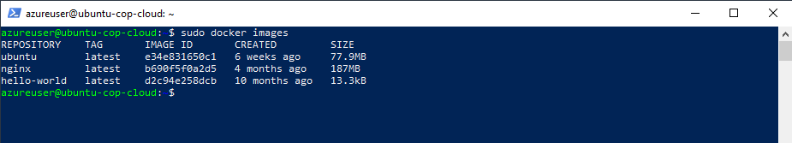
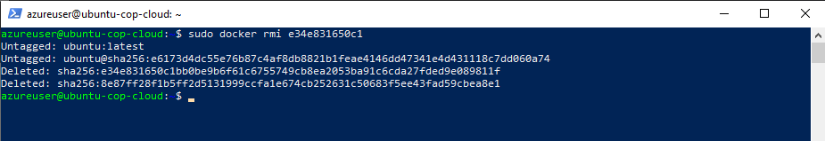
Lab 1 – Running listing and removing images

Slide 13
Run command
docker run [OPTIONS] IMAGE [COMMAND] [ARG...]
Create and run a new container from an image
Aliases:
docker container run, docker run
Options:
-d, --detach Run container in background and print container ID
-e, --env list Set environment variables
-h, --hostname string Container host name
-i, --interactive Keep STDIN open even if not attached
-p, --publish list Publish a container's port(s) to the host
-t, --tty Allocate a pseudo-TTY
-v, --volume list Bind mount a volume

Slide 14
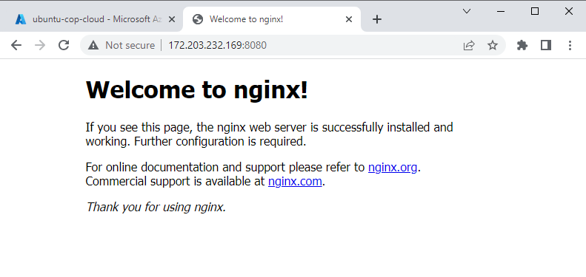
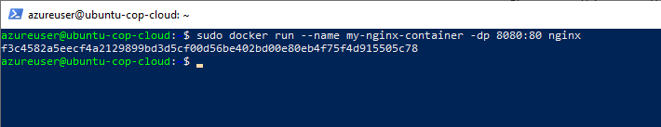
Lab 2 – Running the first container
sudo docker run -it ubuntu top
Use the docker run command to run a container with the ubuntu image using the top command. The -t flags allocate a pseudo-TTY which we need for the top to work correctly.
sudo docker run --name my-nginx-container -dp 8080:80 nginx

Slide 15
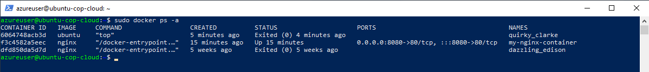
Lab 2 – Listing containers
docker ps
Show all active containers
docker ps -a
Show all containers (Active and Inactive)

Slide 16
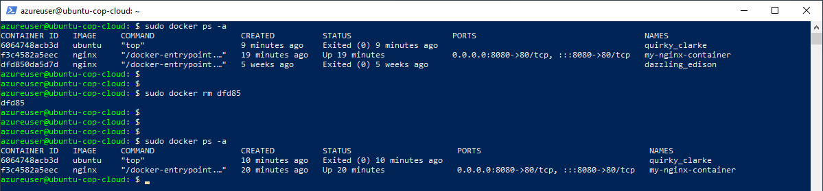
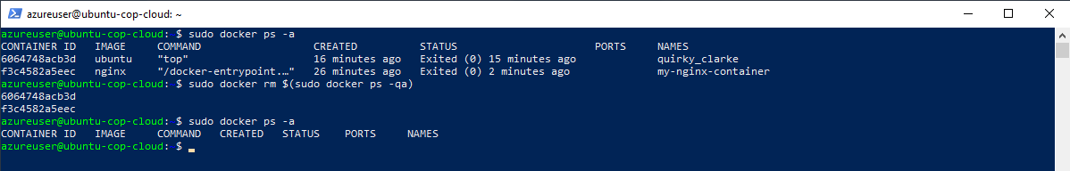
Lab 2 – REMOVING containers
docker rm [CONTAINER ID / CONTAINER NAME]
Remove container
sudo docker rm $(sudo docker ps -qa)
Remove all containers

Slide 17
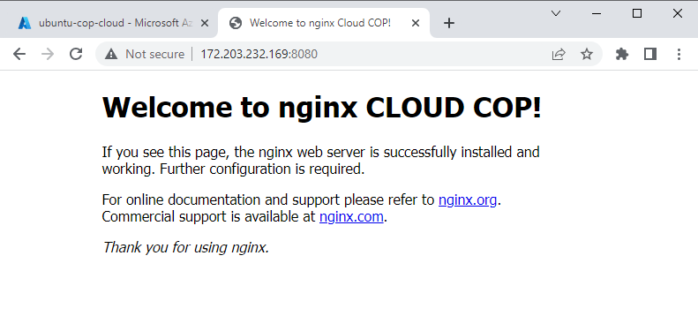
Lab 3 – executing commands into containers
docker exec [OPTIONS] CONTAINER COMMAND [ARG...]
> sudo docker run --name my-nginx-container -dp 8080:80 nginx > sudo docker exec -it 2f652 bash into container
# apt update
# apt install nano # nano /usr/share/nginx/html/index.html

Slide 18
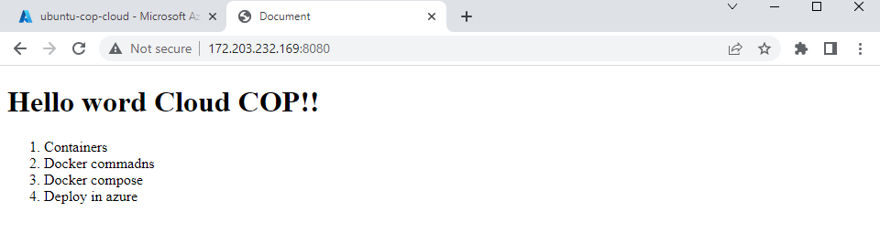
Lab 4 – Working with volumes
docker exec [OPTIONS] CONTAINER COMMAND [ARG...]
> sudo touch /home/azureuser/docker/volume/content/index.html > sudo nano /home/azureuser/docker/volume/content/index.html
Create html content
> sudo docker run -v /home/azureuser/docker/volume/content:/usr/share/nginx/html:ro -dp 8080:80 nginx

Slide 19
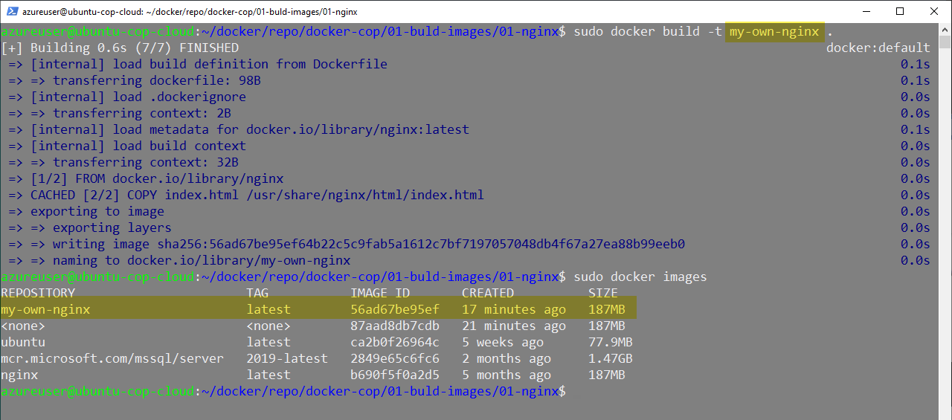
Lab 5 – Creating your own images
FROM nginx
COPY index.html /usr/share/nginx/html/index.html
<!DOCTYPE html>
<html lang="en">
<head>
<meta charset="UTF-8" />
<meta name="viewport" content="width=device-width, initial-scale=1.0" />
<title>Document</title>
</head>
<body>
Hi, Cloud COP form my own nginx
</body>
</html>
> azureuser@ubuntu-cop-cloud:~$ sudo docker build -t my-own-nginx .

Slide 20
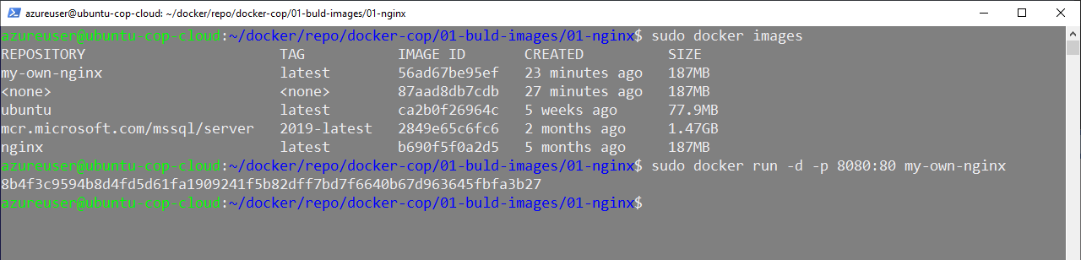
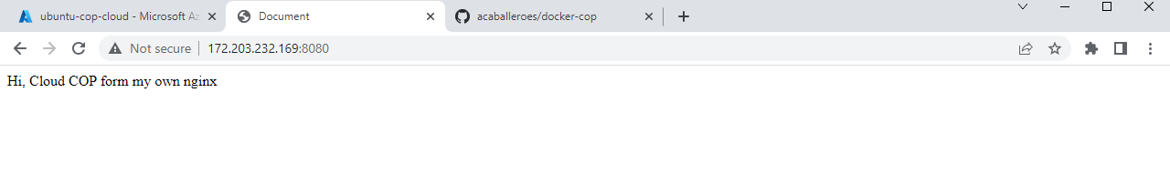
Lab 5 – Running your own images
sudo docker run -d -p 8080:80 my-own-nginx

Slide 21
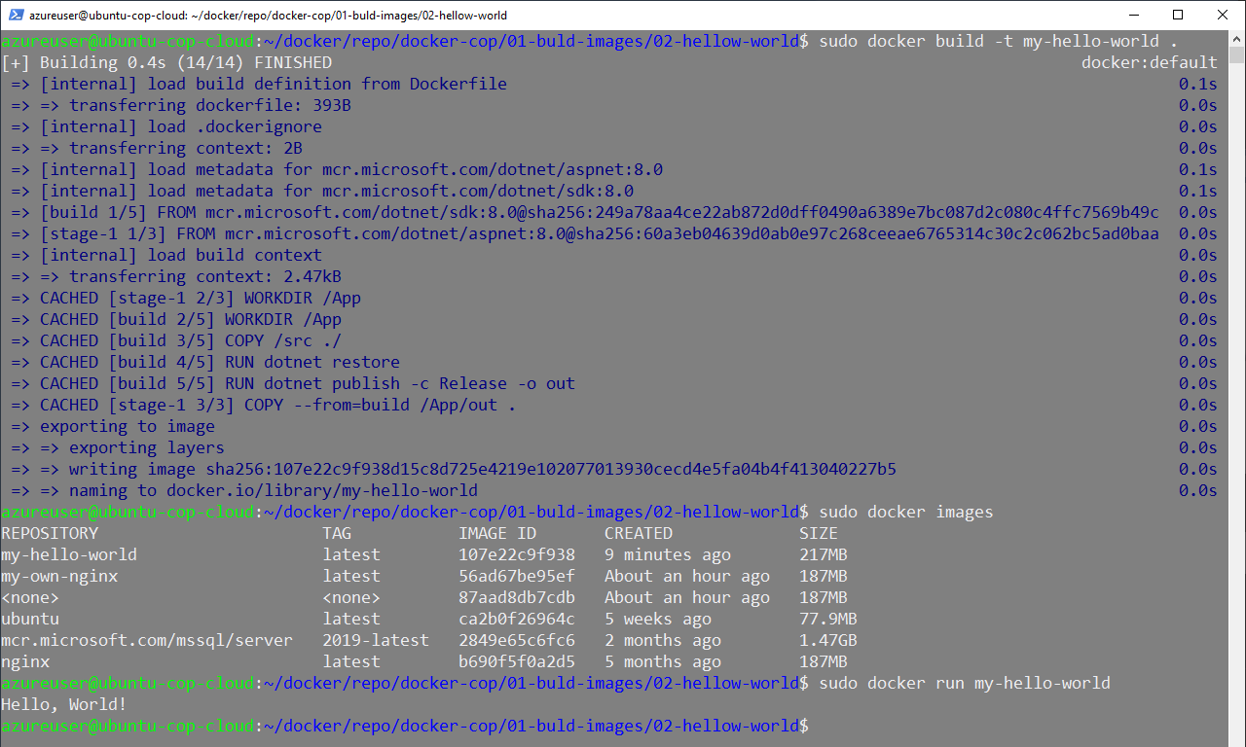
Lab 5 – Running your own images

Slide 22
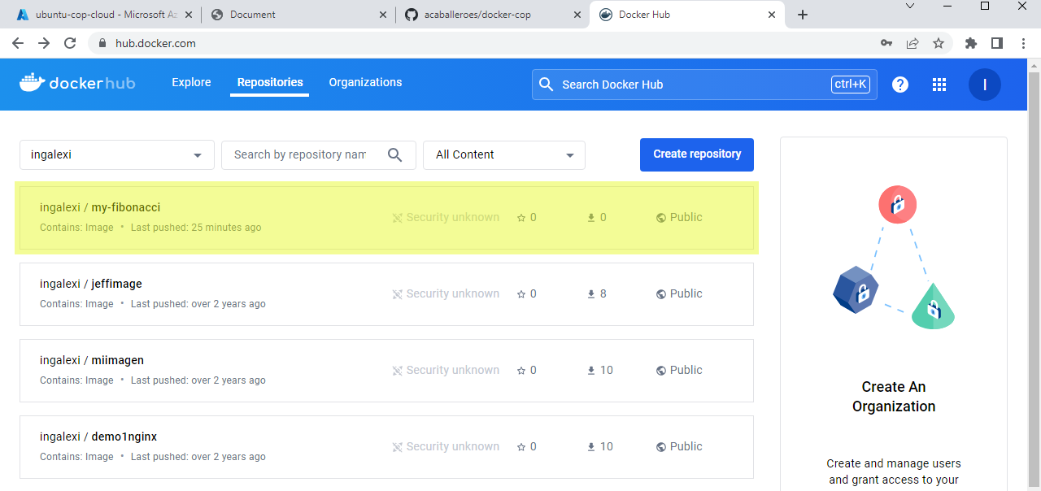
Lab 6 – Publish your own images
> sudo docker build -t ingalexi/my-fibonacci . > docker login > username: ingalexi
> password: *****
> docker push ingalexi/my-fibonacci

Slide 23
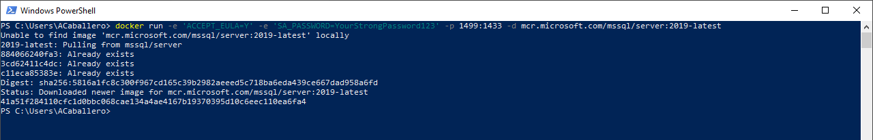
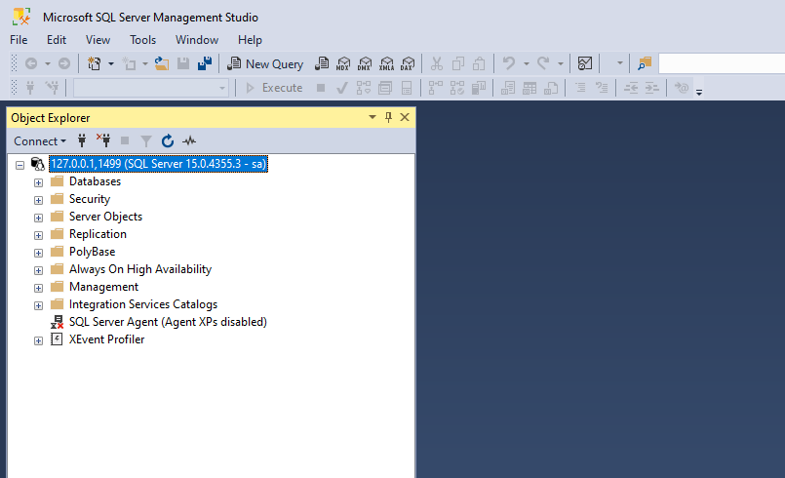
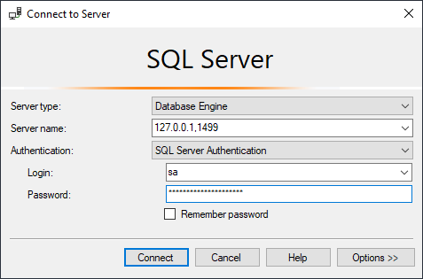
Working with environment variables

Slide 27






