Slide 1

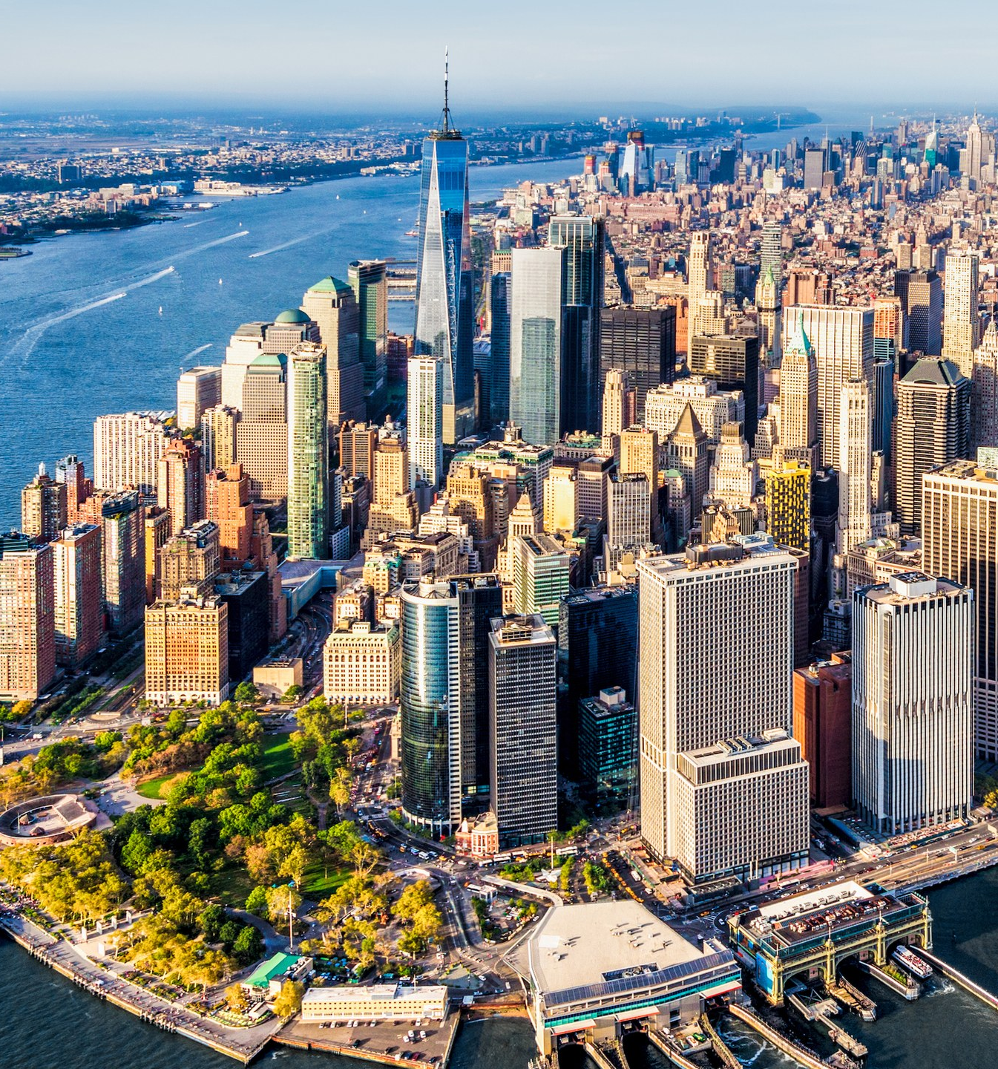
BATTLE OF THE NEIGHBORHOODS
Toronto vs New York City
Andre Cabrino

Slide 2
Problem Statement
Understand the similarities and differences of neighborhoods between Scarborough borough in Toronto and Queens borough in New York City
Select the best neighborhood for a Fortune 500 company to move its headquarters based on venues

Slide 3
Objective
Collect the neighborhoods top venues using Foursquare
Form neighborhood based on venue categories using unsupervised k-means clustering algorithm
Identify and understand the similarities and differences between Scarborough and Queens neighborhoods to obtain insights into the neighborhoods

Slide 4
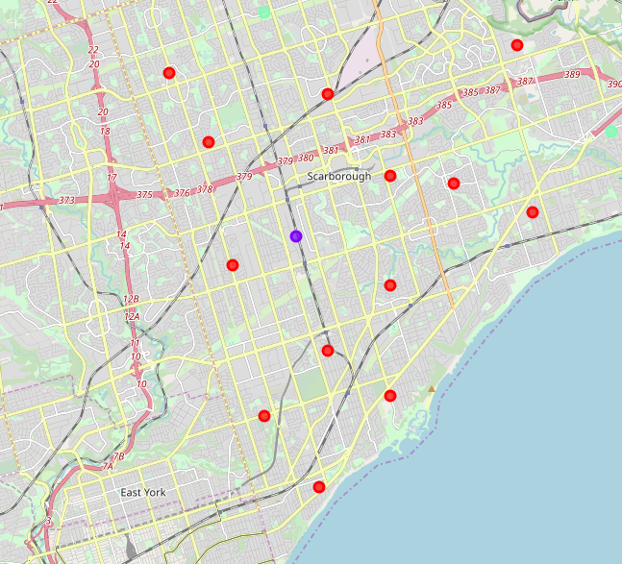
Map of Scarborough in Toronto
Different neighborhood clusters

Slide 5
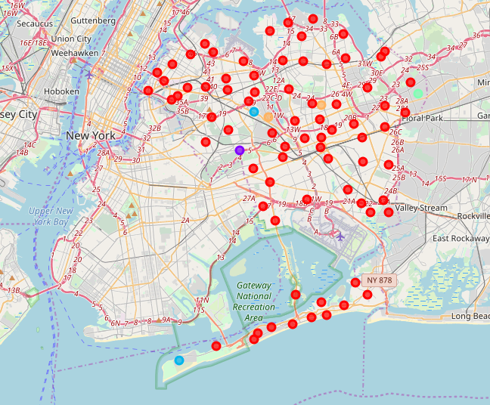
Map of Queens in New York City
Different neighborhood clusters

Slide 6
Comparison between Neighborhoods
Scarborough vs Queens
Scarborough has 79 distinct venues in 51 categories
The most common venues in Scarborough are coffee shops, international restaurants, and skating rinks
Queens has 1744 distinct venues in 270 categories
The most common venues in Queens are bodegas, bakeries, coffee shops, and parks

Slide 7
Conclusion
Based on the quantity of venues and variety of venues, Queens is a better choice than Scarborough to relocate the headquarters of the Fortune 500 company. Queens offer a greater amount of gyms, grocery stores, restaurants for individual and families of the employees.
Of course the quality of the mentioned venues will be subject to a future analysis, the recommendation is based solely on the quantity and variety.

