Slide 1
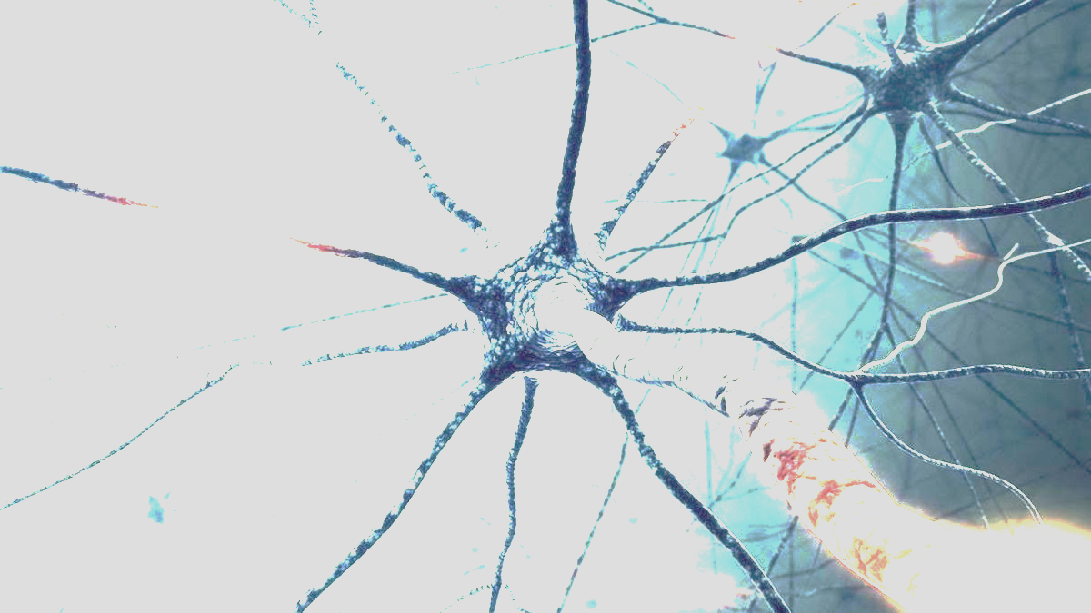
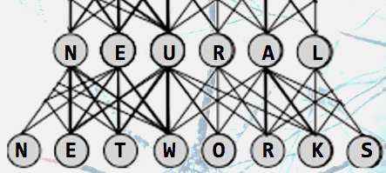
How We Tricked Rocks Into
Thinking, With Lightning
Exploring Artificial Intelligence
and Neural Networks
Antonio Caceres
Monday, January 14th
Otto Library, 3:15PM

