Slide 1

Economic Growth and Environmental Degradation A Twenty-Year View of CO₂ Levels and GDP
Armi Cachila
Tyler Cobb
Yazan Rizeq
Paul Stephens
September 30, 2019

Slide 2
Economic Growth and
Environmental Degradation
The story to be told:
What is the relationship between economic growth and environmental degradation?
How?
We analyzed relationships between CO₂ Levels and GDP using World bank data from 1994 through 2014

Slide 3
Requirements Met
Data set with over 100 records: 20 years, 10 countries, 2 variables (CO₂ and GDP)
Python Flask–powered RESTful API with HTML/CSS, JavaScript, SQL database and a JS library that we created.
Dashboard page with multiple charts that update from the same data. Includes a user-driven interaction and at least three views.

Slide 4
Data Set
CO2 Emissions
(metric tons per capita)
Global data per country
World Bank Open Data
https://data.worldbank.org
Carbon Dioxide Information Analysis Center, Environmental Sciences Division, Oak Ridge National Laboratory, Tennessee, United States.
GDP
(current US$)
Global data per country
World Bank Open Data
https://data.worldbank.org
World Bank national accounts data, and OECD National Accounts data files.

Slide 5
Python Flask–powered RESTful API
…with HTML/CSS, JavaScript, SQL database and a JS library that we created.
App Code:
from flask import Flask, jsonify, render_template
import psycopg2
import psycopg2.extras
​
# Flask Setup
app = Flask(__name__)
name = 'postgres' #default username, use yours if different
password = 'Bootcamp!1' #insert yours
db = 'project' #insert database name you used
​
connection = psycopg2.connect(user = name,
password = password,
host = '127.0.0.1',
port = '5432',
database = db)
cursor = connection.cursor(cursor_factory=psycopg2.extras.DictCursor)
​@app.route("/")
def index():
return render_template("index.html")
@app.route("/<country>")
​
def country(country):
cursor = connection.cursor(cursor_factory=psycopg2.extras.DictCursor)
cursor.execute(f'Select * from merged where country = \'{country}\';')
country_dat = cursor.fetchall()
cursor.close()
country = dict(country_dat[0])
return jsonify(country)
@app.route("/topco2")
def topco2():
cursor = connection.cursor(cursor_factory=psycopg2.extras.DictCursor)
cursor.execute('Select country, total_c02 from merged;')
co2 = cursor.fetchall()
cursor.close()
top_co2 = dict(co2)
return jsonify(top_co2)
​
@app.route("/topgdp")
def topgdp():
cursor = connection.cursor(cursor_factory=psycopg2.extras.DictCursor)
cursor.execute('Select country, total_gdp from merged;')
gdp = cursor.fetchall()
cursor.close()
top_gdp = dict(gdp)
return jsonify(top_gdp)
​
if __name__ == '__main__':
app.run(debug=True)

Slide 6
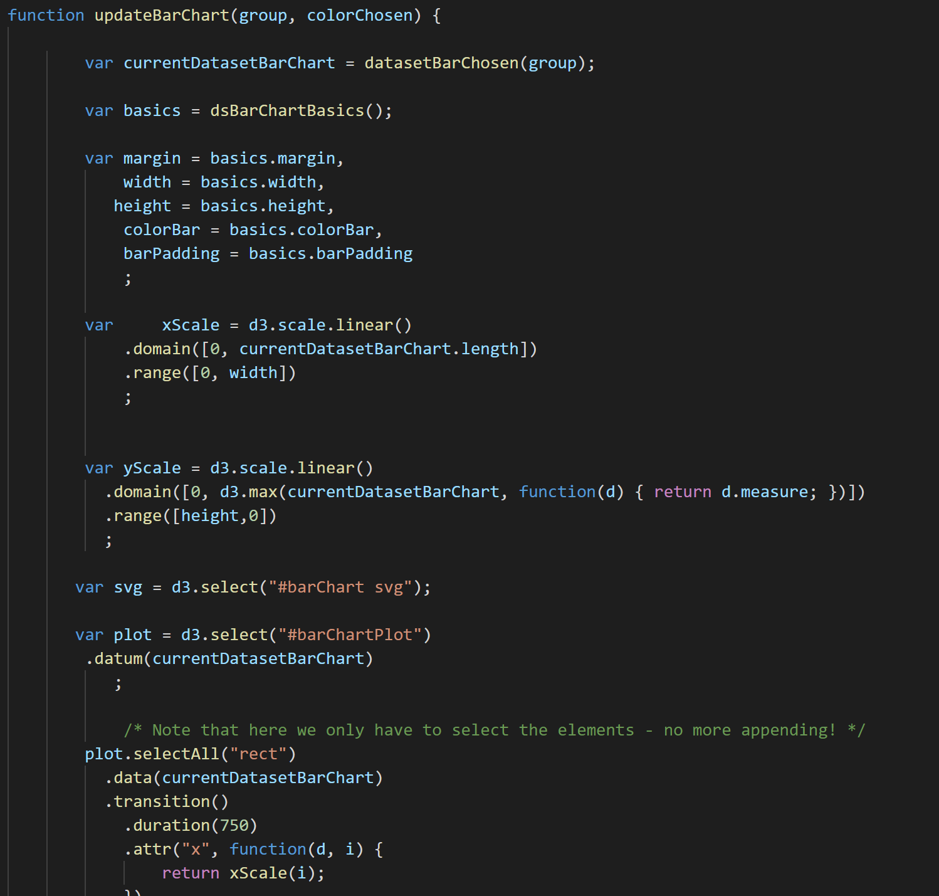
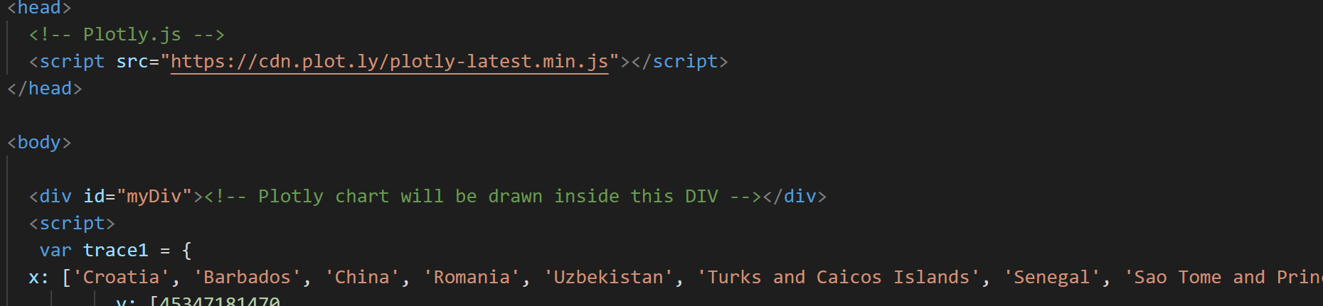
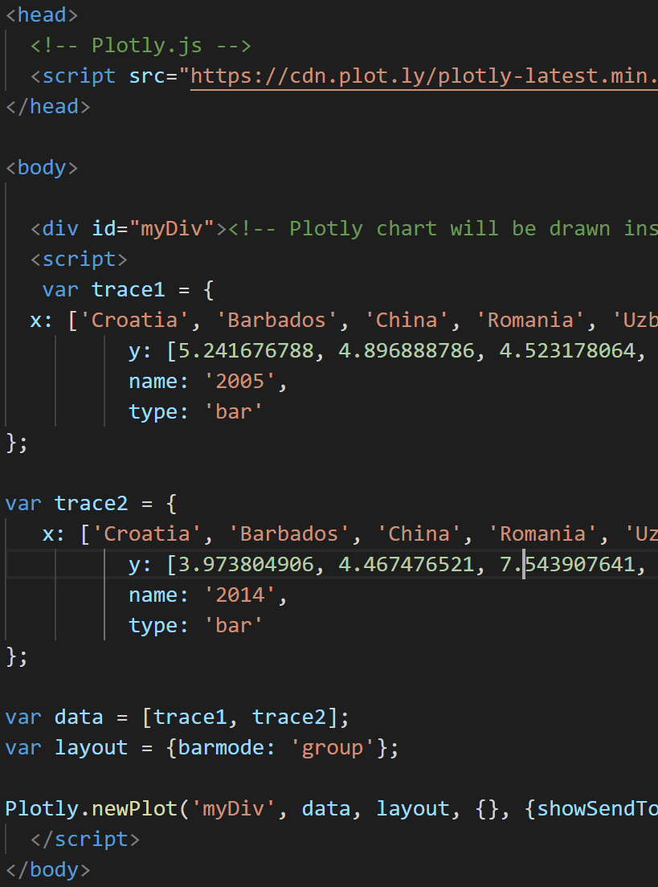
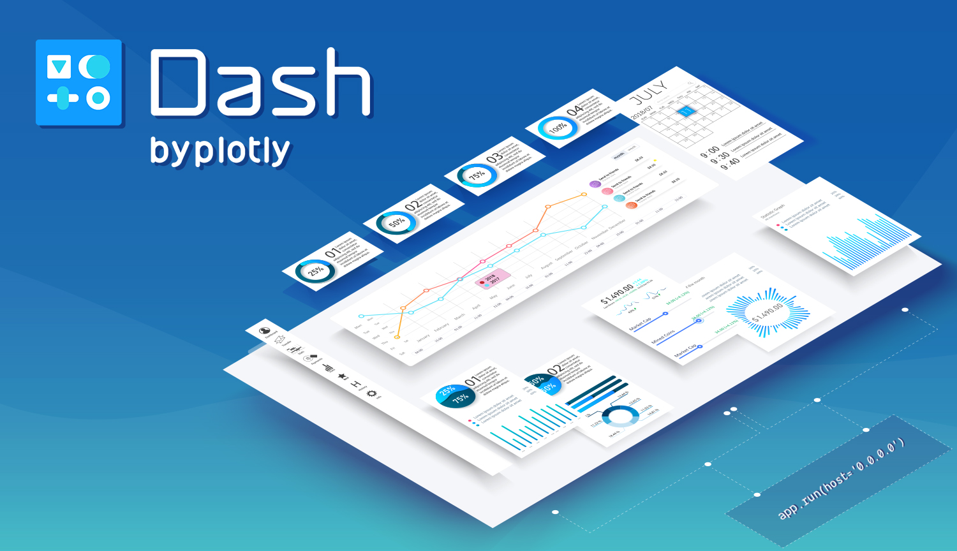
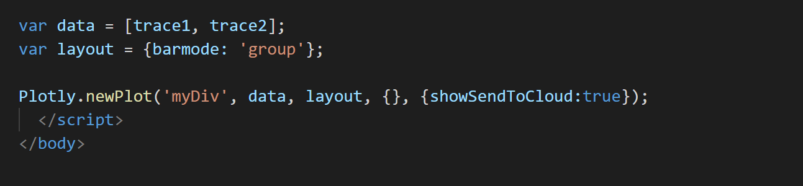
HTML Code

Slide 7
Demo

Slide 8
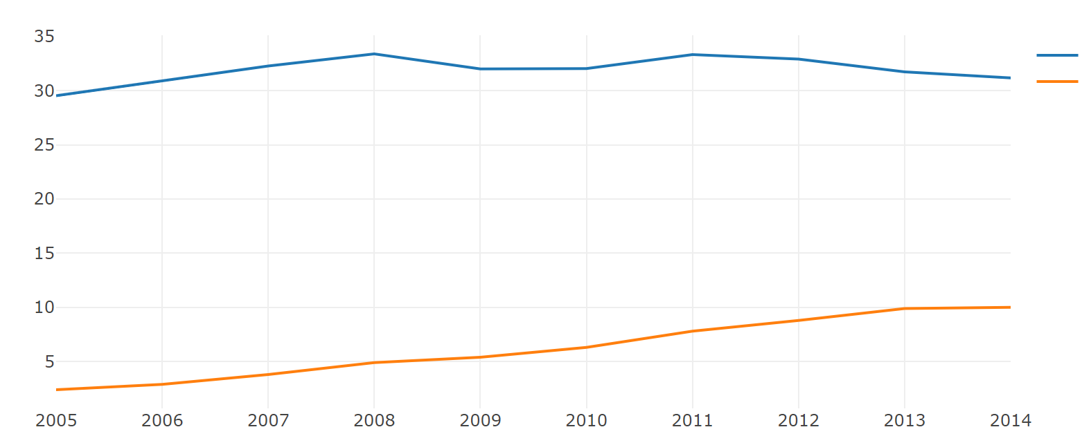
Visual 1
CO2
GDP

Slide 9
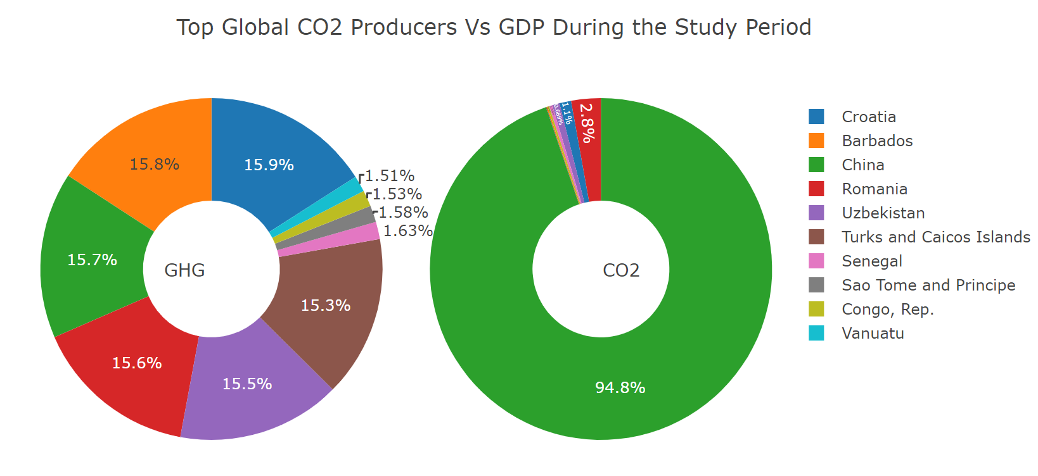
Visual 2

Slide 10
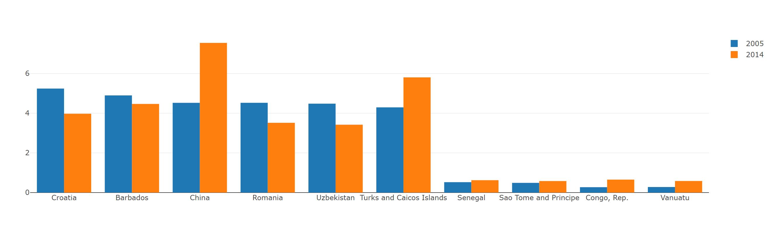
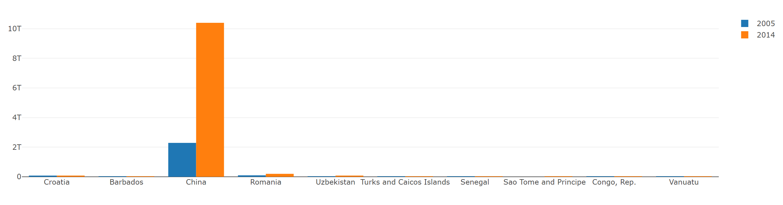
Visual 3

Slide 11
Conclusions and Resources for Further Research
Mild correlation between GDP Growth and CO2 emissions
Variability from country to country and over time
Overall Carbon emissions appears to be on a downward trend
Helpful links
Sweden: Decoupling GDP growth from CO2 emissions is possible
http://www.swemfa.se/2015/05/23/sweden-decoupling-gdp-growth-from-co2-emissions-is-possible/
Structural transformation: how did today’s rich countries become ‘deindustrialized’?
https://ourworldindata.org/structural-transformation-and-deindustrialization-evidence-from-todays-rich-countries

Slide 12



QUESTIONS?

