Slide 1
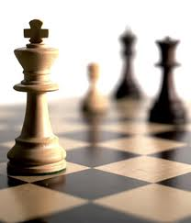

Advanced AI 课程
罗平
Autumn 2016

Slide 2
Pattern Mining over Transaction Database

Slide 3
Frequent pattern mining
2-1

Slide 4
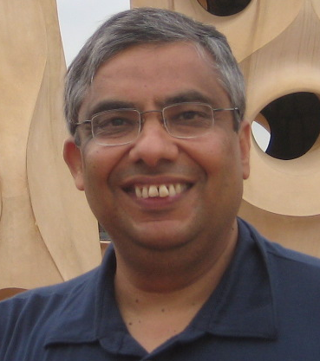
1992年，IBM，Rakesh Agrawal
IBM客户交流会
衔接大客户和IBM研究人员
超市：超市扫码机的普及
数据
积累大量用户购买记录数据

Slide 5
1992年，IBM，Rakesh Agrawal
用户购买数据
购买编号 | 购买记录
1 | B C E
2 | A B
3 | A B C
4 | A B D
5 | A B C D E F G

Slide 6
1992年，IBM，Rakesh Agrawal
频繁模式：经常被一起购买的商品
购买编号 | 购买记录
1 | B C E
2 | A B
3 | A B C
4 | A B D
5 | A B C D E F G

Slide 7

1992年，IBM，Rakesh Agrawal
啤酒和尿布的故事

Slide 8
Problem Statement
Frequent pattern mining
Support
Transaction No. | Items
1 | B C E
2 | A B
3 | A B C
4 | A B D
5 | A B C D E F G
The support of {BC} = 3/5

Slide 9
Problem Statement
Frequent patterns
support is bigger than a parameter α
Transaction No. | Items
1 | B C E
2 | A B
3 | A B C
4 | A B D
5 | A B C D E F G
The support of {BC} = 3/5
{BC} is frequent when α = 0.5

Slide 10
Frequent Pattern Mining
Given: a transaction database, and min_sup α
Output: all the frequent patterns
R. Agrawal, T. Imielinski, A.N. Swami: Mining Association Rules between Sets of Items in Large Databases, SIGMOD 1993. Won the 2003 SIGMOD Test of Time Award for the most impactful paper over the intervening decade. Citations.

Slide 11
Frequent Pattern Mining
Naïve solution
Check all the patterns (itemset) one by one

Slide 12
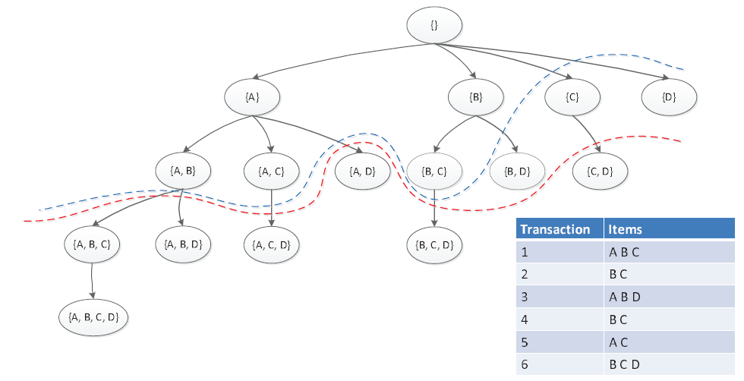
Solution
lexicographic subset tree: list all the itemsets
(all the items are ranked in a fixed sequence)

Slide 13
Solution
Property on lexicographic subset tree
子树根节点对应的itemset是子树上的任意节点对应的itemset的子集

Slide 14
Frequent Patterns
Anti-Monotone重要性质
Frequent itemset的任何子集都是frequent的
等价的形式：对于一个itemset，只要它的任意一个子集不frequent，那么它就不frequent
推出：如果一个itemset不frequent，那么任何包含它的itemset都不frequent
Anti-monotone: 随着itemset的item增加，它的frequency不增加

Slide 15
Solution
Pruning by anti-monotone
The red line in the graph
剪枝的本质：对每棵子树，估算出该棵子树上所有节点的frequency的最大值(upper bound)

Slide 16
A-Priori
Breadth-first traverse on the lexicographic subset tree
with pruning by anti-monotone
Trick: if BC is infrequent, we don’t need to extend ABC

Slide 17
Maximal Frequent Patterns
在某个frequent itemset上，添加任意的item后，都会变为infrequent
那么，它是一个maximal frequent itemset
maximal frequent itemset是最大可能的长

Slide 18
Maximal Frequent Patterns
那么，紧贴着红线的节点都是maximal frequent itemsets吗？

Slide 19
More Works on Frequent Pattern Mining
More efficient algorithm for FPM:
J. Han, J. Pei, Y. Yin, and R. Mao. "Mining Frequent Patterns without Candidate Generation: A Frequent-pattern Tree Approach". Data Mining and Knowledge Discovery: An International Journal, Volume 8, Issue 1, pages 53-87, January 2004, Kluwer Academic Publishers.
Mining maximal frequent patterns
J. Wang, J. Han, and J. Pei, "CLOSET+: Searching for the Best Strategies for Mining Frequent Closed Itemsets", in Proc. 2003 ACM SIGKDD Int. Conf. on Knowledge Discovery andData Mining (KDD'03), Washington, D.C., Aug. 2003.
More: parallel, incremental, top-K, … …

