Slide 1



Recommender Systems
罗平 luop@ict.ac.cn
Autumn 2016

Slide 2
Threat models
11-1

Slide 3
Malicious Behaviors
Malicious behaviors
Try to promote something in the RS
Disrupt and control the RS

Slide 4
Think about how to promote or kill products
Fake ratings
Fake users with the similar taste to existing users
For user-user CF

Slide 5
Goal of Treat Models
For recommender accuracy and neutrality

Slide 6
Solutions
Passive solutions
Require users to prove themselves
CAPTCHA
Detect fake users and ratings
Lockstep behaviors
Active solutions
A recommendation systems which is robust to threats

Slide 7
Data Perturbation
Main Idea: obfuscate (混淆) ratings by applying random data perturbation
Server although does not know the exact values of the customer ratings
Accurate recommendation can still be made because:
The range of data is known
Computation based on aggregation of obfuscated data sets
Tradeoff between degree of obfuscation an accuracy of recommendation
The more "noise" in the data,
the better users' privacy is preserved
the harder the approximation of real data for the server

Slide 8
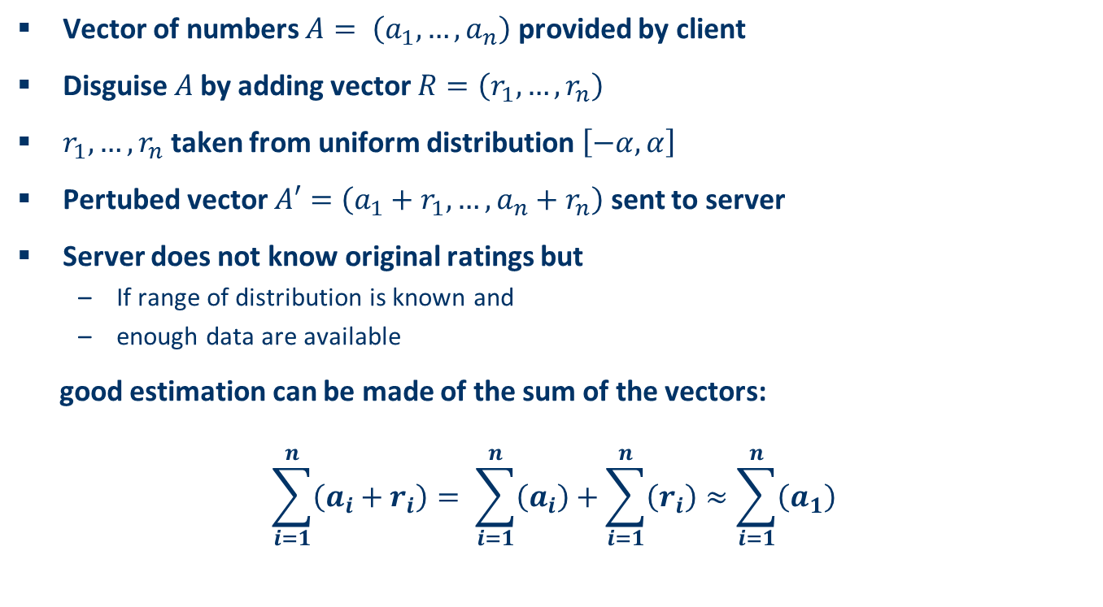
Data perturbation II
Vector of numbers $A= \left(a_{1},…,a_{n}\right)$ provided by client
Disguise $A$by adding vector $R=\left(r_{1},…,r_{n}\right)$
$r_{1},…,r_{n}$ taken from uniform distribution $\left[−α,α\right]$
Pertubed vector $A′=\left(a_{1}+r_{1},…,a_{n}+r_{n}\right)$ sent to server
Server does not know original ratings but
If range of distribution is known and
enough data are available
good estimation can be made of the sum of the vectors:
$$\sum_{i=1}^{n}{\left(a_{i}+r_{i}\right)}= \sum_{i=1}^{n}{\left(a_{i}\right)}+\sum_{i=1}^{n}{\left(r_{i}\right)}≈\sum_{i=1}^{n}{\left(a_{1}\right)}$$

Slide 9
Conclusion
Think carefully about the threats you want to protect from
Think about what threats your users might consider
Define threat model carefully when making privacy claims

Slide 10
The cold start problem
11-2

Slide 11
Learning Objectives
To understand the various cold-start problems:
New user
New item
New system
To understand various approaches to addressing cold start problems

Slide 12
New Users
Problem: lack of a profile of preferences
Not an issue for non-personalized
When possible, provide useful default personalization options
Popular items, demographically relevant
Product association
Even trust-based social network data
Get explicit preferences (products, attributes)
Preference Elicitation
A Q&A phase

Slide 13
Key References
K. Zhou, S.H. Yang and Hongyuan Zha. Functional matrix factorizations for cold-start recommendation. SIGIR, 2011.
M. Sun, F. Li, J. Lee, K. Zhou, G. Lebanon and Hongyuan Zha. Learning Multiple-Question Decision Trees for Cold-Start Recommendation. Proceedings of the 6th ACM International Conference on Web Search and Data Mining (WSDM) , 2013.

Slide 14
New Systems
How to bootstrap a new system?
Syndicated data (get data from another source)
Mostly focuses on use of other forms of data
Tagging
Social networks
Techniques to infer or boost ratings
Preference elicitation strategies

Slide 15
Decision making
11-3

Slide 16
Introduction
The understanding of online users' purchasing behavior is of high importance for companies
This purchasing behavior can be explained by different models of human decision making

Slide 17
Introduction
Research has clearly pointed out that preference stability in decision processes does not exist
For instance, a customer who purchases a digital camera could first define a strict upper limit for the price of the camera, but because of additional technical information about the camera, the customer could change his or her mind and significantly increase the upper limit of the price.
The nonexistence of stable preferences led to the development of different alternative decision models, which are discussed in the following

Slide 18
Preference construction - Theories from Cognition and Decision Psychology
Theory | Description
Context effects | Additional irrelevant (inferior) items in an item set significantly influence the selection behavior
Primacy/recency effects | Items at the beginning and the end of a list are analyzed significantly more often than items in the middle of a list
Framing effects | The way in which different decision alternatives are presented influences the final decision taken
Priming | If specific decision properties are made more available in memory, this influences a consumer's item evaluations
Defaults | Preset options bias the decision process

Slide 19
Theory | Description
Internal vs. external LOC | Externally influenced users need more guidance; internally controlled users want to actively and selectively search for additional information
Need for closure | Describes the individual pursuit of making a decision as soon as possible
Maximizer vs. satisficer | Maximizers try to find an optimal solution; satisficers search for solutions that fulfill their basic requirements
Conformity | A person's behavior, attitudes, and beliefs are influenced by other people
Trust | A person's behavioral intention is related to factors such as the willingness to buy
Emotions | Mental states triggered by an event of importance for a Person
Persuasion | Changing attitudes or behaviors

Slide 20
Context Effects
The way in which we present different item sets to a consumer can have an enormous impact on the outcome of the overall decision process
A decision is always made depending on the context in which item alternatives are presented
Additions of completely inferior item alternatives can trigger significant changes in choice behaviors
Different context effects are presented in the following

Slide 21
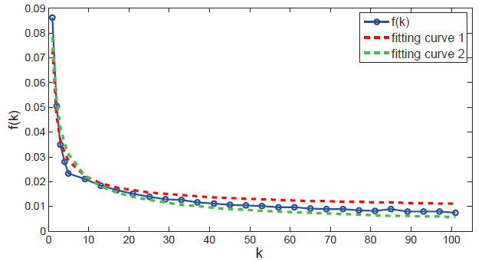
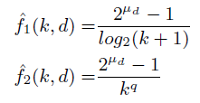
Position Bias

Slide 22
Conformity
Is a process in which a person's behaviors, attitudes, and beliefs are influenced by other people
Recommenders have the potential to affect users' opinions of items
Cosley et al. (2003) investigated whether the display of item predictions affects a user's rating behavior
The outcome of this experiment was that users confronted with a prediction significantly changed (adapted) their rating behavior
The changed rating behavior can be explained by the fact that the display of ratings simply influences people's beliefs

Slide 23
To Switch or Not To Switch
Zhu, H., Huberman, B.A., & Luon, Y., (2012) To Switch or Not To Switch: Understanding Social Influence in Online Choices. Proceedings of the 2012 annual conference on Human factors in computing systems. CHI’2012.
Haiyi ZHU (GroupLens, University of Minnesota)

Slide 24
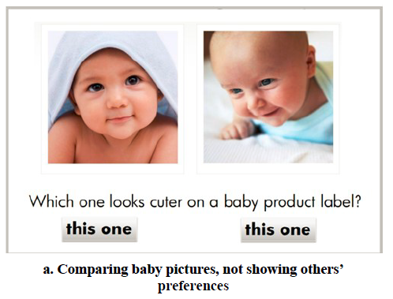
To Switch or Not To Switch
`

Slide 25
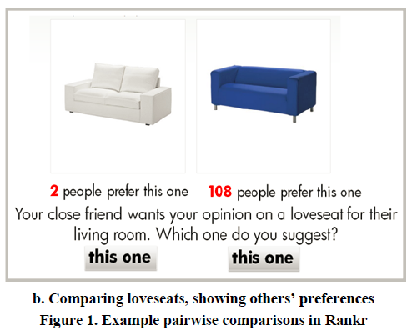
To Switch or Not To Switch
`

Slide 26
Recommendations in ubiquitous environments
11-4

Slide 27
Mobile Applications
Mobile applications have been a domain for recommendation
Small display sizes and space limitations
Naturally require personalized information
Since the end of the 1990s, research into mobile applications has focused heavily on adaptivity
Nowadays, limitative circumstances are now starting to disappear
More powerful CPUs
Better displays
Modern wireless broadband

Slide 28
RS Research Questions in Ubiquitous Domains
What are the specific goals of recommender systems in a mobile context?
Do users expect serendipitous recommendations, or is it more important to be pointed to things that are close to one's current position?
What are the implications of contextual parameters such as localization for the design of recommendation algorithms?
Is location just another preference, a requirement that is always strictly enforced, or something in between?
What role does the modality of interaction play when addressing users "on the go"?
Pushing information can be useful to draw recipients' attention, but the users' permission is surely needed. how should permission protocols for "push" recommendations function?

Slide 29
What else?
11-5

Slide 30
Where We’ve Focused
Basic algorithms
Non-personalized, product association
content-based, knowledge-based, user-, item-, matrix factorization
Evaluation metrics

Slide 31
What We Only Briefly Introduced
Context-Aware Recommenders (location, social networks)
Trust-Based Recommenders
Explanations
Hybrid Recommenders
Winning the Netflix prize
Recommender Attacks and Defenses

Slide 32
What We Didn’t Cover
Multi-Criteria Recommenders
What happens when you have separate criteria instead of just “liking”?
Recommendation Algorithms for Optimizing Hit Rate, User Satisfaction and Website Revenue. IJCAI, 2015.
De-Noising Data
Classifier Learning
Factorization machine (http://www.libfm.org/)
Temporal Recommenders
Deep learning: LSTM (语言的建模 vs. 人类行为的建模)
Social Tagging-Based Recommenders

Slide 33
Getting More Information
Books
Handbook of Recommender Systems (Ricci et al., Eds.)
Including the advanced topics
Research Articles
ACM Conference on Recommender Systems
ACM Trans. on Information Systems
User Modeling and User-Adapted Interaction
KDD, WSDM, WWW, SIGIR

Slide 34
Preview of the RS Papers in KDD 2016
http://www.kdd.org/kdd2016/topics/view/recommender-systems
Reading the introduction

Slide 35
More Tools for Recommendation
11-6

Slide 36
LensKit

Slide 37
Apache Mahout
Built in Java
Uses Hadoop for scalability
General machine learning capabilities
Several recommender algorithms

Slide 38
MyMediaLight
C#/.NET (works on Mono)
Prediction and recommendation
Many algorithms available
Includes built-in cross-validation

Slide 39
GraphLab
C++ and Java (2 versions)
High-performance matrix factorization
Very large data sets on single machines

Slide 40
REST services
EasyRec
PredictionIO
Mahout has a REST API
LensKit has one in progress

Slide 41
Other Libraries
crab (Python)
mrec (Python)
recommenderlab (R)
SUGGEST
RecDB (PostgreSQL)
many more…

Slide 42
General ML Tools
R, Matlab, and their libraries
WEKA (machine learning toolkit)

