Slide 1



Recommender Systems
罗平 luop@ict.ac.cn
Autumn 2016

Slide 2
Introduction to dimensionality reduction recommenders
9-1

Slide 3
Motivation and Intuition
Ratings matrix is an overfit (detailed) representation of user tastes and item descriptions
Leads to computational complexity, potentially poorer results
To have a more compact representation of user tastes and item descriptions
Not pre-defined
Love well-written historical tragedies
Love ballet that tells a story
To derive the taste from the data automatically

Slide 4
History: Singular Value Decomposition
The information retrieval community addressed this problem earlier (1988)
They faced the same issue – keyword vectors had the problem that queries and documents were poorly represented. They wanted to recognize concepts, not words.
Examples
Singular Value Decomposition was used to create a solution
Intuitive description: reduce space to a smaller taste space that is compact and robust
Notes:
Complier, change the air ticket

Slide 5
Singular Value Decomposition
Reduce dimensionality of problem
Results in small, fast model
Need to experiment to find appropriate value of k for a domain (for movies, roughly 13-20)
Challenge #1: missing values
Need some way to fill them
Several alternatives, including clever averages and predictions

Slide 6
Singular Value Decomposition
Challenge #2: computational complexity
SVD computation is O(m^2n + n^3)
Challenge #3: lack of transparency / explainability
Optimal dimensions do not correspond to user-comprehensible concepts

Slide 7
SVD: Take-Aways
Clever and useful approach
Computational advantages at run-time
Significant challenges in model building
Particularly for large models
SVD is growing in use, but still not dominant in the field

Slide 8
Diving Deeper with SVD
9-2

Slide 9
The Algebra of an SVD
Rating matrix M decomposes to UΣV^{T}
U, V orthogonal
Translate vectors into & out of low-dim space
Σ diagonal matrix of singular values
Truncate: keep k ‘most important’ dimensions (highest singular values)
Best rank-k approximation (by RMSE/Frobenius norm)
De-noises the data

Slide 10
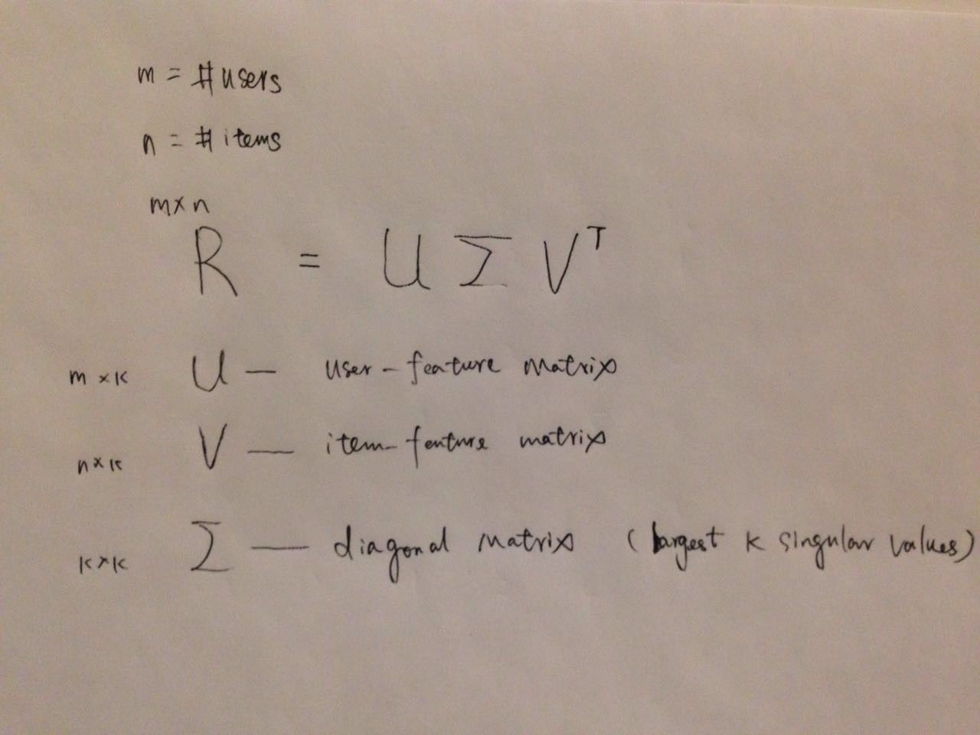

Slide 11
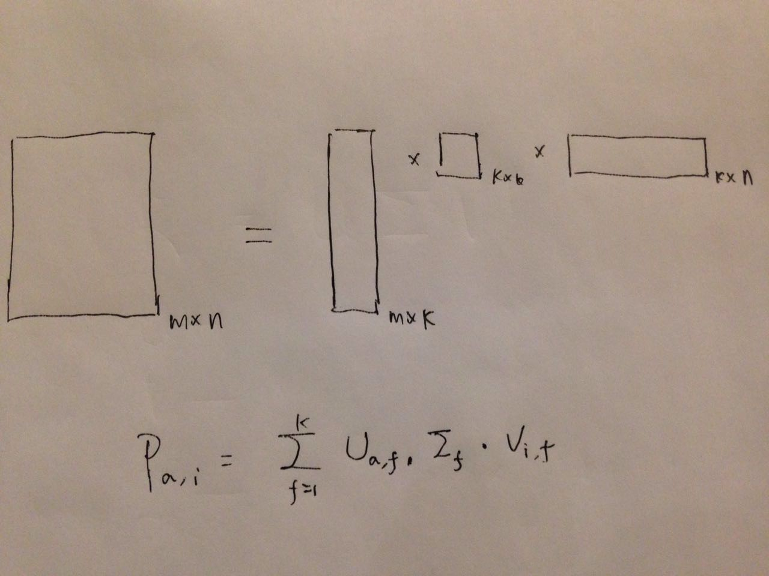

Slide 12
Computing an SVD
Well-known algorithms in many linear algebra packages
Matlab
LINPACK
ARPACK
Very slow

Slide 13
Missing Data
SVD formulation (and many solvers) assume matrix is complete
But if it's complete, don't need recommender
What to do with missing values?
‘Impute’ — assume they are a mean
Normalize data first — assume they are 0
Next: ignore them, and fast

Slide 14
Training SVDS
9-3

Slide 15
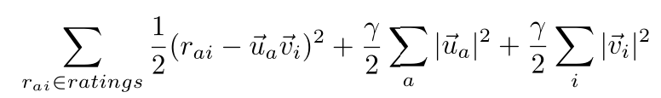
FunkSVD
Train features one at a time
Ignore missing values (mostly)

Slide 16
Gradient Descent
Convex optimization method
We won't cover gradient descent in general here
that's multivariate calculus
Basic idea: how far off we are at one point (prediction) tells us how to improve the prediction
Stochastic gradient descent

Slide 17
Algorithm Structure
Initialize values to train (item/user feature vectors) to arbitrary starting point
Must be non-zero
Try to predict each rating in data set
Use error and update rule to update values for next rating/sample
Iterate until convergence
Stops moving
Iterated enough times

Slide 18
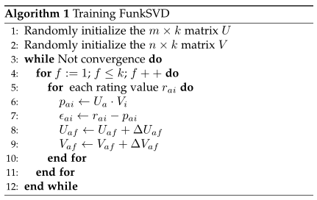
Algorithm Structure
Notes:
f is the index for dimensions

Slide 19
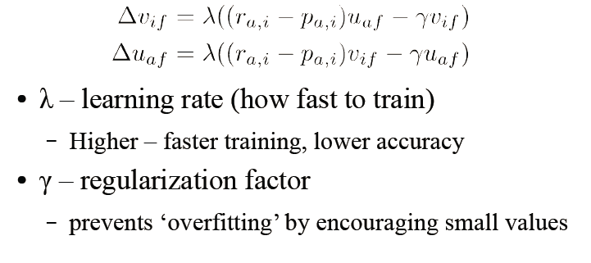
Parameters

Slide 20
Where'd this come from?
Gradient descent to minimize (global) RMSE of final model
Update is derivative of squared error with respect to user or item feature value
With regularization term
General idea: use gradient descent (or other method) to find values that minimize the error (cost function)
Caveat: no longer a true SVD

Slide 21
Adding New Data (folding in)
New user joins the system and rates some items
Adapt the training algorithm for folding in
Fix the vectors for other users and all the items

Slide 22
Extending: SVD++
http://www.recsyswiki.com/wiki/SVD%2B%2B

Slide 23
Probabilistic Matrix Factorization for rating matrix
9-4

Slide 24
PMF
Basic idea: model ratings as a distribution (i.e. Gaussian)
Distribution parameters determined by item, user, and/or latent feature

Slide 25
PMF
Models ratings as drawn from normal distributions
Mean determined by user and item via features

Slide 26
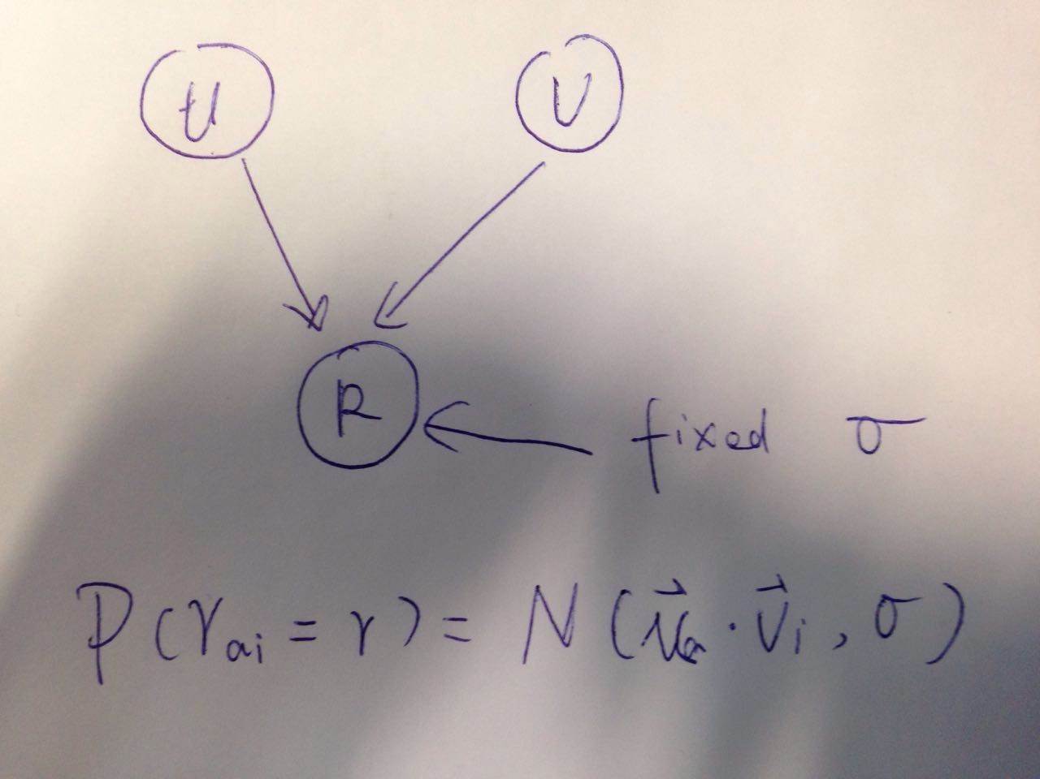
Probabilistic Matrix Factorization

Slide 27
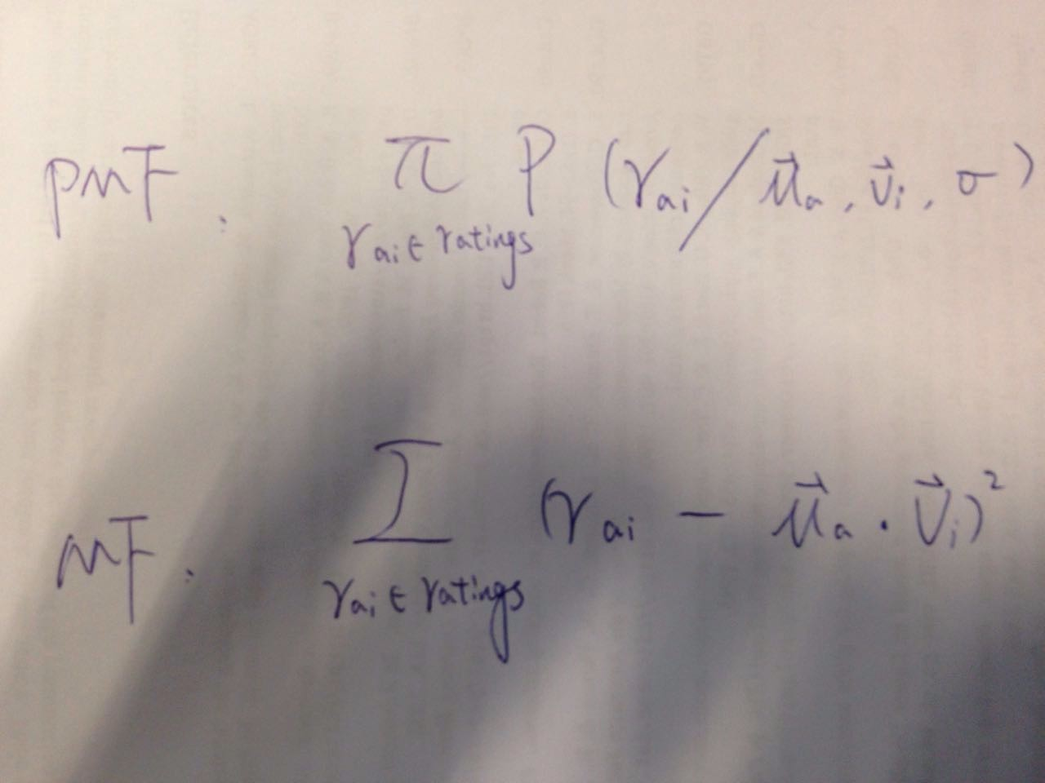
PMF vs. MF

Slide 28
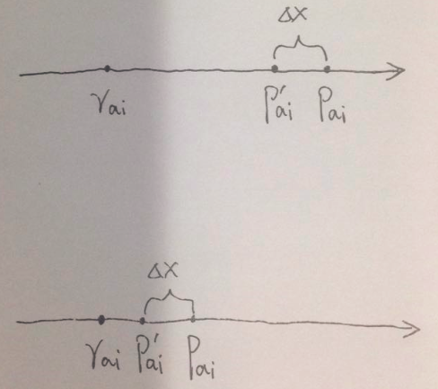
PMF vs. MF

Slide 29
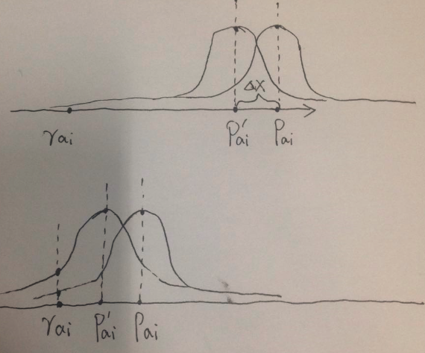
PMF vs. MF

Slide 30
Probabilistic Latent Semantic Analysis for Counting matrix
9-5

Slide 31
Probabilistic Modeling
Many interesting algorithms are based on probabilistic models
Basic idea:
Assume that data is generated by random process (with known structure)
Learn parameters that would generate data that looks like what you have

Slide 32
Personalized
Goal: compute P(i|u)
Probability that user u will select item i
Problem: many, many parameters
For every item in the system
Also, we don't know for items the user hasn't bought!

Slide 33

Probabilistic Latent Semantic Analysis
Goal: compute P(i|u)
Probability that user u will select item i
Decompose with latent factors
P(z|u): a user u picks a taste z
P(i|z): an item i is picked from a taste z

Slide 34
PLSI and SVD
Count data: not for matrix with ratings
Two forms of matrix factorization
PLSI: left and right vectors are stochastic, not orthogonal
SVD: orthogonal
FunkSVD: not orthogonal

Slide 35
Prediction with PLSI without Constraints
Prediction without constraints
For each user: P(i|u)

