Slide 1



Recommender Systems
罗平 luop@ict.ac.cn
Autumn 2016

Slide 2
Introduction to Evaluation of Recommender Systems
8-1

Slide 3
Why a whole module on
evaluation?
• Zillions of algorithms, but which to pick?
• Lessons from commercial experience
• Lessons from the Netflix Challenge
• Lessons from (and for) the research
community

Slide 4
Retrospective vs. Live Recommendations?
• Retrospective evaluation (offline) looks at how recommender would have predicted or recommended for items already consumed/rated.
• Prospective evaluation (online) looks at how recommendations are actually received.
• Fundamental differences …

Slide 5
Overview
Experimental protocols for retrospective evaluation
Metrics for retrospective evaluation
For rating prediction: accuracy
For unary data: decision support metrics
For ranking evaluation
Live evaluation

Slide 6
Evaluation from a Commercial Look
• Nobody cared about accuracy …
– The supermarket recommender (e.g. banana)
• Lift, cross-sales, up-sales, conversions
• Led to thinking about different measures
anchored not only to user experience, but
recommender goals and business purposes

Slide 7
Experimental protocols for retrospective evaluation
8-2

Slide 8
Introduction
• Experimental protocol design
– How do we structure an evaluation
Mostly for retrospective evaluation

Slide 9
Learning Objectives
• Understand basic structure of a cross-fold
recommender evaluation
• Be able to design a plausible, repeatable
evaluation using best practices

Slide 10
Machine Learning
• Hidden data
– Hold out some data, try to predict/classify it
• Cross-validation
– Split data into partitions, hold out each in
turn
– Average results
• Measure score or classification accuracy

Slide 11
Cross Validation
• Partition data set into k partitions
• For i = 1 to k
– train on all sets other than i
– test on set i
• What k to use?
– Large values → more training data
– Small values → more efficient
– 5 and 10 are common

Slide 12
Splitting data
• Split user ratings
• Split users
– Allows more control for measuring expected
user experience
• Split items
– Rarely, if ever, done

Slide 13
Splitting users ratings
• Split user ratings randomly
– Very common
– Use to compare with existing results
• Split user ratings by time
– More accurate simulation of user experience
– Results often worse
• Best, but expensive: only train on ratings
before time of test rating

Slide 14
Drawback of Offline Evaluation
• Often cannot answer if recommender really
works
– User-based evaluation needed
– Link to business metrics is weak

Slide 15
Accuracy Metrics for rating prediction
8-3

Slide 16

Mean Absolute Error (MAE)
• What is error?
– Divergence of prediction from actual opinion
(rating)
– P-R
• Absolute error removes direction
– | P-R |
• MAE = Average ( | P-R | )

Slide 17

Mean Squared Error (MSE)
• Why Squared Error?
– Removes sign – avoids need for absolute value
– Penalizes large errors more than small
•
• One disadvantage – squared error is not on an
intuitive scale …

Slide 18
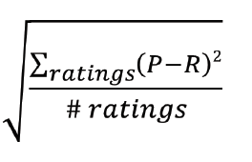
Root Mean Squared Error (RMSE)
•

Slide 19
Reversals
Reversals are large mistakes
Off by 3 points on a 5-point scale
Intuition is that these are really bad, leading to loss of confidence
Percentage of reversals

Slide 20
Warning…
• Consider different coverage to different algorithms

Slide 21
Decision support metrics for Unary data
8-4

Slide 22
Unary Data
Unary data (implicit feedback)
clicks
plays
purchases

Slide 23
What is “Decision Support”
• Measure how well a recommender helps
users make good decisions
– Good decisions are about choosing “good”
items and avoiding “bad” ones

Slide 24
Evaluation Protocol
Split the data by time
For each user, the algorithm outputs a ranking of items this user is likely to buy
A ranking of all the items
Given a set of items this user really buy in the time phase for testing
A set of items this user bought

Slide 25

Precision and Recall
For each user
Precision at position k
Recall at position k
F1 at position k
Average over all the users

Slide 26
Evaluation on the Recommendation with Constraints
Recommendation with constraints
Average over all the recommended items

Slide 27
Limitations
• Precision@k and overall precision are perhaps the most widely used (and easily understood)
• None of these metrics overcome the problem of being based on rated items only
• Weak to business metrics

Slide 28
Rank Metrics for unary data
8-5

Slide 29
Evaluation Protocol
Split the data by time
For each user, the algorithm outputs a ranking of items this user is likely to buy
A ranking of all the items
Given a set of items this user really buy in the time phase for testing
A set of items this user bought

Slide 30
Overview
• Mean Reciprocal Rank
• Discounted Cumulative Gain

Slide 31
Mean Reciprocal Rank
• Reciprocal rank: the rank of the first ‘good’ item
– RR measures how far you have to go to find something good
• MRR is just average over all users

Slide 32
Normalized Discounted Cumulative Gain
• Measure utility of item at each position in
the list
• Discount by position, so things at front are
more important
• Normalized Discounted Cumulative Gain (nDCG)
Normalize by total achievable utility

Slide 33
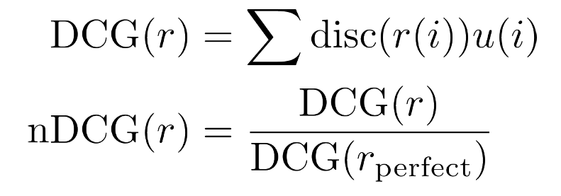
NDCG: the Formula
• NDCG is in range [0,1]; 1 is perfect ranking
• Measures fraction of potential utility
achieved

Slide 34
Utility
• 1/0 (for purchases/clicks/views)

Slide 35
Position Discount
Position i (the click ratio at position i)
1/(log_{2} (i+1))
Position bias
Notes:
回想一下哪些地方使用了log函数？

Slide 36
More metrics
8-6

Slide 37
Discussion on Hidden Data Evaluation
Recommenders are about helping people find new stuff they’ll like
Hidden-data evaluations penalize algorithms that actually find new stuff!
It is hard to beat the recommendation of top K items in terms of these measures
In the end, for real relevance, we need to look at user experience

Slide 38
A couple of stories …
• The perfect supermarket recommender …
Buy Bananas
Maybe Bread Too!

Slide 39
Diversity
• Measure of how different the items
recommended are
– Applied to a top-n list
• Start with a pairwise similarity metric
– E.g., book categories, others
have used tags, keyword vectors
• Intra-list similarity is the average pairwise
similarity, lower score is higher diversity

Slide 40
Diversification
• Common approach is to penalize/remove the
items from the top-n list that are too similar
to prior items already recommended
– Replace the k+1st items with the next first one that does not exhibit too high a similarity

Slide 41
Serendipity
Definition: the occurrence and development of events by chance in a happy or beneficial way
In RS: surprise, delight, not the expected results

Slide 42
Serendipity
Serendipity measure
Preference(item i) – popularity (item i )

Slide 43
Serendipity in Practice
• Don’t need an overall metric to increase
serendipity
– Simply downgrade items that are highly popular
(or otherwise obvious)
– This tends to require experimentation and tuning
– May use diversification factor approach, or a
constant down-weighting by popularity
• Business goal – get people to consume less popular
items

Slide 44
Wrap up …
• Metrics can address “fuzzier” goals such as
producing a diverse, delightfully surprising set of
recommendations; or assessing whether
recommendations go deep into the “long tail” of the
catalog and not just a few recommended items.
• Experimental data shows that these objectives may
even be worth sacrificing some accuracy.

Slide 45
User-centered evaluation (Live evaluation)
8-7

Slide 46
Business Objectives and Metrics
• Users of recommenders have a much broader set of
objectives than the metrics
– Immediate lift
– Net lift (subtract out cost of returns)
– Time to next transaction
– Long-term customer value (lifetime value)
– And much more ….

Slide 47
A Spectrum of Techniques
Large scale online A/B test
Small scale user study
Polls, surveys, online experiment
Consult an expert in user studies, HCI (Human-Computer Interaction), etc.

Slide 48
Large scale online A/B test
Business measures
Lift, cross-sales, up-sales, conversions
Measures
Immediate Behavior (recommendations taken, options changed, etc.)
Longer-term Behavior (return rate, change in purchases, referrals, …)

Slide 49
Small Scale User Study
Can be useful for assessing overall desires, context, usage patterns
Be careful: hard to create good surveys
Techniques for combining responses, identifying underlying factors
Surveys often useful in conjunction with other techniques

Slide 50

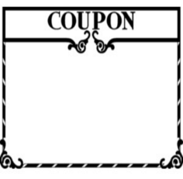




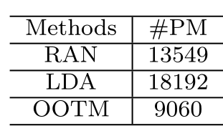






真实场景实施： 北京某标杆性商场店庆
RAN
LDA
OOTM

Slide 51
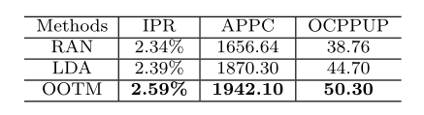

真实场景实施： 北京某标杆性商场店庆
每发一条短信
带来的营业额
增加了29.75%

Slide 52
Take-Away
• No substitute for real user-centered testing
• Need to design tests around business goals
– A/B test

Slide 53
Paper Reading
From Online Behaviors to Offline Retailing, KDD 2016
Style in the Long Tail: Discovering Unique Interests with Latent Variable Models in Large Scale Social E-commerce, KDD 2014

