Slide 1
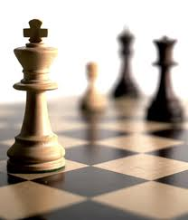


Recommender Systems
罗平 luop@ict.ac.cn
Autumn 2016

Slide 2
Non-personalized recommendation
2-1

Slide 3
Learning Objectives
To understand the value of non-personalized recommenders, and domains where they are most useful
Its drawbacks
Its basics of
Aggregated opinion recommenders
Product association recommendation

Slide 4

The Story of Zagat
Acquired by Google for $125M

Slide 5
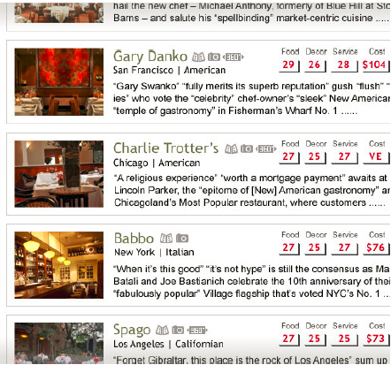
The Story of Zagat
Acquired by Google for $125M

Slide 6
The Secret Formula: Average
Rating={0,1,2,3}
Score = round (MEAN(ratings) * 10)
Max(Score) = 30
Min(Score) = 0

Slide 7
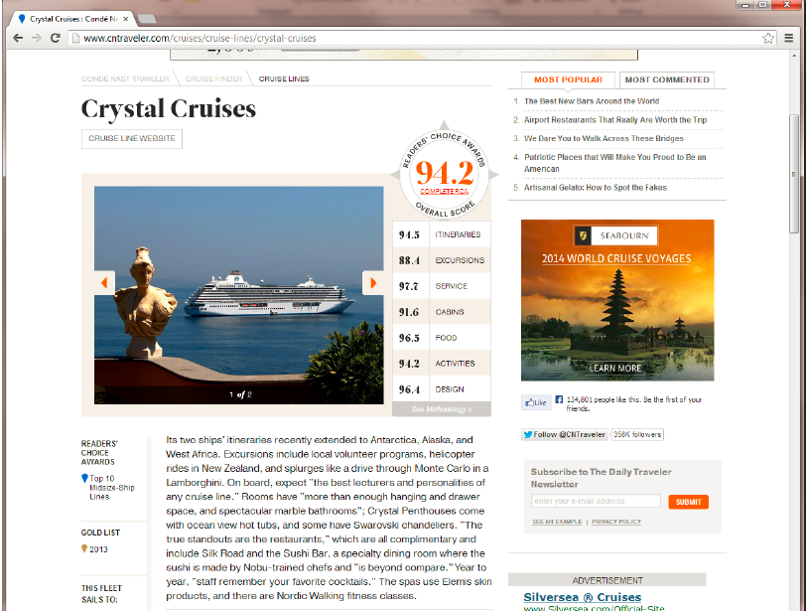
Itineraries
Excursions
Service
Cabins
Food
Activities
Design

Slide 8
Drawback of Zagat
Some early Zagat fans argue the guide has been getting worse. Why?
All the restaurants with the similar scores
Too many mediocre restaurants with good scores
Too many excellent restaurants with mediocre scores

Slide 9
Drawback of Zagat
Reasons
Self-selection bias
ratings from recent users
Users of B&B
Increased diversity of raters for fancy hotels and restaurant
No free water, free spaghetti at fancy restaurants
Free WIFI, free breakfast, free parking at fancy hotels
French meals at Guide Michelin

Slide 10
Given all the ratings for an item
{5, 5, 4, 3, 2, 1}
{1, 1, 1, 1, 1, 1, -1}

Slide 11
More Statistic Summary of Ratings
Net upvotes/ #likes
Show popularity
No controversy
Average rating/ upvote proportions
No popularity
Full distribution

Slide 12
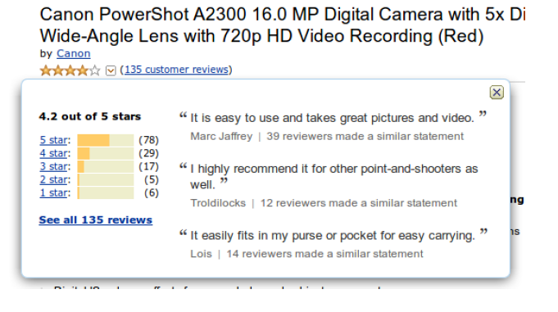
Example of Full Distribution

Slide 13
How to Compare
Item A: {5, 5, 4, 5, 5, 5}
Item B: {5}

Slide 14
Ranking Scores: Damped Means
Problem: few ratings
E.g., Only one 5-star rating
Solution
Assume that everything is average without evidence
Ratings are evidence of non-averageness

Slide 15

Ranking Scores: Damped Means
k: a parameter
mu: the average rating of all the items in the system
Here, n is the number of votings

Slide 16
Ranking Scores: Confidence Interval
Assume certain data distribution for the rating
Lower and upper bound of statistical confidence interval (95%)
Choice of bounds
Lower bound: conservative recommendations
Upper bound: risky for amazing recommendations

Slide 17
Product association recommendation
2-2

Slide 18
Non-Personalized Recommendation by Average Lacks Context
After ordering an ice-cream sundae
You want a recommendation for a sauce
Do you want to hear that ketchup (番茄酱) is the most popular sauce?
Need to consider the current context
With sundae
More-product recommendation
A simple kind of Context-aware Non-personalized recommendation

Slide 19
Transaction Database
Users | Items
User 1 | B C E
User 2 | A B
User 3 | A B C
User 4 | A B D
User 5 | A B C D E F G
Users | Items
User 1 | B C E
User 2 | A B
User 2 | A B C
4 | A B D
5 | A B C D E F G

Slide 20
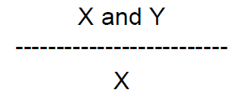
Computing the Association
Percentage of X-buyers who also bought Y
When Y is banana?
Challenge: compensate for overall popularity of Y

Slide 21
Computing the Causal Effect
Treatment effect
Refers to the causal effect of a given treatment or intervention (for example, the administering of a drug) on an outcome variable of interest
X: take the treatment; !X: not take the treatment
Y: the output occurs; !Y: the output does not occur
How to measure this treatment effect?

Slide 22
Computing the Causal Effect
A simple solution
P(Y|X)-P(Y|!X)
or P(Y|X)/P(Y|!X)

Slide 23
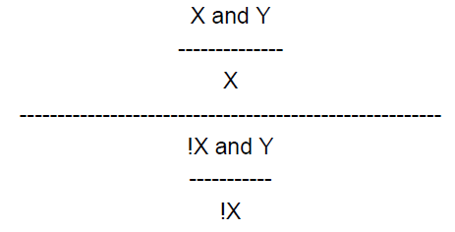
Lift
Adjust by looking at whether X makes Y more likely than not X (!X)
Focus on the increase in Y associated with X

Slide 24
Example of Lift
X = “anchovy paste” (凤尾鱼酱), Y=“banana”
Small value of lift, close to 1

Slide 25
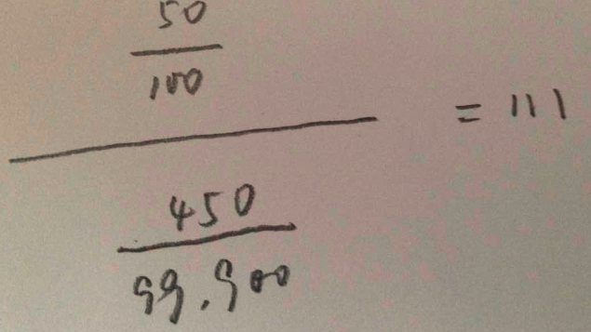
Example of Lift
X = “anchovy paste”, Y=“garlic paste” （蒜泥）
Small value of lift, much bigger than 1

Slide 26
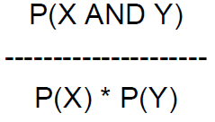
Other Solutions
Association

Slide 27
Discussion
Context-aware recommendation
Simple context: conditioned on one item
Complex context: conditioned on a set of items, or considering the sequence of these items
Non-personal or Personal recommendation
Computing P(Y|X) and P(Y|!X) over all the data
Computing P(Y|X) and P(Y|!X) over the data from the users who have similar tastes to a target user

Slide 28
Take-away Lessons
Non-personalized averages can be effective in the right application
Product associations can provide useful non-personalized recommendations in a context
Need to identify context; data source/scope
Lift, compensation for overall popularity

Slide 29
Assignment
Design a transaction database with 10 users and 5 items
Compute the causal effect between any pair of items
Find two items X and Y, such that P(Y) is big, however, P(Y|X)-P(Y|!X) is small
随机点名号码(1-122): 5位同学
下次课，5位同学中的2位上台表演

Slide 30
Assignment Extension
Algorithm Analysis
For a give transaction database (with 10^9 users, 10^7 items), compute the causal effect between any pair of items
For a give transaction database (with 10^9 users, 10^7 items), find the top-K pairs of items with the biggest values of causal effect

Slide 31
Time Sensitive Ranking for non-personalized recommendation
2-3

Slide 32
Reddit
Social news aggregator
Non-personalized news recommender
Users vote on items to determine top item

Slide 33
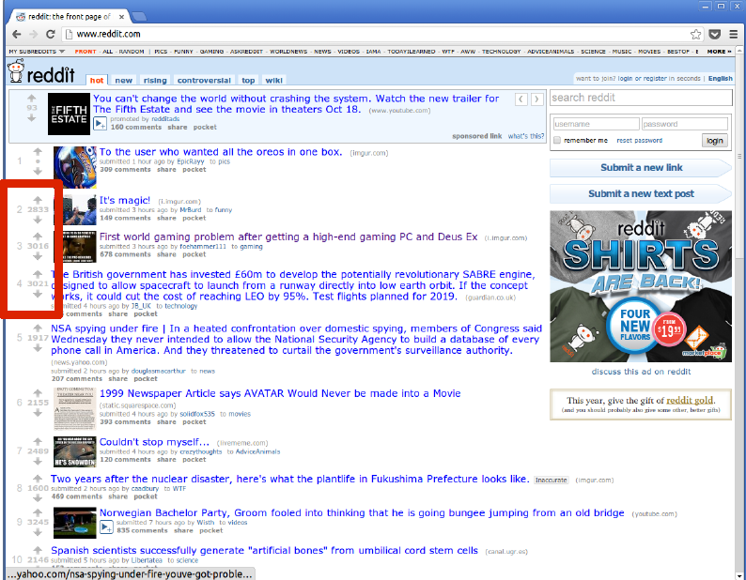
Reddit

Slide 34
Time-shifting
News aggregator
Old news is not interesting even if it has many net upvotes

Slide 35

Reddit Ranking for News
U: #upvotes
D: #downvotes
t_post: time when this news published

Slide 36
Reddit Ranking for News
Log term applied to votes
Decrease marginal value of later votes
Time in seconds
Buries items with negative votes

Slide 37
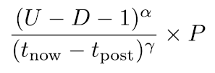
HackerNews Ranking for News
U: #upvotes
D: #downvotes
t_now: time for now
t_post: time when this news published
alpha: 0.8
gamma: 1.8
P: penalty term for different items

Slide 38
Wrap-Up for Time-sensitive Ranking
Many sites use ad-hoc methods for time shifting
Most formulas have constants, will be highly service-dependent

Slide 39
Summary of This Part
Non-Personalized Recommendations
Average, full distribution, damped average, confidence interval
Drawbacks: self-selection bias
Next-product recommendation
Association vs. Causal Effect
Time-sensitive recommendation ranking
Ad-hoc methods

