Slide 1
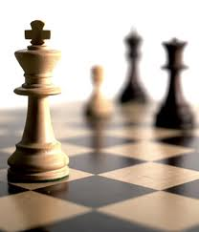
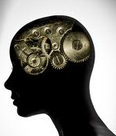

Recommender Systems
罗平 luop@ict.ac.cn
Autumn 2016

Slide 2
Introduction to Content based recommenders
3-1

Slide 3
Learning Objectives
To understand the range and value of content-based approaches to recommendation
To understand the strengths and drawbacks of content-based recommender systems

Slide 4

Applications of Content-based RS

Slide 5
Applications of Content-based RS
Sina.com
toutiao.com

Slide 6
Key Ideas
Model items by relevant item attributes
Models user preferences by attributes
The same attribute space for items and user preferences
Recommendation based on the similarity between items and user preferences

Slide 7
Basic Assumption: Stable Preference
Content: the description of items
Stable preference: long-term interests
News, reading
Clothing
Movies
Hotels
Content based recommendation
A kind of personalized recommendation
But not based on collaborative information

Slide 8
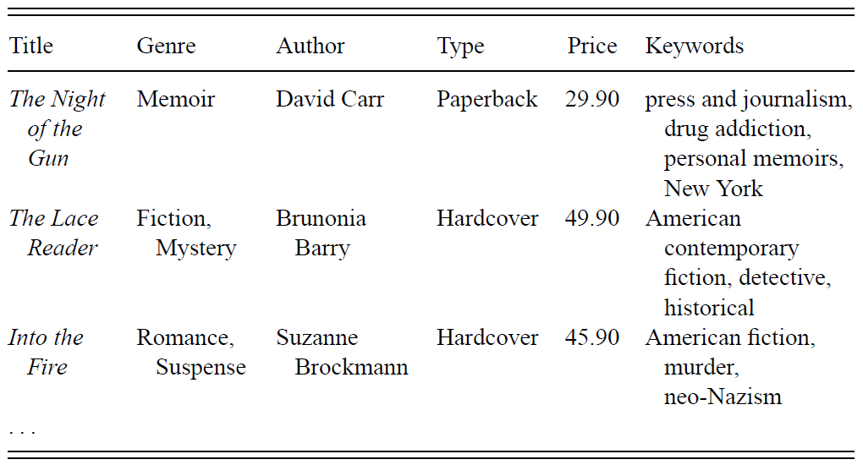
Case Study of CRS 1: Book Recommendation
Item Description

Slide 9
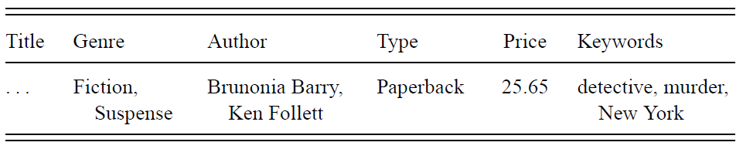
Case Study of CRS 1: Book Recommendation
User Profile
Similarity

Slide 10
Case Study of CRS 1: Book Recommendation
Attrite types
Enumeration
Real values

Slide 11
Case Study of CRS 2: News Recommendation
Krakatoa Chronicle: the First Content-based Recommender
http://www.w3.org/Conferences/WWW4/Papers/93
Kamba, Bharat, and Albers (WWW ‘95)
Notes:
Chronicle 编年史；历史a written record of events in the order in which they happened

Slide 12
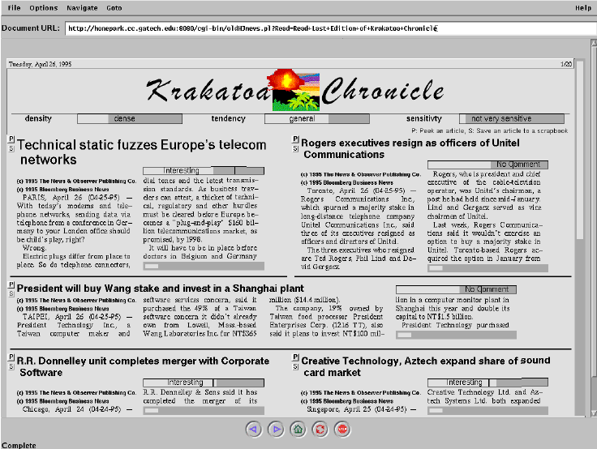
Rating
Scroll bar

Slide 13
Case Study of CRS 2: News Recommendation
Attribute space
Word vocabulary
How to represent an article
How to represent a user

Slide 14
How to Build User Preferences
Ratings
Implicit: actions of read, buy, click, save
Explicit: ratings
We could simply count the number of times the user likes (or dislikes) items with each keyword

Slide 15
How to Use User Preferences
Given a vector of keyword preferences
Do we just add up likes and dislikes?
Can we figure out which keywords are more and less relevant?
Word weighting: TFIDF

Slide 16
Challenges and Drawbacks
Content-Based Techniques in general …
Depend on well-structured attributes that align with preferences
Hard to get these attributes, e.g. paintings, poems
Unlikely to find surprising connections
Harder to find complements than substitutes

Slide 17
IFIDF
3-2

Slide 18
Learning Objectives
To understand the problem that requires a weighting for search or filtering
To understand TFIDF weighting in detail, and how it is used in both search and filtering
To understand the range of variants and alternatives to TFIDF

Slide 19
The Search Problem
What would a primitive search engine does?
Find the keywords in a document
Return the documents whose keywords match with the query
How to identify the keywords
Term frequency: appear multiple times in a document
Document frequency: but not appear in other documents

Slide 20
TFIDF
Term Frequency * Inverse Document Frequency
Term Frequency
Number of occurrences of a term in the document
Inverse Document Frequency
log (#documents / #documents with term)

Slide 21
Does TFIDF always work?
Might not work for
When the true core term is not used frequently in the document
E.g., legal contracts
Unary features
Picture tags
Movie tags
Actor (e.g. famous actor): might not consider IDF
Descriptive terms (e.g. “prison scene” vs. “car chase”): might consider IDF

Slide 22
Variants and Alternatives
Some applications use variants on TF
0/1 boolean frequencies (occurs above threshold)
Logarithmic frequencies (log (tf+1))
Normalized frequency (divide by document length)
BM25 is a ranking function used by search engines
Includes term frequency, document frequency, and document length etc.

Slide 23
More Challenges for Search Engines
Phrases and n-grams
Position in documents
Titles, headings
Term Adjacency
Document Authority
Implied Content
Links, usage

Slide 24
From Items to User Profiles
How do we accumulate profiles?
Add together the item vectors
Do we normalize first?
Do we believe an item with a longer vector is more descriptive of preferences? Then maybe no.
Do we weight the vectors somehow?
Could use ratings for weight
Could use time recency (decay old profiles for drifting preferences)

Slide 25
From Items to User Profiles
How do we factor in ratings?
Simply unary – aggregate profiles of items we rated without weights
Unary with threshold – only put items above a certain rating into our profile (but all likes are equal) – we often think 3.5 in MovieLens
Weight, but positive only – higher weight for things with higher scores
Weight, and include negative also – negative weight for low ratings (normalize rating scale)

Slide 26
Computing Predictions
Prediction is the cosine of the angle between the two vectors (profile, item)
dot-product of normalized vectors
Ranges from -1 to 1
Top-n recommendation

Slide 27
Strength of this Approach
Entirely content-based
Understandable profile
Easy computation
Flexibility
can integrate with query-based systems
Use the open-source project: e.g. Apache Lucene

Slide 28
Challenges
Depend on different applications
Right weights for attributes (TFIDF or not)
Deal with different ratings on items for building user profiles

Slide 29

Reddit Ranking for News
U: #upvotes
D: #downvotes
t_post: time when this news published

Slide 30
Content-based Reddit Ranking for News
U: #upvotes
D: #downvotes
t_post: time when this news published
(
)
 Similarity (this news, this user)

Slide 31
Similarity
3-3

Slide 32

Similarity between Two Sets
Jaccard Index
https://en.wikipedia.org/wiki/Jaccard_index

Slide 33
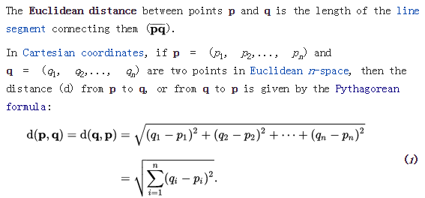
Similarity between Two Real-valued Vectors
Euclidean distance
https://en.wikipedia.org/wiki/Euclidean_distance
Notes:
Pythagorean: 毕达哥斯拉

Slide 34
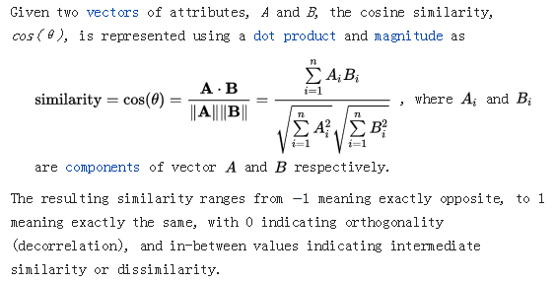
Similarity between Two Real-valued Vectors
Cosine Similarity
https://en.wikipedia.org/wiki/Cosine_similarity

Slide 35
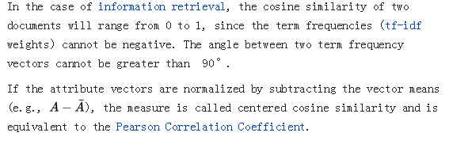
Similarity between Two Real-valued Vectors
Cosine Similarity
Notes:
Pythagorean: 毕达哥斯拉

Slide 36
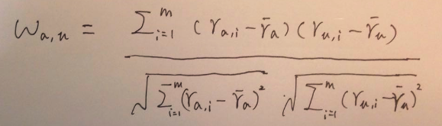
Similarity between Two Real-valued Vectors
Pearson Correlation Coefficient
The Cosine similarity of user-mean norm
is Pearson correlation.
https://en.wikipedia.org/wiki/Pearson_product-moment_correlation_coefficient#For_a_sample
Notes:
Pythagorean: 毕达哥斯拉

Slide 37
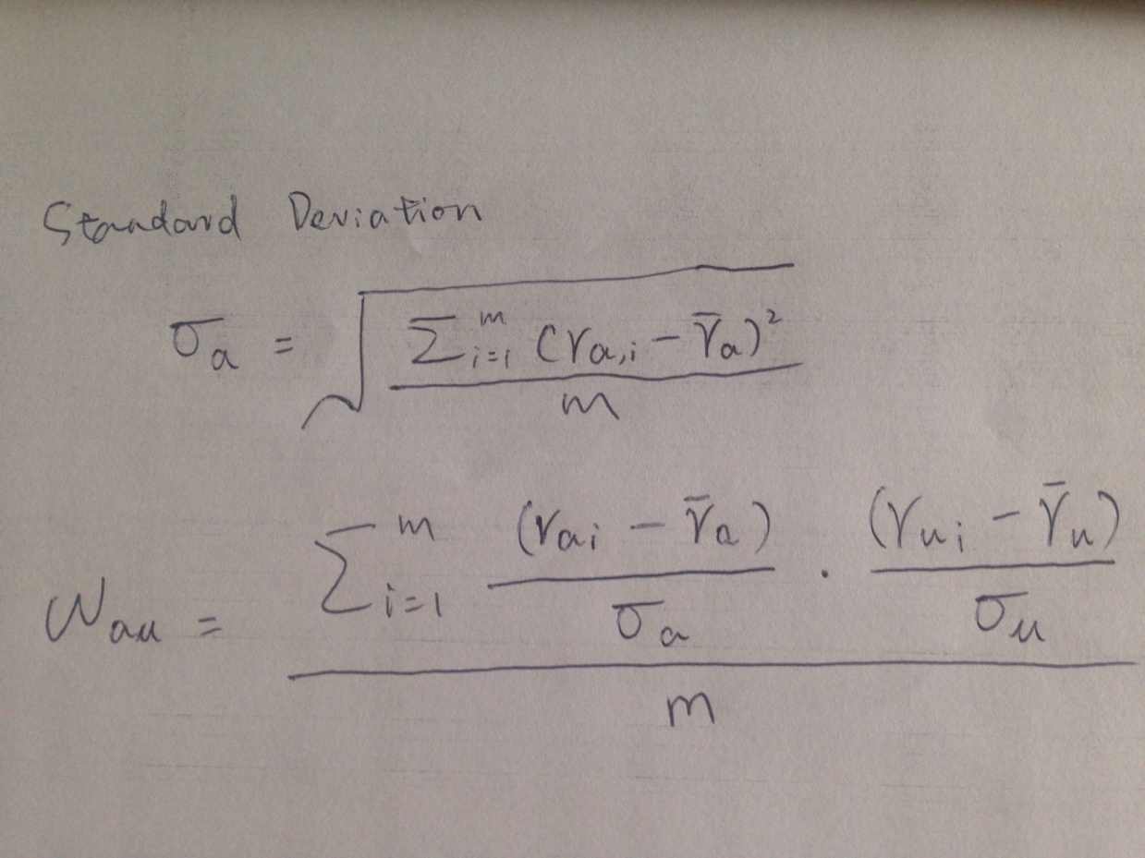
Similarity between Two Real-valued Vectors
Pearson Correlation Coefficient (expressed by z-score)
https://en.wikipedia.org/wiki/Pearson_product-moment_correlation_coefficient#For_a_sample
Notes:
Pythagorean: 毕达哥斯拉

Slide 38
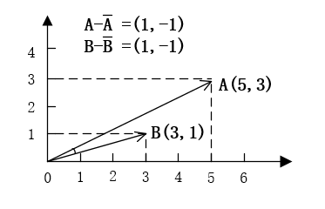
Similarity between Two Real-valued Vectors
Pearson Correlation Coefficient vs. Cosine Similarity
Notes:
Pythagorean: 毕达哥斯拉

Slide 39
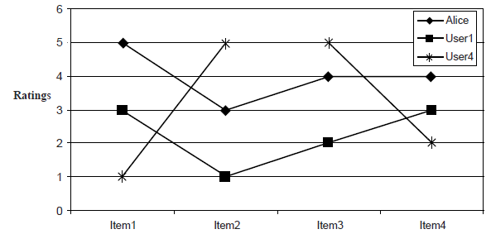
Similarity between Two Real-valued Vectors
Pearson Correlation Coefficient vs. Cosine Similarity
Notes:
Pythagorean: 毕达哥斯拉

Slide 40
Similarity between Two Real-valued Vectors
Spearman's rank correlation coefficient
Covert the raw scores to their ranks
Compute the Pearson Correlation Coefficient based on the vectors of ranks
Examples
V1 | 5 | 10 | 3 | 8
V2 | 3 | 6 | 9 | 1
Rank(V1) | 3 | 1 | 4 | 2
Rank(V2) | 3 | 2 | 1 | 4
https://en.wikipedia.org/wiki/Spearman%27s_rank_correlation_coefficient
Notes:
Pythagorean: 毕达哥斯拉

Slide 41
Assignment
Implement Cosine similarity, Pearson Correlation, Spearman Ranking Correlation in Excel
Design some examples to show their characteristics
Make a video to show how to automatically compute the user-user similarity matrix in a single formula

Slide 42
Assignment
Video making
For Windows users, Freemake Video Converter and Handbrake both provide good results.
For OSX users, we recommend Handbrake and other free converters available through the Apple App Store (e.g. Miro Video Converter).
For Linux users, FFmpeg is a well-known transcoding solution.

Slide 43
Assignment
Paper reading
Jonathan L. Herlocker, Joseph A. Konstan, Al Borchers, and John Riedl. 1999. An Algorithmic Framework for Performing Collaborative Filtering. Proceedings of the 22Nd Annual International ACM SIGIR Conference on Research and Development in Information Retrieval, ACM, 230–237.
Google scholar citation: 2769 (at Jun 21, 2016)

