Slide 1



Recommender Systems
罗平 luop@ict.ac.cn
Autumn 2016

Slide 2
Show for Assignment

Slide 3
Knowledge-based recommendation
4-1

Slide 4


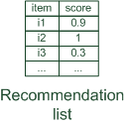




Basic I/O Relationship
Knowledge-based: "Tell me what fits based on my needs"

Slide 5


Why do we need knowledge-based recommendation?
Products with low number of available ratings
Time span plays an important role
five-year-old ratings for computers
user lifestyle or family situation changes
Customers want to define their requirements explicitly
"the color of the car should be black"

Slide 6
Knowledge Base
Structured knowledge base for items
Camera database
Real estate database
Car database
Database for Private Equity
Hotel database
Ticket database: air, train, show
Different attributes over items
Notes:
TV, phone

Slide 7
User Requirements
Explicit requirements on the attributes of items
Conversational recommendation process
Users specify the requirements
Systems try to identify solutions
If no solution can be found
users change requirements
Or return some default items

Slide 8
Output Items
Constraint-based
Based on explicitly defined set of recommendation rules
Hard or soft constraints
Case-based
Based on different types of similarity measures
Retrieve items that are similar to specified requirements

Slide 9
Output Items
Default items
Item ranking
Soften the requirements

Slide 10
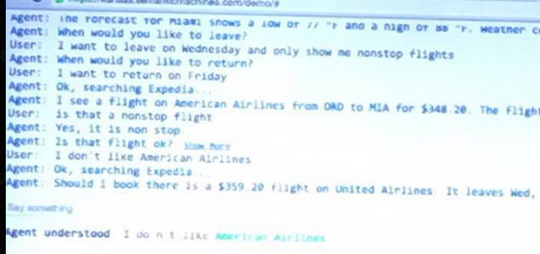
Conversational Recommendation Systems in Natural Language
Task-oriented chatbot: how to build it based on the conversation data from call center
Demo from Semantic Machines

