Slide 1
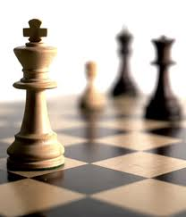


Recommender Systems
罗平 luop@ict.ac.cn
Autumn 2016

Slide 2
Introduction to User-User Collaborative Filtering
5-1

Slide 3
Learning Objectives
To understand the intuition and history of the user-user collaborative filtering algorithm
To review the basic ideas and assumptions (and therefore limitations) behind the algorithm

Slide 4
History
1992: Information Tapestry, Doug Terry, Xerox Parc
1994-1995 : Early Automated CF Systems
GroupLens (for news), Minnesota and MIT
Ringo (for music), MIT

Slide 5
ACM Software System Award (2010)
For the GroupLens Collaborative Filtering Recommender Systems, which showed how to automate the process by which a distributed set of users could receive personalized recommendations by sharing ratings, leading to both commercial products and extensive research.
http://awards.acm.org/award_winners/riedl_2663490.cfm

Slide 6
Core Assumptions/Limitations
Assumption: Our past agreement predicts our future agreement
Base Assumption #1: Our tastes are either individually stable or move in sync with each other
Base Assumption #2: Our system is scoped within a domain of agreement
Politics, humor, technology

Slide 7
Breaking Down User-User Collaborative Filtering
5-2

Slide 8
Key Reference
Paul Resnick, Neophytos Iacovou, Mitesh Suchak, Peter Bergstrom, and John Riedl. GroupLens: An Open Architecture for Collaborative Filtering of Netnews. CSCW, 1994
An Algorithmic Framework for Collaborative Filtering
by Herlocker, Konstan, Borchers, Riedl
Proc. SIGIR 1999

Slide 9
Rating Matrix
Matrix R
R_{ui}: the rating from user u on item I
A very sparse matrix
Question
To infer the values in the empty cells

Slide 10

协同过滤：细节
问题：预测用户a在商品i上的评分
其中，U_a是跟用户a品味“最相似”的n个用户的集合
使用Pearson Correlation
Notes:
分歧终端机

Slide 11

协同过滤：细节
问题：预测用户a在商品i上的评分
评分的归一化
Notes:
分歧终端机

Slide 12

协同过滤：细节
评分的归一化
加权平均
w_{ua}是用户u和a之间的Pearson Correlation
w_{ua} 怎么计算
Notes:
分歧终端机

Slide 13
Algorithm for U-U CF
For a user u
Compute its similarity values to all the other users
Identify its nearest neighbors
With the nearest neighbors, for each item i
Predict r_{ui} to the weighted sum of the ratings on item i from the neighbors

Slide 14
Issues on U-U CF
Low coverage
For an item, on which all the nearest neighbors have few ratings

Slide 15
Implementation Issues
Given m users and n items
Computation can be a bottleneck
Correlation between two users is O(n)
All correlations for a user is O(mn)
All pairwise correlations is O(m^2n)
Recommendations at least O(mn)
Lots of ways to make more practical
More persistent neighborhoods
Cached or incremental correlations

Slide 16
User-User CF Variations and Tuning
Similarities
Significance weighting
Variance weighting
Considering the rating variance for an item
Selecting neighborhoods
Normalizing ratings

Slide 17
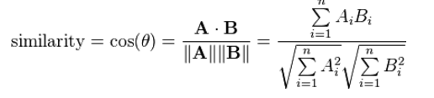
Computing Similarities
Pearson correlation
Spearman rank correlation
Hasn't been found to work as well here
Cosine Similarity

Slide 18
Significance Weighting
Consider the number of co-rated items
multiply by min(n,50)/50
n is the number of common ratings
50 is the cutoff number

Slide 19

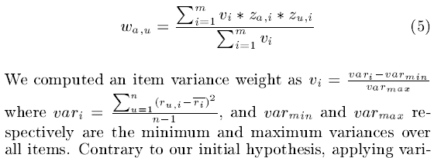
Considering the Rating Variance for an Item
Variance weighting
Z-score based

Slide 20
Normalizing Ratings, Why?
Users rate differently
Some rate high, others low
Averaging ignores these differences
Normalization compensates for them

Slide 21
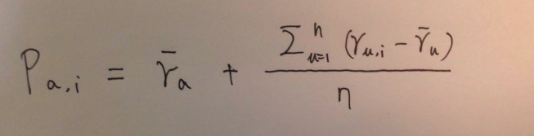
Rating Normalization: Mean-centering
May be out of the rating scale

Slide 22
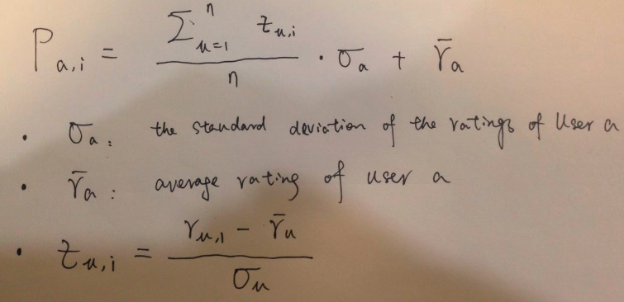
Rating Normalization: z-score normalization

Slide 23
Selecting Neighborhoods
Threshold similarity
Top-N neighbors by similarity
Combined

Slide 24
How Many Neighbors?
In theory, the more the better
If we have a good similarity measure
In practice, noise from dissimilar neighbors decreases usefulness
Between 25 and 100 is often used
Fewer neighbors → lower coverage
Use the same group of neighbors for different items
Give up personalized recommendation if the neighbors do not have enough ratings on the target item

Slide 25
Good Configurations
Similarities
Pearson correlation, Spearman ranking correlation
Significance weighting
Needed
Variance weighting
Does not work
Selecting neighborhoods
Top 30
Normalizing ratings
Needed

Slide 26
Revisit to Key Reference
An Algorithmic Framework for Collaborative Filtering
by Herlocker, Konstan, Borchers, Riedl
Proc. SIGIR 1999

