Slide 1
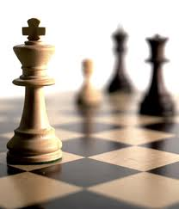


Recommender Systems
罗平 luop@ict.ac.cn
Autumn 2016

Slide 2
Introduction to Item-item Collaborative filtering
7-1

Slide 3
Learning Objectives
To understand the motivation, history, and intuition behind item-item CF algorithms
To gain a basic understanding of the algorithm idea, preparing you to master the details later this module
To understand some of the practical strengths and weaknesses of the algorithm

Slide 4
Key References
Badrul Sarwar, George Karypis, Joseph Konstan, and John Riedl. Item-based Collaborative Filtering Recommendation Algorithms. WWW, 2001.
Mukund Deshpande, George Karypis: Item-based top-N recommendation algorithms. ACM Trans. Inf. Syst. 22(1): 143-177 (2004)

Slide 5
Motivation
User-User CF was great, except …
Low coverage
With large item sets, small numbers of ratings, too often there are points where no recommendation can be made

Slide 6
Motivation (2)
Computational performance
With millions of users (or more), computing all-pairs correlations is expensive
Even incremental approaches were expensive
And user profiles could change quickly – needed to compute in real time to make users happy

Slide 7
Item-Item Similarity
Item-Item similarity is fairly stable …
Dependent on having many more users than items
Average item has many more ratings than an average user
Intuitively, items don’t generally change rapidly – at least not in ratings space
Item similarity is a route to computing a prediction of a user’s item preference

Slide 8
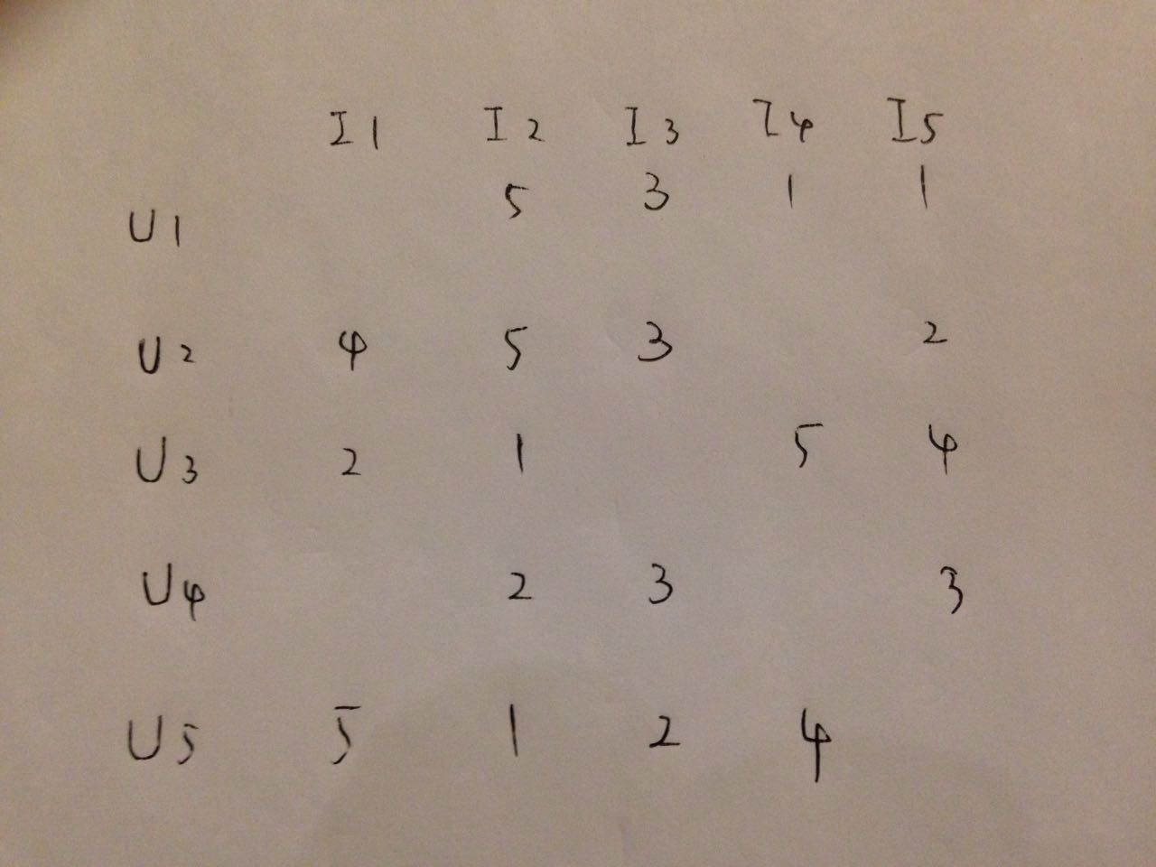
?

Slide 9
A little more detail …
Two step process:
Compute similarity between pairs of items
Predict user-item rating
Weighted sum of rated “item-neighbors”

Slide 10
Benefits of Item-Item
It actually works quite well
Good MAE performance on prediction; good rank performance on top-N
Efficient implementation
At least in cases where |U| >> |I|
Benefits of pre-computability

Slide 11
Comparison between UU and II
UU CF
Getting information from the subset of people who most share your tastes
II CF
To getting information from potentially everybody in the community, but filtered so that the rated items, which are similar to the target item, are considered

Slide 12
Item-Item CF algorithm
7-2

Slide 13
Framework of Item-Item CF
Pre-compute item similarities over all pairs of items
Look for items similar to those the user likes
Or has purchased
Or has in their basket

Slide 14
Picking Item Neighbors
To predict the rating of user u on item i
For a user u
Itemset_u: the set of items user u has rated
For item i
Neighbor_i: the set of items which are top-k similar to item i
The intersection of Itemset_u and Neighbor_i

Slide 15
Picking Neighbors
Too small: intersection of Itemset_u and Neighbor_i
Give up prediction
Good value of k important
k too large → too much noise (low-similarity items)
k too small → low coverage
k = 20 often works well

Slide 16

Scoring Items
For each item to score
Find the similar items the user has rated
Compute the weighted average of user’s ratings

Slide 17
A Revisit to User-User Variations and Tuning
Similarities
Significance weighting
Variance weighting
Considering the rating variance for an item
Selecting neighborhoods
Normalizing ratings
Apply this analysis framework to item-item collaborative filtering

Slide 18
Item Similarity
For two item rating vectors
Normalization first: subtract user mean
Cosine similarity
Notes:
这里不要用Pearson

Slide 19
Significance Weighting
May not be too useful
Since the number of ratings on each item is relatively large

Slide 20
Variance Weighting: User Weight
Consider the rating variance for each user
How to adapt the Cosine similarity

Slide 21
Another User Weight: User Trust
Goal: incorporate user trustworthiness into item relatedness computation
User's global reputation, not per-user trust
Solution
weight users by trust before computing item similarities
High-trust users have more impact
Massa and Avesani. 2004. ‘Trust-Aware Collaborative Filtering for Recommender Systems’.

Slide 22
Selecting Item Neighbors
Similar solution

Slide 23
Normalization
Not needed

Slide 24
Core Assumptions/Limitations
Item-item relationships
Your taste obeys that of most people
Main limitation/complaint: lower serendipity
Show a case where the results from UU-CF and II-CF are totally different

Slide 25
Conclusion
Item-item is efficient and straightforward
A few parameters need tuning for specific data, domain
Limitation: lower serendipity

Slide 26
Item-item Collaborative Filtering on unary data
7-3

Slide 27
Unary Data
We've talked about item-item over rating data
Unary data (implicit feedback)
clicks
plays
purchases
But some tweaks are needed

Slide 28
Unary Data: Data Representation
Need some matrix to represent data
Logical (1/0) user-item ‘purchase’ matrix
Not ‘purchase’: 0
Purchase count matrix
Log function on counts

Slide 29
Unary Data: Data Normalization
Normalize user vectors to unit vectors
Intuition: users who like many items provide less information about any particular pair

Slide 30

Similarities and Aggregating Scores
Cosine similarity
Aggregating scores
For count matrix: weighted average
For binary matrix: sum of neighbor similarities

