Slide 1



Recommender Systems
罗平 luop@ict.ac.cn
Autumn 2016

Slide 2
Hybrid Recommendation Methods
10-1

Slide 3



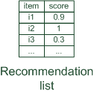
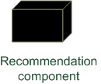



Hybrid Recommender Systems
Hybrid: combinations of various inputs and/or composition of different mechanism
Collaborative: "Tell me what's popular among my peers"
Content-based: "Show me more of the same what I've liked"
Knowledge-based: "Tell me what fits based on my needs"

Slide 4
Hybrid Recommenders
Combine 2 or more algorithms
General technique, not specific to any one algorithm
Similar to the ensemble method (stacking or boosting) in machine learning

Slide 5
Hybrid Techniques
Aggregating the output from diff. algorithms
Weighted sum
Aggregating multiple rankings
Switching – switch algorithms
Hybrid Recommender Systems: Survey and Experiments, by Robin Burke

Slide 6
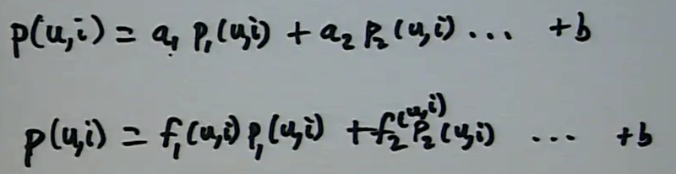
Feature-Weighted Linear Stacking
Winning NetFlix Prize algorithm
Linear combination of 100+ algorithms
Coefficients depend on user/item features
Relative weight of algorithms shifts for different recommendation contexts

Slide 7
Deriving Weights
Training data splitting
One: for training individual methods
One: for training the parameters for the hybrid methods
Infer coefficients from data
Find coefficients w_{i,j} that minimize RMSE
Learn coefficients with standard machine learning /optimization algorithm (gradient descent)
Lessons from the Netflix prize. Yehuda Koren et al. 2007.

