Slide 1
第3章 交互处理
1 进程组织
进程和线程
客户进程和服务器进程
代码迁移
2 进程交互
3 进程协作

Slide 2
1.1 Process & Thread
Processes form a building block in distributed systems
The operating system maintains the concurrency transparency for process executions.
Drawbacks of Process
In a single-threaded process, whenever a blocking system call is executed, the process as a whole is blocked
Costs for creating process and context switching are high
Multiple threads of control are permitted in a process.
Thread Context vs. Process Context
Process Context Thread Context
Address space tables Saved processor registers
Communication interfaces, open files Priority and execution state
Semaphores, other synchronization objects Software interrupt handling information
List of thread identifiers Execution environment identifier
Pages of address space resident in memory; hardware cache entries.

Slide 3
Thread Usage in Non-distributed Systems
Example: 2ms for processing a request, 8ms for I/O delay
Single-thread process:
process 100 requests per second
Two-thread process:
process 125 requests per second
Two-thread process with cache (75% cache hit ratio, 0.5ms for searching the cache) :
process 500 requests per second in ideal situation, maybe process 400 requests per second
Two-thread process with cache in 2-CPU system:
process 444 requests per second

Slide 4
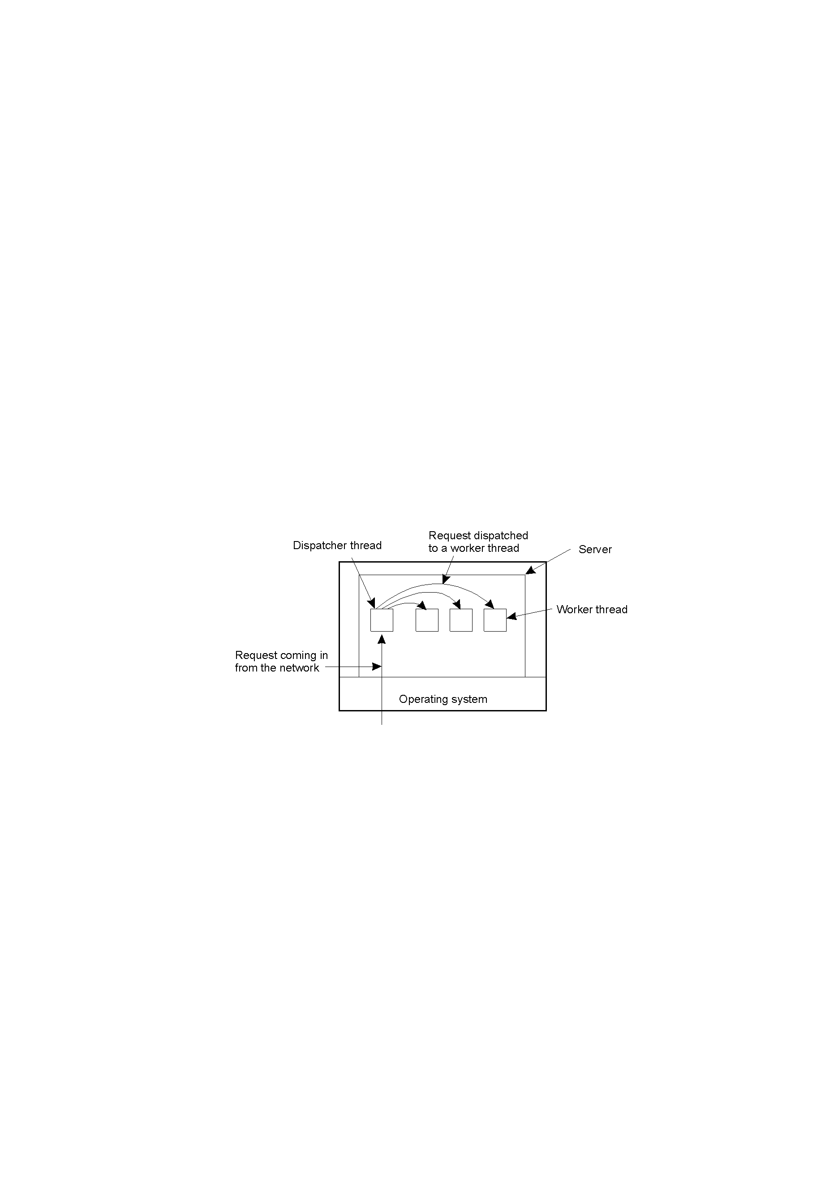
Threads in Distributed Systems
Multi-threaded Clients
Web browser
Multi-threaded Servers
Different policies with respect to threading in constructing a server
A multithreaded server organized in a dispatcher/worker model (an example of thread-per-request)
About thread origin:
A thread is created on demand
A pool of threads are maintained
About thread creating:
Implement the server with only a single thread of control
Use a separate thread for each of object (thread-per-object)
Use a separate thread for each invocation request (thread-per-request)
Use a separate thread for each client (thread-per-client)

Slide 5
最佳线程池大小-1
线程池技术与实时创建线程的比较：
带来的节省：线程创建开销
带来的开销：线程池的管理（并发控制、线程上下文切换）
增大线程池中线程
优点：增加了并发度
缺点：增大了线程池管理开销
结论：并不是线程数越多越好
总收益 = 线程创建开销 － 线程管理开销
总收益达到最大值时的线程数为最佳线程数

Slide 6
最佳线程池大小-2
线程创建开销：系统配置(CPU、内存、操作系统)一定时，创建一个线程的开销可以认为是一个常数值c1，创建n个线程：c1×n
线程切换开销：一次线程上下文切换开销可以认为是一个常数c2，n个线程的线程池切换开销：n×c2
r：并发的请求数目
实际系统中，每一时刻并发的请求数目r是一个随机的值
f(r)：r 的概率分布函数
 | Cost of thread pool | Cost of no thread pool | Gain of thread pool
0=< r <= n | c2×n | c1×r | c1×r – c2×n
r > n | c2×n +c1× (r - n) | c1×r | c1×n – c2×n

Slide 7

线程池预期收益
连续化，便于数学处理；p(r)为概率密度
导数为零即为极值点
结果为：E(n)取得最大值时的n值（记作n*）满足：
where
并发请求数为均匀分布Uniform(0, N)时，上式变换成：
From: Yibei Ling et. al, Analysis of optimal thread pool size, ACM SIGOPS Operating Systems Review, Volume 34 , Issue 2 (April 2000)

Slide 8
线程池的实现：同步模式
方法一：区分监听线程和工作线程：Half-Sync /Half-Async Pattern
方法二：监听和请求处理都由同一个线程来完成，区分线程状态：leader、follower、processor：Leader/Follower Pattern
Events
Events
Events
Events
Multiplex
Multiplex
Multiplex
Dispatch
Dispatch
Dispatch
Process
Process
Process
Half-Sync/Half-Async请求处理过程
Leader/Follower
请求处理过程

Slide 9
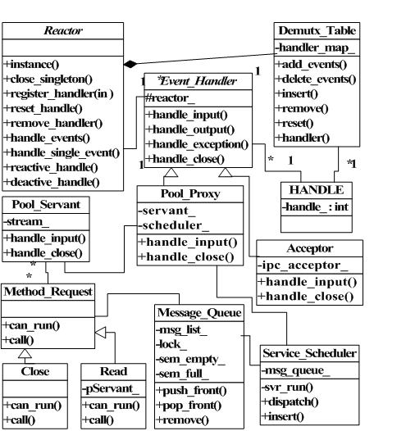
Half-Sync/Half-Async Pattern
异步层：监听网络端口，接收到消息后放入到消息队列，使用Reactor模式实现异步层；
同步层：构成线程池，包含多个并发执行的服务；
使用Active-Object模式实现同步层和消息队列；
使用Acceptor-Connector模式来管理客户连接；

Slide 10
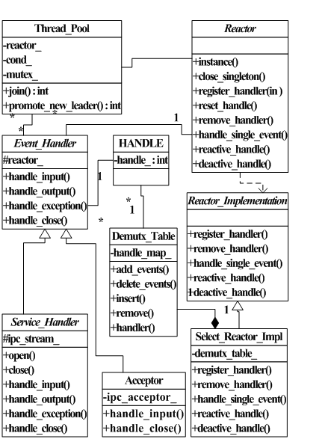
Leader/Follower Pattern
可以使用Reactor模式来实现事件的多路分离
事件源和分离机制可以采用Linux系统下的fd_set和select系统调用
线程间的同步机制使用的是信号量，所有follower线程都在一个信号量队列上排队等待；
同Half-Sync/Half-Async线程池一样，在Leader/Follower中也使用Acceptor-Connector模式来管理用户连接；

Slide 11
固定线程数的线程池的性能-1
LF和HH线程池处理一个消息的时间为多路分离Multiplex、分配Dispatch和处理Process消息的时间，再加上线程管理时间；
HH的线程管理开销：
数据转移开销：数据从监听线程转给工作线程，具体动作包括为请求动态分配内存，以及将请求放入队列和取出队列
线程同步开销：监听线程和工作线程都需要去访问消息队列，造成了资源的竞争，需要额外的同步机制来协调下列行为：监听线程获取和释放资源锁，对应的工作线程获取和释放资源锁，监听线程在将一个请求放入队列后通知工作线程
上下文开销：一个请求由监听线程负责放入消息队列，但是却由工作线程来处理，所以，每个请求都会造成一次线程上下文切换

Slide 12
固定线程数的线程池的性能-2
LF的线程管理开销：
同步开销：LF中多个线程共享一个事件源，所以，需要协调它们间的行为，即，有同步开销，此时的同步开销只是一个获取锁和释放锁的开销，低于HH的同步开销
上下文开销：在LF处理请求过程中并不需要线程上下文切换，但是在线程由follower成为leader时需要进行线程上下文切换，所以当两个请求同时到达时，这种上下文切换会影响第二个请求的处理时间，也会带来一定的上下文开销

Slide 13
1.2 Processes in Clients
User Interfaces
The X Window System
User Interface for Supporting Compound Document
Draw-and-drop operation
In-place editing
General Design Factors of Client-Side Software for Distribution Transparency
Access transparency—— generate a client stub from an interface definition of what the server has to offer
Location, migration and relocation transparency——using a convenient naming system
Failure transparency—— A client middleware
Replication transparency——See next page
Concurrency transparency/Persistence transparency——No contribution from client

Slide 14
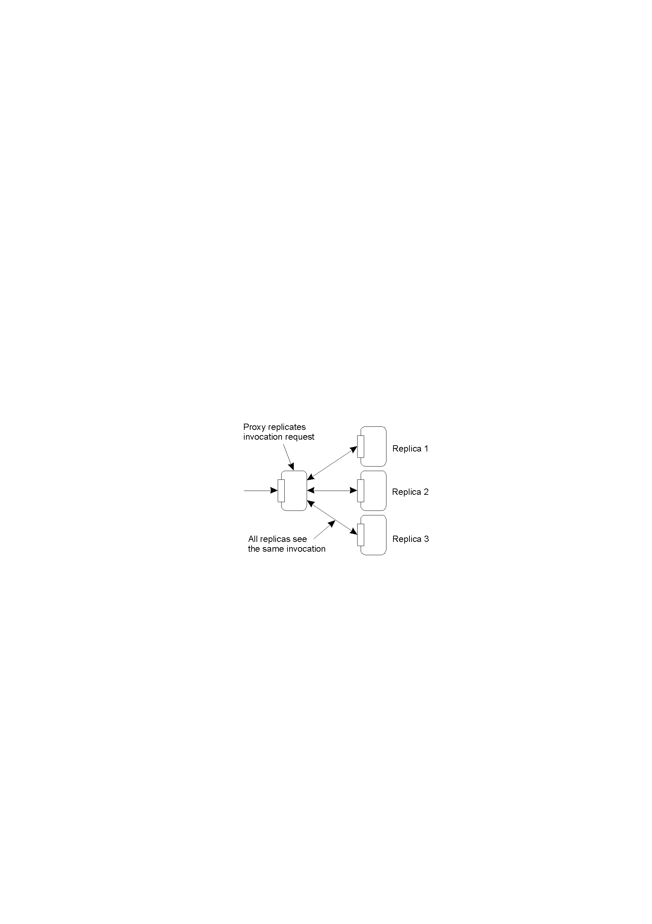
Replication Transparency with the aid of a client-side proxy
A possible approach to transparent replication of a remote object using a client-side solution

Slide 15
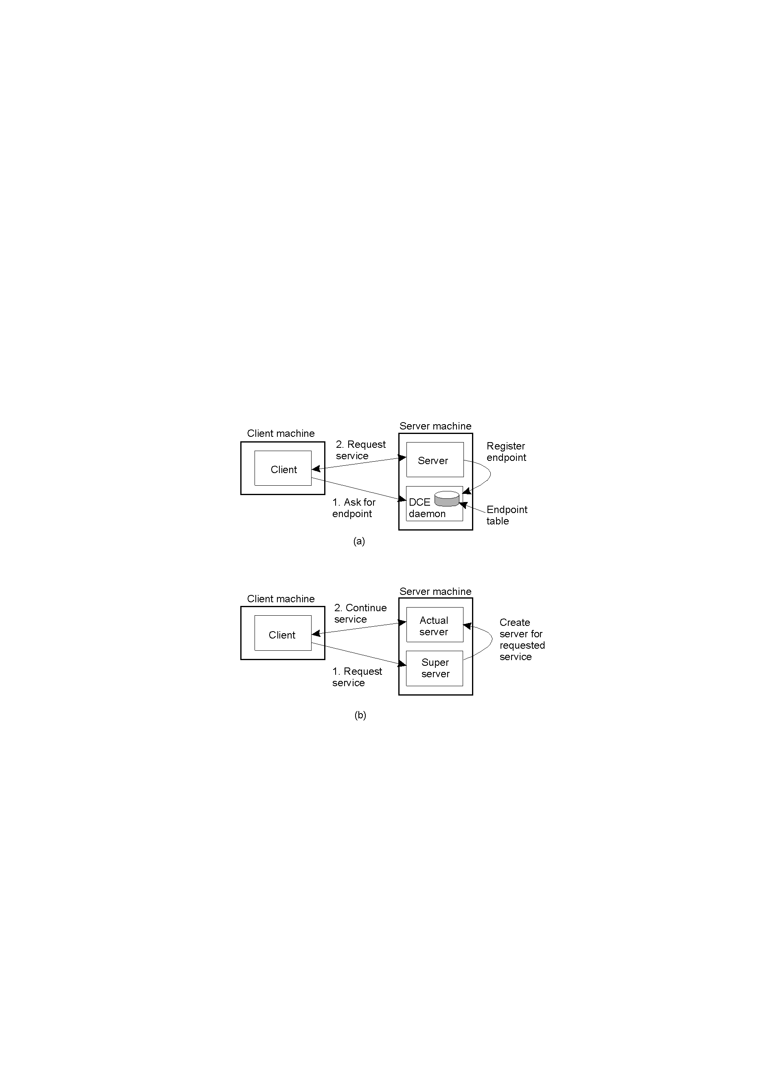
Processes in Servers - I
General Design Issues
A concurrent server or a iterative server
Where clients contact a server——endpoint (port)
Client-to-server binding using a daemon as in DCE
Client-to-server binding using a superserver as in UNIX

Slide 16
Processes in Servers - II
General Design Issues
Whether and how a server can be interrupted
User may abruptly exit client application, breaking the connection to the server
Need the approach for building suitable communication way to handle out-of-band data: server listens to a separate port or server process out-of-band data through a signal in UNIX systems (send/recv with MSG_OOB flag will trigger a SIGURG signal)
A stateless server or a stateful server
Stateful server dose maintain and recover its states as it was just before the crash

Slide 17
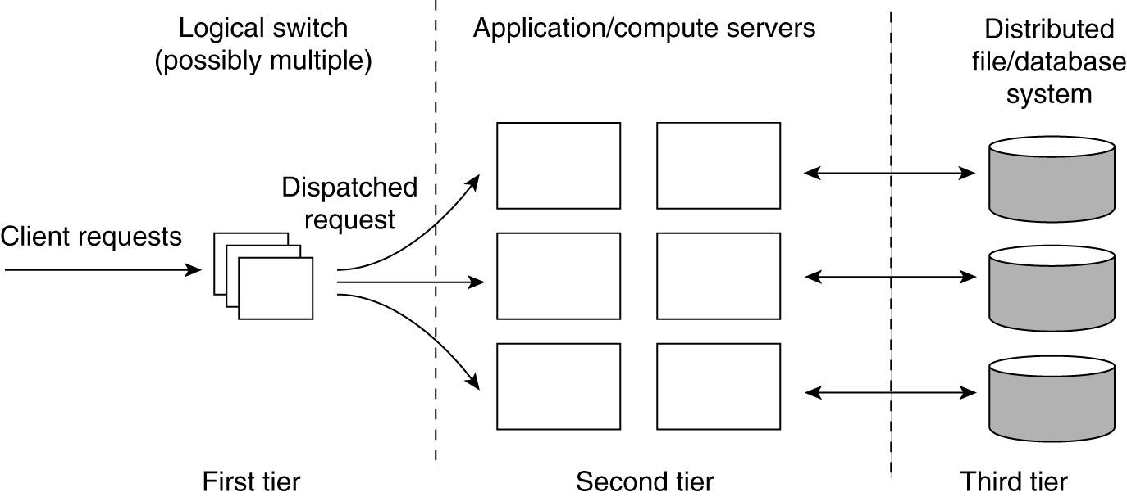
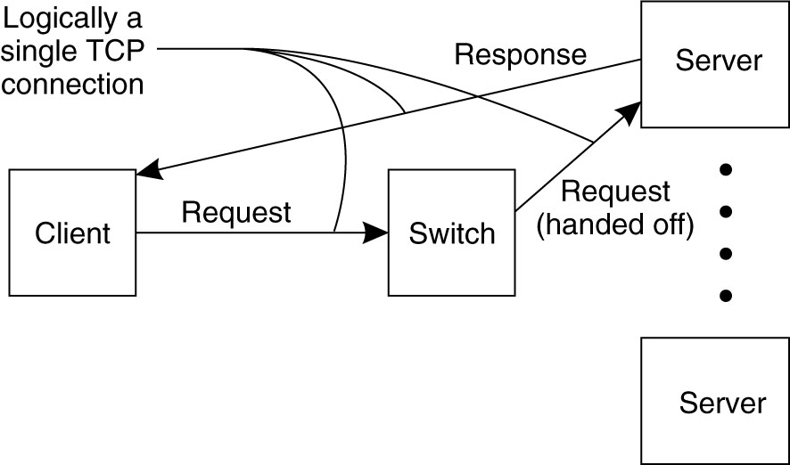
As to server clusters
General organization and management:
For a cluster of N servers, the probability of operation without a single server being faulty is (1-p)^{N}, where p is the probability that a server is currently faulty. (36% where p=0.001 and N=1000)
the access point(s) of clusters:
implement transport-layer switches by TCP handoff
implement a stable access point by employing MobileIP-like mechanism
load balancing:
code migration
round robin

Slide 18

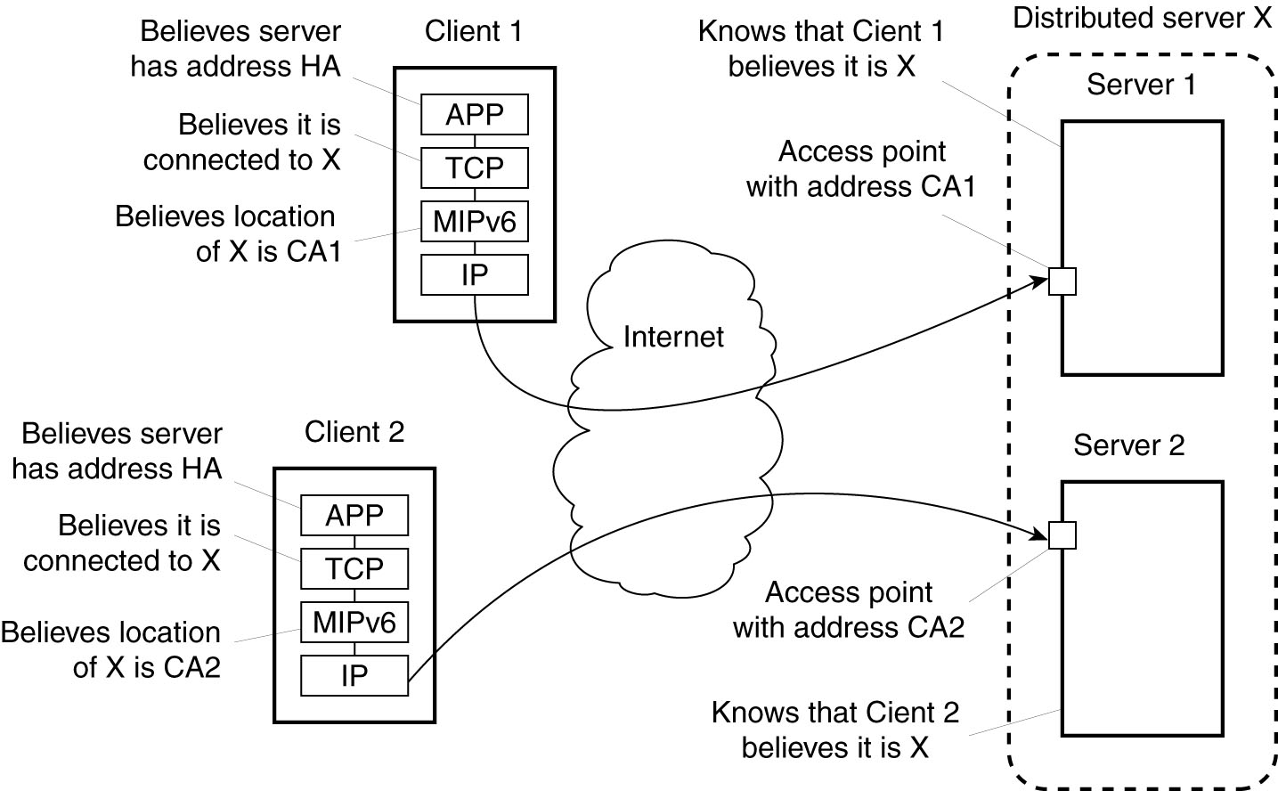
Mobile IP: at home location, keep track of current location of entity
care-of-address
A contact address assigned to the server cluster is similar to the home address of a mobile node in mobile IP;
the address of a node in the cluster is similar to the care-of-address of a mobile node.

Slide 19
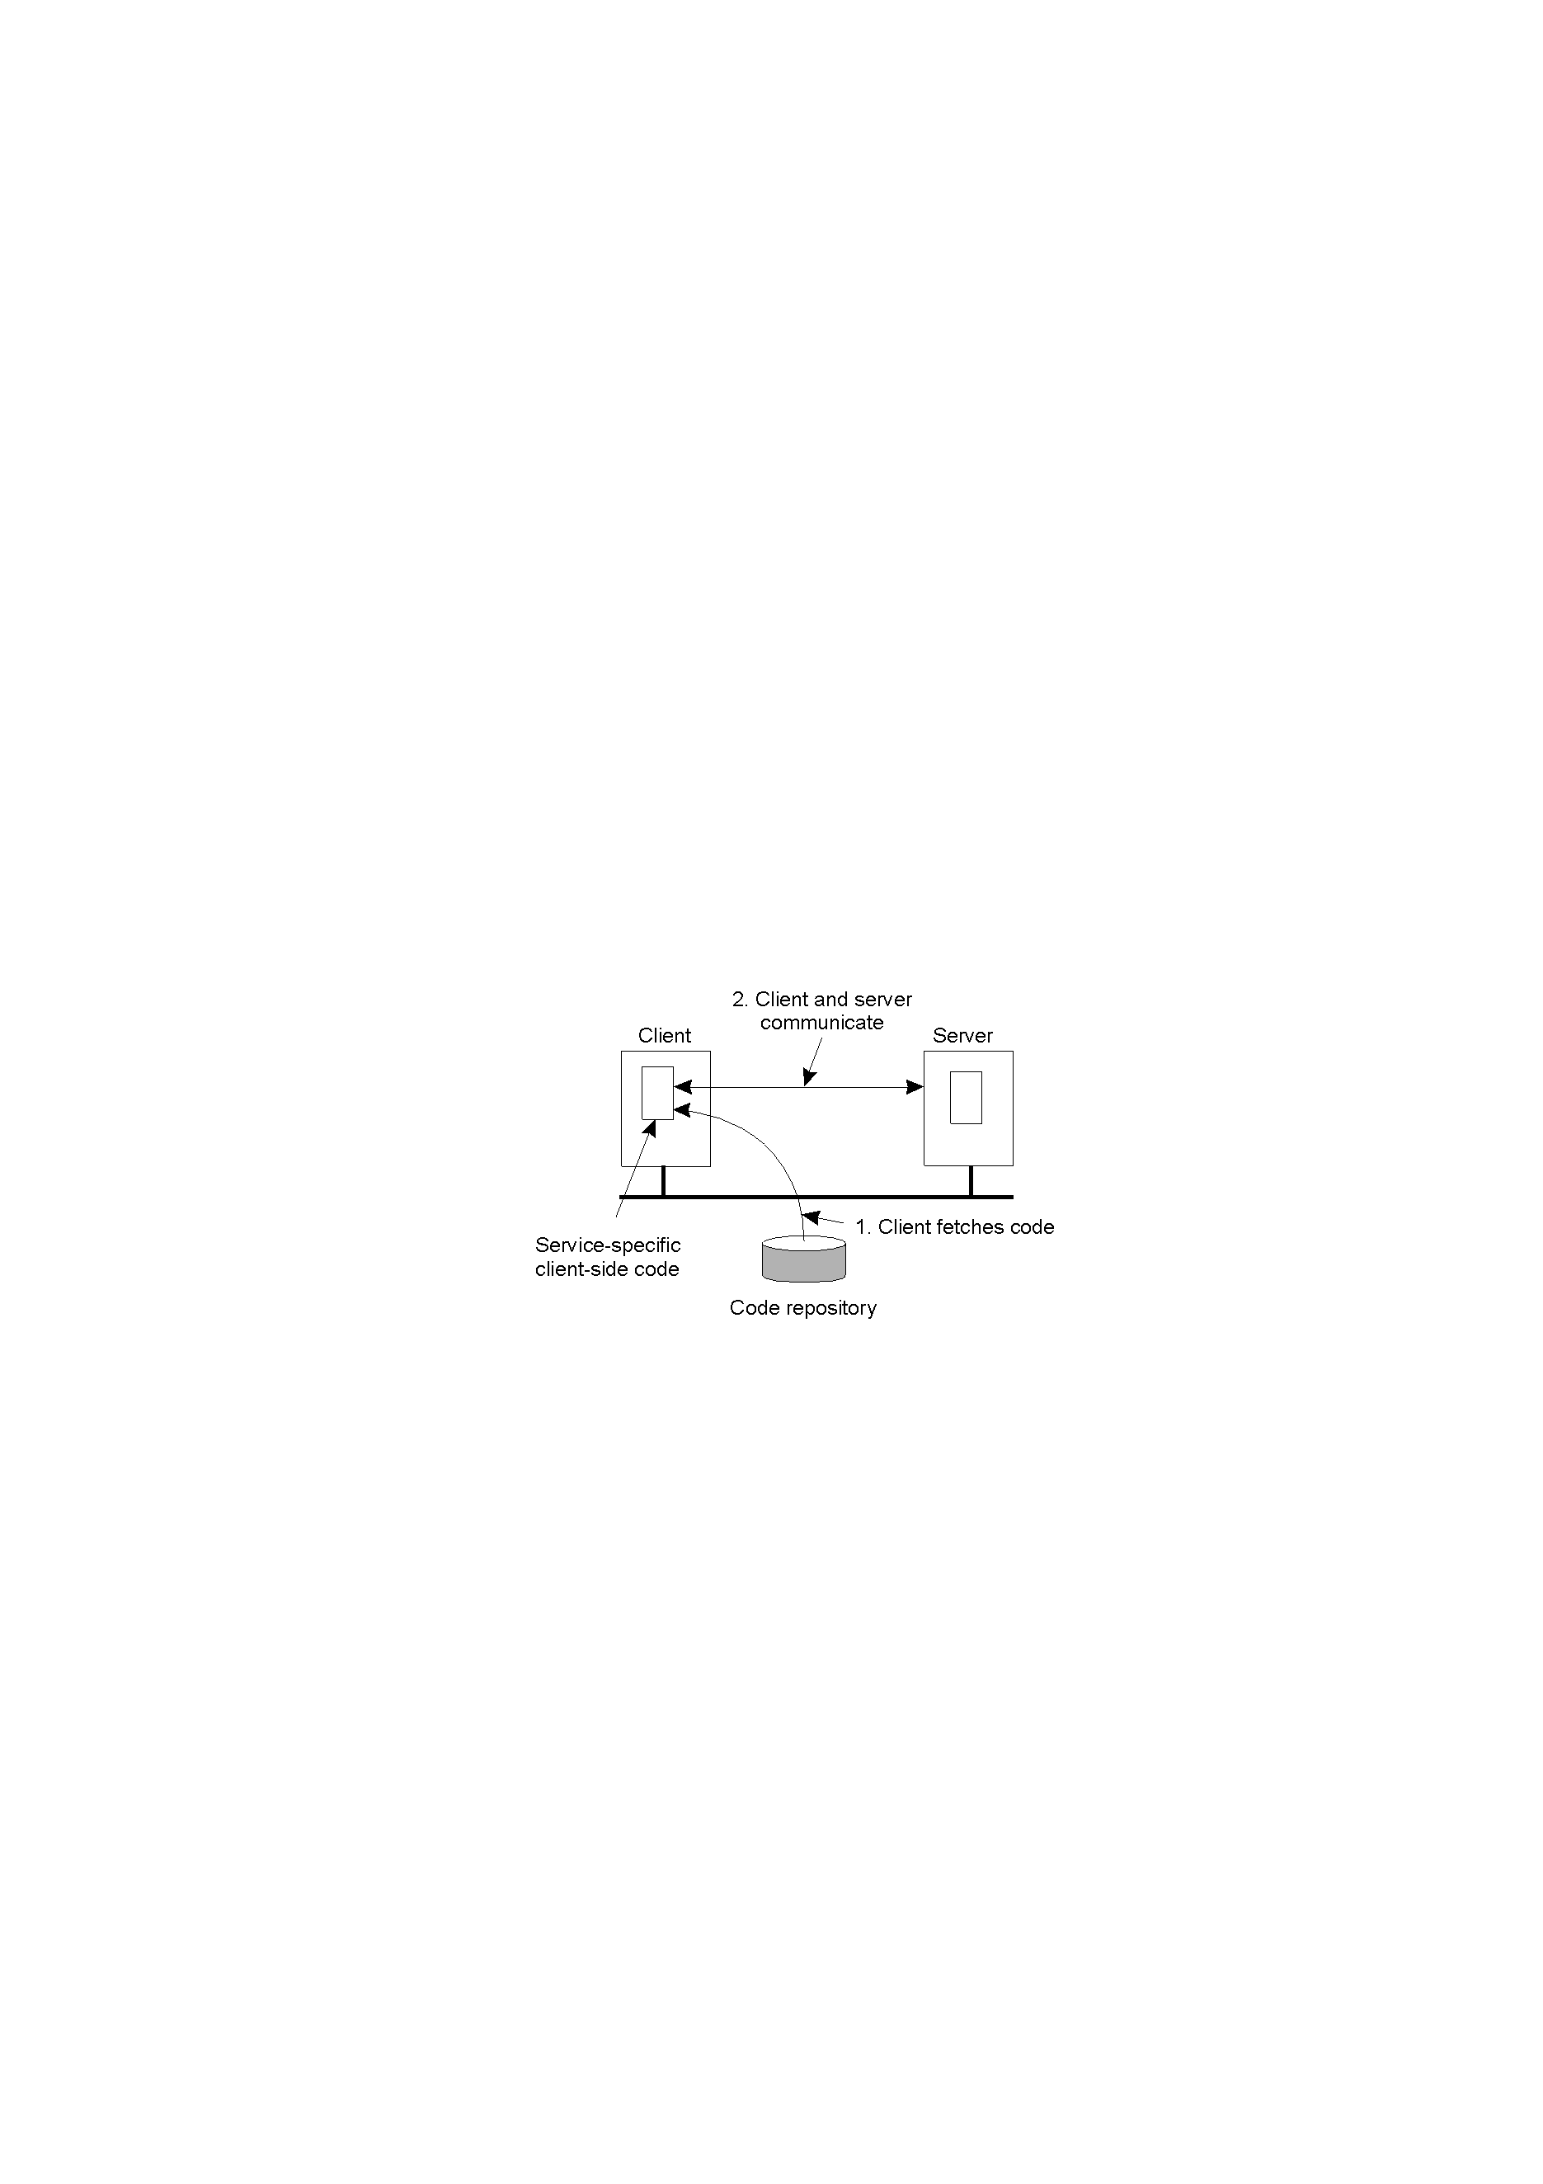
1.3 Code Migration
Reasons for Migrating Code
To improve computing capacity
To minimize communication
To exploit parallelism
Flexibility——Dynamically Configuration
The principle of dynamically configuring a client to communicate to a server
The client first fetches the necessary software, and then invokes the server

Slide 20
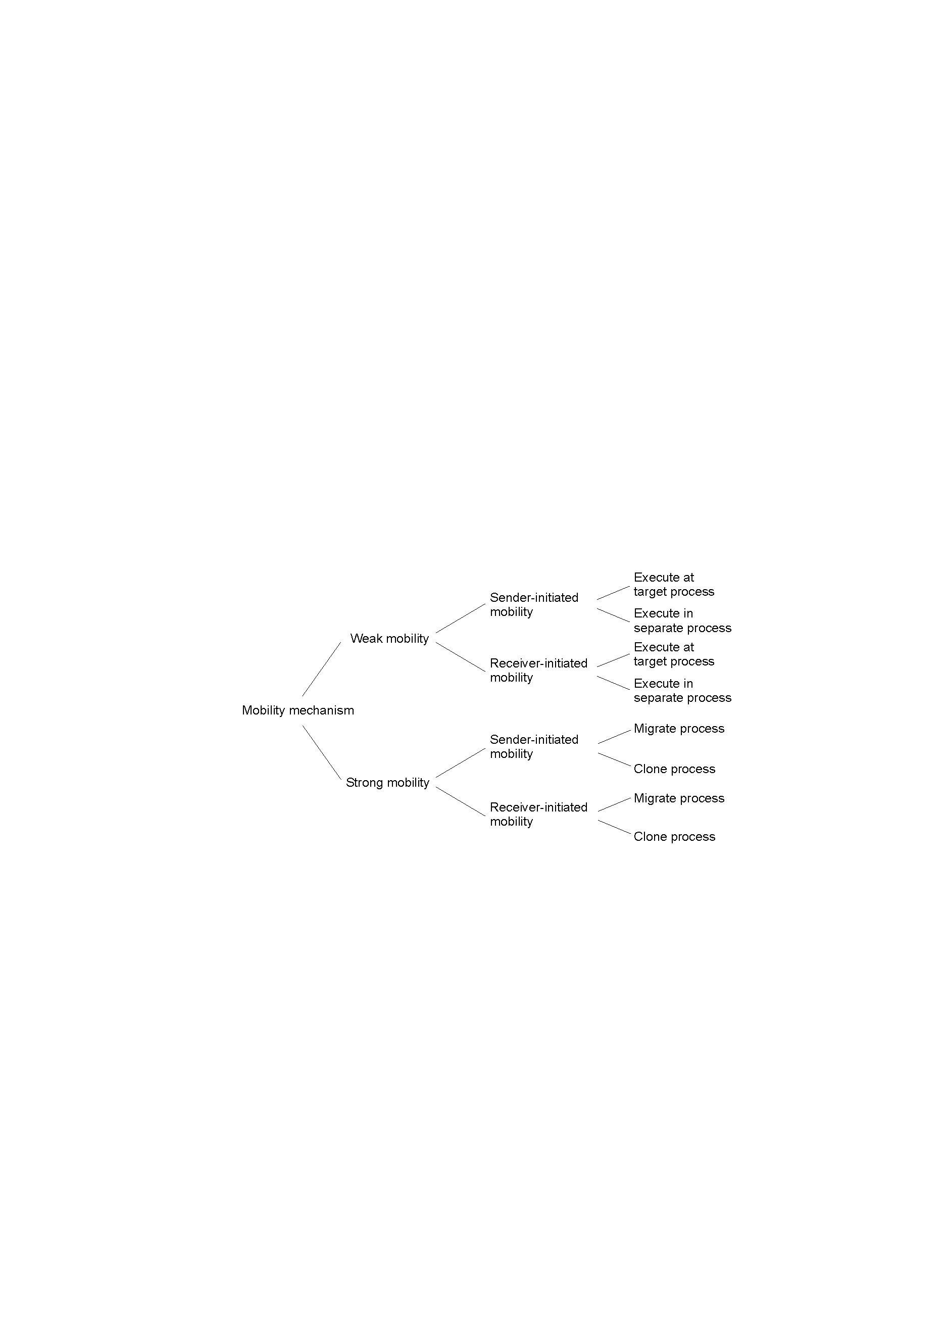
Models for Code Migration
Transfer code segment
Transfer code segment
and data segment

Slide 21
Migration and Local Resources
Process-to-resource bindings
Binding by identifier
Binding by value
Binding by type
Resource-to-machine bindings
Unattached resources
Fastened resources
Fixed resources
Strategies for code migration:
GR: Establish a global system-wide reference
MV: Move the resource
CP: Copy the value of the resource
RB: Rebind process to locally available resource
Resource-to machine binding
 | Unattached | Fastened | Fixed
By identifier By value By type | MV (or GR) CP (or MV, GR) RB (or GR, CP) | GR (or MV) GR (or CP) RB (or GR, CP) | GR GR RB (or GR)
Process-to-resource binding

