Slide 1
第3章 交互处理
1 进程组织
2 进程交互
3 进程协作
Notes:
进程组织：进程和线程，客户进程和服务器进程，代码迁移

Slide 2
进程间交互
操作系统：
(单机内) 进程间通信(IPC) 机制：Named Pipe, Signal, Semaphore, Shared Memory
(多机间) 基于套接字(Socket)的IPC机制
分布式系统中的数据传递：
点对点方式
应用层多播/组播方式
应用层广播方式

Slide 3
Overlay Networks
An overlay network is a virtual network that is built on top of another.
Why are they required? There are many limitations of the current Internet architecture including the lack of security, QoS guarantees, mobility support, multicast support, end-to-end service guarantees, etc.
Routing overlay: Tailored for network style, e.g., wireless ad hoc networks, disruption-tolerant networks
Service overlay: Tailored for application needs, and built for the purpose of providing a specific application, e.g., application layer multicast, content delivery network (CDN), VoIP, distributed systems management

Slide 4
进程间交互
 | Routing Overlay | Service Overlay
Point-to-Point | 2. P2P Routing 5. MANET Routing | 4. Middleware Communication Protocols
Multicast | 1. Gossiping | 3. Application level Multicasting

Slide 5
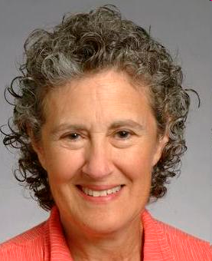
Barbara Liskov (1939-)
美国第一个获得计算机科学博士学位的女性(1968年斯坦福大学)
美国国家工程院院士、美国艺术与科学院院士，2004 获IEEE John von Neumann Medal，2008获Turing Award，现任MIT教授
编程语言和系统设计方面尤其是数据抽象、容错和分布式计算方面的贡献
2种计算机语言：CLU(一种支持数据抽象的面向对象编程语言)和Argus(一种分布式程序实现的高级语言),提出了面向对象设计中的Liskov替换原则(LSP)
小型、低成本、交互式的分时操作系统Venus，面向对象数据库系统Thor，Byzantine分布式容错系统
Abstraction and Specification in Program Development // Program Development in Java: Abstraction, Specification, and Object-oriented Design

Slide 6
Barbara微软亚洲研究院访谈
我并没有规定自己一定要达到什么程度，我只是在我可及的范围内工作
一个人能否成功，找到自己的所爱和所长是非常必要的
持续的学习和探索，一定会让人发现自己的强项在哪里，关键在于不要放弃这种寻找和尝试
自信从何而来？它源自于阅历的持久积淀
研究者要做的，是选择最佳的解决方案，同时要充分论证为什么这种方案是最理想的

Slide 7
1. Gossiping

Slide 8
Epidemic Protocols
A way to rapidly propagate information in very large-scale distributed systems using only local information
Strength: Scalability and high reliability
Used in applications such as failure detection, data aggregation, resource discovery and monitoring, and database replication
State of a Node:
Susceptible; Infective; Removed
Simple epidemic broadcast algorithm/infect-forever model: nodes are always either susceptible or infective
Propagation models:
Anti-entropy
Rumor mongering: Rumor spreading, Gossiping

Slide 9
Anti-Entropy Model: a kind of simple epidemics
A node P picks another Q at random, and subsequently exchanges updates with Q by one of three ways, called push, pull and push-pull.
Push: P only pushes its own updates to Q
Pull: P only pulls in new updates from Q
Push-Pull: P and Q send updates to each other
It is a basic result of epidemic theory that simple epidemics eventually infect the entire population.
Round: define a round as spanning a period in which every node will at least once have taken the initiative to exchange updates with a randomly chosen other node.
The number of rounds to propagate a single update to all nodes takes O(log(N)) rounds, where N is the number of nodes in the system.
Assuming that infectious processes try to contaminate f other processes in each round
the expected fraction of infected members after r rounds is 1/(1+ne^{-fr})
the number of rounds R necessary to infect the entire system is log_{(f+1)}(n)+log(n)/f+O(1)

Slide 10
Anti-Entropy Model: Push versus Pull
Let p_{i} be the probability of a site's remaining susceptible after the i-th round of anti-entropy.
For pull, a site remains susceptible after the i+1st round if it was susceptible after the i-th round and it contacted a susceptible site in the i+1st round. Thus, p_{i+1} = (p_{i})²
For push, a site remains susceptible after the i+1st round if it was susceptible after the i-th round and no infectious site chose to contact it in the i+1st round. Thus, p_{i+1} = p_{i} *(1-(1/n))^{n(1-pi)} ≈ p_{i} *e⁻¹
Either pull or push-pull is greatly preferable to push

Slide 11
Gossiping - I
n individuals, initially inactive (susceptible).
We plant a rumor with one person who becomes active (infective), phoning other people at random and sharing the rumor
Every person hearing the rumor also becomes active and likewise shares the rumor
When an active individual makes an unnecessary phone call (the recipient already knows the rumor), then with probability 1/k the active individual loses interest in sharing the rumor
the individual becomes removed

Slide 12
Gossiping - II
Let s, i, and r represent the fraction of individuals susceptible, infective, and removed, respectively, so that s + i + r = 1
The function i(s) is zero when s=e ^{–(k+1)(1-s)} : S decreases exponentially with k
Gossiping cannot guarantee that all nodes will actually be updated
If k=3, s<=0.02
If k=4, s< 0.007
Increasing k is an effective way of insuring that almost everybody hears the rumor

Slide 13
Gossiping - III
Side-effect: spreading the deletion of a data item is hard.
Cause: the deleted data are interpreted as updates on something the server did not have before.
Solution: introduce and spread death certificates. Death certificates need to be cleaned up regularly.
Parameters in epidemic dissemination :
n: the size of a system
b: the capacity of message buffer
t: the times of message forwarding
f: the size of processes selected randomly for forwarding messages

Slide 14
2. P2P Routing

Slide 15
P2P Lookup/Routing
Functional requirements:
Locate and communicate with any individual resource
Add new resources or remove them at will
Add hosts or remove them at will
Provide simple APIs to store and find data
Typical DHT interface: put(key, value), get(key) → value
Non-functional requirements:
Global scalability
Load balancing
Accommodating to highly dynamic host availability
Optimization for local interactions between neighboring peers
Security of data in an environment with heterogeneous trust
Anonymity, deniability and resistance to censorship

Slide 16
Pastry
所有节点和对象都被分配了一个128位的GUID(Globally Unique IDentifiers)值(用16进制表示)，它随机分布在区间[0, 2¹²⁸ - 1]
每个活节点都保存一个叶子集合(leaf set)，叶子集合是一个大小为2l的向量L， L包含有和当前节点GUID相邻的2l个(l个大于，l个小于)其他节点的GUID和节点IP地址
在一个具有N个节点参与的网络中，Pastry路由算法能够在O(log N)步内正确地将消息路由到任何GUID对应的地址上

Slide 17
Circular routing alone is correct but inefficient
The dots depict live nodes. The space is considered as circular: node 0 is adjacent to node (2¹²⁸-1). The diagram illustrates the routing of a message from node 65A1FC to D46A1C using leaf set information alone, assuming leaf sets of size 8 (l = 4). This is a degenerate type of routing that would scale very poorly; it is not used in practice.

Slide 18
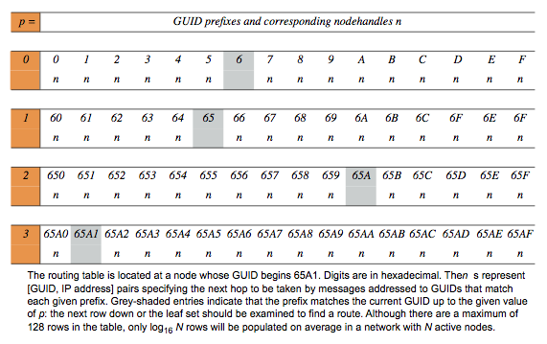
Routing table R in Pastry
路由表：路由表的行数和一个GUID的16进制表示的位数相同，因此，路由表有128/4＝32行

Slide 19
Routing process at any node A to node D
≠
p

Slide 20
节点加入：假设新节点的GUID是X，并且它所联系的附近节点的GUID为A
节点X发送一个专门的连接请求消息给节点A，并且这个消息的目标地址被设为X。这样，节点A按正常的方式通过Pastry分发这个消息，假设路由连接消息路途上的节点有B，C。Pastry将会把这个连接请求消息发送到那些已经存在于系统中并且与X接近的节点上去；我们不妨把这些节点称为Z
X的路由表：A是X的一个邻居节点，从而节点A的路由表的第一行将是节点X路由表的第一行(X0)的首选。另一方面，对于节点X路由表的第二行(X1)来说，节点A的路由表可能与X1是不相关的了，因为节点X的GUID和节点A的GUID它们的十六进制形式的第一位并不相同。不过，路由算法可以确保节点X的GUID和节点B的GUID的第一位是相同的，这也意味着，节点B路由表的第二行(B1)对于X1(节点X路由表的第二行)来说是合适的首选。相似的，节点C路由表的第三行(C2)对于节点X路由表的第三行(X2)来说是合适的首选，其他的以此类推
X的叶子集合：既然节点Z的GUID从数值上接近节点X的GUID，那么X的叶子集合应该和Z的叶子集合是相似的。事实上，理想化的X的叶子集合与Z的叶子集合只有一个成员不同。因此Z的叶子集合对于X来说是一个足够好的近似
X将路由表和叶子集合的信息发送给路由表和叶子集合中的所有节点，相关节点接收到X的信息，然后调整它们的路由表或叶子集合

Slide 21
节点失效：当某个节点发现有节点失效时，为了修复自身的叶子集合L，它找到靠近失效节点的某个活节点，然后从这个邻居节点中获得它叶子集合L’的一份拷贝，L’中包含一部分与L重叠的GUID，其中有一个合适的代替失效节点的节点。别的相邻节点也会收到有节点失效的通知，然后这些节点执行上述类似的操作，以修复它们的叶子集合。这个修复过程能够保证节点的叶子集合可以得到修复，除非节点中的l个连续的相邻节点同时失效
对路由表的修复基于“一旦发现”机制。即使一些路由表项不再有效，消息的路由仍能继续进行：如果路由失败，那么将使用路由表同一行的其他项
使用一个简单的闲聊(gossip)协议来定期在节点之间交换路由表信息，从而修复路由表失效的项，并避免地域特性的缓慢退化。闲聊协议每隔20分钟运行一次
性能(Pastry的可靠版本MSPastry)：RDP (Relative Delay Penalty)值在网络消息丢失率为0％情况下约为1.8，在网络消息丢失率为5％情况下约为2.2

Slide 22
3. Application Layer Multicasting

Slide 23
Application Layer Multicasting
The crucial design issue is the construction of the overlay network
Nodes are organized into a tree or a mesh network
Metrics: link stress, stretch, tree cost
Link stress: it counts how often a packet crosses the same link.
Stretch, Relative Delay Penalty (RDP): it measures the ratio in the delay between two nodes in the overlay, and the delay that those two nodes would experience in the underlying network.
Tree cost: it is generally related to minimizing the aggregated link costs
Examples: ESM (End System Multicast), Scribe

Slide 24
ESM (End System Multicast)
Goal:
To provide the real-time multicasting of video over the Internet
To seek resilience to change through self-organization, e.g. to deal gracefully with dynamic joining and leaving by nodes, failure of nodes and changes in the configuration and performance of the underlying network.
Solution: constructing a tree for each video stream, rooted in the source of that particular stream
Key elements:
how to maintain membership information: gossip protocol;
how to deal with new peers joining the tree;
how to deal with peers leaving the tree (whether gracefully or through failure);
how to adapt the tree structures for performance.

Slide 25
Joining a tree
A new node that wants to join contacts the source node (the root of the tree) and is given a randomly selected set of nodes taken from the group view maintained by the source. The new node must select an appropriate parent from this set.
Step 1: The new node probes the set of members provided by the source and collects the following information on each candidate:
the performance that node is currently receiving in terms of the throughput and latency from the source;
the saturation of that node in terms of the number of children it already supports.
Step 2: The new node eliminates candidates that it deems saturated and then calculates the service it can expect from each of the other candidates in terms of throughput and delay.
node selection is based on throughput
and then delay
S
A
E
G
B
C
D
F

Slide 26
Dealing with nodes leaving
Members can leave a tree either through (a) an explicit leave request or through (b) failure.
(a) The leaving member notifies children that it is leaving and is then expected to keep forwarding data for a period to avoid disruption of service further down the tree.
(b) Members periodically send alive messages to their children and failure is detected when these messages are not received.
All the children must invoke the parent selection procedure, with extra checks carried out to ensure candidates are not already descendants of the given nodes.
S
A
E
G
B
C
D
F

Slide 27
Performance-aware adaptation
Each node continually monitors the service it is getting from its parent node. Adaptation is triggered if the detected rate drops significantly below the expected rate from the source. To avoid thrashing, a node must wait for a particular period, known as the detection time, before electing to adapt.
Once a decision is made to adapt, the node will invoke the parent selection algorithm to determine a new, more optimal parent. In this way, the tree construction is constantly re-evaluated and will self-organize to optimize overall performance.
S
A
E
G
B
C
D
F

Slide 28
Scribe: an application level multicast infrastructure
Scribe is built on top of Pastry, an object location and routing scheme
Each group has a unique groupId. The Scribe node with a nodeId numerically closest to the groupId acts as the rendezvous point for the associated group. The rendezvous point is the root of the multicast tree created for the group.
Scribe nodes that are part of a group’s multicast tree are called forwarders with respect to the group
Scribe scales across a wide range of groups and group sizes. Also, it balances the load on the nodes while achieving acceptable delay and link stress when compared with Internet protocol multicast

Slide 29
Functionality of Scribe
Creating a group
Joining a group
Leaving a group
Maintaining the tree: Parent sends heartbeat messages to check if nodes are alive
Repairing the tree
A multicast tree

Slide 30
Creating a group (1100)
1111
0100
GroupID | 1100
ACL | xxx
Parent | Null
1100
1101
Rendezvous Point
1001
(the root of the multicast tree)
Group Creator
creates Group 1100
0111

Slide 31
Joining a group
GroupID | 1100
Parent | 1001
Child | 0100
1111
0100
GroupID | 1100
ACL | xxx
Parent | Null
1100
1101
GroupID | 1100
Parent | 1100
Child | 1001
Join request
GroupID | 1100
Parent | 1001
Child | 0111
Rendezvous Point
1001
(Pastry root)
GroupID | 1100
Parent | 1101
Child | 0100
Child | 0111
0111
Joining member

Slide 32
Multicasting
1111
Message
0100
1100
1101
Multicast down tree
Rendezvous Point
1001
(Pastry root)
0111

Slide 33
Leaving a group
1111
0100
GroupID | 1100
ACL | xxx
Parent | Null
Child | 1101
Leave request
1100
1101
1001
Leave request
GroupID | 1100
Parent | 1001
Rendezvous Point
Member
(Pastry root)
GroupID | 1100
Parent | 1100
Child | 1101
GroupID | 1100
Parent | 1101
0111
Leaving member

Slide 34
Repairing the tree
GroupID | 1100
Parent | 1001
Child | 0100
GroupID | 1100
Parent | 1100
Child | 1001
1111
Join request
0100
Join request
1100
1101
Rendezvous Point
Failed Node
1001
(Pastry root)
GroupID | 1100
Parent | 1111
Child | 0100
Child | 0111
GroupID | 1100
ACL | Xxx
Parent | Null
Child | 1111
0111
GroupID | 1100
Parent | 1001
Child | 0111

Slide 35
Summary
Problems with Scribe
Best-effort delivery
No built-in protection of information
Possible concurrency problems
Comparing Scribe and IP multicast
Scribe scales better and supports dynamic groups
Scribe nearly as efficient as IP multicast

Slide 36
4. Middleware Communication Protocols

Slide 37
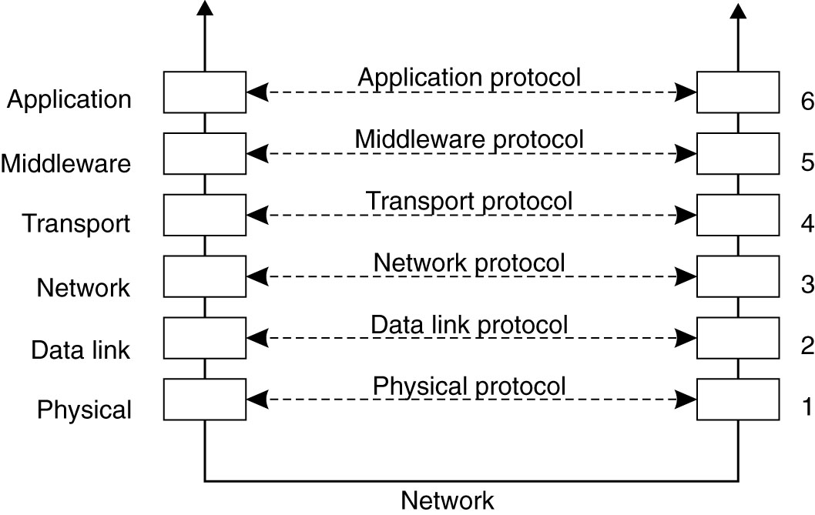
Middleware Communication Protocols
Remote Procedure Call (RPC)
Remote Method Invocation (RMI)
Message-Oriented Middleware (MOM)
Stream-Oriented Communication

Slide 38
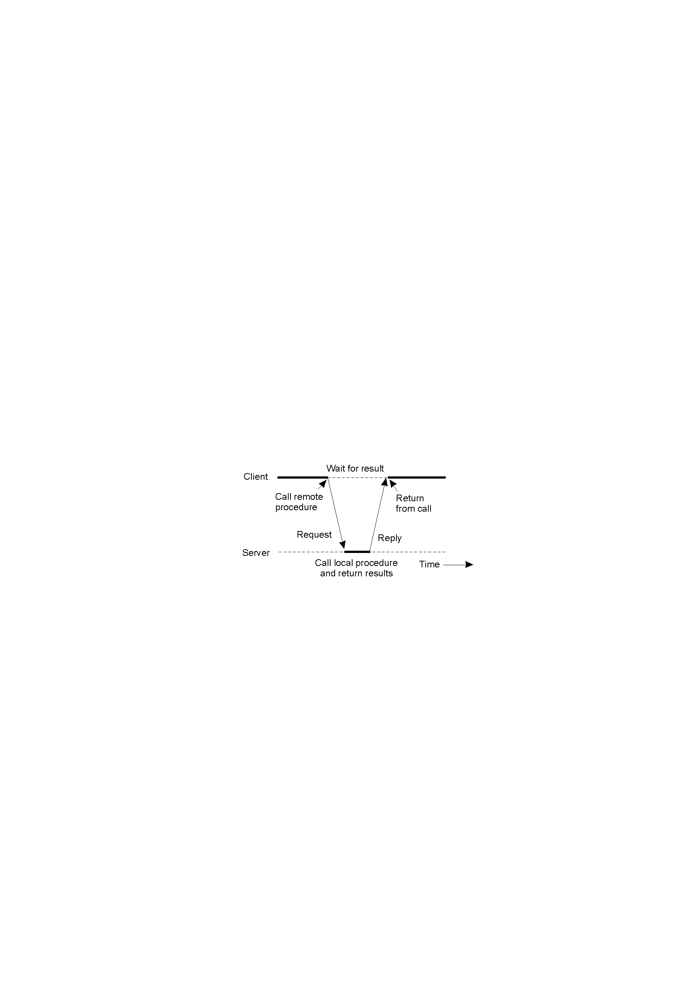
Remote Procedure Calls
Idea inferred from conventional procedure call
Allowing programs to call procedures located on other machines
Achieve transparency
How to implement the calling ?
Parameter passing mechanism?
RPC semantics ?
How to deal with the failures?

Slide 39
Steps of a Remote Procedure Call
Client procedure calls client stub in normal way
Client stub builds message, calls local OS
Client's OS sends message to remote OS
Remote OS gives message to server stub
Server stub unpacks parameters, calls server
Server does work, returns result to the stub
Server stub packs it in message, calls local OS
Server's OS sends a message to client's OS
Client's OS gives a message to client stub
Stub unpacks result, returns to client

Slide 40
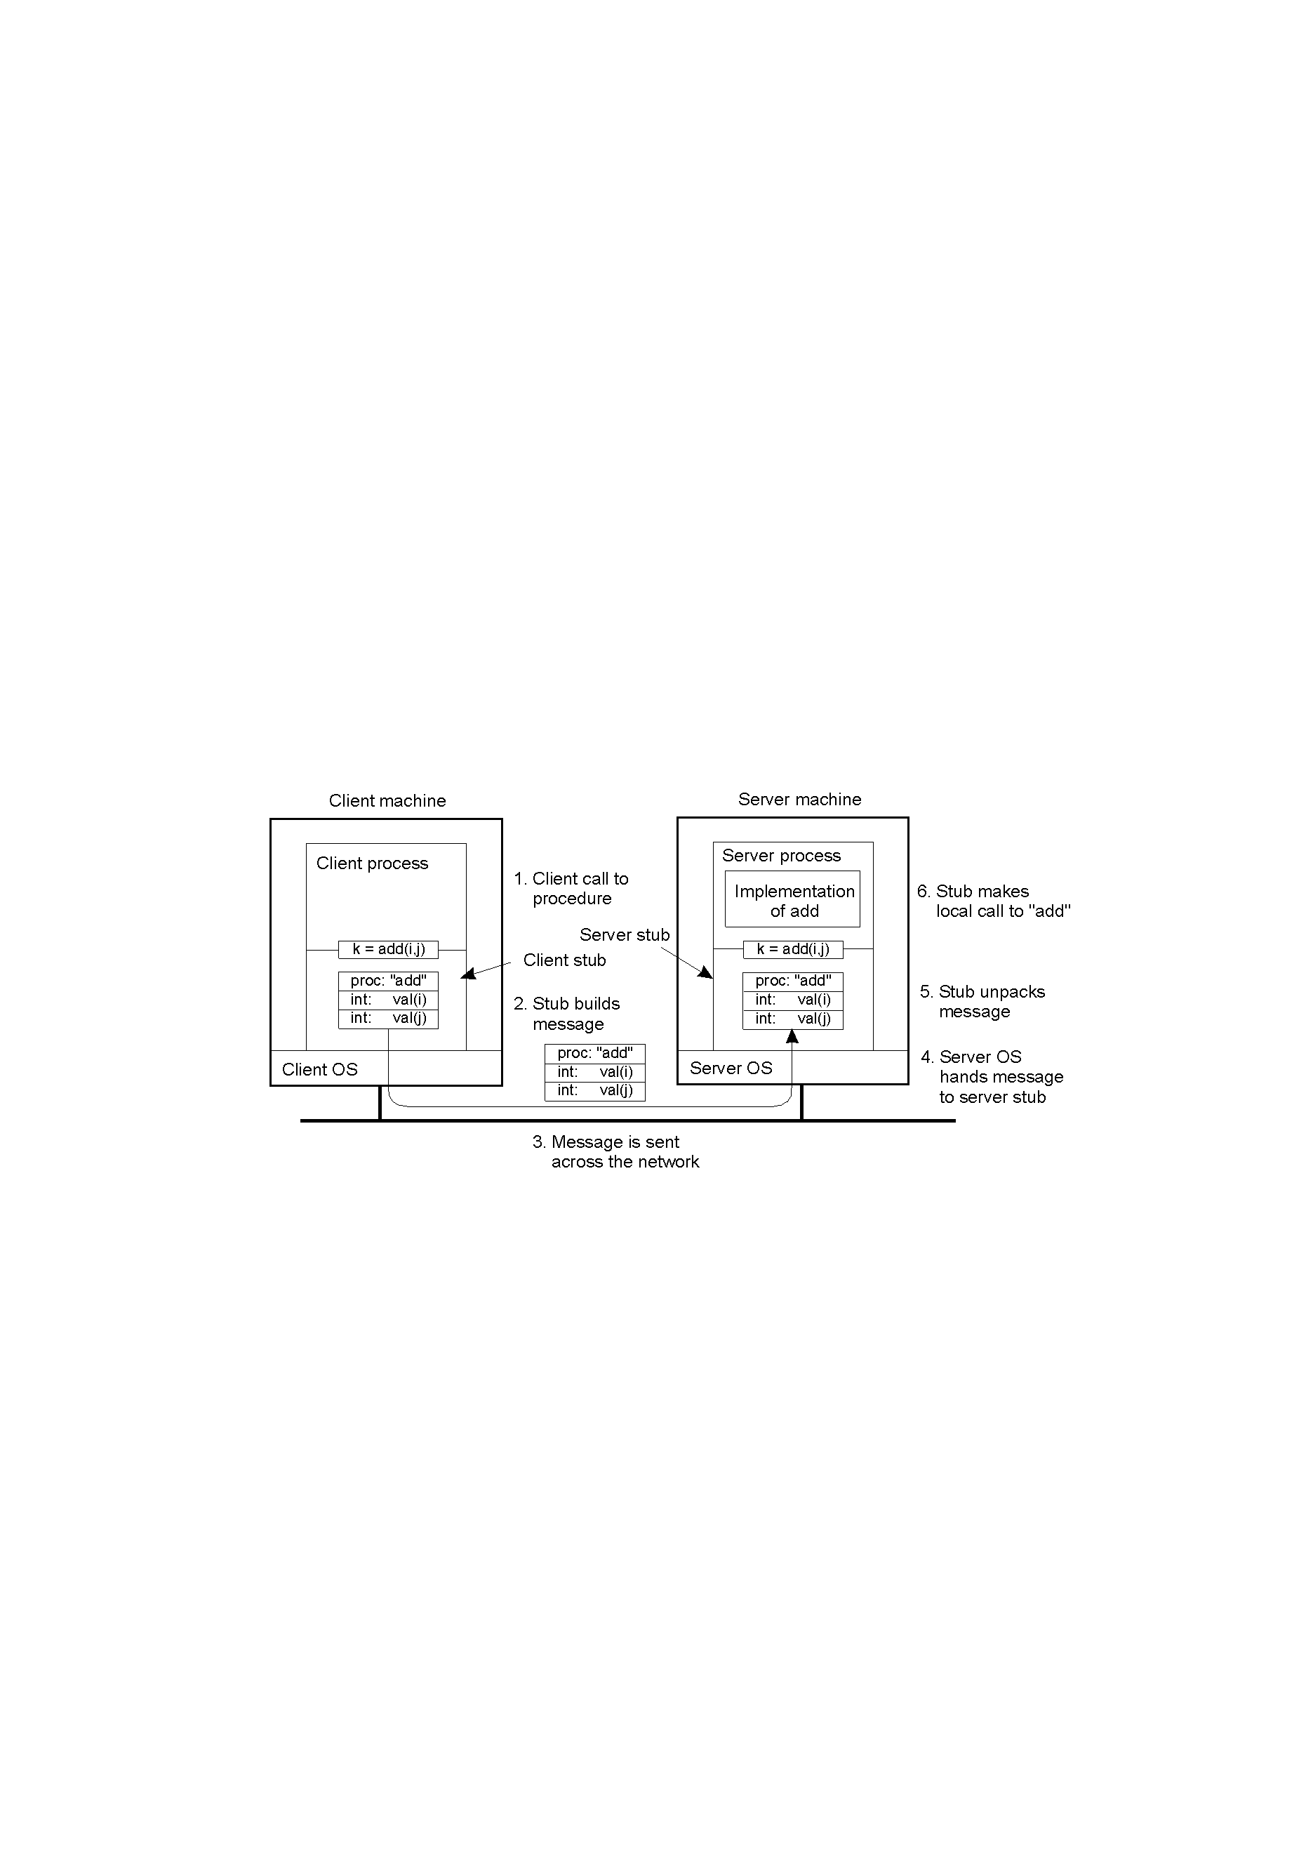
Example of a Remote Procedure Call
Steps involved in doing remote computation through RPC

Slide 41
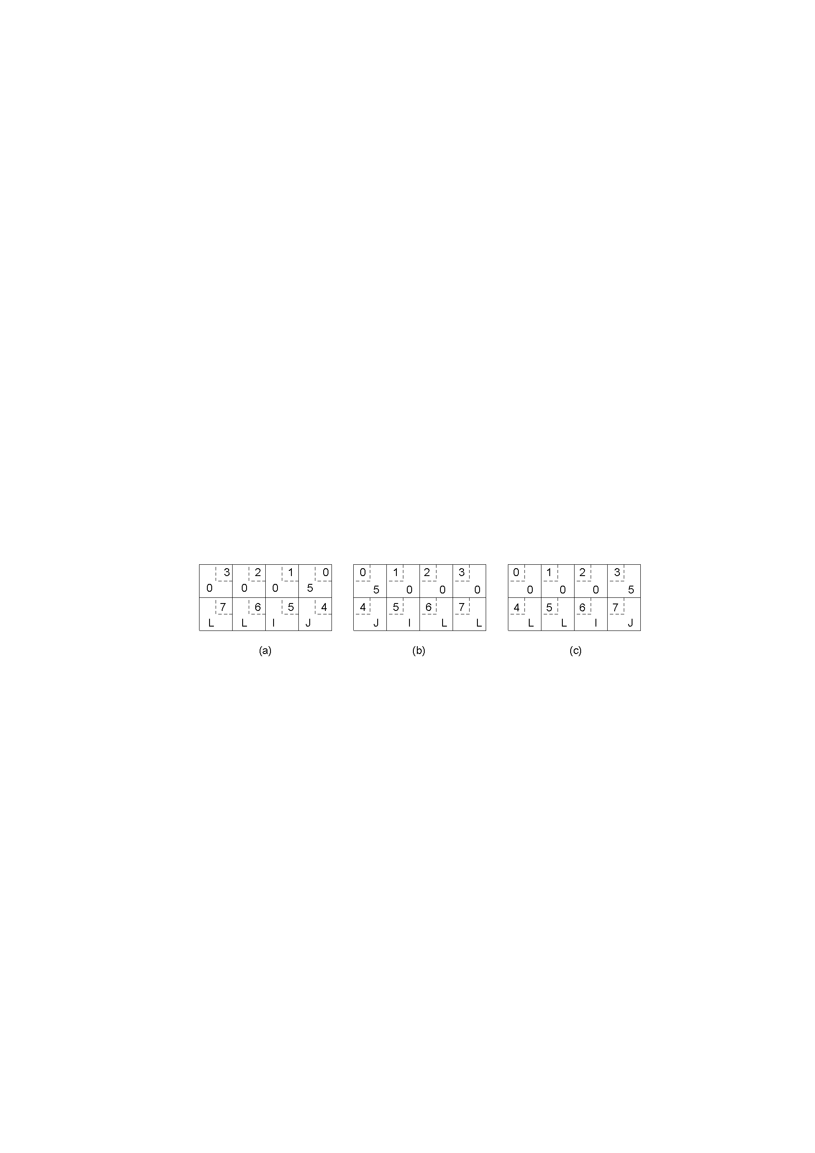
Parameter Passing
Different Encoding: EBCDIC versus ASCII
Different Endianness
Reference Parameter Passing:
call-by-reference has been replaced by copy/restore
Original message on the Pentium - 5 JILL
The message after receipt on the SPARC
The message after being inverted. The little numbers in boxes indicate the address of each byte

Slide 42

Parameter Passing: Parameter Specification
Define message format:
Agree on the representation of simple data structures
Agree on the service of data transport
A procedure b)The corresponding message.

Slide 43
RPC Semantics
At least once semantics
At most once semantics
Maybe — Guarantee nothing
Can RPC have the exactly once semantics similar to the local calls? No.
Fault tolerance measures
Invocation semantics
Retransmit request
Duplicate
Re-execute procedure
message
filtering
or retransmit reply
No
Not applicable
Not applicable
Maybe
Yes
No
Re-execute procedure
At-least-once
Yes
Yes
Retransmit reply
At-most-once

Slide 44
Failures that can occur in RPC Systems
The client is unable to locate the server.
The request message from the client to server is lost.
The server crashes after receiving a request.
The reply message from the server to the client is lost.
The client crashes after sending a request.

Slide 45
RPC Failures and Solutions (1)
Client cannot locate the server
to have the error raise an exception (e.g. Java)
to use signal handlers (e.g. defining a signal type SIG-NOSERVER)
drawbacks：not every language has exceptions or signal handlers, and that will destroys the transparency we have been trying to achieve.
Lost request message
start a timer at client stub, if the timer expires before a reply or acknowledgement comes back, the message is sent again.

Slide 46
RPC Failures and Solutions (2)
Server crashes
client sets a timer and the timer expires
its solution depends on RPC semantics:
at least once semantics: client stub reissues request and server re-executes it
at most once semantics: client stub gives up immediately and reports failure
maybe semantics: guarantee nothing

Slide 47
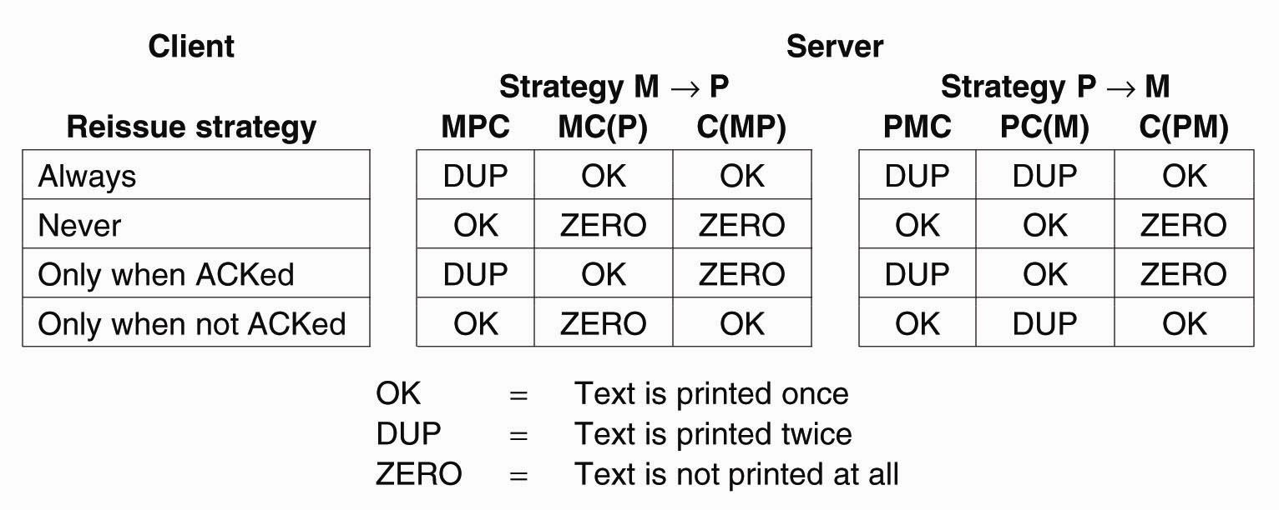
Example
Server’s Task | Results
M: send the message to client P: print some text C: crash | OK: text is printed once DUP: text is printed twice ZERO: text is not printed at all
(Reboot after crashing)

Slide 48
RPC Failures and Solutions (3)
Lost Reply Messages
client stub sets a timer and the timer expires
send the request once more
idempotent and un-idempotent requests
client assigns each request a sequence number
at-least-once semantics: resend the request, re-execute it
at-most-once semantics: resend the request, filter the duplicated request, retransmit the reply (if any)/re-execute it

Slide 49
RPC Failures and Solutions (4)
Client crashes
Orphan & grand-orphan: a computation is active and no parent is waiting for result.
extermination: the client stub makes a log entry before sending a RPC message, and kill the orphan after being rebooted
reincarnation: the client broadcasts a message after restart, so servers kill all remote computation on behalf of that client
gentle reincarnation: the client broadcasts a message, so servers try to locate their owner and kill it if the owner cannot be found.
expiration: each RPC is given a standard amount of time, if it cannot finish in the specified period, it must explicitly ask for another quantum
In practice, none of these methods are desirable

Slide 50
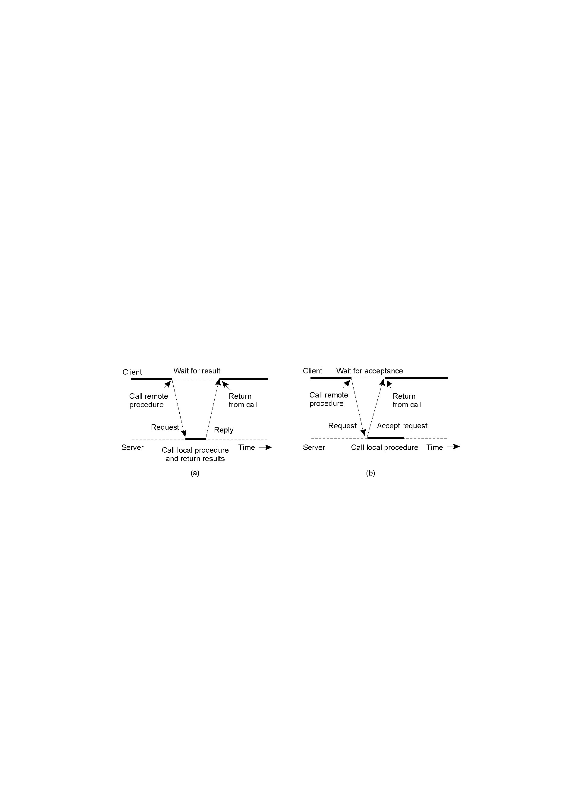
Extended RPC Models: Asynchronous RPC -1
a) The interconnection between client and server in a traditional RPC
b) The interaction using asynchronous RPC
Server immediately sends a reply back to the client the moment the RPC request is received

Slide 51
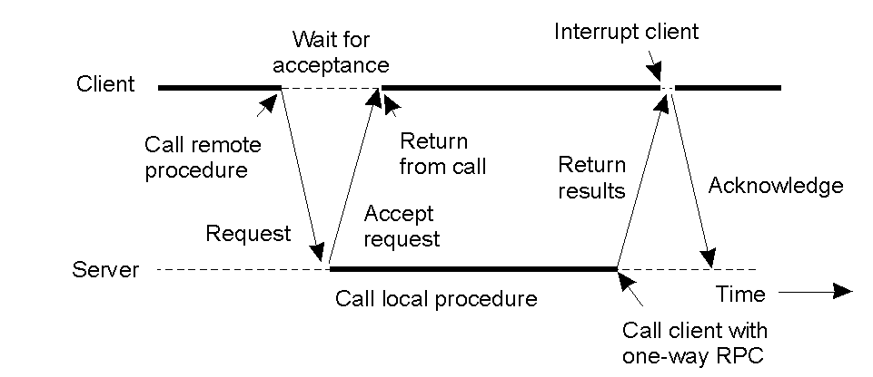
Extended RPC Models:Asynchronous RPC-2
Deferred Synchronous RPC: A client and server interacting through two asynchronous RPCs

Slide 52
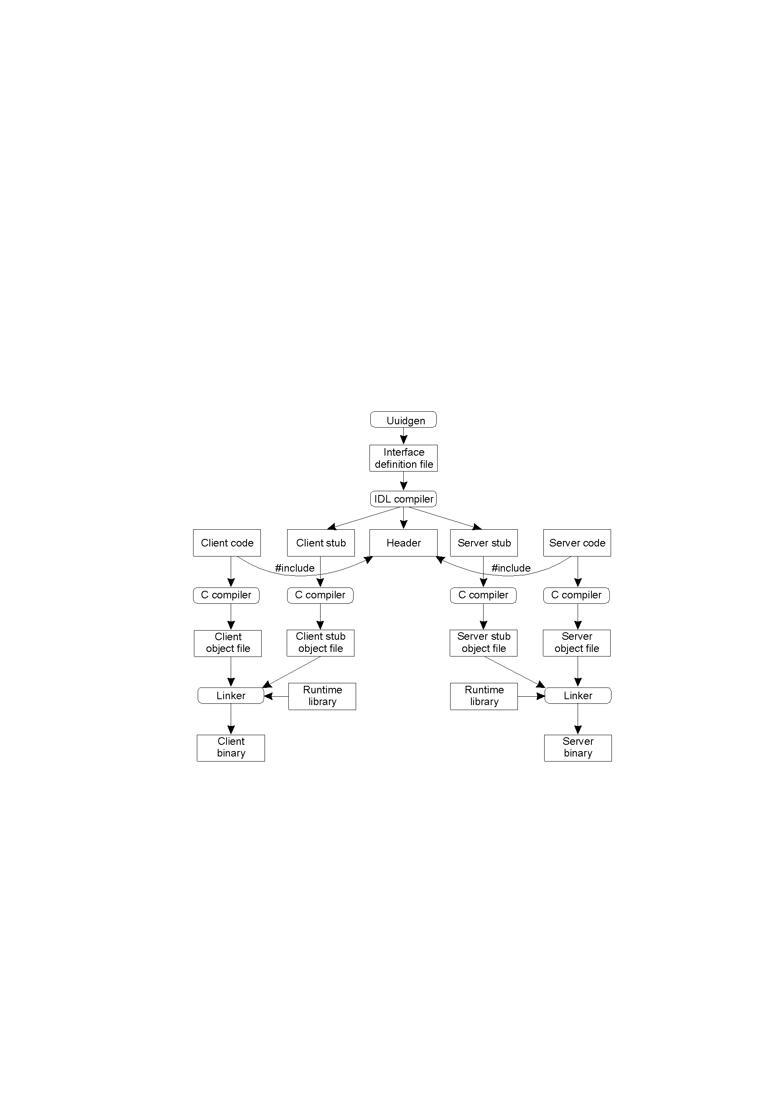
Case Study: DCE RPC(1)
The steps in writing a client and a server in DCE RPC.

Slide 53
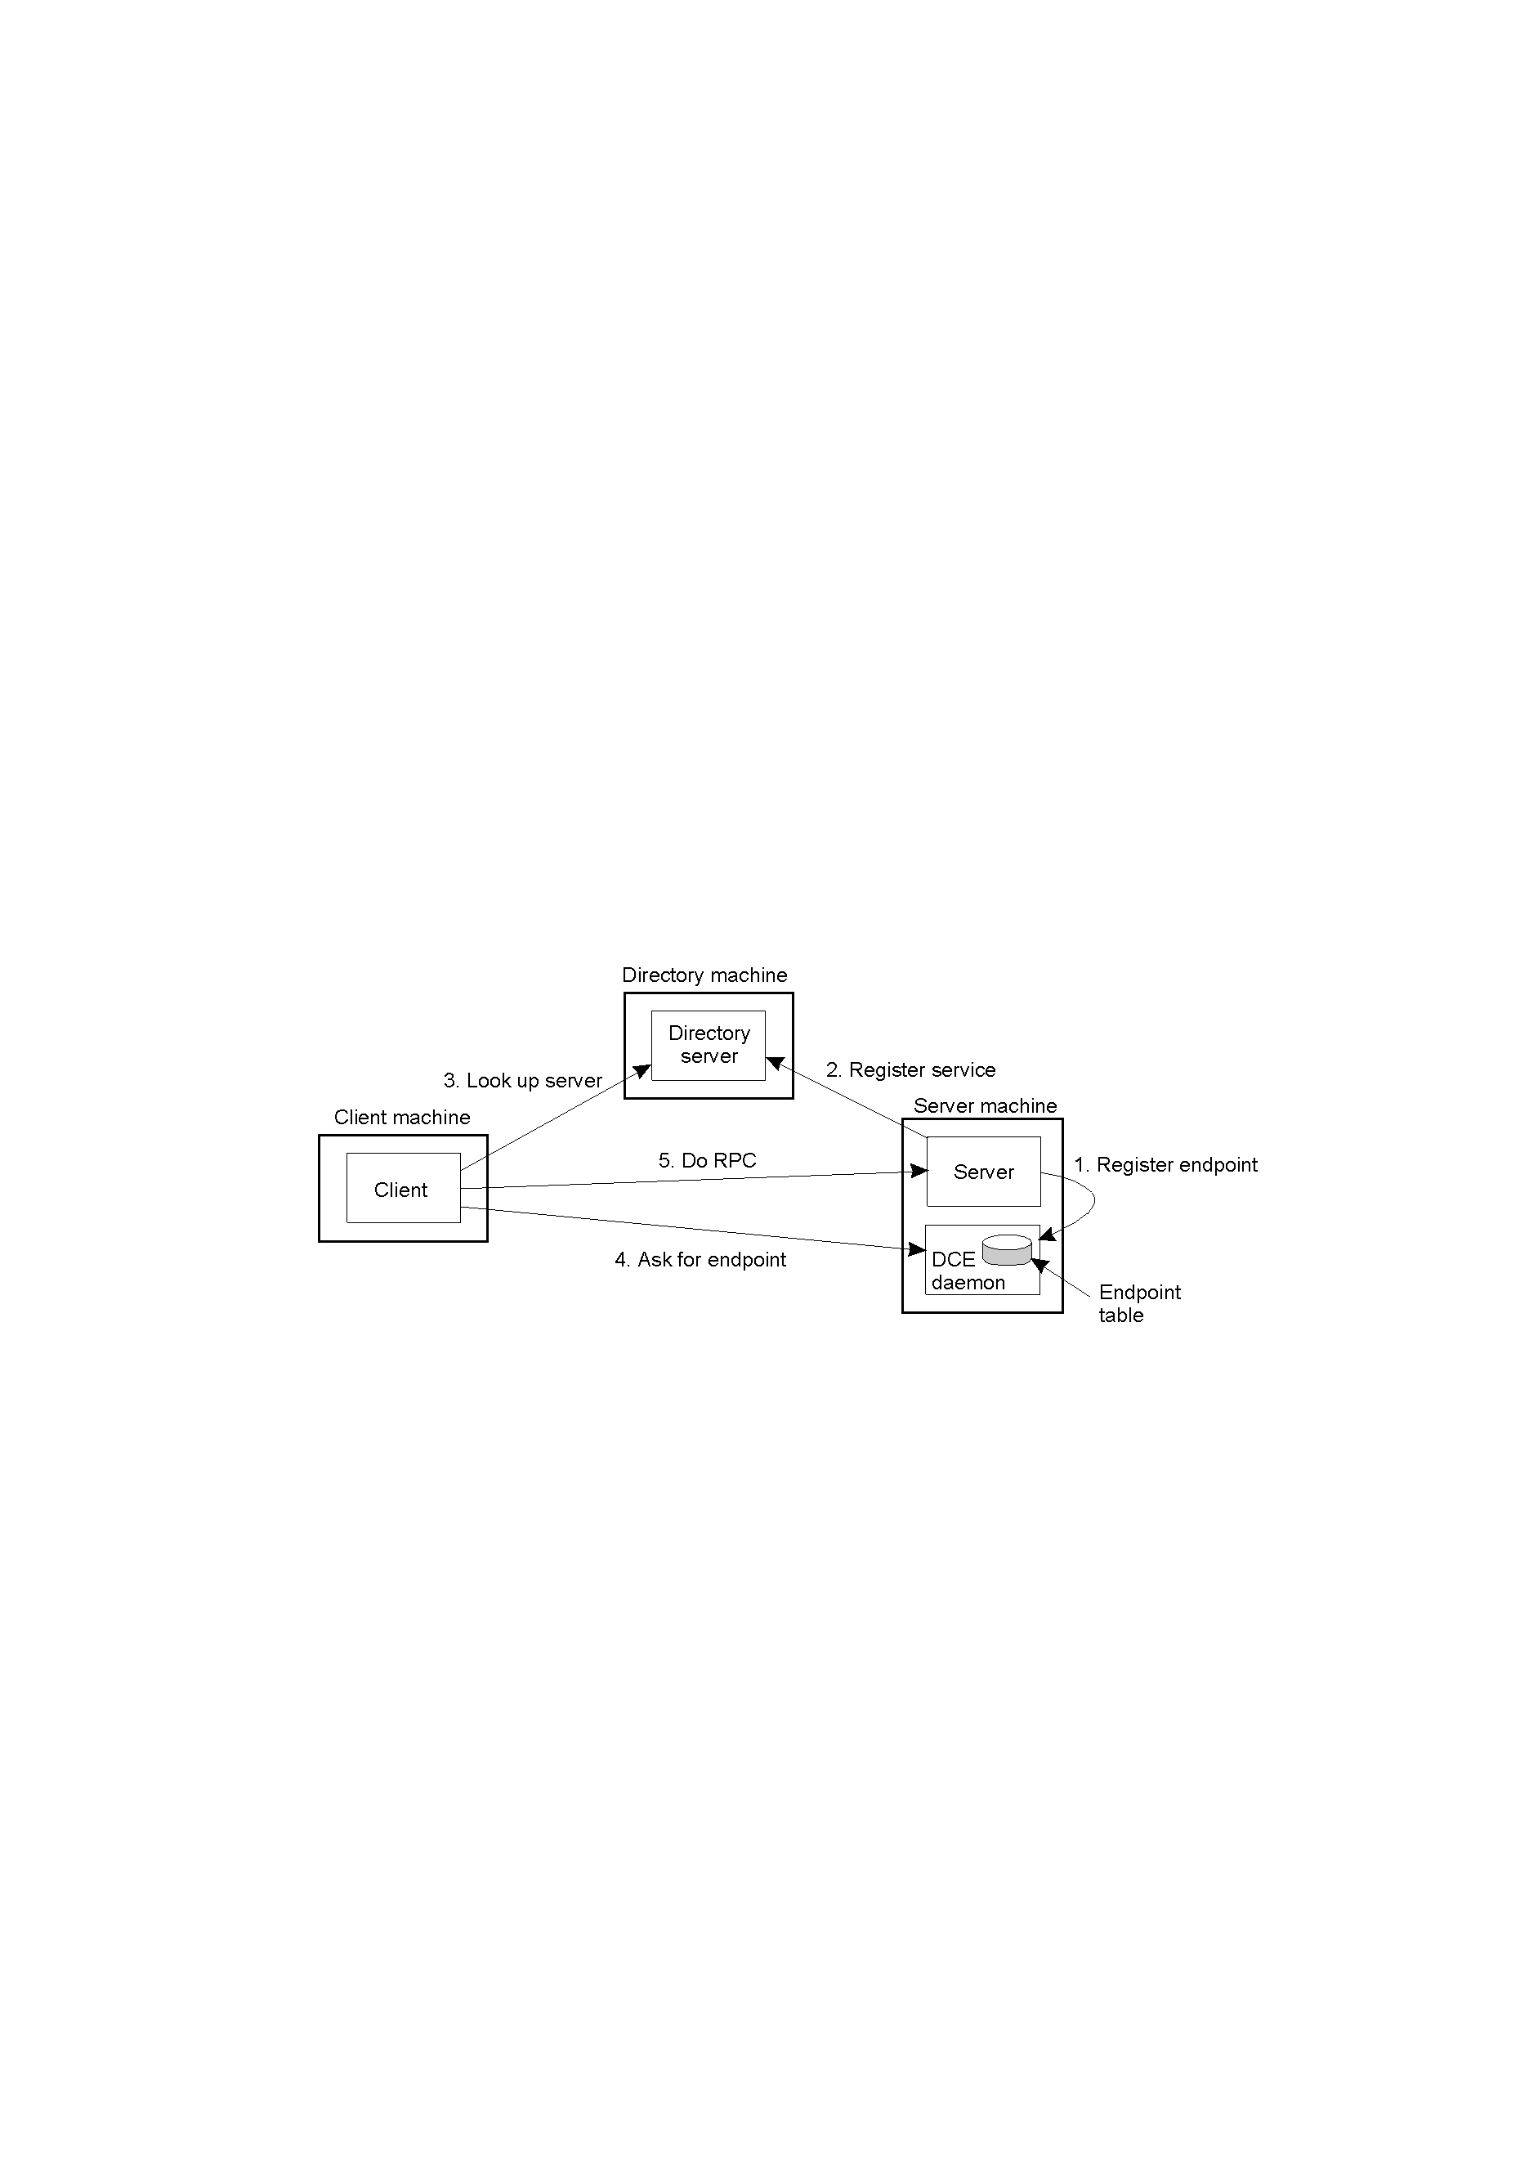
Case Study : DCE RPC(2)
Client-to-server binding in DCE.

Slide 54
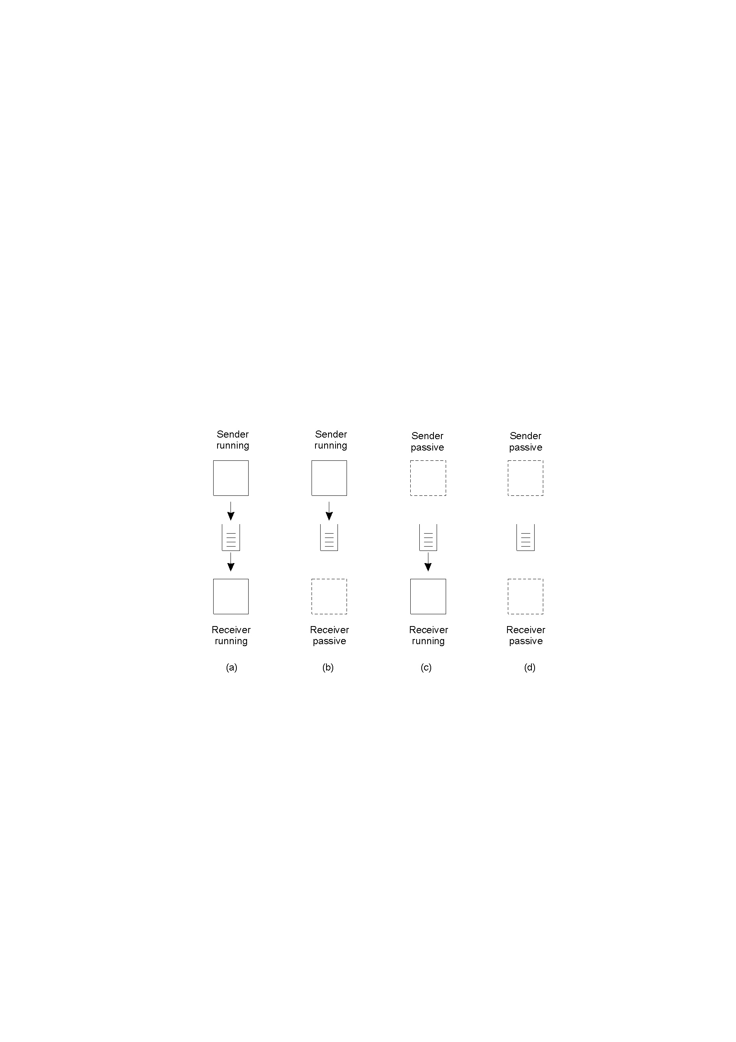
Message-oriented Middleware
Message-oriented middleware (Message-queuing systems) provide message-oriented persistent asynchronous communication, offering intermediate-term storage capacity for messages, without requiring either the sender or receiver to be active during message transmission
Message-Queuing Model:
Four combinations for loosely-coupled communications using queues.

Slide 55
Basic Interface for a Message-Queuing System
Queue:
Transient queue, persistent queue, transactional queue;
Local queue, remote queue;
Source queue, destination queue
Primitive | Meaning
Put | Append a message to a specified queue
Get | Block until the specified queue is nonempty, and remove the first message
Poll | Check a specified queue for messages, and remove the first. Never block.
Notify | Install a handler to be called when a message is put into the specified queue.
Basic interface to a queue in a message-queuing system.

Slide 56
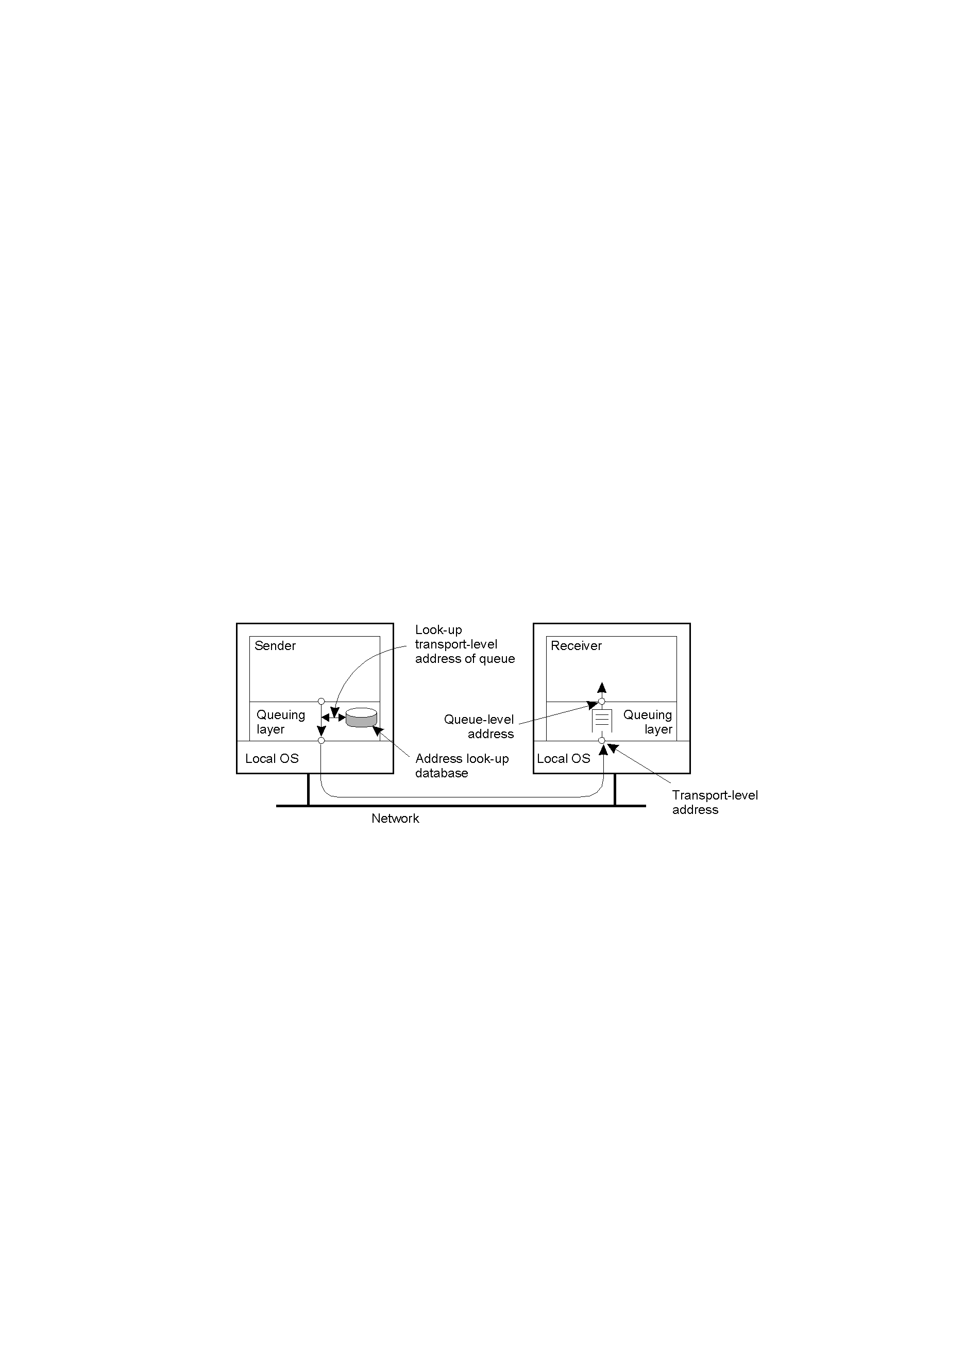
General Architecture of a Message-Queuing System-1
Queue Manager
The relationship between queue-level addressing and network-level addressing.

Slide 57
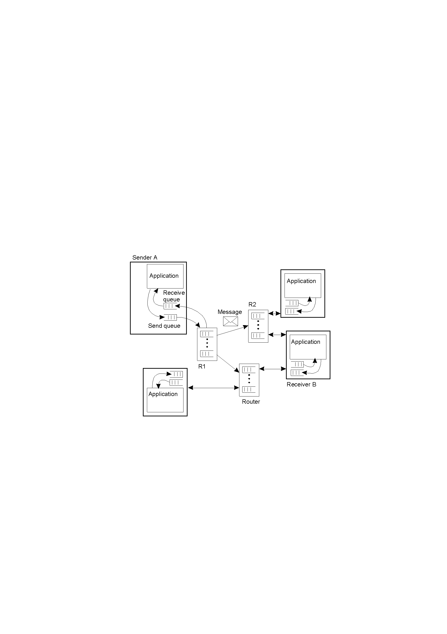
General Architecture of a Message-Queuing System (2)
Two ways of addressing:
Maintain a mapping of queues to network locations in every queue manager;
Add routers that know about the network topology (for scalable MOM).
MOM ➔ a complete, application-level overlay network on top of an existing computer network
The general organization of a message-queuing system with routers.

Slide 58
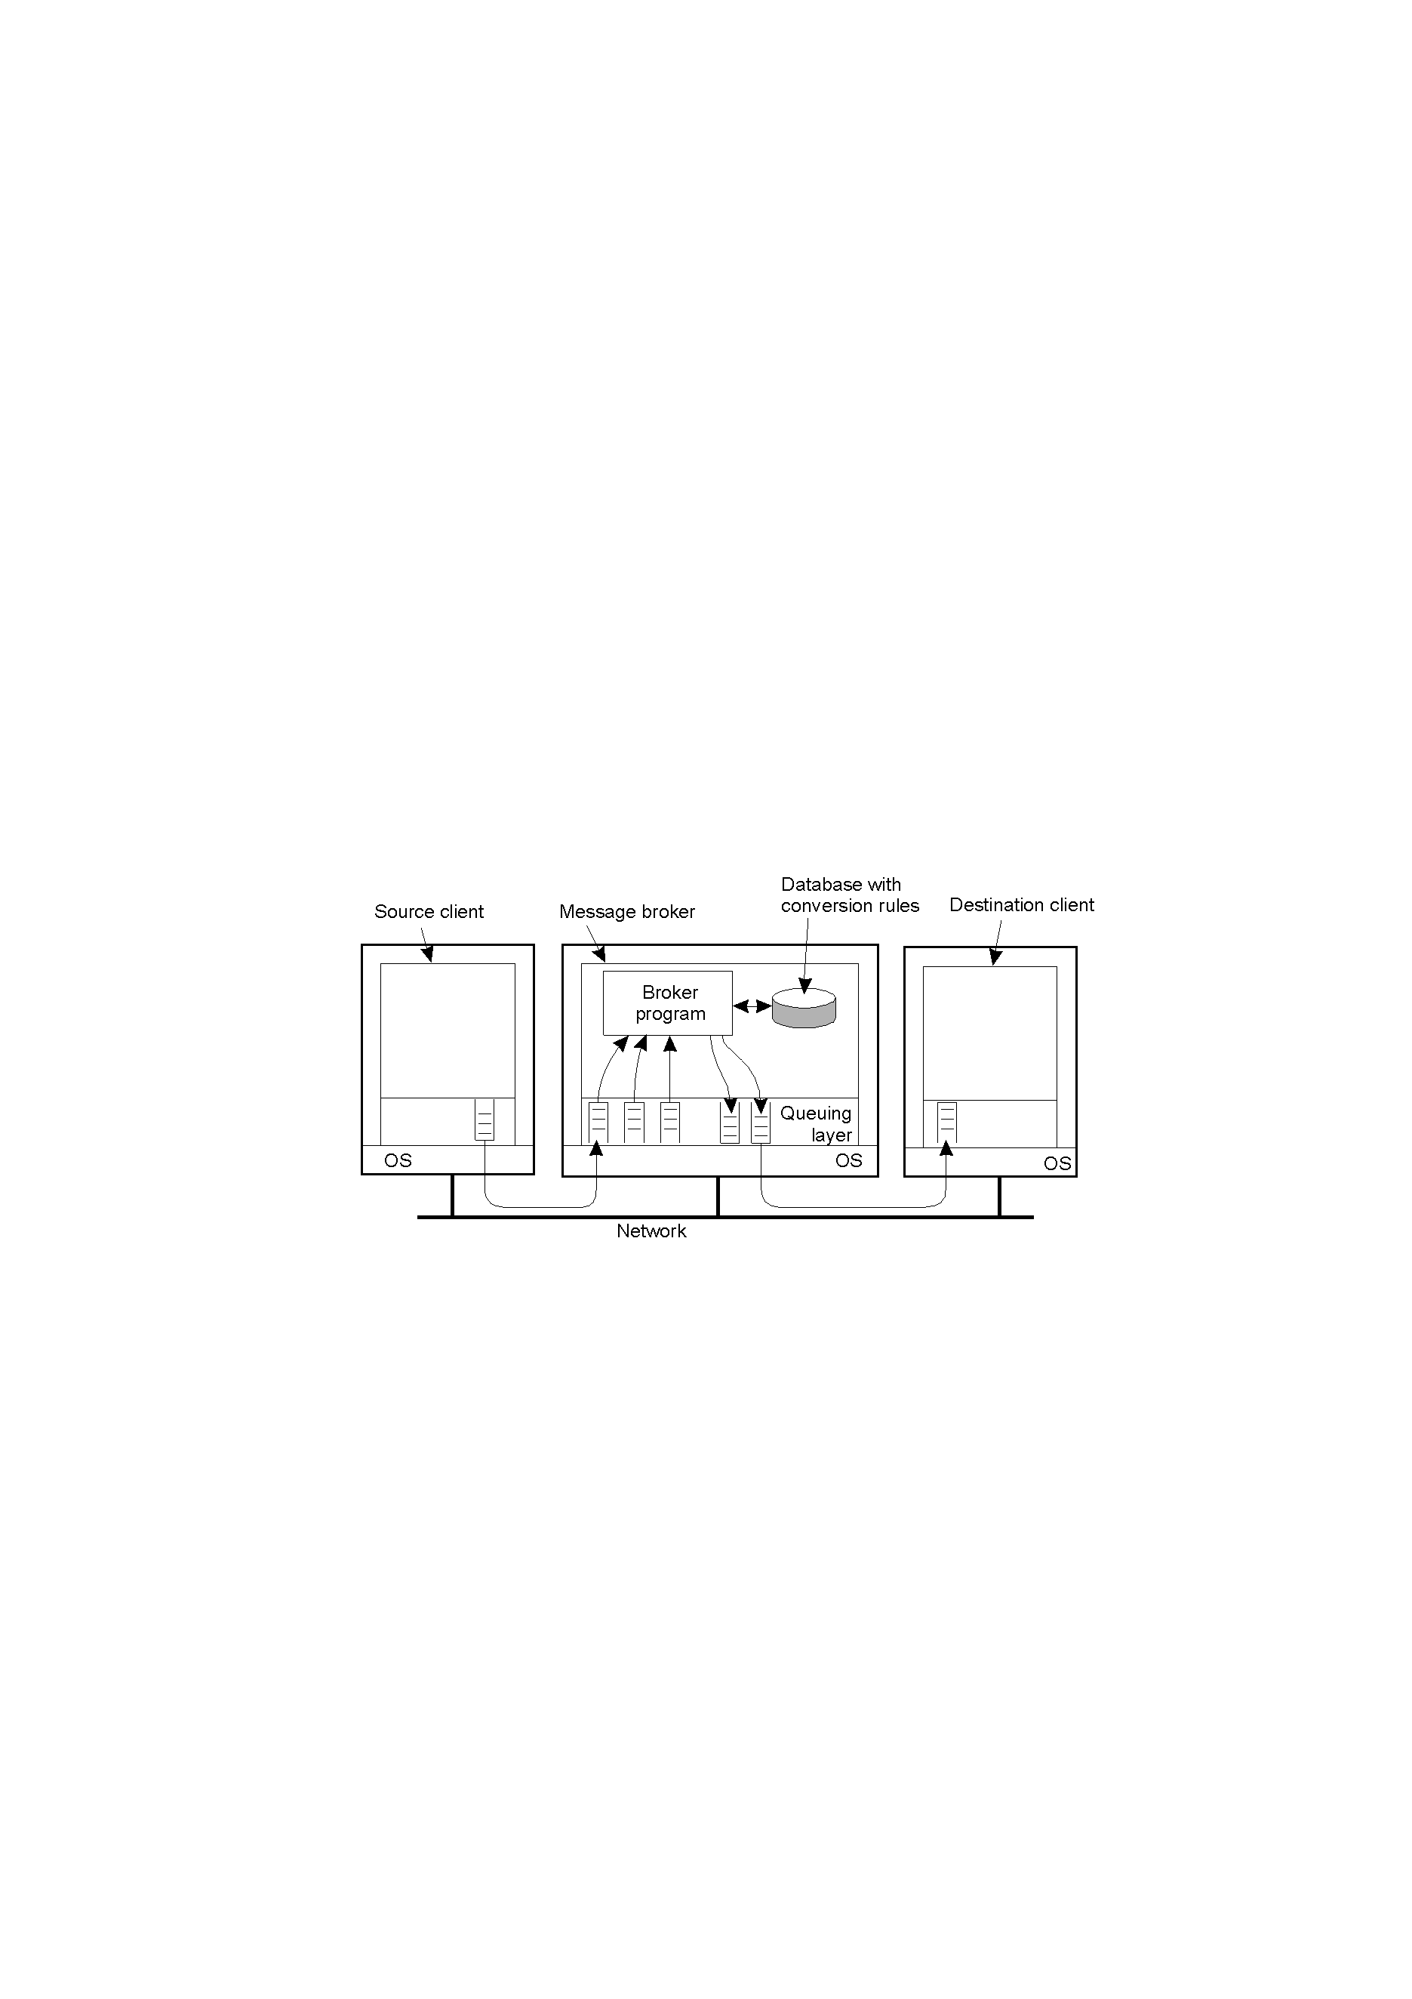
Message Brokers
A message broker is used for converting incoming messages to a format that can be understood by the destination application.
It acts as an application-level gateway in a message-queuing system.
The general organization of a message broker in a message-queuing system.

Slide 59
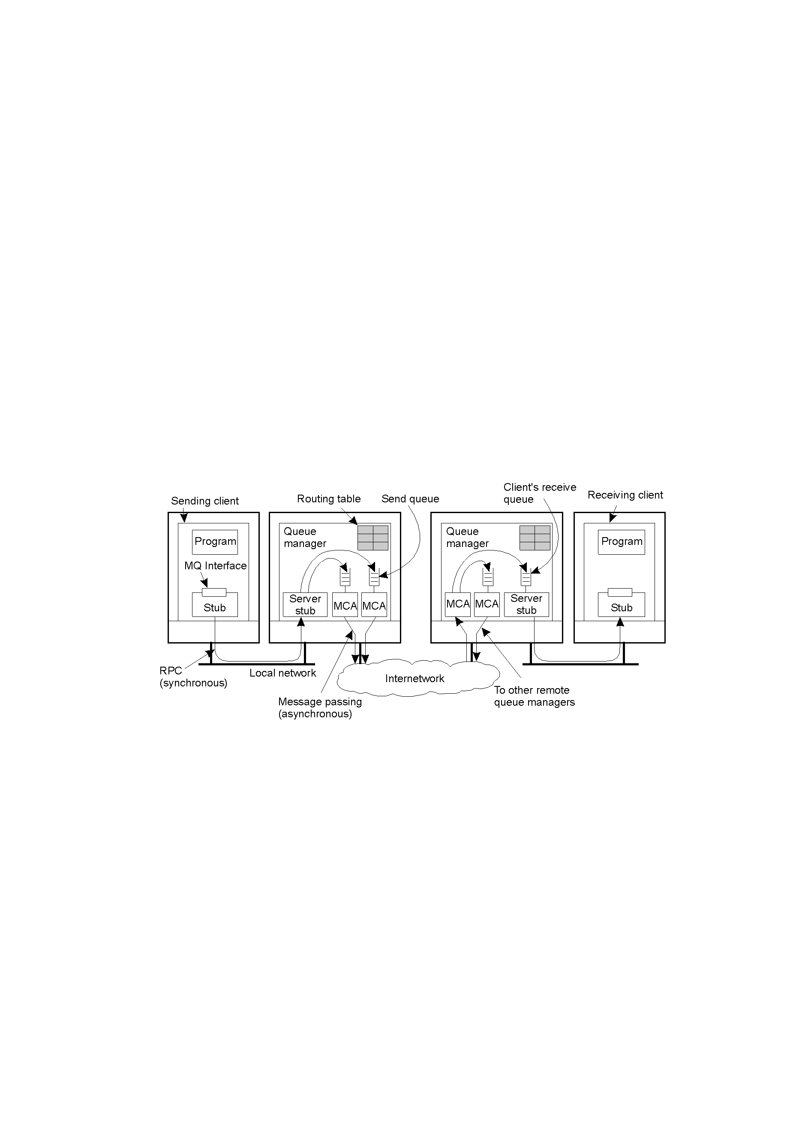
Case Study: IBM MQSeries / WebSphere MQ
General organization of IBM's MQSeries message-queuing system.
MCA: Message Channel Agent
APIs: MQopen, MQput, MQget, MQclose

Slide 60
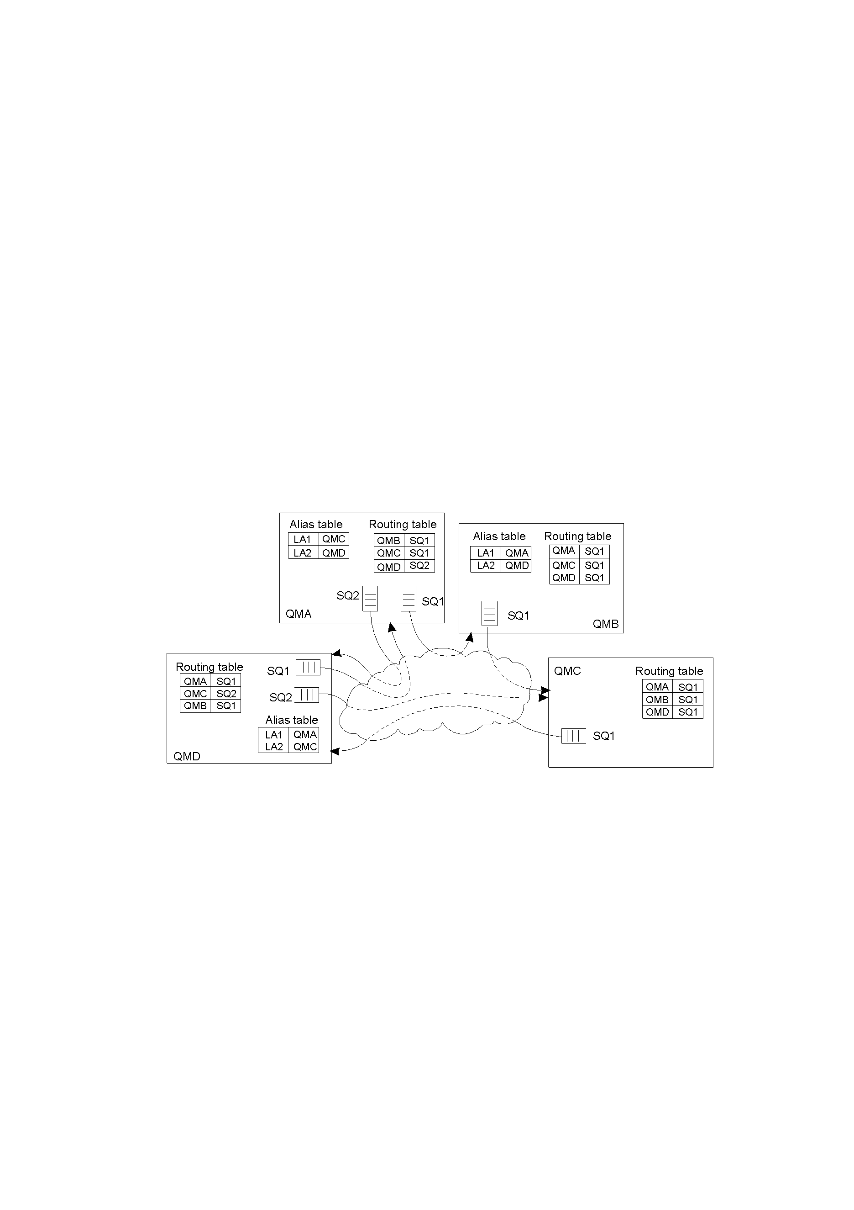
Queue Manager: aliases
Aliases are introduced to deal with rename or replacement of a queue manager
Routing Table:
(destQM, sendQ)
Alias defined within a queue manager M1 is another name for a queue manager M2, but which is available only to applications interfacing to M1.
The general organization of an MQSeries queuing network using routing tables and aliases.

Slide 61
Comparing MOMs with e-mail systems
MOM is more general, used for data integration
Email systems provide direct support for end users such as automic message filtering, but not providing guaranteed message delivery, message priorities, efficient multicasting, load balancing, fault tolerance, etc.

Slide 62
Stream-oriented communication
Stream-oriented communication can exchange time-dependent information such as audio and video streams
Concentrate on continuous multimedia streams using isochronous transmission
Continuous / discrete media
Simple / complex stream
Asynchronous / synchronous / isochronous transmission mode

Slide 63
Quality of Service
Nonfunctional requirements: timeliness, reliability, scalability, extensibility, etc.
as to timeliness during setting up a stream:
The required bit rate at which data should be transported
The maximum delay until a session has been set up
The maximum end-to-end delay
The maximum delay variance, or jitter
The maximum round-trip delay

Slide 64
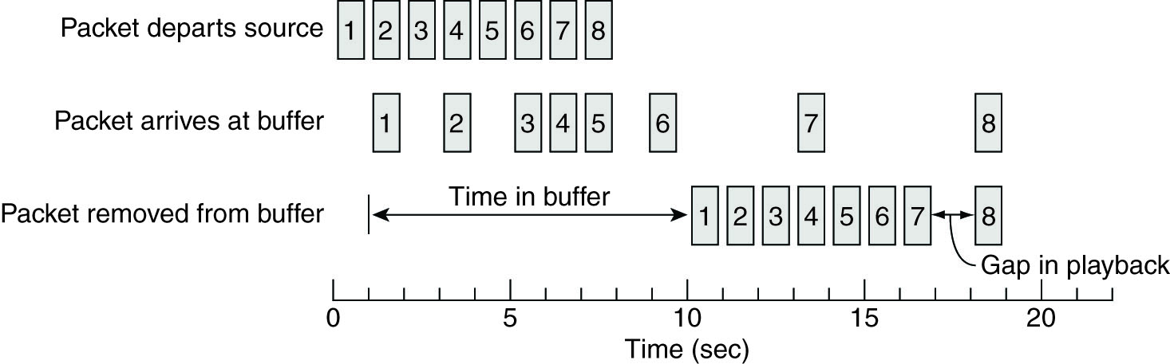
Enforcing QoS-I
IP, the best-effect datagram service, will lose/drop packets
Network-level solutions: differentiated service provided by Internet
Middleware-level solutions: use buffers to reduce jitter

Slide 65
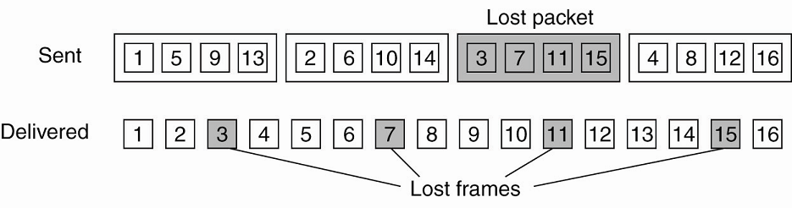
Enforcing QoS- II: Packet loss recovery techniques
Sender-based repair
Active
Passive
Retransmission
Interleaving
Forward error correction
Media-specific
Media-Independent
encode the outgoing packets in such a way that any k out of n received packets is enough to reconstruct k correct packets: parity coding, Reed-Solomon coding

Slide 66
Enforcing QoS- III: error concealment techniques
Receiver-based repair
Insertion
Interpolation
Regeneration
Interpolation of transmitted state
Splicing
Waveform substitution
Time scale modification
Model-based recovery
Packet repetition
Pitch waveform replication
Silence/Noise substitution

Slide 67
Stream Synchronization
Maintain temporal relations between streams
Synchronization between a discrete stream and a continuous one
Synchronization between continuous streams
Lip synchronization
How to synchronize
Achieve lip synchronization by alternating between reading an image and reading a block of audio sample every 33ms (assuming that the images are to be displayed at 30Hz)
Employ synchronization specification, such as the ones in MPEG (Motion Picture Experts Group) standards

Slide 68
5. Routing over MANETs

Slide 69


The Routing Problem
Y
Z
S
E
F
B
C
M
L
J
A
G
H
D
K
I
N
How to find a suitable path from source S to destination D?

Slide 70
Challenges in MANET Routing
Routing in mobile ad hoc networks is different:
Topology changes rapidly when terminals move fast.
Periodic updates of routing tables need energy without contributing to the transmission of user data, sleep modes are difficult to realize
Limited bandwidth of the system is reduced even more due to the exchange of routing information
New performance criteria may be used
route stability despite mobility
energy-effective

Slide 71
Challenges in MANET Routing
MANET routing requirements:
Route computation must be distributed and should not involve global system state
As few nodes as possible must be involved in route computation and state propagation
Short control messages to low overhead
Broadcast must be avoided as far as possible
Loop free and then no count-to-infinity
Backup routes (multiple disjoint routes) should be available when the primary route has become stale.

Slide 72
Loop Problem in Distance Vector Routing
broken link
(D, 2)
(D, 2)
1
1
1
A
B
C
D
Dest. | Next | Metric | …
… | … | …
D | B | 3
Dest. | Next | Metric | …
… | … | …
D | C | 2
Dest. | Next | Metric | …
… | … | …
D | B | 3

Slide 73
Count-to-infinity in Distance Vector Routing
A
B
C
B cannot reach C now.
Distance to C via B is 2.
Since links are unreliable in mobile ad hoc networks, this routing algorithm is obviously not a good choice.
New distance adopted since it comes from B.
……

Slide 74
Routing Protocols for MANET
Proactive Protocols
Continuously determine routes independent of traffic pattern
Usually table driven
A lot of routing information may never be used!
Traditional link-state and distance-vector routing protocols in wired networks are proactive
Reactive Protocols
On Demand - maintain routes only if needed
Route discovery by some global search - usually initiated by the source
Bottleneck due to latency of route discovery
May not be appropriate for real-time communication
Flooding is reactive

Slide 75
Trade-Off
Latency of route discovery
Proactive protocols have lower latency since routes are maintained at all times
Reactive protocols have higher latency because a route from X to Y will be found only when X attempts to send to Y
Overhead of route discovery/maintenance
Proactive protocols may have higher overhead due to continuous route updating
Reactive protocols may have lower overhead since routes are determined only if needed

Slide 76
Routing Protocols for MANET
Proactive protocols
WRP (Wireless Routing Protocol)
DSDV (Destination-Sequenced Distance Vector Routing)
Reactive protocols
DSR (Dynamic Source Routing)
AODV (Ad hoc On-Demand Distance Vector)
TORA (Temporally Ordered Routing Algorithm)

Slide 77
Routing Protocols for MANET
Hybrid protocols
Protocols that initiate the route-determination procedure on demand, but at limited search cost.
ZRP (Zone Routing Protocol)
FSR (Fisheye State Routing)
LANMAR (Landmark Routing for MANET with Group Mobility)
Geographic routing
LAR (Location-Aided Routing)
Face Routing
GOAFR (Greedy Other Adaptive Face Routing)

Slide 78
DSDV (Destination Sequenced Distance Vector)

Slide 79
DSDV
Every node maintains a routing table for all known destinations and records the number of hops to each destination.
Routing information must be updated periodically
Keep the simplicity of DV (Distance Vector)
It brings traffic overhead even if there is no change in network topology and nodes in the working mode
Maintains routes which are never used
Be adaptive to dynamic topology, and solve problems of DV routing (loops, count-to-infinity)

Slide 80
DSDV: Guarantee Loop Freeness
Each route is tagged with a destination sequence number
Sequence number indicates the “freshness” of a route
Routes with more recent sequence numbers are preferred for packet forwarding
If same sequence number, one having smallest metric used
Hosts perform periodic triggered updates, issuing a new sequence number
Guarantees loop freeness

Slide 81
DSDV: Responsive to Topology Changes
Broken links are assigned a metric of ∞
Any route through a hop with a broken link is also assigned a metric of ∞
“∞ routes” are assigned new sequence numbers by any host and immediately broadcast via a triggered update
If a node has an equal/higher sequence number with a finite metric for an “∞ route”, a route update is triggered
Make immediate route advertisement on significant changes in routing tables

Slide 82
DSDV: Damping Fluctuations
Problem : Table fluctuations if worse metrics are received first, causing a ripple of triggered updates
Solution : Use average settling-time as a parameter before advertising routes
Make immediate route advertisement on significant changes in routing table
but wait with advertising of unstable routes

Slide 83
Table Entries
DSDV: Protocol
Destination | Next | Metric | Seq. No. | Install Time | Stable Data
A | A | 0 | A-550 | 001000 | Ptr_A
B | B | 1 | B-102 | 001200 | Ptr_B
C | B | 3 | C-588 | 001200 | Ptr_C
D | B | 4 | D-312 | 001200 | Ptr_D
Sequence number originated from destination. Ensures loop freeness.
Install Time when entry was made (used to delete stale entries from table)
Stable Data Pointer to a table holding information on how stable a route is. Used to damp fluctuations in network.

Slide 84
Route Advertisements
DSDV: Protocol
Advertise to each neighbor its own routing information
Destination Address
Metric = Number of Hops to Destination
Destination Sequence Number
Rules to set sequence number information
On each advertisement increase own destination sequence number (use only even numbers)
If a node is no more reachable (timeout) increase sequence number of this node by 1 (odd sequence number) and set metric = ∞

Slide 85
Route Selection
DSDV: Protocol
Update information is compared to its own routing table
Select route with higher destination sequence number (This ensure to use always newest information from destination)
Select the route with better metric when sequence numbers are equal.

Slide 86
DSDV: Protocol
A
1
B
2
C
Dest. | Next | Metric | Seq
A | A | 0 | A-550
B | B | 1 | B-100
C | B | 3 | C-586
Dest. | Next | Metric | Seq
A | A | 1 | A-550
B | B | 0 | B-100
C | C | 2 | C-588
Dest. | Next | Metric | Seq.
A | B | 1 | A-550
B | B | 2 | B-100
C | C | 0 | C-588
B increases Seq. No. from 100 -> 102, B broadcasts routing information to Neighbors A, C including destination sequence numbers
Route Advertisement
(A, 1, A-550)
(B, 0, B-102)
(C, 1, C-588)
(A, 1, A-550)
(B, 0, B-102)
(C, 1, C-588)
A
1
B
1
C
Dest. | Next | Metric | Seq
A | A | 0 | A-550
B | B | 1 | B-102
C | B | 2 | C-588
Dest. | Next | Metric | Seq
A | A | 1 | A-550
B | B | 0 | B-102
C | C | 1 | C-588
Dest. | Next | Metric | Seq.
A | B | 2 | A-550
B | B | 1 | B-102
C | C | 0 | C-588

Slide 87
Respond to Topology Changes
DSDV: Protocol
Immediate advertisements
Information on new routes, broken links, metric change is immediately propagated to neighbors.
Full/Incremental Update:
Full Update: Send all routing information from own table.
Incremental Update: Send only entries that have changed. (Make it fit into one single packet)

Slide 88
New Node
DSDV: Protocol
2. Insert entry for D with sequence number D-000, then immediately broadcast own table
1. D broadcast for first time Send Sequence number D-000
(D, 0, D-000)
A
B
C
D
Dest. | Next | Metric | Seq.
A | A | 0 | A-550
B | B | 1 | B-104
C | B | 2 | C-590
Dest. | Next | Metric | Seq.
A | A | 1 | A-550
B | B | 0 | B-104
C | C | 1 | C-590
Dest. | Next | Metric | Seq.
A | B | 2 | A-550
B | B | 1 | B-104
C | C | 0 | C-590
D | D | 1 | D-000

Slide 89
New Node (cont’d)
DSDV: Protocol
3. C increases its sequence number to C-592 then broadcasts its new table.
4. B gets this new information and updates its table…….
(A, 2, A-550)
(B, 1, B-104)
(C, 0, C-592)
(D, 1, D-000)
(A, 2, A-550)
(B, 1, B-104)
(C, 0, C-592)
(D, 1, D-000)
………
………
A
B
C
D
Dest. | Next | Metric | Seq.
A | A | 0 | A-550
B | B | 1 | B-104
C | B | 2 | C-590
Dest. | Next | Metric | Seq.
A | A | 1 | A-550
B | B | 0 | B-104
C | C | 1 | C-592
D | C | 2 | D-000
Dest. | Next | Metric | Seq.
A | B | 2 | A-550
B | B | 1 | B-104
C | C | 0 | C-592
D | D | 1 | D-000

Slide 90
No loops, No count to infinity
DSDV: Protocol
1. Node C detects broken Link: -> Increase Seq. No. by 1 (only case where not the destination sets the sequence number -> odd number)
Immediate Advertisement
2. B does its broadcast -> no affect on C (C knows that B has stale information because C has higher seq. number for destination D) -> no loop -> no count to infinity
(D, 2, D-100)
(D, 2, D-100)
A
B
C
D
Dest. | Next | Metric | Seq.
… | … | …
D | B | 3 | D-100
Dest.c | Next | Metric | Seq.
… | … | …
D | C | 2 | D-100
Dest. | Next | Metric | Seq.
… | … | …
D | D | ∞ | D-101

Slide 91
Immediate Advertisement
DSDV: Protocol
1. Node C detects broken Link: -> Increase Seq. No. by 1(only case where not the destination sets the sequence number -> odd number)
3. Immediate propagation B to A: update information has higher Seq. No. -> replace table entry
2. Immediate propagation C to B: update information has higher Seq. No. -> replace table entry
(D, ∞, D-101)
(D, ∞, D-101)
A
B
C
D
Dest. | Next | Metric | Seq.
… | … | …
D | B | 4 | D-100
Dest. | Next | Metric | Seq.
… | … | … | ...
D | B | 3 | D-100
D | B | ∞ | D-101
Dest.c | Next | Metric | Seq.
… | … | …
D | C | 3 | D-100
Dest.c | Next | Metric | Seq.
… | … | … | ...
D | C | 2 | D-100
D | C | ∞ | D-101
Dest. | Next | Metric | Seq.
… | … | …
D | B | 1 | D-100
Dest. | Next | Metric | Seq.
… | … | …
D | D | 1 | D-100
D | D | ∞ | D-101

Slide 92
Problem of Fluctuations
DSDV: Protocol
What are Fluctuations
Entry for D in A: [D, Q, 14, D-100]
D makes Broadcast with Seq. No. D-102
A receives from P Update (D, 15, D-102) -> Entry for D in A: [D, P, 15, D-102] A must propagate this route immediately.
A receives from Q Update (D, 14, D-102) -> Entry for D in A: [D, Q, 14, D-102] A must propagate this route immediately.
This can happen every time D or any other node does its broadcast and lead to unnecessary route advertisements in the network, so called fluctuations.
A
P
Q
11 Hops
10 Hops
(D,0,D-102)
D

Slide 93
Damping Fluctuations (cont’d)
DSDV: Protocol
How to damp fluctuations
Settling Time = time between arrival of first route and the best route with a given seq. no.
Record last and avg. Settling-Time of every Route in a separate table, i.e. Stable Data.
A node still must update its routing table on the first arrival of a route with a newer seq. no., but it can wait to advertise it. Time to wait is proposed to be 2*(avg. Settling Time).
Like this, fluctuations in larger networks can be damped to avoid unnecessary advertisement, thus saving bandwidth.
A
P
Q
11 Hops
10 Hops
D

Slide 94
DSDV: Summary
Advantages:
Simple (almost like Distance Vector)
Loop free through destination seq. numbers
No latency caused by route discovery
Disadvantages:
No sleeping nodes
Most routing information never used
Not suitable to large-scale MANET

Slide 95
AODV (Ad hoc On-Demand Distance Vector)

Slide 96
AODV
A pure on-demand protocol, using a broadcast route discovery mechanism
Broadcast discovery packages only when necessary
Maintain routes only between nodes which need to communicate
Node does not need to maintain knowledge of another node unless it communicates with it
Disseminate information about changes in local connectivity to only those neighboring nodes that are likely need it
Distinguish between local connectivity management and general topology maintenance
Provide loop-free routes even while repairing broken links

Slide 97
Route Table Management
“Partial” routing tables are constructed lazily
Node not on active paths maintain no routing entries
No periodic updates
Entries are updated only when a node sends to another node unavailable in its routing table
Reduce packet overhead
Route Table entry
Destination
Next Hop
Number of hops (metric)
Sequence numbers of destination
Active neighbors for this route (Neighbor ID)
Expiration time for the route table entry

Slide 98
Step 1: Path Discovery
Initiated whenever nodes want to communicate
Route Request packets (RREQ) are broadcast
RREQ format:
< source_addr, source_sequence-# , broadcast_id, dest_addr, dest_sequence_#, hop_cnt >
broadcast id incremented with every RREQ, so RREQ is uniquely identified by <source_addr , broadcast_id>
source sequence number is used to maintain freshness about reverse route to source
destination sequence number is specified for freshness of a route before it can be accepted by the source

Slide 99
Path Discovery
Neighboring nodes satisfy RREQ by sending Route reply (RREP) or broadcast RREQ after incrementing hop_cnt
send RREP if the neighbor is the target, or knows the current route (goto Step 2)
RREP format: <source_addr, dest_addr, dest_sequence_#, hop_cnt, lifetime>
Otherwise setup a pointer to the neighbor from whom RREQ was received (reverse path)
If the neighbor has received the RREQ, then it will not broadcast this RREQ

Slide 100
Reverse Path Setup
When a node forwards a RREQ, it sets up a reverse route entry for the source in its routing table.
This reverse route entry contains
source node
source sequence number (used to maintain freshness about reverse route to source)
number of hops
neighbor from which the RREQ was received

Slide 101
Example: Reverse Route Entry
Reverse Route Entry at Node B:
RREQ
A
B
C
Source ID | Source Sequence Number | Number of hops | Neighbor ID
A | 1 | 1 | A
Reverse Route Entry at Node C:
RREQ
A
B
C
Source ID | Source Sequence Number | Number of hops | Neighbor ID
A | 1 | 2 | B

Slide 102
Example: Path Discovery
Y
Z
S
E
F
B
C
M
L
J
A
G
H
D
K
I
N
Represents a node that has received RREQ for D from S

Slide 103
Example: Path Discovery
Y
Broadcast transmission
Z
S
E
F
B
C
M
L
J
A
G
H
D
K
I
N
Represents transmission of RREQ

Slide 104
Example: Path Discovery and Reverse Path Setup
Y
Z
S
E
F
B
C
M
L
J
A
G
H
D
K
I
N
Represents links on Reverse Path

Slide 105
Example: Path Discovery and Reverse Path Setup
Y
Z
S
E
F
B
C
M
L
J
A
G
H
D
K
I
N
Node C receives RREQ from G and H, but does not forward
it again, because node C has already forwarded RREQ once
(i.e. same request ID).

Slide 106
Example: Path Discovery and Reverse Path Setup
Y
Z
S
E
F
B
C
M
L
J
A
G
H
D
K
I
N
Some reverse paths will be removed
according to Route Request Expiration Timer

Slide 107
Example: Path Discovery and Reverse Path Setup
Y
Z
S
E
F
B
C
M
L
J
A
G
H
D
K
I
N
Node D does not forward RREQ, because node D
is the intended target of the RREQ

Slide 108
Example: Route Reply
Y
Z
S
E
F
B
C
M
L
J
A
G
H
D
K
I
N
Represents links on path taken by RREP

Slide 109
Step 2: Reach Destination
Destination sends the RREP, the RREP message contains
the destination’s current sequence no.
a hop count of zero
the length of time this route is valid

Slide 110
Step 2: Get Recent Available Route
An intermediate node (not the destination) may also send a RREP provided that it knows a more recent path than the one previously known to the source.
To determine whether the path is more recent, destination sequence number is used.
a path is more recent if the sequence no. in the routing table is larger than the destination sequence no. specified in RREQ.
If an intermediate node sends the RREP, the RREP message contains
its record of the destination sequence number
a hop count equal to its distance from the destination
the amount of time for which its route table entry for the destination will still be valid

Slide 111
Step3: Forward Path Setup
Node propagates RREP back to source along the reverse path
Forward links are setup when RREP travels along the reverse path
Updates information on reception of subsequent RREPs
Y
S
E
Z
F
B
C
M
L
J
A
G
H
D
K
I
N
Represents a link on the forward path

Slide 112
Forward Route Entry at Node B
Example: Forward Route Entry
RREP
A
B
C
Destination ID | Destination Sequence Number | Number of hops | Neighbor ID
C | 6 | 1 | C
Forward Route Entry at Node A
RREP
A
B
C
Destination ID | Destination Sequence Number | Number of hops | Neighbor ID
C | 6 | 2 | B

Slide 113
Step 4: Data Delivery
Y
DATA
Z
S
E
F
B
C
M
L
J
A
G
H
D
K
I
N
Forward route entries in routing tables are used to forward data packet. Route is not included in packet header.

Slide 114
Parameters for Protocol
Route Request Expiration Timer for purging reverse paths which do not lie on source-destination route
timeout should be long enough to allow RREP to come back
Route Caching Timer (time after which the route is considered invalid) for purging inactive route
if no data being sent using a particular routing table entry, that entry will be deleted from the routing table (even if the route may actually still be valid)
Active_timeout Period used to determine if neighboring node is active

Slide 115
Path Maintenance
When destination node or intermediate node moves, a special RREP is sent to the affected source nodes
When next hop becomes unreachable, the upstream node sends an unsolicited RREP with increased sequence number and hop cnt ∞ to all active upstream neighbors
Source may restart route discovery process on receipt of RREP if the route is still needed

Slide 116
Local Connectivity Management
Node learns of their neighbors in the following ways:
on receipt of broadcast message
on receipt of hello message: neighbor nodes in an active path are required to periodically send “hello” messages
Absence of hello message is used as an indication of link failure
Ensure that only nodes with bidirectional connectivity are considered to be neighbors

Slide 117
Proof of the loop-free property
Suppose that there is a loop in a route to a destination Z, and that node X_{i} (i=1,2,…n) are the nodes in the loop
Let X_{i} → X_{j} denote that in the routing table entry of X_{i} for Z, node X_{j} is the next hop to Z, let T_{i}, M_{i} be the des_sequence_#, hop number for the route entry at X_{i} for Z
For each X_{i}, X_{i} → X_{i+1} (i=1,2,…n), and X_{n} → X₁
Following the algorithm, T_{i}<=T_{i+1} whenever X_{i} → X_{i+1}
T₁<=T₂<=…<=T_{n}<=T₁ ➔ des_sequence_# are same for every X_{i} in the loop
Following the algorithm, X_{i} → X_{i+1} only if M_{i} = M_{i+1} + 1
➔ M₁=M_{n}+(n-1) (*)
Because X_{n} → X₁, M_{n} = M₁+1
As a result, n=0; this is a contradiction

Slide 118
References (1. && 2.)
Alan Demers, et. al., Epidemic Algorithms for Replicated Database Maintenance, ACM PODC, 1987
Patrick T. Eugster, et.al., Epidemic information dissemination in distributed systems, IEEE Computer, May 2004
Jinu Kurian and Kamil Sarac, A Survey on the Design, Applications, and Enhancements of Application-Layer Overlay Networks, ACM Computing Surveys, Vol. 43, No. 1, November 2010
Miguel Castro, et. al., Scribe: A Large-Scale and Decentralized Application-Level Multicast Infrastructure, IEEE Journal on Selected Areas in Communications, Vol. 20, No. 8, October 2002
CDK5, Chapter 10 and 20

