Slide 1



Recommender Systems
罗平 luop@ict.ac.cn
Autumn 2016

Slide 2
Explaining Recommendations
6-1

Slide 3
Learning Objectives
To understand the variety of ways that explanations are made in recommender systems, and how users react to them
To understand how explanations can fit into a recommender system
To recognize pitfalls in explanation

Slide 4
Recommendation Explanation
Tencent Video Website
http://v.qq.com/movie/me.html

Slide 5
Key Reference
Explaining Collaborative Filtering Recommendations by Herlocker, Konstan, and Riedl (Proc. CSCW 2000)
Still on-going
Notes:
Computer-supported cooperative work

Slide 6
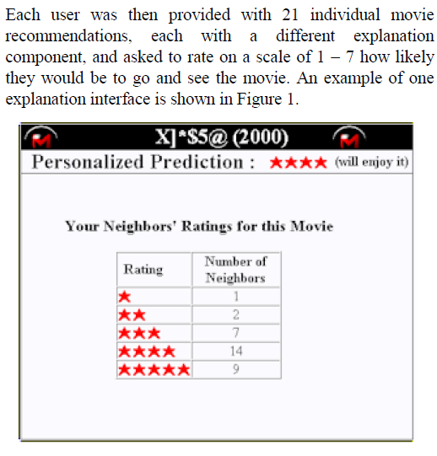
User Study on Explanation

Slide 7
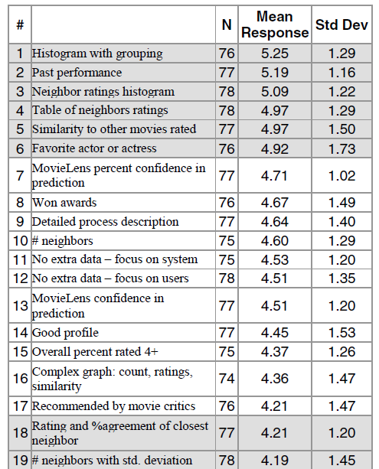
User Study on Explanation

Slide 8
Key Lessons
Simplicity is key – users didn’t like “correlation”, statistical terms, or being overwhelmed with data
Simple visualizations work well – histogram, table
Supporting information valued – historical success, attribute-linked data, associations

