Slide 1


Advanced AI 课程
罗平
Autumn 2016

Slide 2
Mining Frequent and Dominant Patterns
2-2

Slide 3
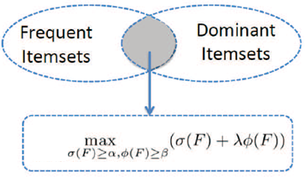
Mining Frequent and Dominant Patterns for Recommendation:
KDD 2012,
CIKM 2012 (Best Student Paper)

Slide 4
Incorporating occupancy into frequent pattern mining for high quality pattern recommendation
Linpeng Tang, Lei Zhang, Ping Luo, Min Wang, CIKM, 2012.
[pdf] [blog] [bib] Best Student Paper Award
Harnessing the wisdom of the crowds for accurate web page clipping
Lei Zhang, Linpeng Tang, Ping Luo, Enhong Chen, Limei Jiao, Min Wang, Guiquan Liu, KDD, 2012.
[pdf] [bib]

Slide 5
Problem Statement
Propose a new interestingness measure
Occupancy
Transaction No. | Items | Occupancy in this transaction
1 | B C E | 2/3
2 | A B
3 | A B C | 2/3
4 | A B D
5 | A B C D E F G | 2/7
The occupancy of {BC} =

Slide 6
Problem Statement
Propose a new interestingness measure
Weighted Occupancy
Transaction No. | Items | Occupancy in this transaction
1 | B(2) C(3) E(5) | 5/10
2 | A(3) B(2)
3 | A(2) B(3) C(4) | 7/9
4 | A(4) B(2) D(3)
5 | A(2) B(3) C(4) D(1) E(2) F(2) G(1) | 7/15
The occupancy of {BC} =

Slide 7
Problem Statement
Dominant patterns
occupancy is bigger than a parameter β
Transaction No. | Items
1 | B C E
2 | A B
3 | A B C
4 | A B D
5 | A B C D E F G
The occupancy of {BC}
{BC} is dominant when β = 0.5
Notice: difference from maximal frequent patterns?

Slide 8

Problem Statement
Qualified patterns, which are both frequent and dominant
Quality
Task: Top qualified pattern mining
support
occupancy

Slide 9
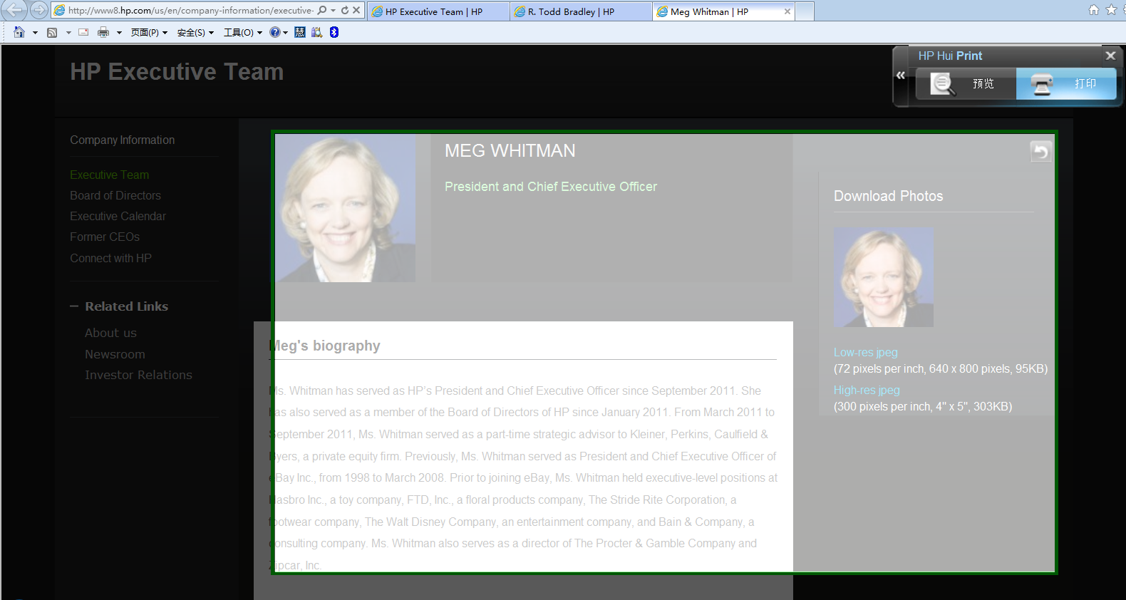
Motivating Application
Web page printing: HP Smart Print
First-round recommendation based on Web page analysis
Manually adjustment required
Not wanted !

Slide 10
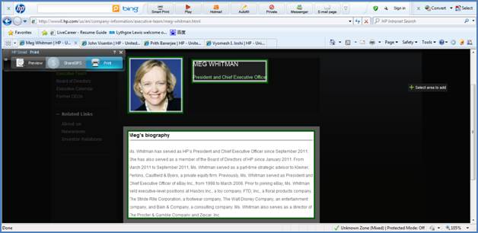
Motivating Application
Web page printing: Smart Print
Tedious selections

Slide 11
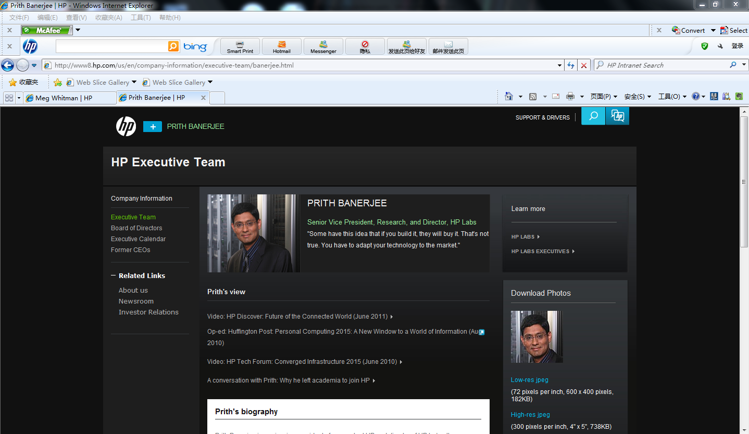
Motivating Application
Goal: one-click solution
More accurate print-area recommendation
Solution
Leverage the print logs from all the users
Print log
Current page

Slide 12
Motivating Application
One piece of print log
A selected print-area = a clip = an item
A piece of print log = a set of clips

Slide 13







Motivating Application
Print log database
Log No. | Clips
1 | B C E
2 | A B
3 | A B C
4 | A B D
5 | A B C D E F G
… | …
Print Log Database
Transaction Database

Slide 14
Motivating Application
Print-area recommendation: pattern mining problem
Given
The transaction database of print logs
A query Web page
Task
Identify all the candidate clips inside the query page, denoted by Q
Find a subset of Q for recommendation
Support
Occupancy

Slide 15
Motivating Application
Support
Transaction No. | Items
1 | B C E
2 | A B
3 | A B C
4 | A B D
5 | A B C D E F G
The more frequently a pattern appears in the database,
the more number of users select this set of clips for printing.

Slide 16
Motivating Application
Occupancy
Transaction No. | Items | Occupancy in this tran.
1 | B C E | 2/3
2 | A B
3 | A B C | 2/3
4 | A B D
5 | A B C D E F G | 2/7
The occupancy of {BC} =
The bigger the occupancy is,
the more complete the recommendation is.

Slide 17
Motivating Application
Mining top qualified pattern for recommendation

Slide 18
Challenges
The property of occupancy
Neither monotone nor anti-monotone
Transaction No. | Items
1 | A B C D E
2 | A B C
3 | A B C
4 | A B C
5 | A C D E F
occu(ABCD) =
< occu(ABC)
occu(ABCDE) =
> occu(ABC)

Slide 19
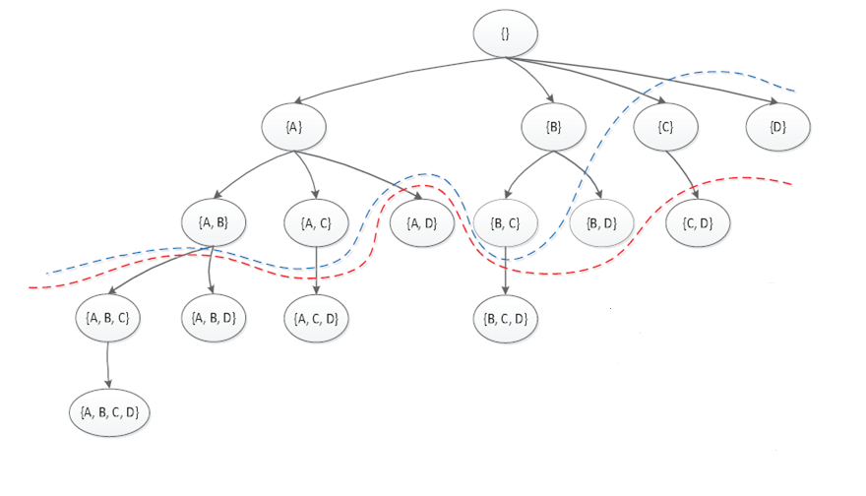
Solution
The quality upper bound
0.6
For a subtree we can give the upper bounds of the occupancy and quality values for all the nodes in this subtree.
Notes:
With the proposed occupancy measure we can inject them to further prune the search space. Specifically, we can give the upper bounds of quality for all the nodes in a subtree. In other words, the quality of any node in a given subtree will be no bigger than its upper bound. For example, for the subtree {C} we can efficiently calculate the quality upper bound for all the nodes in this subtree. Here, this upper bound is 0.6. It means that the quality values of all the nodes in this subtree, including node C and node CD, are less than 0.6.
The fast computation for this quality upper bound is omitted here. Just stop by our posters for the details.

Slide 20
Solution
0.8
The upper bound
0.6
Pruning the search process:
If the upper bound on quality is smaller than the current maximal quality value in the search process
Notes:
Then, this upper bound can be used to further prune the search space. Specifically, we can maintain the current biggest quality value in the search process. For example, when we reach the subtree {C} we know that the node {BC} is the current top qualified node with the quality value of 0.8. Then, if the upper bound on the node {C} is less than the 0.8, this subtree will be pruned too.
In this example, this upper bound is 0.6 for the subtree {C}. It is smaller than 0.8. Thus, we do not need to check the whole subtree of {C}. Thus, this subtree is pruned.
The blue line in this figure is the cut line for our problem. Clearly, it further reduces the search space.

Slide 21
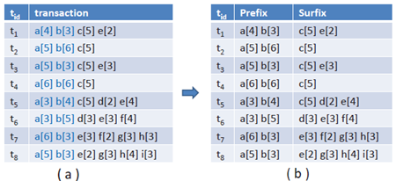
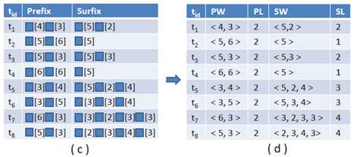
Upper Bound Estimation

Slide 22

Upper Bound Estimation
Assume that there is an itemset X’ in the subtree with the suffix length of u and the frequency of v
Then, for any itemset X’ in the subtree,

Slide 23
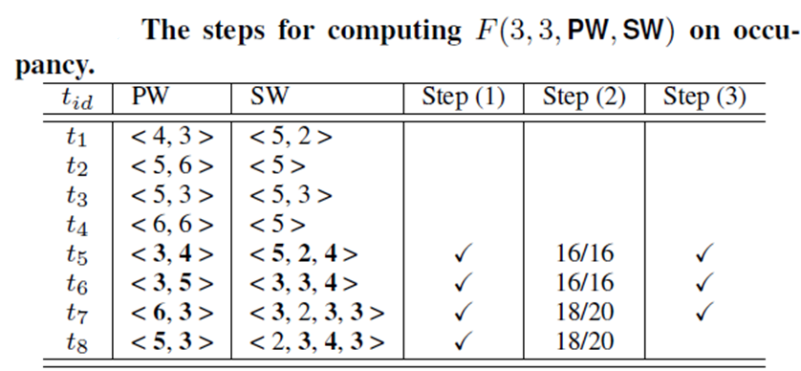
Upper Bound Estimation
Assume that there is an itemset in the subtree with the suffix length of 3 and the support of 3

Slide 24
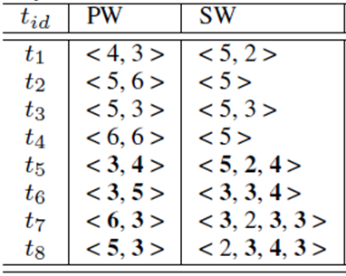
Upper Bound Estimation
Three different upper bound functions
Upper bound | Bound efficiency | Bound tightness | # of searched node
F | fast | loose | large
F^ | tradeoff | tradeoff | tradeoff
F’ | slow | tightest (theoretical proof) | small
Notes:
In this paper, we proposed three efficient functions for computing upper bounds, the first one is fast, but is very loose thus leading to large search space.
The third one is slow but is very tight thus leading to small search space. Actually the overall running time is proportional to number of searched node and inverse proportional to the bound efficiency. To improve the overall performance, we proposed the second function, which is the tradeoff between bound tightness and bound efficiency. Interested people can refer to our paper for more details.

Slide 25
Experiments
Effectiveness
Does the concept of occupancy help to improve the recommendation performance?
Efficiency
Does our algorithm with the proposed pruning strategy can significantly reduce running time?
Notes:
Next, we will evaluate the effectiveness and efficiency of the recommendation method.
We try to answer two questions: the first one is : Does the concept of occupancy help to improve the recommendation performance ?
The second one is : Does our algorithm with the pruning strategy can significantly reduce time complexity?

Slide 26
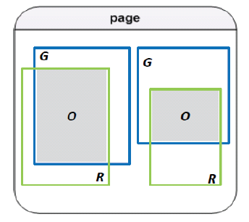
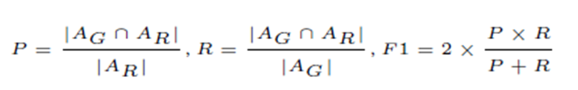
Experiments
Evaluation on effectiveness
Ground truth
2000 Webpages from 100 printworthy Websites
Evaluation method
Leave one out cross validation for each webpage
Evaluation measure
Notes:
First, we will show the effectiveness. To evaluate the recommendation quality we collected 2000 Web pages which are from the 100 Web sites. These Web sites are frequently printed by Internet users. On each page we manually labeled its ideal print areas as the ground truth. Then, we can compare the recommended print-areas with the ground truth, and then calculate the recommendation precision and recall.

Slide 27
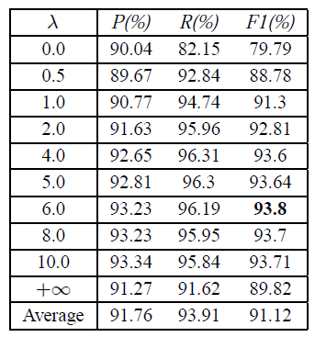
Experiments
Evaluation on effectiveness
support
occupancy
Frequency only
by 14%
increase
Best
frequency+
occupancy
decrease
The recommendation performance of our method (α=0.05 β=0.1)
Notes:
This table shows the results of our method with the increase of lamda from 0 to infinite. The average performance first increases and reach the best when lamda=6 and then the performance decreases with the increase of lamda. Lamda=0 means that we only consider the pattern frequency, in other word, we do not consider pattern occupancy and recommend the pattern with the highest frequency. here, the f1 score is 79%. We can see that incorporating occupancy into frequent pattern mining can greatly improve recommendation performance.

Slide 28
Experiments
Evaluation on efficiency
Problem setting
Size of transaction database
Notes:
Next we will show the efficiency of the proposed algorithm DOFIA over the large synthetic data. Here, the baseline method is to find all frequent itemsets first, compute the occupancy and quality for them, and then output top-k qualified ones. The implementation of MAFIA includes a fast algorithm for frequent pattern mining, which is adopted in this comparison.
Here we only present some results.

Slide 29
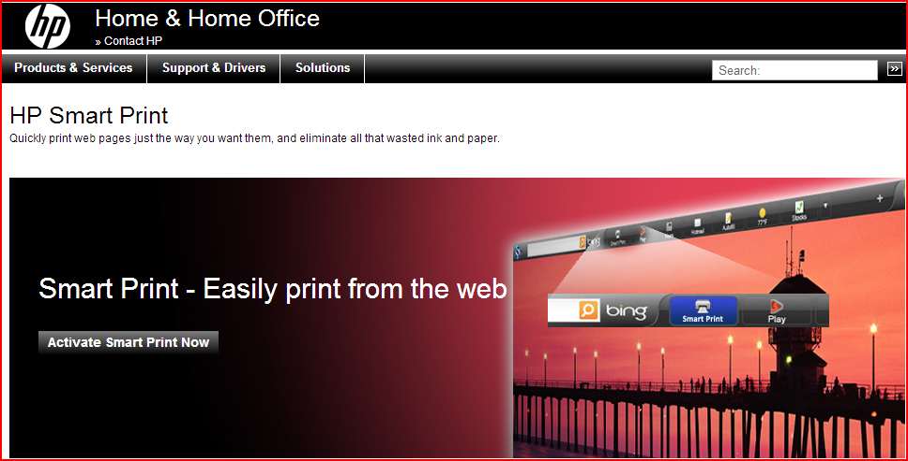
Business Impact
HP Product: Smart Print
More than one million downloads and usages
5 USA patents filed

Slide 30
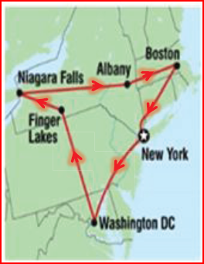
Other Applications
Occupancy for sequential pattern mining
Travel package recommendation

Slide 31
作业
设计一个Transaction Database
画出它的lexicographic subset tree
给定min_sup, min_occu的阈值，计算出在这些阈值下的frequent patterns, dominant patterns, maximal frequent patterns
要求：这个例子中，必须包含一个pattern，使得：
它是maximal frequent pattern，但它不是dominant pattern

Slide 32
随机点名五人
随机点名号码

