Slide 1


Advanced AI
课程
罗平
Autumn 2016

Slide 2
PROMINENT STREAK DISCOVERY
2-4

Slide 3
Prominent Streak Discovery in Sequence Data. Xiao Jiang, Chengkai Li, Ping Luo, Min Wang, Yong Yu. KDD 2011, pages 1280-1288.
Discovering General Prominent Streaks in Sequence Data. Gensheng Zhang, Xiao Jiang, Ping Luo, Min Wang, Chengkai Li. ACM TKDD, 8(2):article 9, June 2014.

Slide 4
Prominent Streaks
Prominent streaks stated in news articles:
  “This month the Chinese capital has experienced 10 days with a maximum temperature in around 35 degrees Celsius – the most for the month of July in a decade.”
  “The Nikkei 225 closed below 10000 for the 12th consecutive week, the longest such streak since June 2009.”
  “He (LeBron James) scored 35 or more points in nine consecutive games and joined Michael Jordan and Kobe Bryant as the only players since 1970 to accomplish the feat.”

Slide 5
Concepts
Streak
  Input: a sequence of values
  Streak <[l, r], v> is a triple: left-end ( l ), right-end ( r ), minimum value in interval [l,r]
  3 1 7 7 2 5 4 6 7 3
  <[6, 8], 4>
Streak dominance relation
  s1=<[l1, r1], v1> dominates s2=<[l2, r2], v2> iff
  r1 - l1 > r2 - l2, v1 >= v2 or r1 - l1 >= r2 - l2, v1 >v2
Prominent streaks (PS)
  A streak is prominent if it is not dominated by any other streaks.

Slide 6
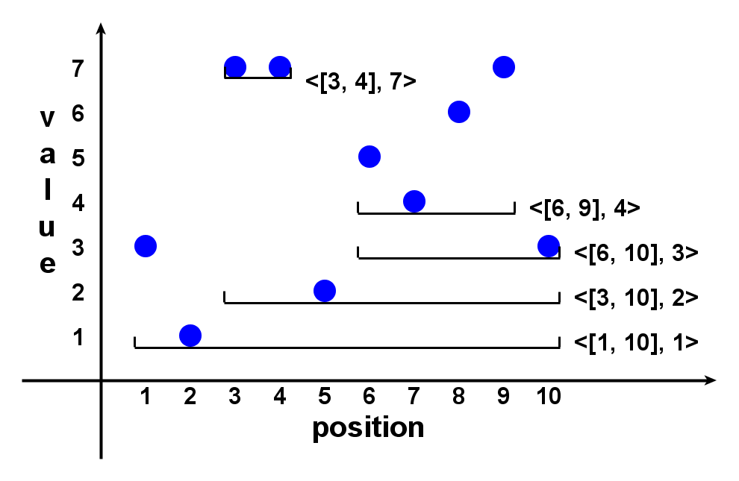
Example
  3 1 7 7 2 5 4 6 7 3

Slide 7
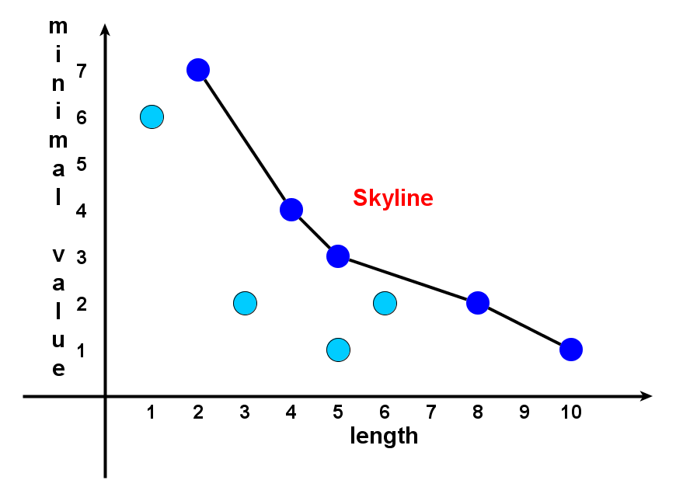
Prominent Streaks are Skyline Points in 2-d Space
  3 1 7 7 2 5 4 6 7 3

Slide 8
Tasks
Task 1: discovery
  Find all prominent streaks in a sequence
Task 2: monitoring
  Always keep prominent streaks up-to-date, when sequence grows (real-world sequences often grow)

Slide 9
Solution Framework
Data Value Sequence
  3 1 7 7 2 5 4 6 7 3
Candidate Generation Algorithms (brute-force, NLPS, LLPS)
Candidate Streaks
Skyline Operation [Börzsönyi et al. 2001]
(many algorithms)
Prominent Streaks

Slide 10
Candidate Generation:
Number Of Candidates
Brute-force
  Quadratic
NLPS
  Superlinear
LLPS
  Linear

Slide 11
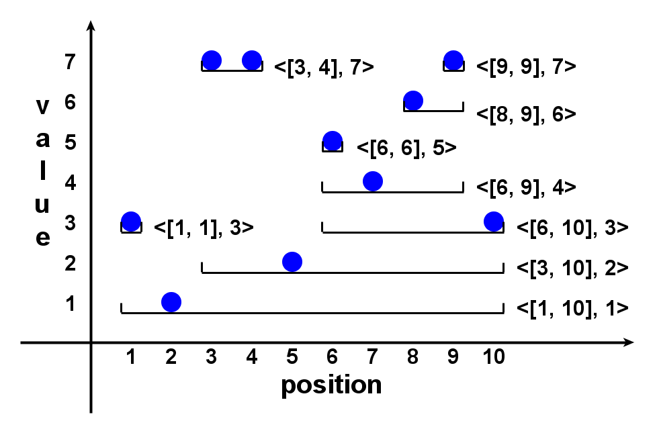
Local Prominent Streak
Local dominance relation
  s1=<[l1, r1], v1> locally dominates s2=<[l2, r2], v2> iff
  s1 dominates s2 and [l1, r1] ⊃ [l2, r2]
Local prominent streak (LPS)
  A streak is locally prominent if it is not locally dominated by any other streaks.

Slide 12
Important Properties
(1) LPS is sufficient
  A prominent streak must be an LPS.
(2) LPS is small
  The number of LPSs is less than or equal to the sequence length.
  (Hint: The number of LPSs getting min value at position k is at most 1.)
Conclusion
  LPS is an excellent set of candidate streaks, of linear size.
  Candidate generation problem => finding local prominent streaks

Slide 13
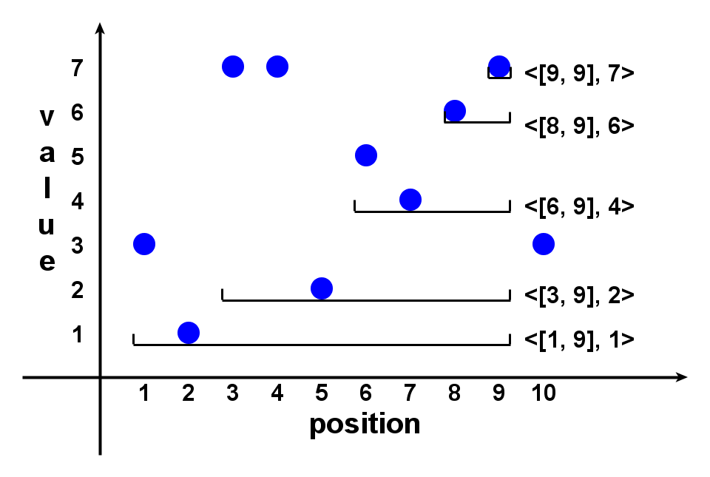
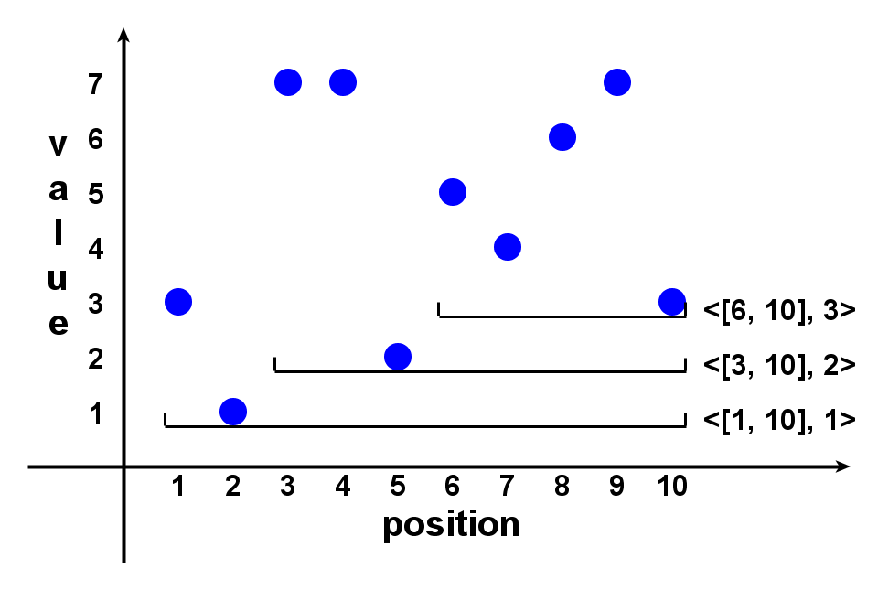
Linear LPS (LLPS) Method
  Sequence p₁, p₂, …, p_{n}.
  1. Maintain a list of candidate streaks when scanning the sequence rightward.
  2. After p_{k} , right-ends of candidates are all k.
  3. At p_{k+1} , try to extend the candidates rightward.
  Candidates s:
  (3.a) s.v < p_{k+1} : extend.
  (3.b) s.v > p_{k+1} : belong to LPS.
  (3.c) s.v >= p_{k+1} : extend the leftmost (longest) such s.
  4. After p_{n} all remaining candidates are LPS.

Slide 14
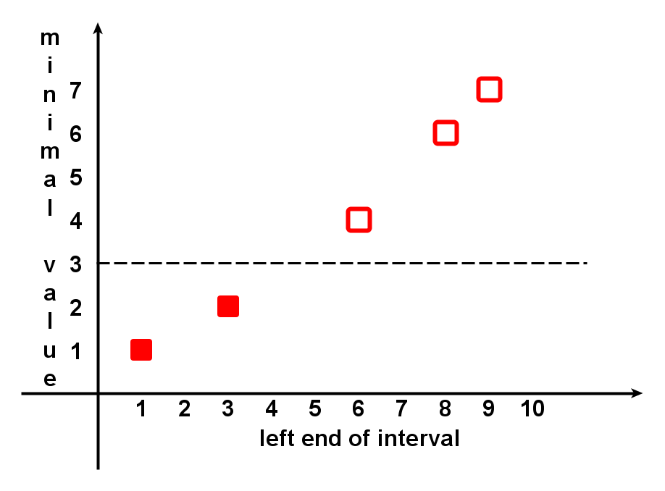
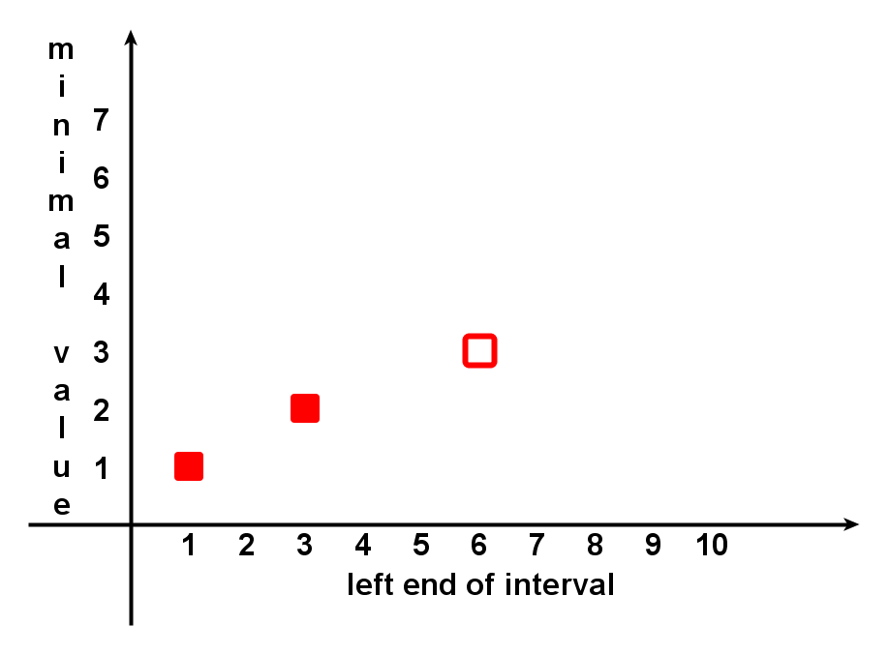
Linear LPS (LLPS) Method
  Candidates share the same right-end, their minimum values monotonically increase, if they are listed in the increasing order of left-ends.

Slide 15
Linear LPS (LLPS) Method
  After p_{k} , it has found:
  All LPSs ending before k
  Candidates ending at k either are LPSs or can be grown to LPSs ending after k.
  Monitoring (keeping prominent streaks up-to-date) is simple:
  If PSs till k are requested, compare all found LPSs and all remaining candidates.

Slide 16
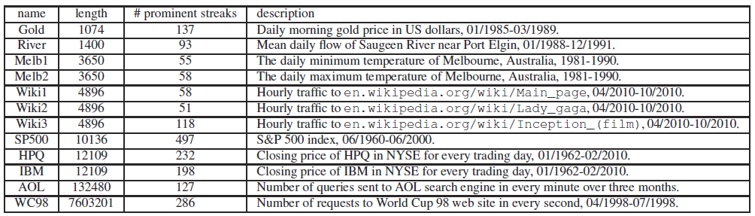
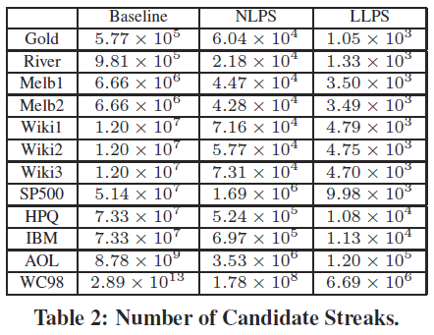
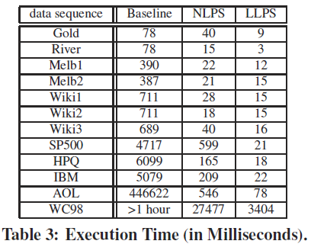
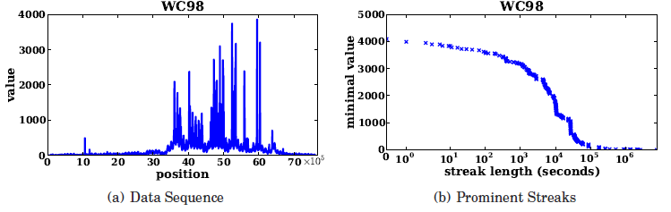
Datasets In Experiments

Slide 17


Sample Prominent Streaks
Melbourne daily min/max temperature between 1981 and 1990 (Melb1 & Melb2)
  More than 2000 days with min temperature above zero
  6 days: the longest streak above 35 degrees Celsius
Traffic count of Wikipedia page of Lady Gaga (Wiki2)
  More than half of the prominent streaks are around Sep. 12th (VMA 2010)
  at least 2000 hourly visits lasting for almost 4 days

Slide 18
General Prominent Streaks
Top-k, multi-dimensional and multi-sequence PS
  “He (LeBron James) scored 35 or more points in nine consecutive games and joined Michael Jordan and Kobe Bryant as the only players since 1970 to accomplish the feat.”
  “Only player in NBA history to average at least 20 points, 10 rebounds and 5 assists
  per game for 6 consecutive seasons.” (http://en.wikipedia.org/wiki/Kevin Garnett)
NLPS/LLPS extended to such general PSs

Slide 19
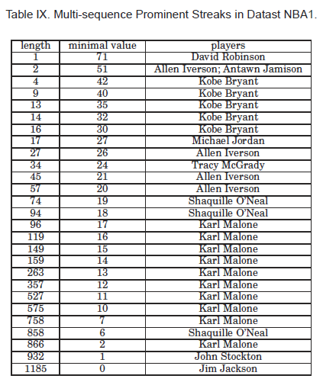
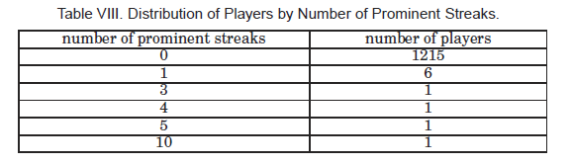
Experiments On Multi-Sequence PSs

Slide 20
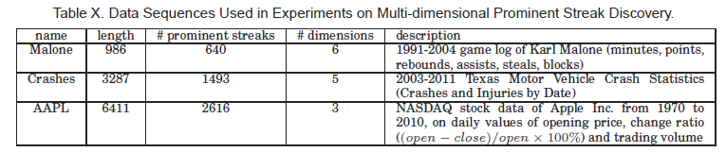
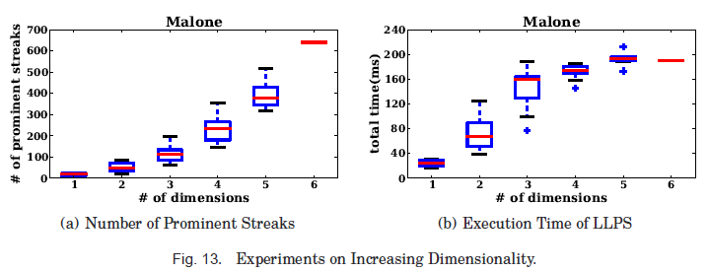
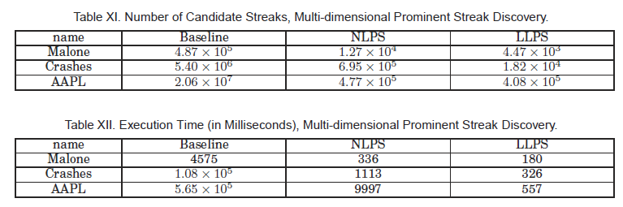
Experiments On Multi-Dim PSs

Slide 21
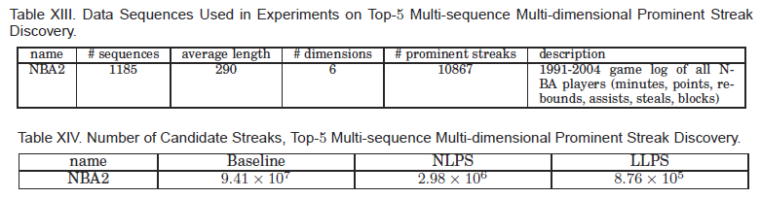
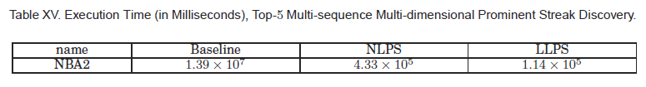
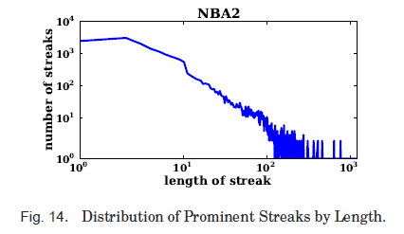
Experiments On General PSs

