Slide 1
SiGMA: Learning under Graph-Level Heterogeneity
with Gated Message-Passing and Attention
Raphael Pellegrin — 11/06/2026 — Harvard GeoML group meeting

Slide 2
Punchline
Within one dataset, different graphs need different computation.
Standard GNNs still apply a fixed template to every graph.
SiGMA keeps MP heads and attention heads in parallel.
Sigmoid gates let each graph emphasize, downweight, or skip heads — and even skip layers.

Slide 3
Background: node-level heterogeneity
Most heterogeneity work is node-level (homophily / heterophily).
Methods redesign aggregation for heterophilic nodes.
Literature rarely asks: across a collection of graphs, do whole graphs prefer different operators or depths?
Node-level heterophily: who to aggregate from.
Graph-level heterogeneity: which computational recipe a whole graph needs.

Slide 4
Graph-level heterogeneity
Some graphs are consistently easy; others are consistently hard.
Difficulty is model-dependent (hard for GCN can be easier for GIN).
Datasets look homogeneous at the task level, but architectures use one fixed template.
Claim: heterogeneity is an interaction between input and architecture — route per graph.

Slide 5
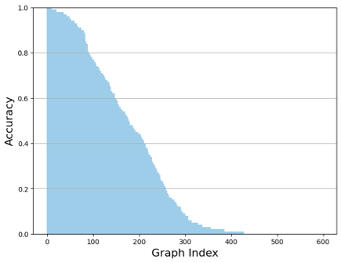
Heterogeneity profiles — ENZYMES (GAT)

Slide 6
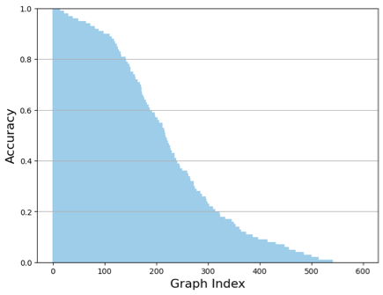
Heterogeneity profiles — ENZYMES (GIN)

Slide 7
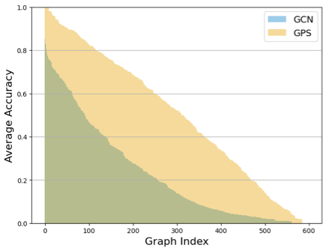
Heterogeneity profiles — ENZYMES (GCN / GPS)

Slide 8
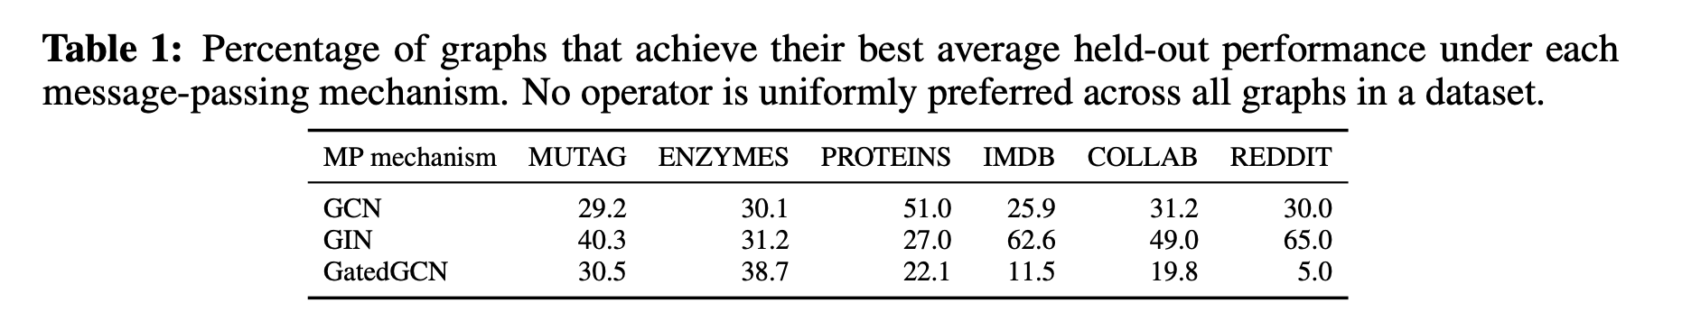
Preference of MPGNN operator
Compare GCN / GIN / GatedGCN under the same protocol.
No operator dominates every graph in a dataset.
“Best MP for this dataset” is really the best average MP.
A hybrid with multiple MP heads is a natural response.

Slide 9
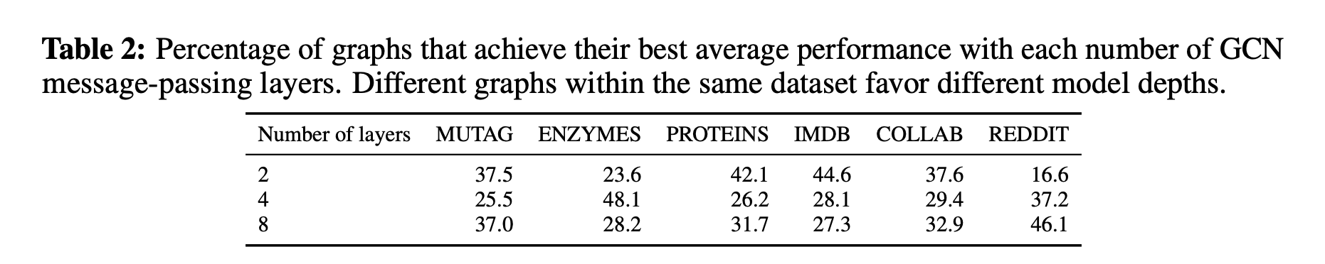
Preference of depth
Not all graphs want the same number of MP layers.
Depth preferences are spread, not concentrated.
Picking one global depth is a compromise.
We want models that can use or skip layers.

Slide 10
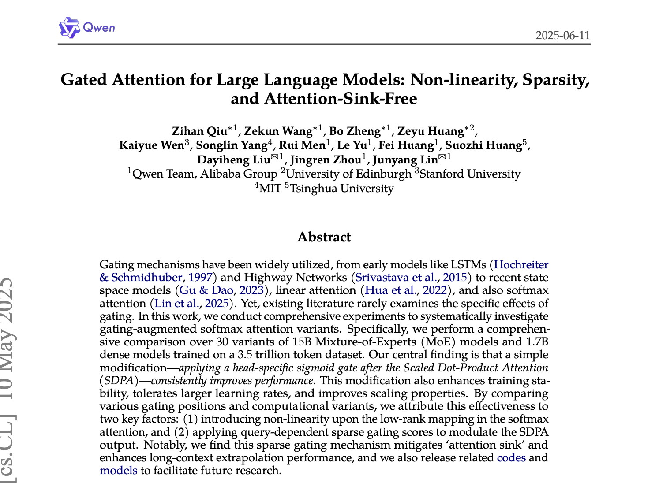
Inspiration: gated attention
Extra capacity without control can waste compute and hurt optimization.
Sigmoid gates let a block contribute continuously between 0 and 1.
Without gates, every head is always on and can interfere.
With gates, a graph can open needed heads and approximately skip layers.

Slide 11
Background: GraphGPS
Hybrid layer = local MP + global attention.
GPS does not run multiple heterogeneous MP operators in parallel.
GPS lacks explicit per-head sigmoid gates.
SiGMA keeps the local+global idea, then generalizes with gated heads.

Slide 12
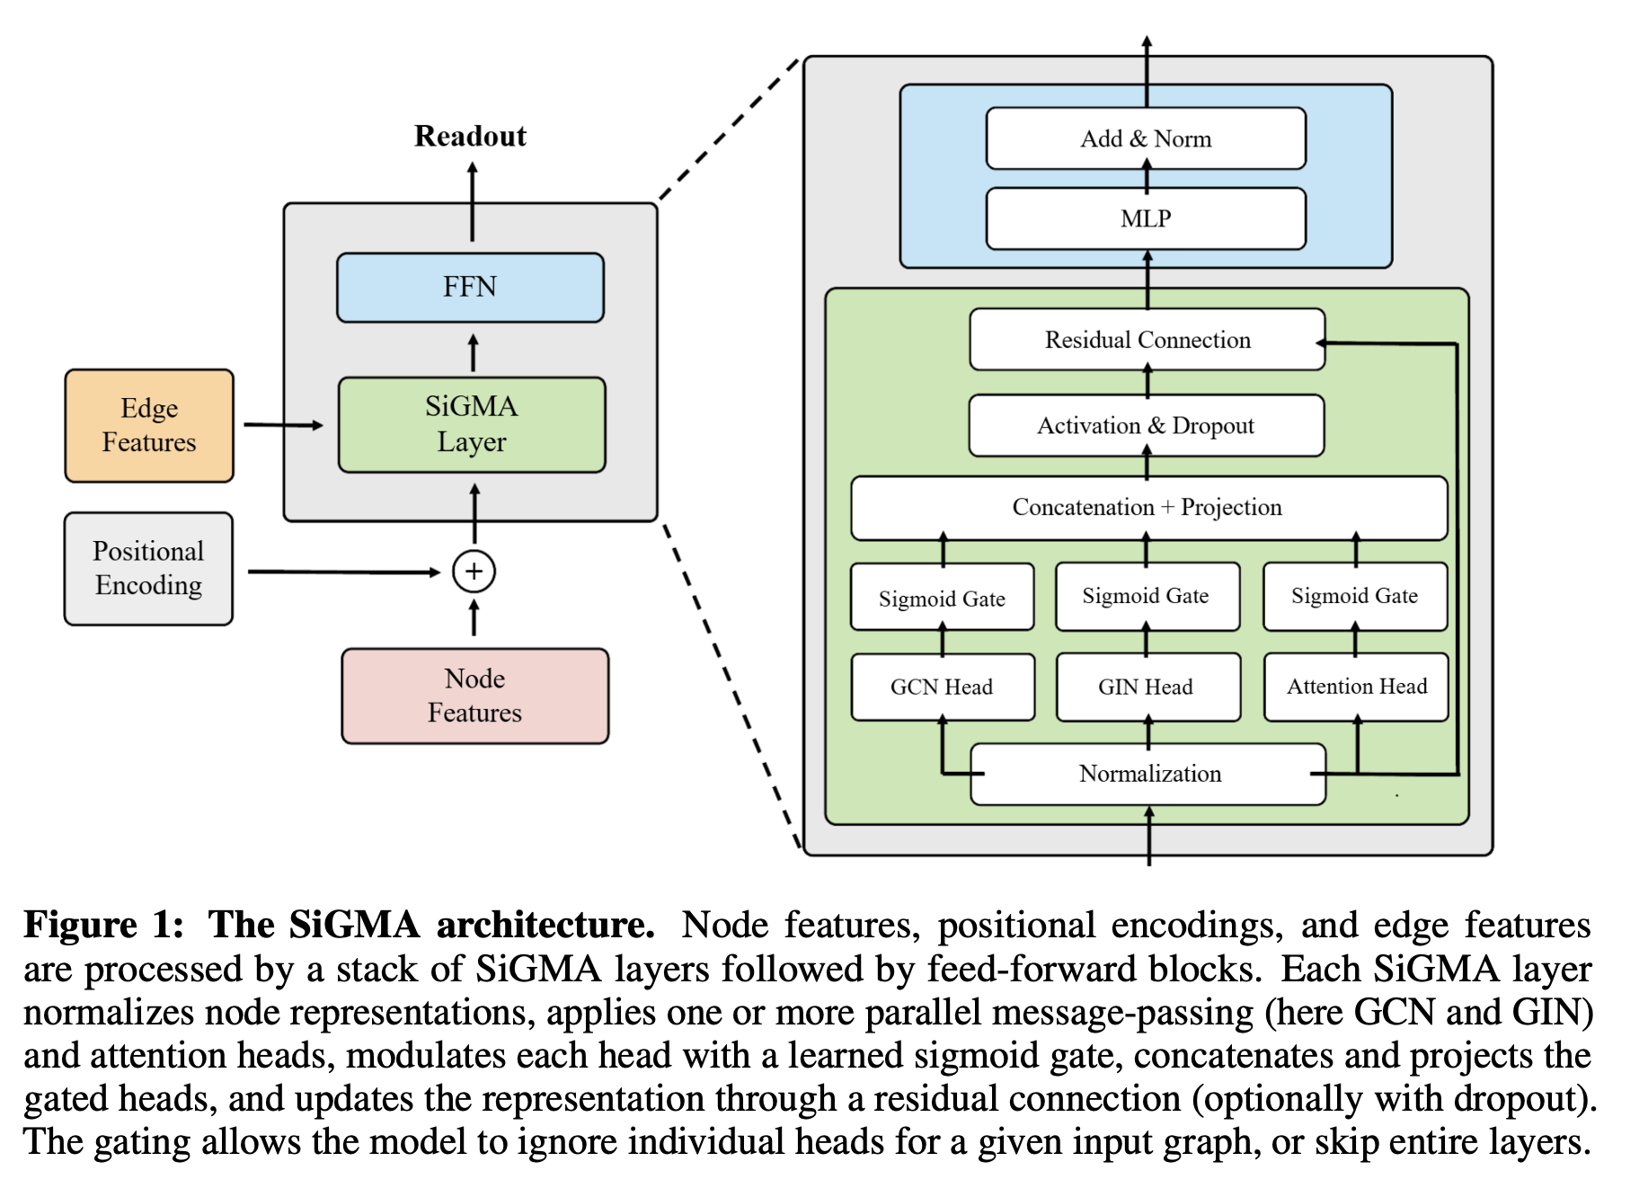
SiGMA architecture
Sigmoid Gated Message-Passing and Attention

Slide 13
SiGMA design principle
Per layer: attention heads (global) + MP heads (local; e.g. GCN + GIN).
Each head produces an update and a gate logit.
Head output is multiplied by σ(gate).
Concatenate gated heads → project → residual → FFN.
Multiple operators address operator preference; gates + residual give soft depth.

Slide 14
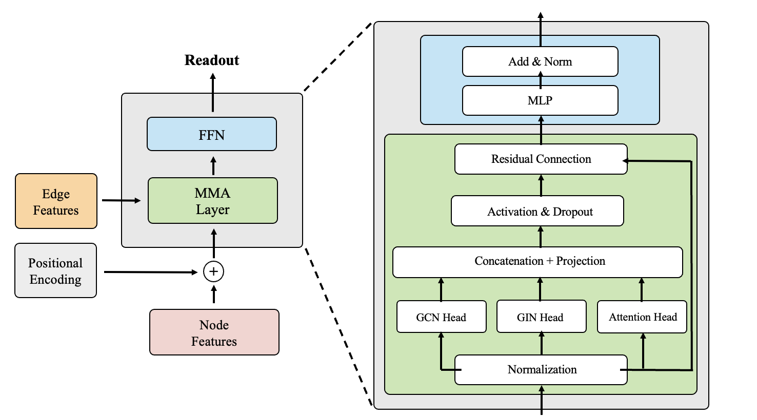
MMA: same hybrid without gating
MMA = Mixture of Message-Passing and Attention (ungated)

Slide 15
Synthetic operator routing
Rooted star graphs; label rule chosen by type τ at the root.
τ=0 favors degree-normalized (GCN-like) sums; τ=1 favors unnormalized (GIN-like) sums.
Opposite-sign pairs force graph-specific routing.
Success: high accuracy on both types, and gates that open the matching head.

Slide 16
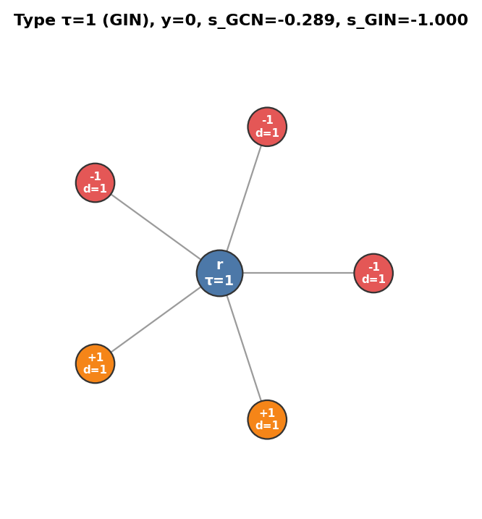
Example graphs in the synthetic experiment

Slide 17
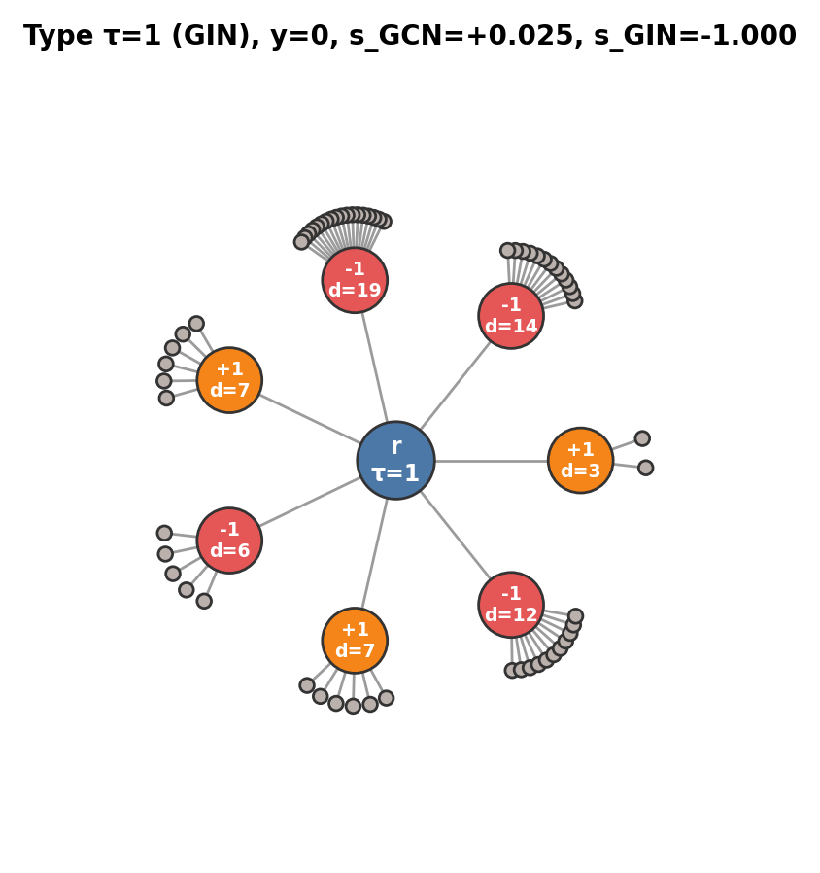
Example graphs in the synthetic experiment

Slide 18
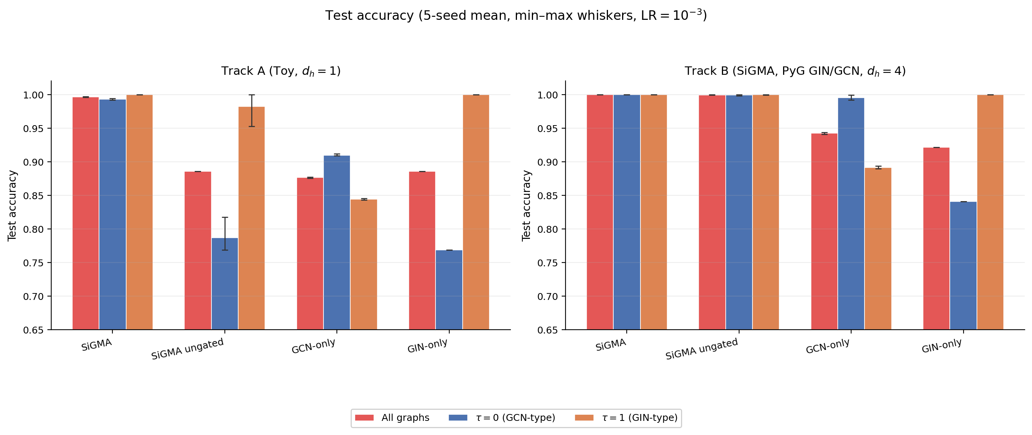
SiGMA can route to the right operator

Slide 19
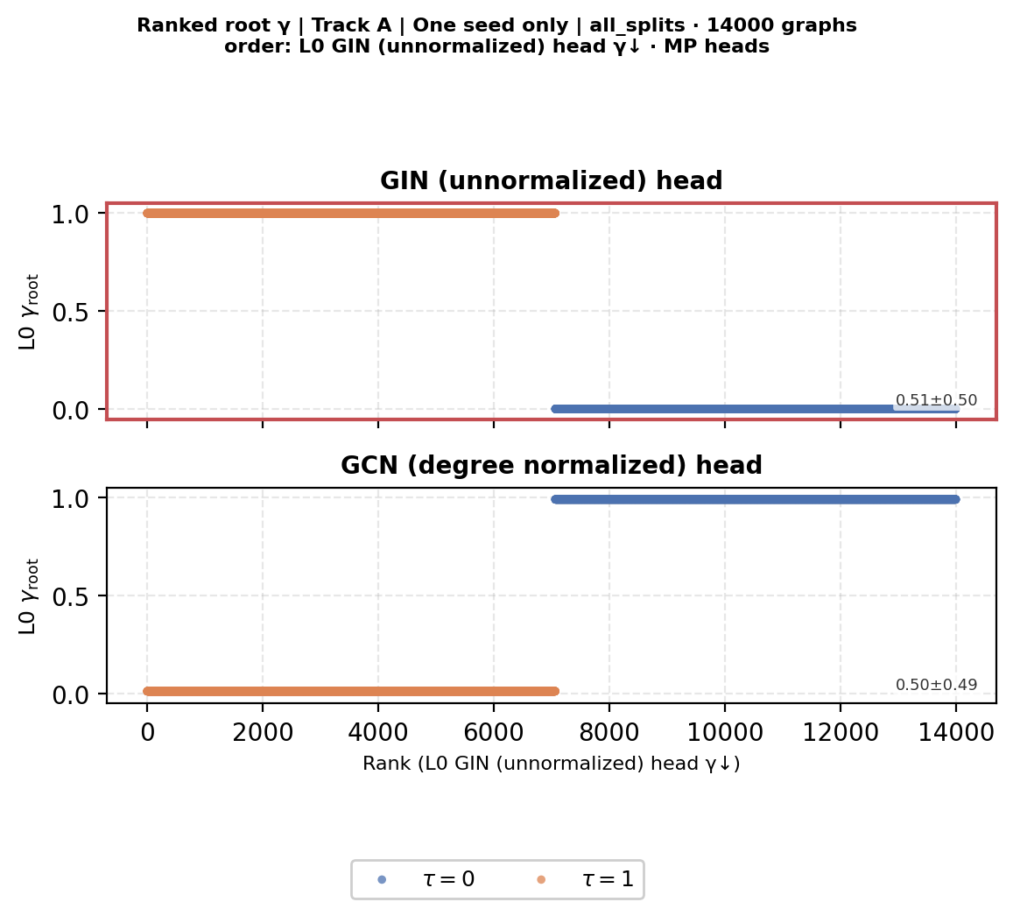
Gates align with generative type

Slide 20
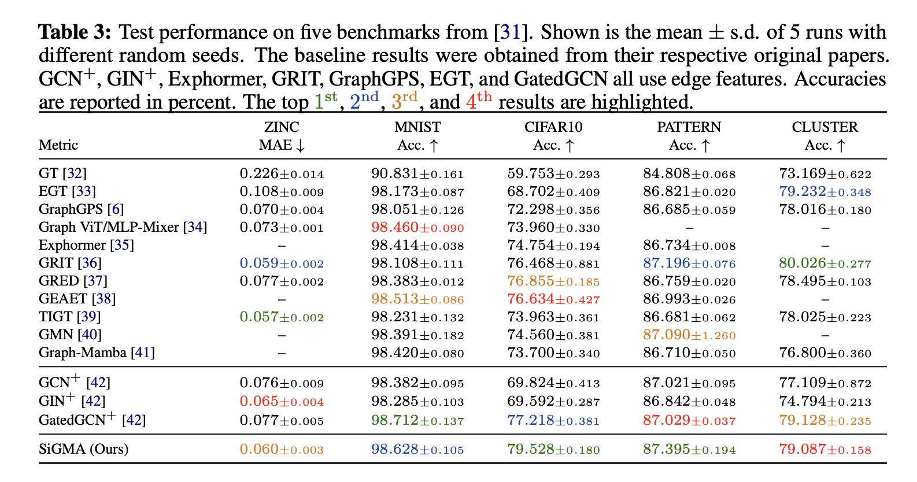
Experiments: real datasets
Benchmarks from Dwivedi / LRGB families.
ZINC, MNIST, CIFAR10, PATTERN, CLUSTER, Peptides, VOC-SP, COCO-SP, …
Competitive / strong gains, especially CIFAR10 and PATTERN.

Slide 21
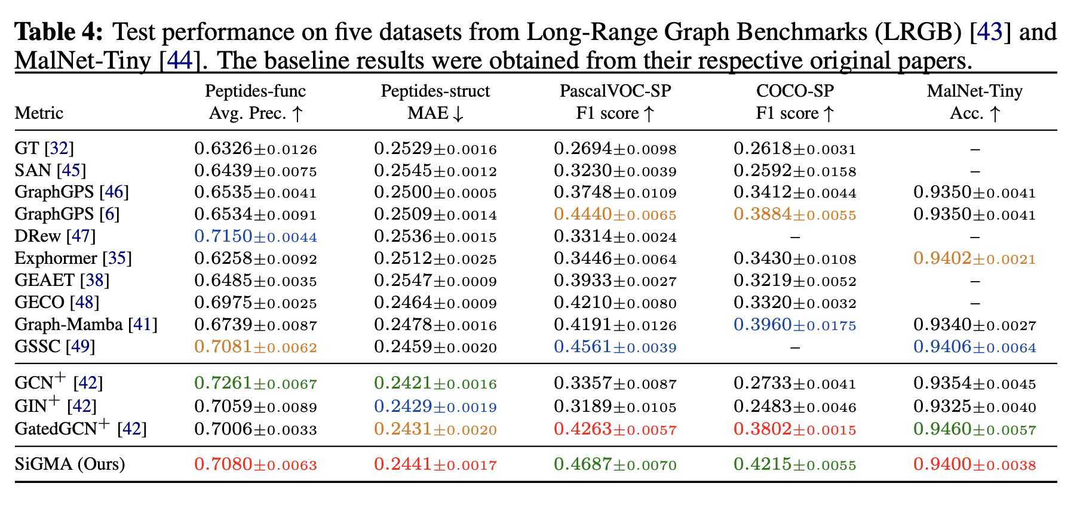
Real-dataset results

Slide 22
Theory
Prop. 1: SiGMA is at least as expressive as its strongest MP component.
Prop. 2: gated residuals allow near-identity layers — no forced oversmoothing from depth alone.
Depth preference across graphs is real; gating gives selective depth use.

Slide 23
Takeaways
Graph-level heterogeneity is real: graphs disagree on depth and MP operator.
Fixed templates are a dataset-level compromise.
SiGMA: GPS-style hybrid + multiple heads + sigmoid gates.
Synthetic routing shows gates track operator need.
Recipe: strong GNN baselines → multiple operators → attention → gate them.
Code: https://github.com/Weber-GeoML/SiGMA

Slide 24
Thank you
Questions?

Slide 25
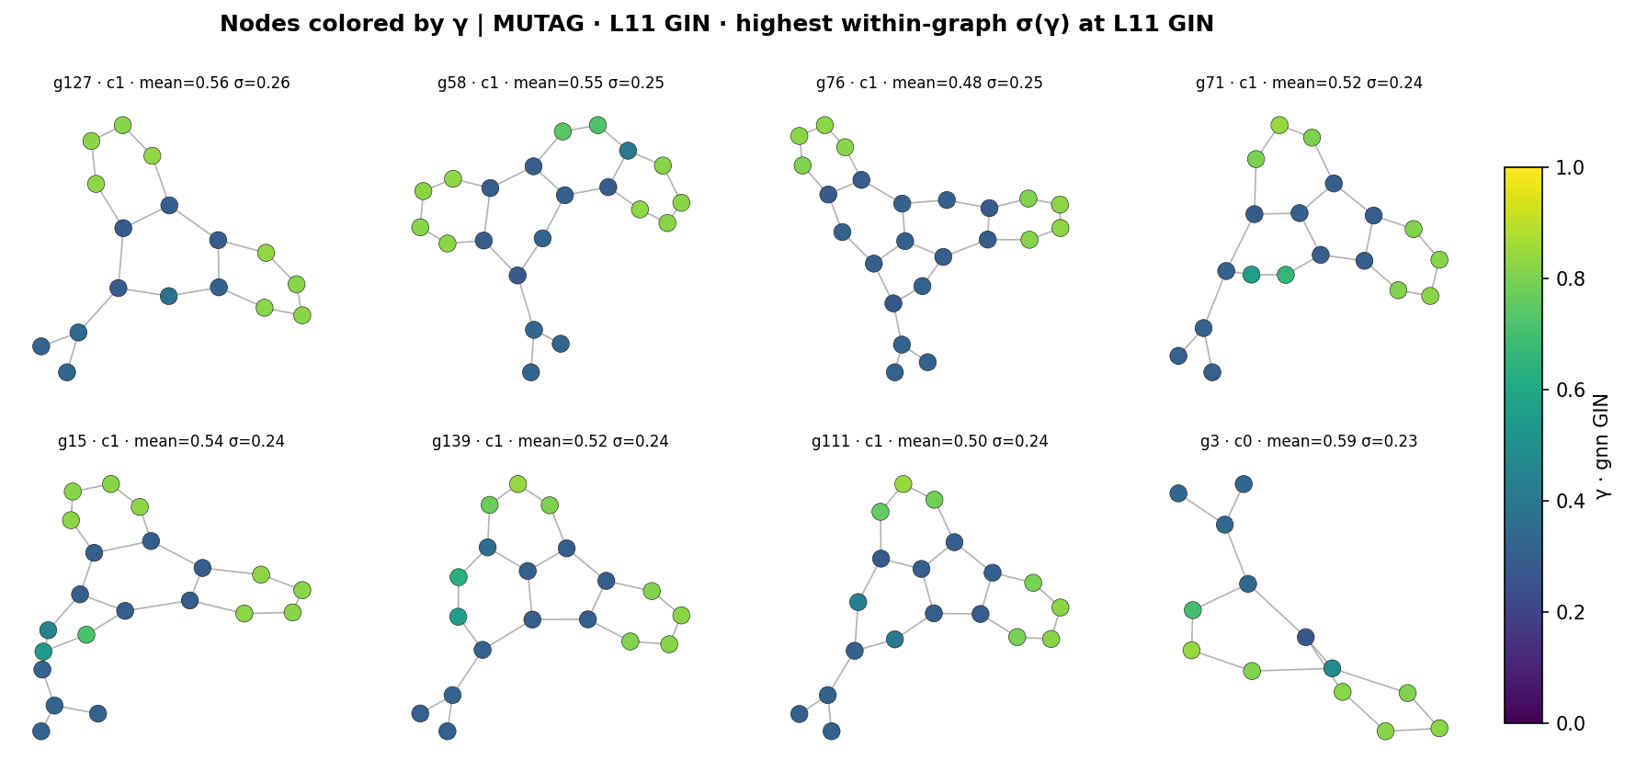
Appendix: gate values are per-node

Slide 26
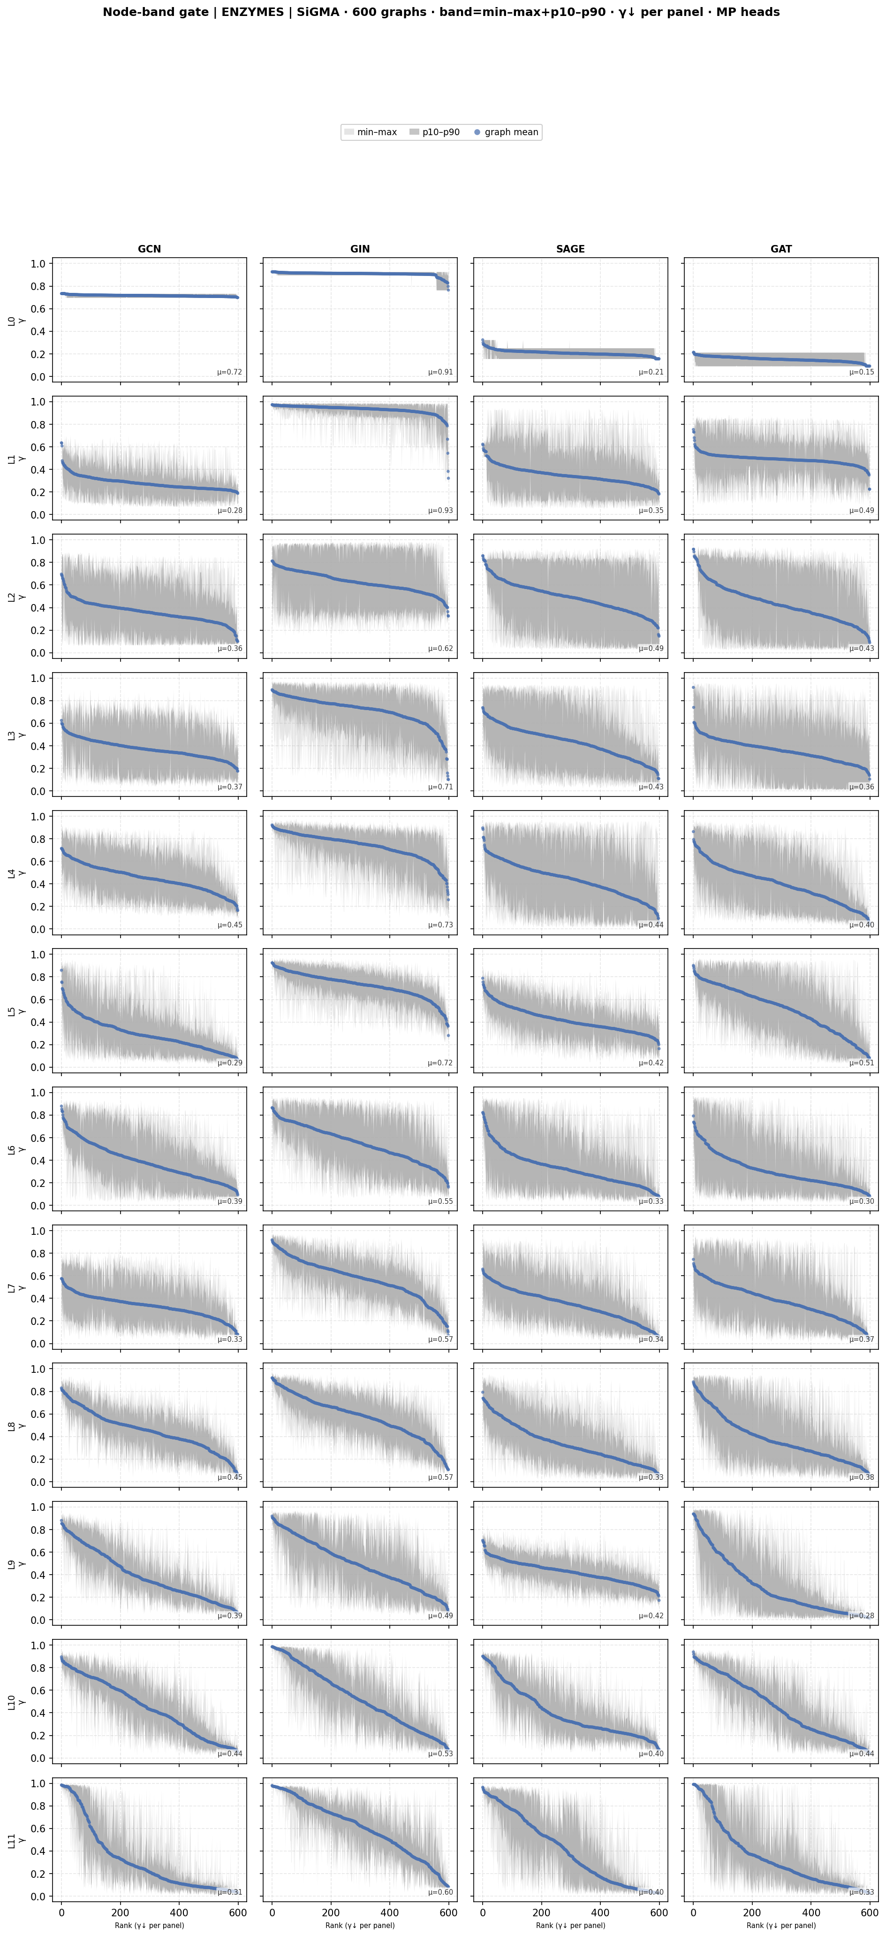
Appendix: gates — ENZYMES

Slide 27
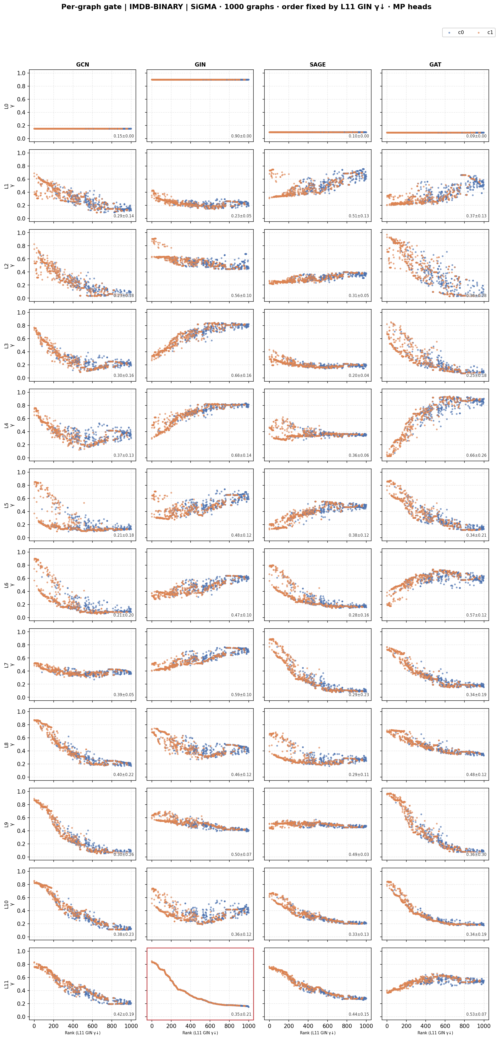
Appendix: gates — IMDB

Slide 28
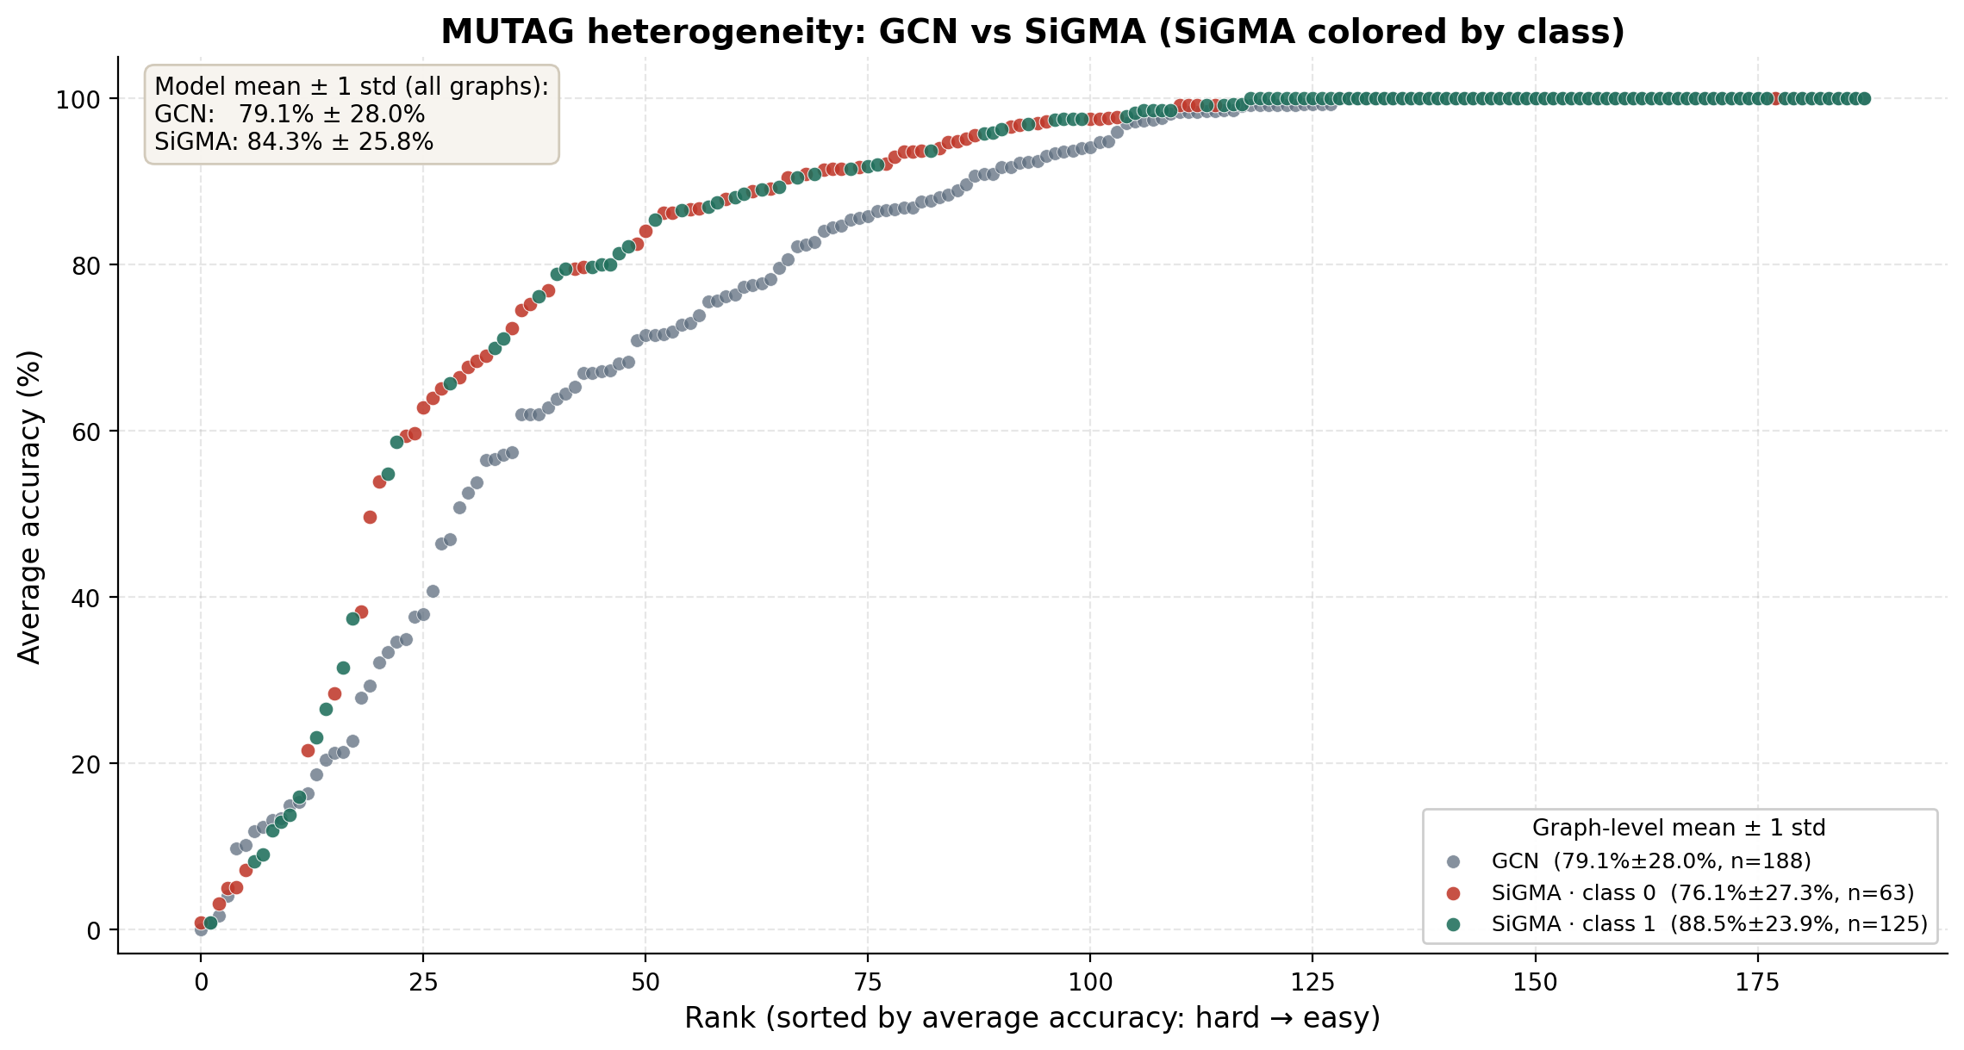
Appendix: heterogeneity profiles (MUTAG)

