Slide 1
Motors and Generators

Slide 2
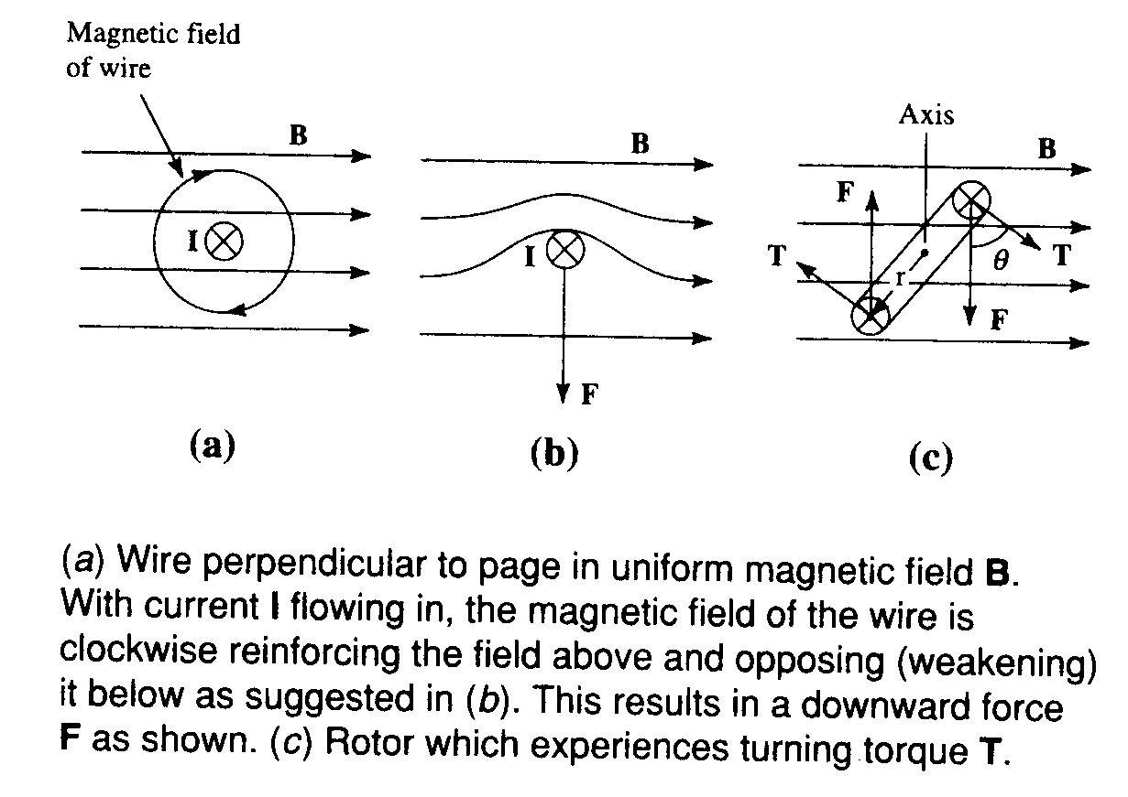






Lorentz Force (Motor Equation)
Adds up
subtracts
Wire $⊥$ page in uniform B
Lorentz’s $Force$
Exerts a downward force
$$F=\left(I×B\right)L (N)$$
$$I=current in Amps$$
$$B=magentic flux density, T$$
$$Fmax=IBL (N)$$
$$L=length of wire into the page (m)$$

Slide 3
In a motor, two conductors (of coil) are mounted on a rotor with axis. The rotor experiences a total turning torque
1
1
Rotor Experiencing a Torque
Relationship between force F, torque τ, linear momentum p, and angular momentum L in a system which has rotation constrained to only one plane (https://en.wikipedia.org/wiki/Torque)

Slide 4
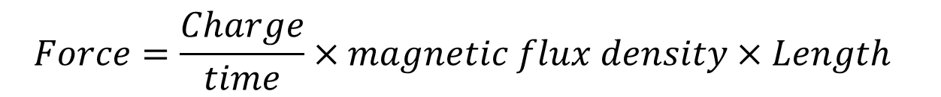
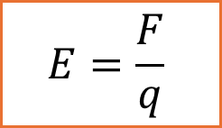
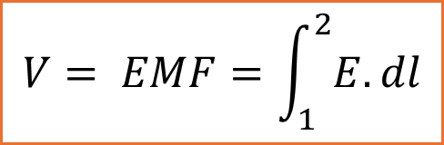
Motor and Generator Equations
Motor equation
$$Force=currrent×magnetic flux density×Length$$
$$Force=\frac{Charge}{time}×magnetic flux density×Length$$
$$\frac{Force}{Charge}×Distance =\frac{Distance}{time}×magnetic flux density×Length$$
$$E=\frac{F}{q}$$
$$V= EMF=\int_{1}^{2}{E.dl}$$
Generator equation
$$EMF= Electric field×Distance =velocity×magnetic flux density×Length$$

Slide 5
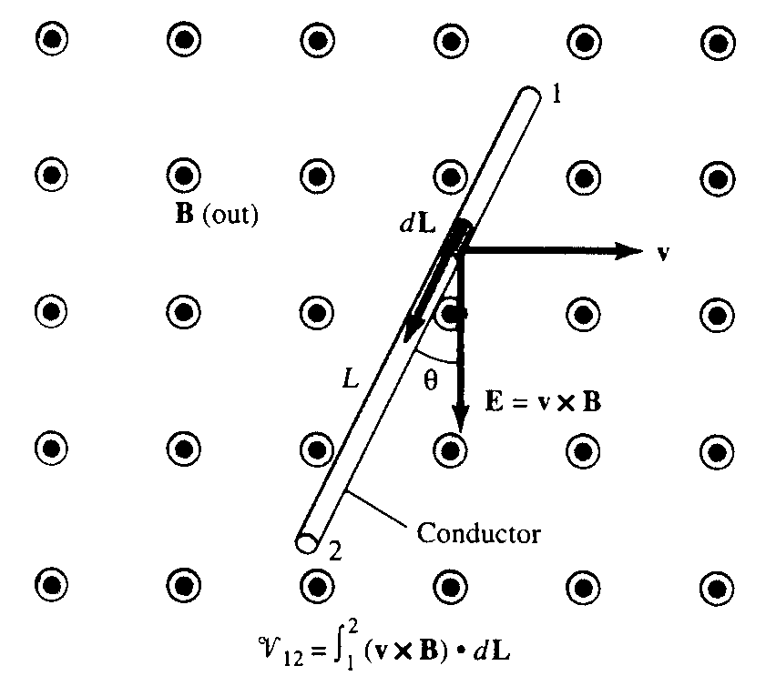
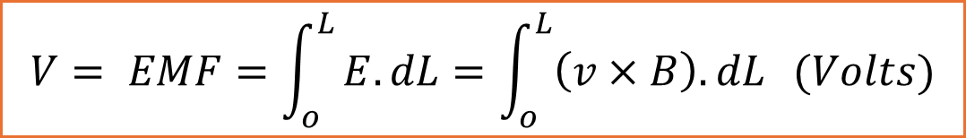


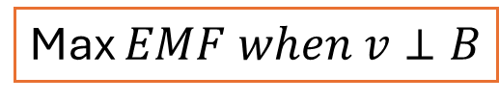



Induced EMF on moving conductor
$$V= EMF=\int_{o}^{L}{E.dL=\int_{o}^{L}{\left(v×B\right).dL} (Volts)}$$
Generator equation
$$V=EMF between points 1 and 2 on conductor$$
$$I=current in Amps$$
$$B=magentic flux density (T)$$
A conductor moving to right with velocity v across a uniform magnetic field B generates an EMF over infinitesimal length dL as
$$L=length of conductor (m)$$
Max $EMF when v⊥B$
$$EMF=vBLcosθ$$
$$dV=\left(v×B\right).dL$$
Thus, a moving conductor through a magnetic flux density B with velocity v produces an electric field E along the conductor. Integrating E over the length L gives the total induced EMF
$$dV=E.dL$$

Slide 6



Example: Generator voltage: Given that L = 0.4m, velocity = 3 m/s, and B = 2 milliTesla, and $θ=20o. Find EMF, V$
Solution:
Solution:
Max $EMF when v⊥B$
$$V=vBLcosθ$$
$$V=3×2×0.940×0.4 mV$$
$$V=2.26 mV$$

Slide 7
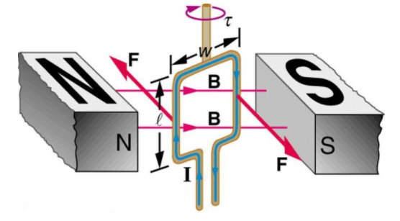
Torque on a current loop in a Magnetic Field
Torque is clockwise as viewed from top side
Uniform Magnetic flux density B across North and south poles
Current carrying coil having uniform current I and area A= lw

Slide 8
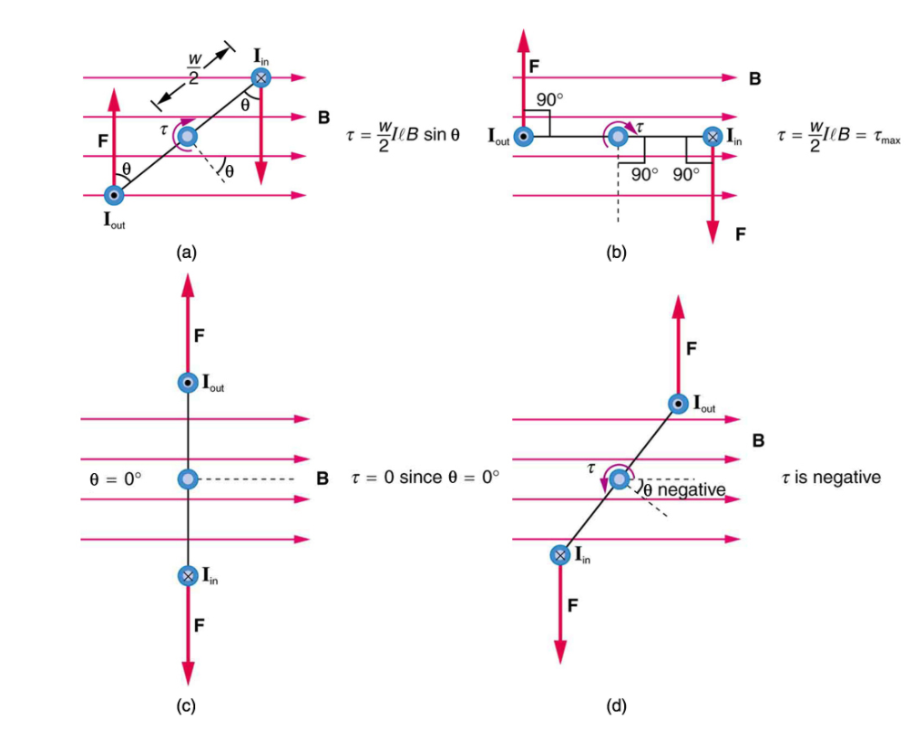
Loop at different rotation angels as viewed from top
general
Max torque
0 torque
Negative torque

Slide 9


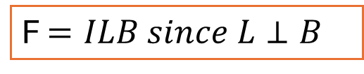


Torque is clockwise as viewed from top side
$$Total Torque τ$$
$$τ=0.5wFsinθ+0.5wFsinθ$$
F $=ILB since L⊥B$
Perpendicular to the loop makes an angle $θ$ with the field that is the same as angle between lever w/2 and F
For N turns:
Forces on the top and bottom segments are vertical and, therefore, parallel to the shaft, producing no torque
$$τ=NIABsinθ$$
Each vertical segment has a length L that is perpendicular to B

Slide 10

Find the maximum torque on a 100-turn square loop of a wire of 10.0 cm on a side that carries 15.0 A of current in a 2.00-T field.
Solution:
Torque on the loop can be found using
Maximum torque occurs when θ = 90º and sin θ = 1.
$$τ=NIABsinθ$$
For sin θ = 1, the maximum torque is
Entering known values yields
τmax= (100)(15.0 A)(0.100 m2)(2.00 T) = 30.0 N⋅m
Sufficient to be used in motors.

Slide 11
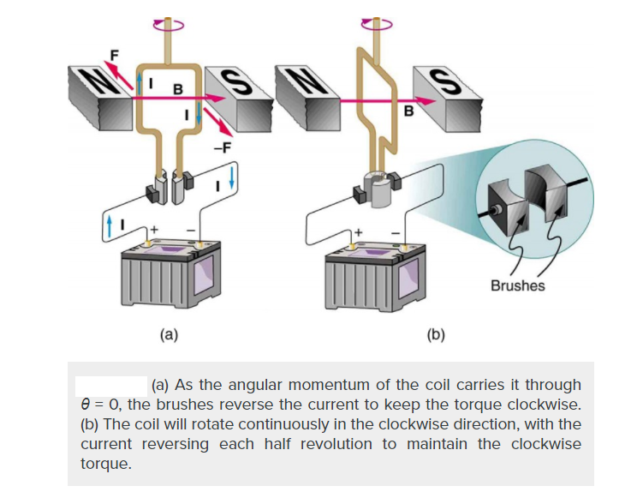
The torque found in the preceding example is the maximum. As the coil rotates, the torque decreases to zero at θ=0. The torque then reverses its direction once the coil rotates past θ=0. This means that, unless we do something, the coil will oscillate back and forth about equilibrium at θ=0
As the angular momentum of the coil carries it through the zero-torque point, the brushes reverse the current direction to keep the torque clockwise. In the right figure coil will rotate continuously in the clockwise direction reversing every half-cycle to maintain clockwise torque

