Slide 1
Waveguides

Slide 2
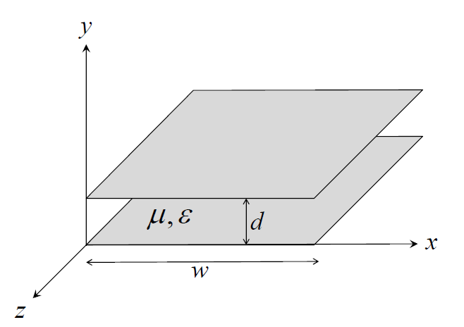
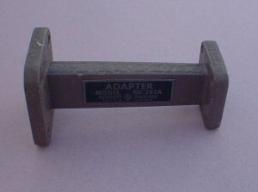
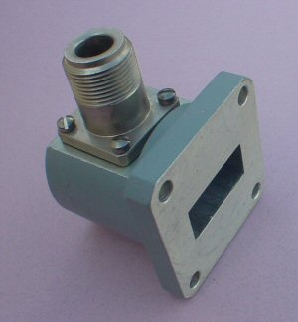
Waveguides
A waveguide is a structure that guides waves with minimal loss of energy by restricting the transmission of energy to one direction.
Rectangular waveguides are one of the earliest type of the transmission lines. They are used in many applications. A lot of components such as isolators, detectors, attenuators, couplers and slotted lines are available for various standard waveguide bands between 1 GHz to above 220 GHz.
Rectangular waveguide
Waveguide to coax adapter
Parallel Plate Waveguides

Slide 3
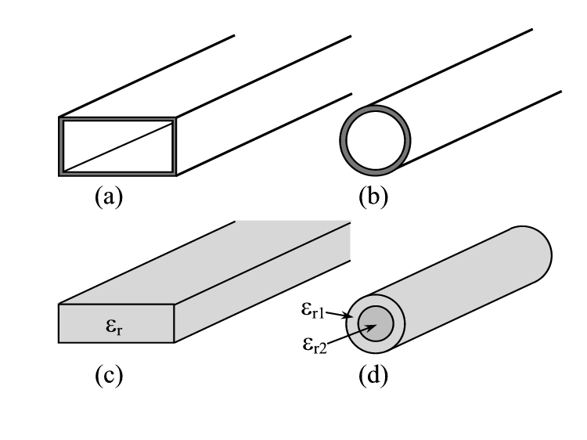
Waveguides
In electromagnetic wave propagation, the propagation is via the transverse electromagnetic (TEM) mode, meaning both the electric and magnetic field components were transverse, or perpendicular, to the direction of propagation.
Here, we investigate wave-guiding structures that support propagation in non-TEM modes, namely in the transverse electric (TE) and transverse magnetic (TM) modes.
In general, the term waveguide refers to constructs that only support non-TEM mode propagation. Such constructs share an important trait: they are unable to support wave propagation below a certain frequency, termed the cutoff frequency.
In that sense parallel plate waveguides are exception as they do allow propagation of TEM modes.
Rectangular Metallic Waveguide
Circular Metallic Waveguide
Dielectric Waveguide
Optical Fiber

Slide 4
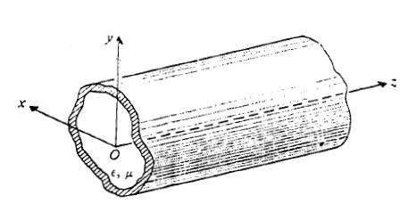
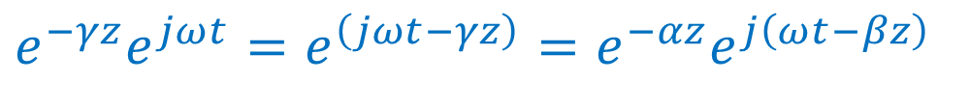
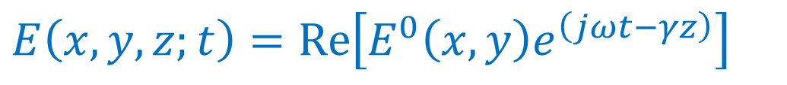
Wave Propagation along Uniform Guiding structures:
Conductor
Propagation along z
Dielectric filled or hollow
Cross-section
Uniform Waveguide with arbitrary section
Assuming wave propagate in + z direction
$$e^{−γz}e^{jωt}=e^{\left(jωt−γz\right)}=e^{−αz}e^{j\left(ωt−βz\right)}$$
$$E\left(x,y,z;t\right)=\operatorname{Re}\left[E^{0}\left(x,y\right)e^{\left(jωt−γz\right)}\right]$$
When working with phasors we can drop the time and z-dependence as shown in exponential variation. We can simply replace partial differentials with z and t by multiplying with -𝛾 and $jω$
E⁰(x , y) is two-dimensional vector phasor that depends only on cross-sectional coordinates
We can write H (x, y, z, t) in a similar manner

Slide 5
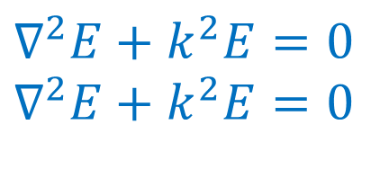

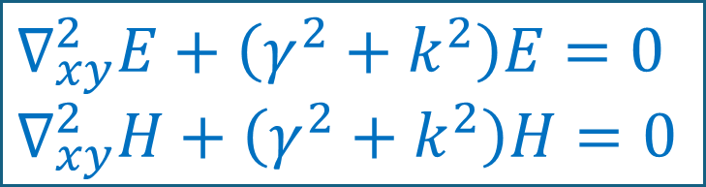
Consider a straight waveguide in form of a dielectric filled metal tube having an arbitrary cross-section
We can write the homogenous vector Helmholtz’s equations as follows:
For charge free region:
$$∇^{2}E+k^{2}E=0 \\ ∇^{2}E+k^{2}E=0$$
$$k=ω\sqrt{με}$$
Uniform Waveguide with arbitrary section
Where E and H are 3-dimensional vector phasors, k is the wave number
Expanding in rectangular coordinates, and using $\frac{∂E}{∂z}=−γ$ while removing time dependence, we have
$$∇_{xy}^{2}E+\left(γ^{2}+k^{2}\right)E=0 \\ ∇_{xy}^{2}H+\left(γ^{2}+k^{2}\right)H=0$$

Slide 6
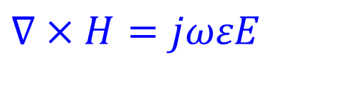
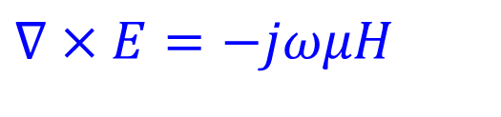
Recalling Maxwell’s Equation, we have
$$∇×E=−jωμH$$
$$∇×H=jωεE$$
Expanding curls and separating, we get

Slide 7
Putting the value of E_{y}⁰ from second expression on the Right side into first equation, we get
We have derived expressions for one component of H in terms of H_{z} and E_{z}
But why, So that we can define wave propagation mode using H_{z} and E_{z,} and their characteristics

Slide 8
It is convenient to classify the propagating waves in a uniform waveguide into three types according to whether H_{z} and/or E_{z} exists.
Transverse Electromagnetic (TEM) Waves. These are waves that contain neither H_{z} nor E_{z}.
2. Transverse Magnetic (TM) Waves. These are waves that contain a nonzero E_{z} but H_{z} =0.
3. Transverse Electric (TE) Waves. These are waves that contain a nonzero H_{z} but E_{z}= 0.
The propagation characteristics of the various types of waves are different; they will be discussed in subsequent subsections.

Slide 9
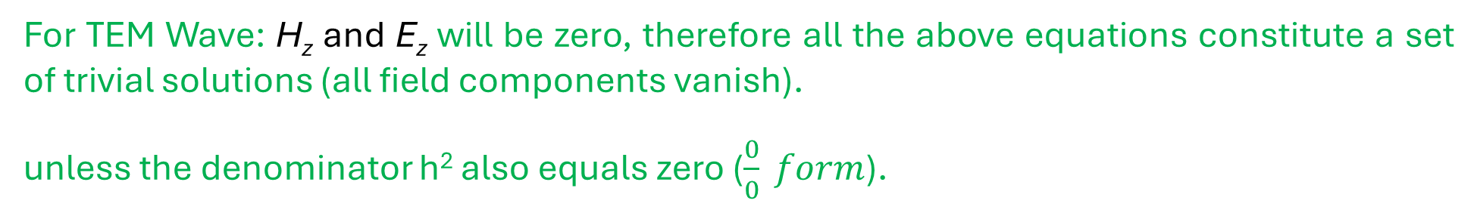
Similarly, we can get, other components in terms of H_{z} and E_{z}
For TEM Wave: H_{z} and E_{z} will be zero, therefore all the above equations constitute a set of trivial solutions (all field components vanish).
unless the denominator h² also equals zero ($\frac{0}{0} form$).
Same as plane wave in unbounded medium

Slide 10
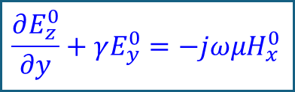

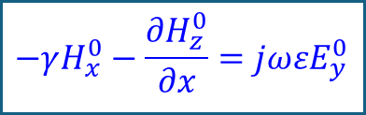
Propagation Velocity
Wave Impedance
$$−γH_{x}^{0}−\frac{∂H_{z}^{0}}{∂x}=jωεE_{y}^{0}$$
H_{z}$=Ez=0$
$$\frac{∂E_{z}^{0}}{∂y}+γE_{y}^{0}=−jωμH_{x}^{0}$$
General form for (E/H) Impedance relation

Slide 11
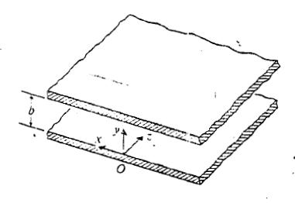

Parallel Plate Waveguide:
Allows for TEM wave propagation.
Also supports TE/TM wave propagation
Conductor
Propagation along z
For TM mode: H_{z} = 0
$$\frac{∂E}{∂x}=0$$
Parallel Plate Waveguide:
Boundary Condition
Tangential E must vanish

Slide 12

For TM mode: H_{z} = 0
A_{n} is the magnitude of excitation
At cutoff frequency γ = 0
$$γ^{2}=−({k2− k}_{c}^{2})$$

Slide 13
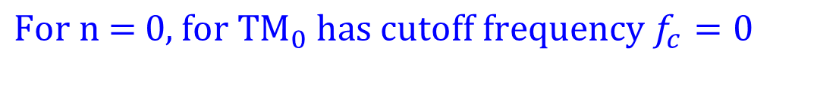
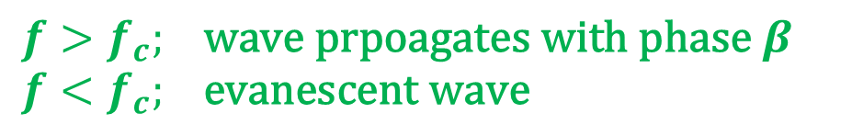
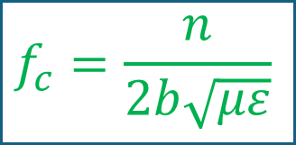
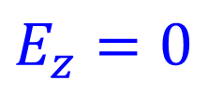
At cutoff frequency γ = 0
$$f_{c}=\frac{n}{2b\sqrt{με}}$$
$$f>f_{c}; \text{wave} \text{prpoagates} \text{with} \text{phase} β \\ f<f_{c}; \text{evanescent} \text{wave}$$
$$\text{For} \text{n}\text{ = 1, }\text{T}{\text{M}}_{1} \text{has} \text{cutoff} \text{frequency} 1/2b\sqrt{με}$$
$$\text{For} \text{n}\text{ = 0, }\text{for} \text{T}{\text{M}}_{0} \text{has} \text{cutoff} \text{frequency} f_{c}=0$$
$$E_{z}=0$$
$$\text{T}{\text{M}}_{0} \text{is} \text{hence} \text{same} \text{as} \text{TEM} \text{mode} \text{and} \text{has} \text{cutoff} \text{frequency}\text{ = 0} \text{Hz}$$
The lowest frequency mode allowed is called dominant mode: Here it is TEM mode.

Slide 14
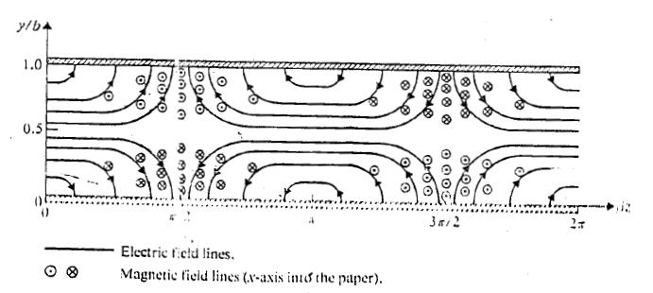
Filed lines for TM₁ Mode in parallel plate waveguide:
|E_{y}|max at y = b
E_{z} max at y = b/2
E = Ez
|E_{y}|max at y = 0
E_{z}
At y = 0 and b, there will be surface currents due to discontinuity in the tangential H field whereas there will be surface charges due presence of normal electric field (in accordance with boundary conditions around conductors)

Slide 15

TE Waves between Parallel Plates
Ez = 0
Conductor
Propagation along z
$$\frac{∂H}{∂x}=0$$
Boundary Condition
Parallel Plate Waveguide:
E_{x} must vanish
Notice the differential

Slide 16
The cutoff frequency for TE_{n} and TM_{n} mode for a parallel plate waveguide is same.
For n = 0, both H_{y} and E_{x} vanish; hence the TE₀ mode does not exist in parallel plate waveguide

Slide 17
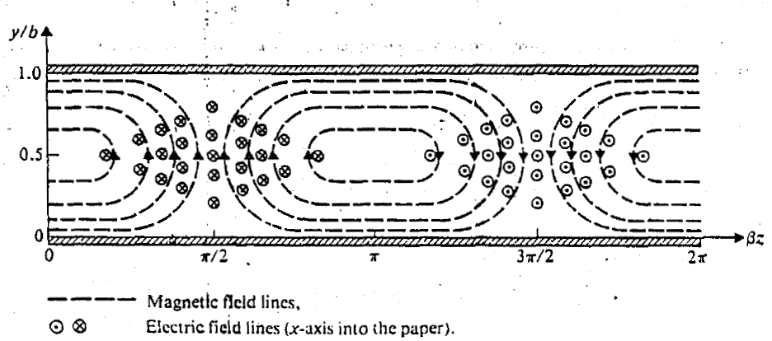
Filed lines for TE₁ Mode in parallel plate waveguide:
Propagation along z
H_{z} max at y = b
y
|E_{x}| max at y = b/2
H_{z} = 0
z
H_{z} max at y = 0
At y = 0 and b, there will be surface currents due to discontinuity in the tangential H field whereas there will be surface charges due presence of normal electric field (in accordance with boundary conditions around conductors)

Slide 18
Rectangular waveguide Analysis

Slide 19
Rectangular waveguides:
The analysis of parallel-plate waveguides in previous slides we assumed the plates to be of an infinite extent in the transverse x direction; that is, the fields do not vary with x.
In practice, these plates are always finite in width, with fringing fields at the edges. Electromagnetic energy will leak through the sides of the guide and create undesirable stray couplings to other circuits and systems.
Thus, practical waveguides are usually uniform structures of a cross section of the enclosed variety. The simplest of such cross sections, in terms of ease both in analysis and in manufacture, are rectangular cross-and circular sections.
We will deal with rectangular waveguide as it is easier to analyse. Circular geometry requires knowledge of Bessel’s functions and hence will be skipped in the course.
TEM waves are not supported in cross-section of enclosed variety.

Slide 20
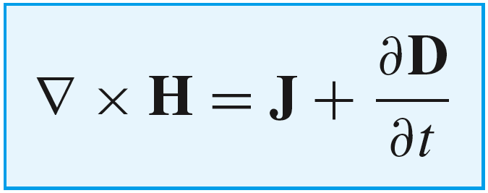
TEM mode does not exist in rectangular waveguides….
Assume, TEM exists inside a rectangular waveguide, the lines of B or H will be closed loops in the plane perpendicular to the direction of propagation. According to Maxwell’s first equation the magnetomotive force (MMF) around each of this closed loop must be equal to the current (conduction or displacement) passing through the loop.
In the case of guide with an inner conductor, like a coaxial cable, the current through the H loops is the conduction current in the inner conductor.
However, for a hollow wave guide having no inner conductor, this axial current must be a displacement current. But axial displacement current requires an axial component of D or E, which is not present in a TEM wave
So, TEM wave or mode cannot exist in a single-conductor waveguide.

Slide 21
A waveguide will propagate “higher-order” modes, which are classified as either transverse magnetic (TM) or transverse electric (TE).
There are two problems with propagating higher-order modes:
TE and TM modes have a limited bandwidth. In fact, none of these modes can propagate at frequencies below a minimum frequency known as the cutoff frequency.
2. TE and TM modes are dispersive. That is, the phase velocity is dependent on frequency—for some modes highly dependent!
A waveguide also has two important advantages.
1. It can typically handle very large power (e.g., kilowatts).
2. It can have very low loss (low value of α).

Slide 22
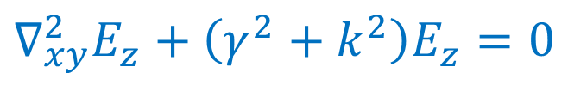
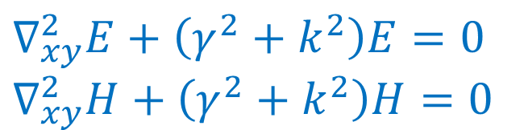
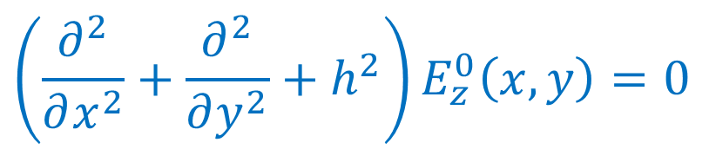

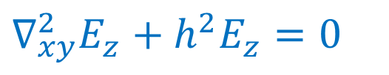
Transverse Magnetic Waves in rectangular waveguides:
For transverse magnetic (TM) waves: H_{z} = 0
Conducting walls
$$∇_{xy}^{2}E+\left(γ^{2}+k^{2}\right)E=0 \\ ∇_{xy}^{2}H+\left(γ^{2}+k^{2}\right)H=0$$
y
a
Propagation along z
b
z
x
While we have written E_{z} as phasor
a > b
$$E_{z}\left(x,y,z\right)=E_{z}^{0}\left(x,y\right)e^{−γz}$$
$$∇_{xy}^{2}E_{z}+\left(γ^{2}+k^{2}\right)E_{z}=0$$
Second order PDE
$$\left(\frac{∂^{2}}{∂x^{2}}+\frac{∂^{2}}{∂y^{2}}+h^{2}\right)E_{z}^{0}\left(x,y\right)=0$$
$$∇_{xy}^{2}E_{z}+h^{2}E_{z}=0$$

Slide 23
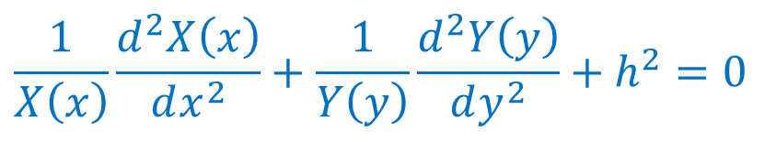
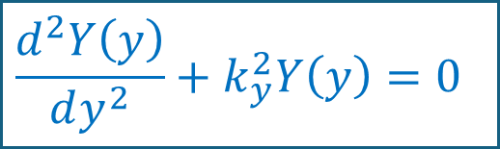
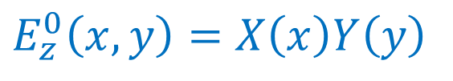

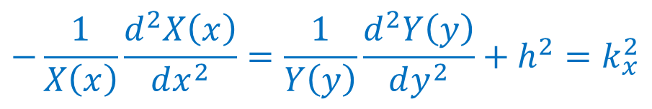
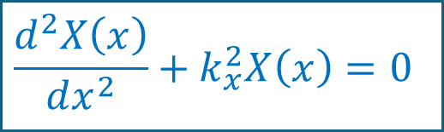
Assuming E_{z} as product of two separate functions in x and y, we write
$$E_{z}^{0}\left(x,y\right)=X\left(x\right)Y\left(y\right)$$
Substitution in PDE and dividing by E_{z} gives:
$$\frac{1}{X\left(x\right)}\frac{d^{2}X\left(x\right)}{dx^{2}}+\frac{1}{Y\left(y\right)}\frac{d^{2}Y\left(y\right)}{dy^{2}}+h^{2}=0$$
Rearranging, we have
$$−\frac{1}{X\left(x\right)}\frac{d^{2}X\left(x\right)}{dx^{2}}=\frac{1}{Y\left(y\right)}\frac{d^{2}Y\left(y\right)}{dy^{2}}+h^{2}=k_{x}^{2}$$
$$k_{y}^{2}=h^{2}−k_{x}^{2}$$
$$\frac{d^{2}X\left(x\right)}{dx^{2}}+k_{x}^{2}X\left(x\right)=0$$
$$\frac{d^{2}Y\left(y\right)}{dy^{2}}+k_{y}^{2}Y\left(y\right)=0$$

Slide 24
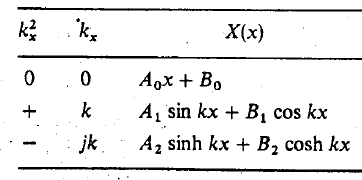

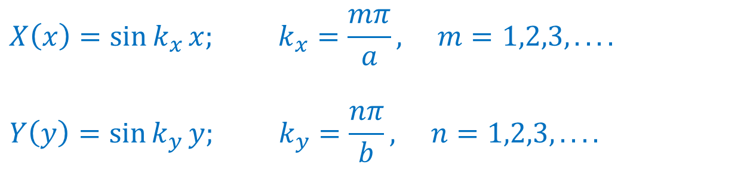


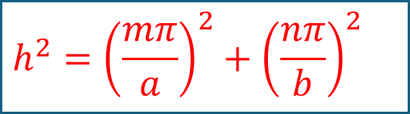

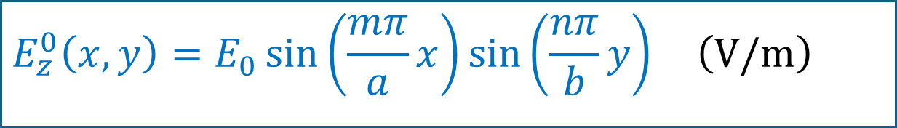

Along the x-direction, boundary conditions
Conducting walls
$$E_{z}^{0}\left(0,y\right)=0$$
$$E_{z}^{0}\left(a,y\right)=0$$
y
$$E_{z}^{0}\left(x,0\right)=0$$
$$E_{z}^{0}\left(x,b\right)=0$$
a
Propagation along z
Tangential E must vanish
z
b
x
Applying boundary conditions we get
$$X\left(x\right)=\sin{k_{x}}x; k_{x}=\frac{mπ}{a}, m=1,2,3,....$$
$$Y\left(y\right)=\sin{k_{y}}y; k_{y}=\frac{nπ}{b}, n=1,2,3,....$$
$$h2 =k_{x}^{2} +{ k}_{y}^{2}$$
$$E_{z}^{0}\left(x,y\right)=E_{0}\sin\left(\frac{mπ}{a}x\right)\sin\left(\frac{nπ}{b}y\right) \left(\text{V}\text{/}\text{m}\right)$$
$$h^{2}={\left(\frac{mπ}{a}\right)}^{2}+{\left(\frac{nπ}{b}\right)}^{2}$$

Slide 25
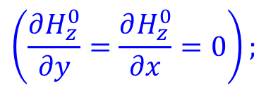
Since we have the expression for E_{z}, we can use
y
For TM Wave H_{z} = 0
$$\left(\frac{∂H_{z}^{0}}{∂y}=\frac{∂H_{z}^{0}}{∂x}=0\right);$$
a
b
z
z = 0 plane
x

Slide 26
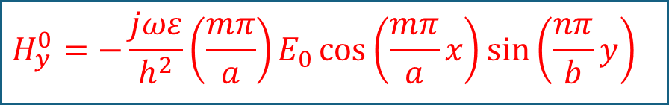
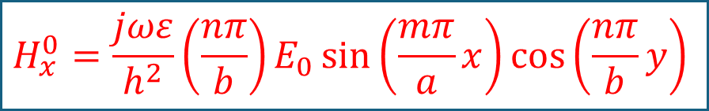
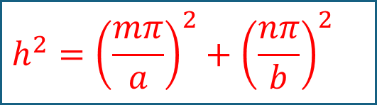
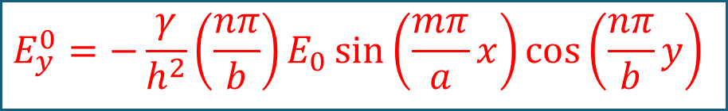
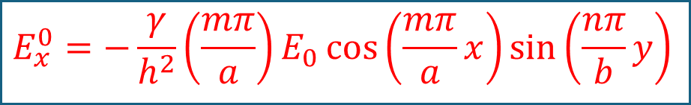
$$E_{x}^{0}=−\frac{γ}{h^{2}}\left(\frac{mπ}{a}\right)E_{0}\cos\left(\frac{mπ}{a}x\right)\sin\left(\frac{nπ}{b}y\right)$$
$$H_{x}^{0}=\frac{jωε}{h^{2}}\left(\frac{nπ}{b}\right)E_{0}\sin\left(\frac{mπ}{a}x\right)\cos\left(\frac{nπ}{b}y\right)$$
$$E_{y}^{0}=−\frac{γ}{h^{2}}\left(\frac{nπ}{b}\right)E_{0}\sin\left(\frac{mπ}{a}x\right)\cos\left(\frac{nπ}{b}y\right)$$
$$H_{y}^{0}=−\frac{jωε}{h^{2}}\left(\frac{mπ}{a}\right)E_{0}\cos\left(\frac{mπ}{a}x\right)\sin\left(\frac{nπ}{b}y\right)$$
$$h^{2}={\left(\frac{mπ}{a}\right)}^{2}+{\left(\frac{nπ}{b}\right)}^{2}$$
For TM modes in rectangular waveguides, neither m nor n can be zero
m and n define a possible mode that may be designated as TM_{mn} mode.
m: The number of half cycle variations in x-direction
n: The number of half cycle variations in y-direction
The lowest mode/ dominant mode will be TM₁₁ mode
The mode having lowest cutoff frequency is called the dominant frequency

Slide 27
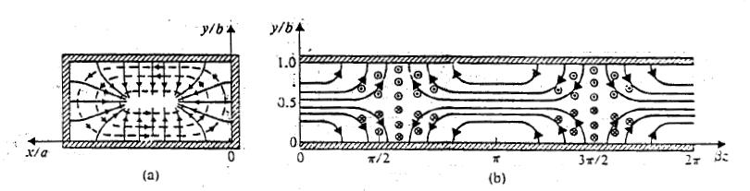
TM₁₁ Mode Pattern
y
y
x
E and H line are perpendicular to one another everywhere
E lines are normal while H lines are parallel to conductor walls
y
z

Slide 28
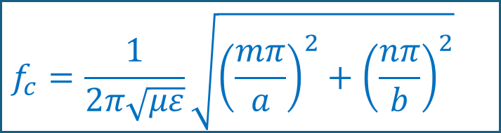
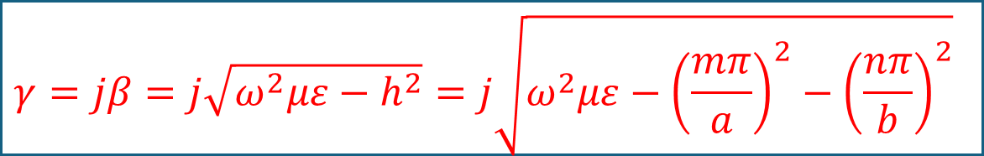
Cutoff Frequency for various modes:
$$γ=jβ=j\sqrt{ω^{2}με−h^{2}}=j\sqrt{ω^{2}με−{\left(\frac{mπ}{a}\right)}^{2}−{\left(\frac{nπ}{b}\right)}^{2}}$$
$$\text{If} ω^{2}με>h^{2};\text{then} \text{only} γ \text{will} \text{be} \text{imaginary} \text{and} \text{mode} \text{propagates} \\ \text{If} ω^{2}με<h^{2}; \text{then} γ \text{will} \text{be} \text{real} \text{and} \text{wave} \text{will} \text{attenuate} \text{as} \text{it} \text{propagates}\text{ (}\text{evanescent} \text{waves}\text{)}$$
At cutoff γ = 0
$$f_{c}=\frac{1}{2π\sqrt{με}}\sqrt{{\left(\frac{mπ}{a}\right)}^{2}+{\left(\frac{nπ}{b}\right)}^{2}}$$

Slide 29
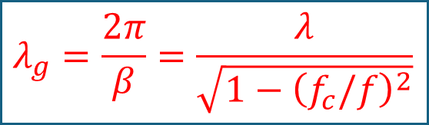
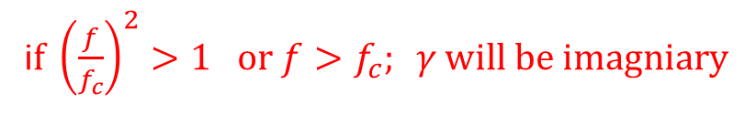
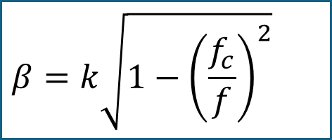
Above cutoff
i$\text{f} {\left(\frac{f}{f_{c}}\right)}^{2}>1 \text{or} f>f_{c}; γ \text{will} \text{be} \text{imagniary}$
Guided wavelength
$$λ_{g}=\frac{2π}{β}=\frac{λ}{\sqrt{1−{\left(f_{c}/f\right)}^{2}}}$$
Where,
where
$$β=k\sqrt{1−{\left(\frac{f_{c}}{f}\right)}^{2}}$$
Allows guided propagation

Slide 30
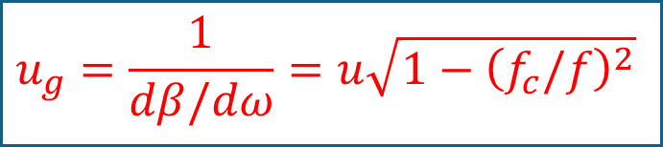


Phase Velocity:
$$u_{p}=\frac{ω}{β}=\frac{u}{\sqrt{1−{\left(f_{c}/f\right)}^{2}}}$$
Waveguide is called dispersive because phase velocity is function of frequency
In Waveguide
$$u_{g}=\frac{1}{dβ/dω}=u\sqrt{1−{\left(f_{c}/f\right)}^{2}}$$
Group Velocity:
$$β=ω\sqrt{με}\sqrt{1−{\left(\frac{f_{c}}{f}\right)}^{2}}$$
Propagation constant

Slide 31



Wave Impedance:
$$Z_{TM}=\frac{E_{x}^{0}}{H_{y}^{0}}=−\frac{E_{y}^{0}}{H_{x}^{0}}=\frac{γ}{jωε}=\frac{jβ}{jωε}=η\sqrt{1−{\left(\frac{f_{c}}{f}\right)}^{2}}$$
$$i\text{f} {\left(\frac{f}{f_{c}}\right)}^{2}<1 \text{or} f<f_{c}; γ \text{will} \text{be} \text{real}$$
Propagation factor becomes
$$e^{−γz}=e^{−αz}$$
The wave diminishes rapidly with z and is said to be evanescent.
Waveguide behaves as high pass filter.

Slide 32




Transverse Electric Waves:
For transverse magnetic (TM) waves: E_{z} = 0
Conducting walls
$$∇_{xy}^{2}E+\left(γ^{2}+k^{2}\right)E=0 \\ ∇_{xy}^{2}H+\left(γ^{2}+k^{2}\right)H=0$$
y
a
Propagation along z
b
z
While we can write H_{z} as phasor
x
$$H_{z}\left(x,y,z\right)=H_{z}^{0}\left(x,y\right)e^{−γz}$$
$$∇_{xy}^{2}H_{z}+\left(γ^{2}+k^{2}\right)H_{z}=0$$
$$\left(\frac{∂^{2}}{∂x^{2}}+\frac{∂^{2}}{∂y^{2}}+h^{2}\right)H_{z}^{0}\left(x,y\right)=0$$
$$∇_{xy}^{2}H_{z}+h^{2}H_{z}=0$$

Slide 33

Boundary Conditions:
In x-direction
y
a
b
z
x
In y-direction
$$H_{z}^{0}\left(x,y\right)=H_{0}\cos\left(\frac{mπ}{a}x\right)\cos\left(\frac{nπ}{b}y\right)$$

Slide 34
On solving using procedure as TM case:
y
a
b
z
x

Slide 35

For TE modes, either m or n (but not both) can be zero.
If a>b the lowest mode will be TE₁₀ mode
m: The number of half cycle variations in x-direction
n: The number of half cycle variations in y-direction

Slide 36

Allows guided propagation
Phase Velocity:
Group Velocity:
Wave Impedance:
$$λ_{g}=\frac{2π}{β}=\frac{λ}{\sqrt{1−{\left(f_{c}/f\right)}^{2}}}$$

Slide 37

Uniform Plane waves
Constant phase planes moving the distance

Slide 38





Uniform Plane waves
$$E=E0 cos⁡(ωt −k0z)$$
$$ω is angular frequency:time oscillation$$
$$E=E0\cos\left(−k0z\right)at t=0$$
At successive times curve effectively travels in + x
A point of constant phase moves forward.
$(ωt −k0z)$ = constant
$\frac{dz}{dt}= \frac{ω}{k0}=up$
Phase velocity: velocity of Equi phase front

Slide 39




$${∇2E}_{x}(z)+k_{0}^{2}E_{x}(z)=0$$
$$E_{x}(z)=E0e^{−jk0z}$$
$$∇×E=jωμ0H$$
$$E_{x}(z)=\frac{k0}{ωμ0}H_{y}(z)$$

Slide 40

Wave Propagation inside the waveguide
The Wave velocity is given by
Phase velocity
Wave velocity
Group velocity
The Phase velocity is given by
Analogy!
using
Beach
Point of contact
Phase velocity
Wave velocity
The Group velocity is given by
Group velocity
Ocean

Slide 41

ω-β diagram for waveguide
For TEM: Constant slope;
Same as velocity of light in an unbounded dielectric medium with constitutive parameters μ and ε
For TE or TM: slope is not constant
It intersects the ω axis (β=0) at ω = ω_{c}
OP slope represents the phase velocity at that point P.
Local slope represents the group velocity at point P.

Slide 42

Rectangular Waveguide
Example
Let’s determine the TE mode impedance looking into a 20 cm long section of shorted WR90 waveguide operating at 10 GHz.
From the Waveguide Table 7.1, a = 0.9 inch (or) 2.286 cm and b = 0.450 inch (or) 1.143 cm.
Mode
Cutoff Frequency
Mode
Cutoff Frequency
$$f_{c_{mn}}=\frac{c}{2}\sqrt{{\left(\frac{m}{a}\right)}^{2}+{\left(\frac{n}{b}\right)}^{2}}$$
TE₁₀
6.56 GHz
TE₁₀
6.56 GHz
TE₀₁
13.12 GHz
Rearrange
TE₀₁
13.12 GHz
TE₁₁
14.67 GHz
TE₂₀
13.13 GHz
TE₂₀
13.13 GHz
TE₁₁
14.67 GHz
TE₀₂
26.25 GHz
TE₀₂
26.25 GHz
TM₁₁
TE₁₀
TE₀₁
TE₂₀
TE₁₁
TE₀₂
6.56 GHz
13.12 GHz
14.67 GHz
26.25 GHz
13.13 GHz
At 10 GHz, only the TE₁₀ mode is supported!

Slide 43


Rectangular Waveguide
Example
The TE₁₀ mode impedance
The TE₁₀ mode propagation constant is:
$$Z_{10}^{TE}=\frac{120π Ω}{\sqrt{\text{1−}{\left(\frac{\text{6.56}\text{GHz}}{\text{10}\text{GHz}}\right)}^{2}}}=500Ω.$$
$$β=k\sqrt{1−{\left(\frac{f_{c}}{f}\right)}^{2}}=\frac{2πf}{c}\sqrt{1−{\left(\frac{f_{c}}{f}\right)}^{2}} \\ =\frac{2π\left(10x10^{9}Hz\right)}{3x10^{8}\frac{m}{s}}\sqrt{1−{\left(\frac{6.56GHz}{10GHz}\right)}^{2}}=158\frac{rad}{m}$$
The impedance looking into a short circuit is given by

Slide 44









Example: Determine (a) the wave impedance and guided wavelength at a frequency equal to twice the cutoff frequency in a waveguide for TEM, TE and TM modes.
(b) Repeat the same calculations when the operating frequency is half the cutoff frequency.
TEM
$Z_{TEM}=\frac{E_{x}^{0}}{H_{y}^{0}}=−\frac{E_{y}^{0}}{H_{x}^{0}}=$ $η$
$$λ_{TEM}=\frac{2π}{β}=λ$$
Case 1: ${\left(f_{c}/f\right)}^{2}$ = 1/4
$$Z_{TE}=\frac{E_{x}^{0}}{H_{y}^{0}}=−\frac{E_{y}^{0}}{H_{x}^{0}}=\frac{jωμ}{γ}=\frac{η}{\sqrt{1−{\left(f_{c}/f\right)}^{2}}}$$
$$Z_{TE}=\frac{ηΩ}{\sqrt{1−{\left(f_{c}/f\right)}^{2}}}=1.155η$$
$$Z_{TM}=\frac{E_{x}^{0}}{H_{y}^{0}}=−\frac{E_{y}^{0}}{H_{x}^{0}}=\frac{γ}{jωε}=η\sqrt{1−{\left(\frac{f_{c}}{f}\right)}^{2}}$$
$$Z_{TM}=\frac{η\sqrt{1−{\left(f_{c}/f\right)}^{2}}Ω}{1}=0.866η$$
$$λ_{g}=\frac{2π}{β}=\frac{λ}{\sqrt{1−{\left(f_{c}/f\right)}^{2}}}$$
$$λ_{TM}=\text{1.155}λ$$

Slide 45









(b) Repeat the same calculations when the operating frequency is half the cutoff frequency.
$Z_{TEM}=\frac{E_{x}^{0}}{H_{y}^{0}}=−\frac{E_{y}^{0}}{H_{x}^{0}}=$ $η$
$$λ_{TEM}=\frac{2π}{β}=λ$$
TEM
Case 2: ${\left(f_{c}/f\right)}^{2}$ = 4; evanescent wave
$$Z_{TE}=\frac{E_{x}^{0}}{H_{y}^{0}}=−\frac{E_{y}^{0}}{H_{x}^{0}}=\frac{jωμ}{γ}=\frac{jωμ}{h\sqrt{1−{\left(f_{c}/f\right)}^{2}}}$$
$$Z_{TE}=\frac{j3.63fcμ}{h}$$
$$Z_{TM}=\frac{E_{x}^{0}}{H_{y}^{0}}=−\frac{E_{y}^{0}}{H_{x}^{0}}=\frac{γ}{jωε}=\frac{−jh}{ωε}\sqrt{1−{\left(\frac{f_{c}}{f}\right)}^{2}}$$
$$Z_{TM}=\frac{−j0.276h}{fcε}$$
$$λ_{g}=\frac{2π}{β}=\frac{λ}{\sqrt{1−{\left(f_{c}/f\right)}^{2}}}$$
$$λ_{TM/TE}=not valid$$

Slide 46
Propagation inside a Waveguide
Port2
Port1
TE10 mode propagation in a rectangular Waveguide

Slide 47

Surface Currents on guide wall for TE₁₀ mode

