Slide 1
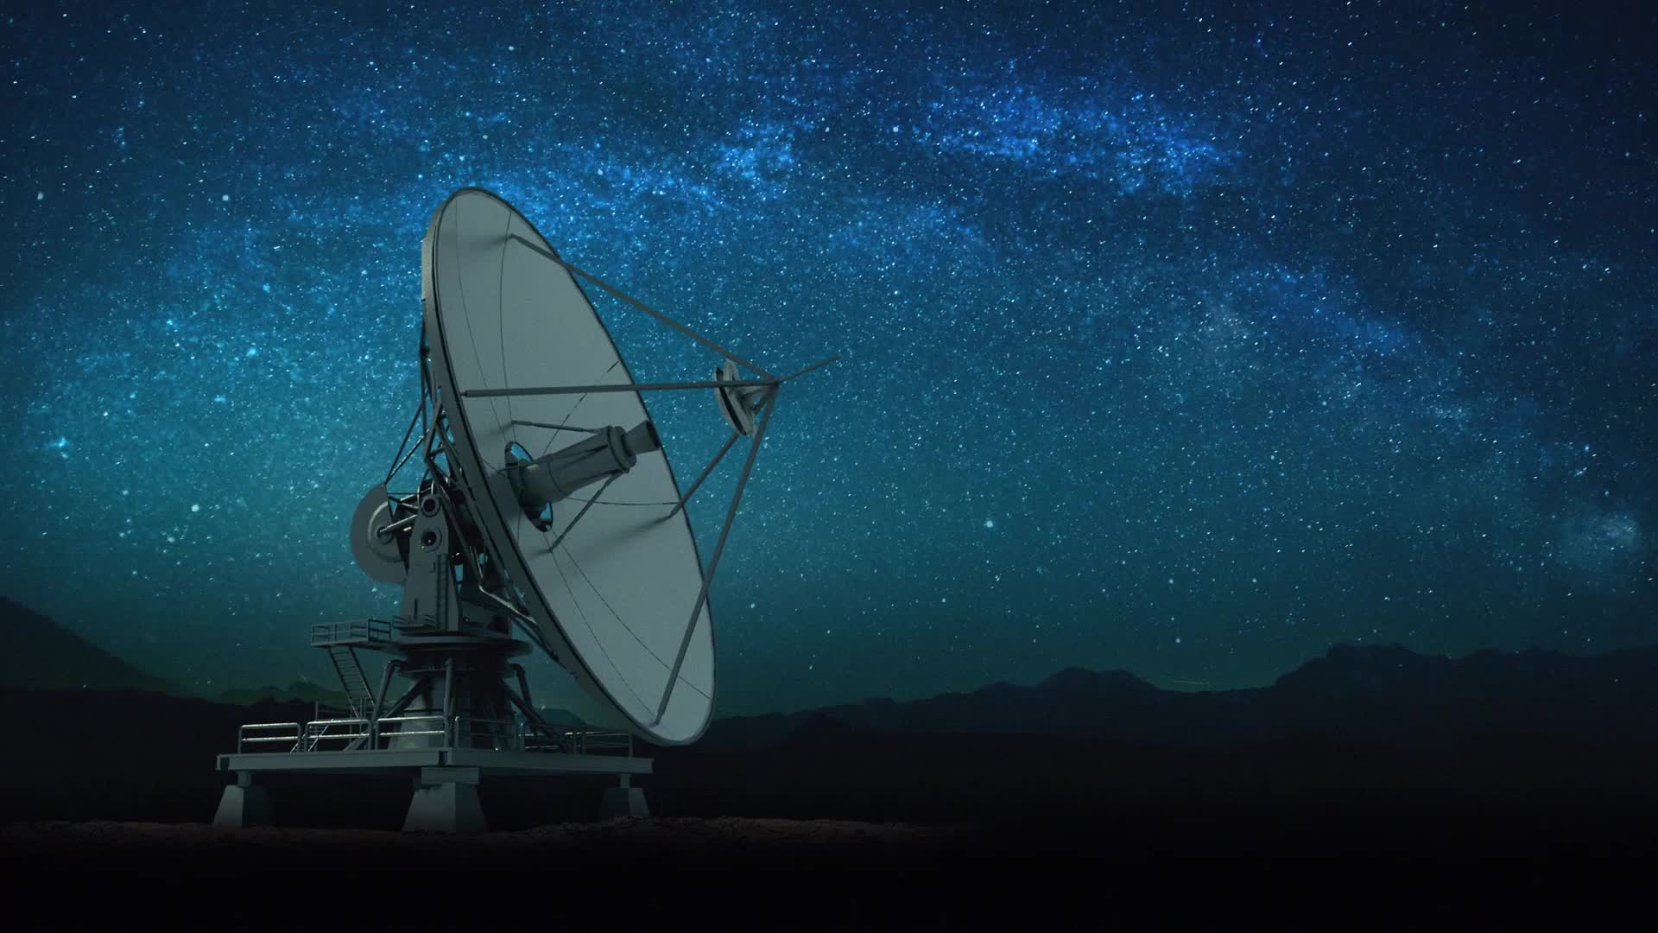
Antennas
Antennas radiate EM wave (power) or receive EM wave (power).

Slide 2
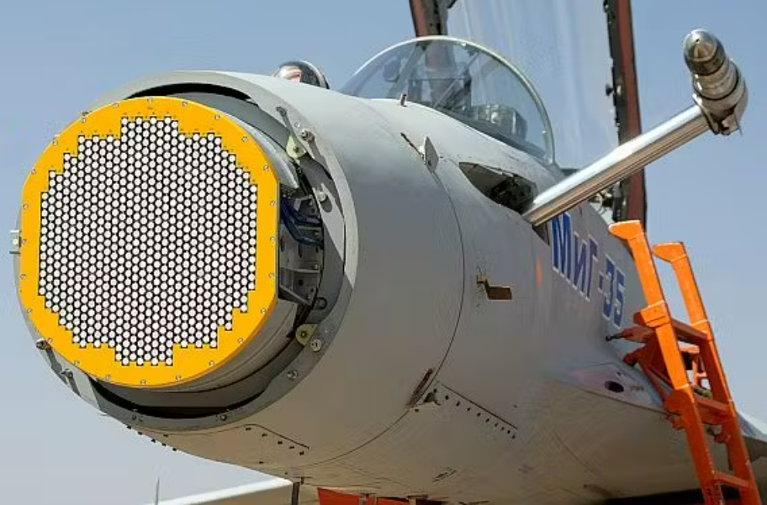
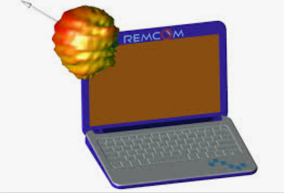
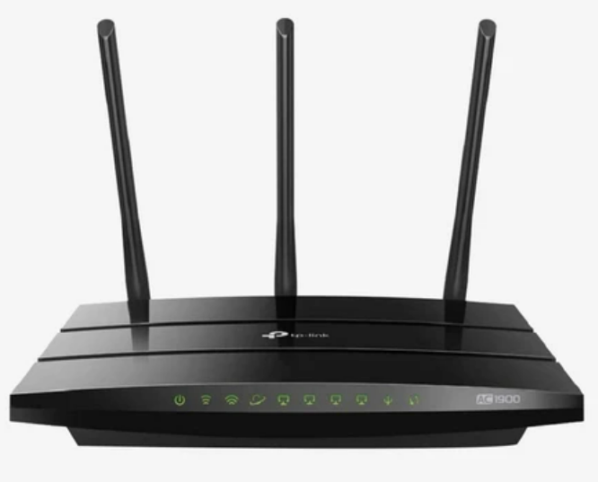
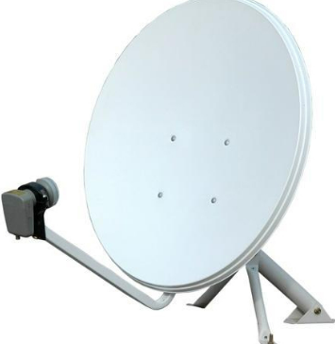
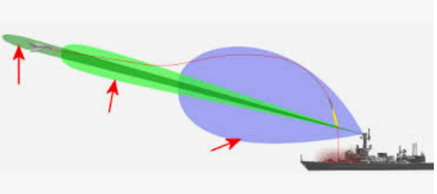
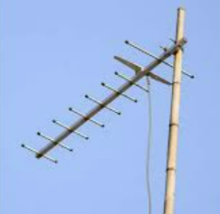
Examples:

Slide 3
Antennas Basics

Slide 4
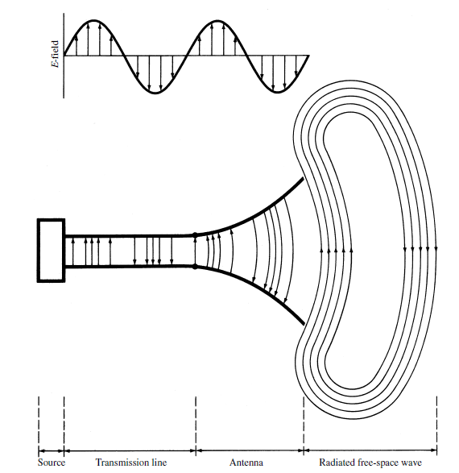
Antenna - Introduction
An antenna is a device which performs two functions:
It converts the Radio Frequency energy from a transmitter into radio waves (EM waves) to be radiated by the antenna.
It converts radio waves from free space into an electrical voltage and current to be processed by a receiver.
Transmitting antenna transforms power in the form of time-dependent electrical current into time-and-space-dependent electro-magnetic (EM) wave.
Receiving antenna transforms time-and-space-dependent EM wave into time-dependent electrical current (power).
Voltage, current on TL
E, H
EM Waves
Transition from guided wave to free space wave or vice-versa

Slide 5
Animated diagram of a half-wave dipole antenna receiving a radio wave. The antenna consists of two metal rods connected to a receiver R. The electric field (E, green arrows) of the incoming wave pushes the electrons in the rods back and forth, charging the ends alternately positive (+) and negative (−).
The oscillating field induces standing waves of voltage (V, represented by red band) and current in the rods. The oscillating currents (black arrows) flow down the transmission line and through the receiver (represented by the resistance R).

Slide 6
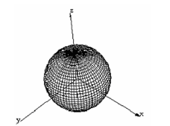
Isotropic antenna
Radiation pattern in 3D space ( use spherical coordinates)
A hypothetical antenna that radiates or receives equally in all directions.
Isotropic antennas do not exist physically but represent a convenient reference antenna for expressing directional properties of physical antennas.
The radiation pattern for the isotropic antenna is a sphere with the antenna at its center.
Power at each point on this spherical surface is same

Slide 7
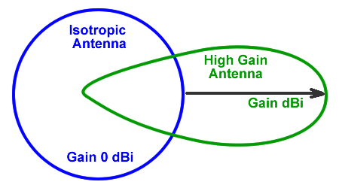

Slide 8

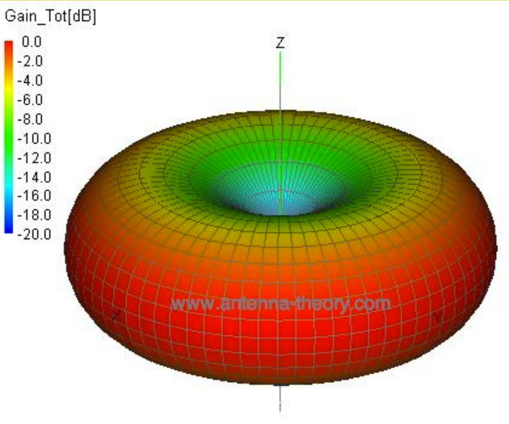
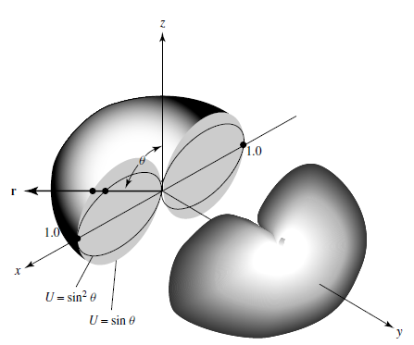
Dipole antenna 3D pattern
Power mainly directed perpendicular to Dipole axis

Slide 9
Hertz Dipole
Infinitesimally small dipole (current filament)

Slide 10
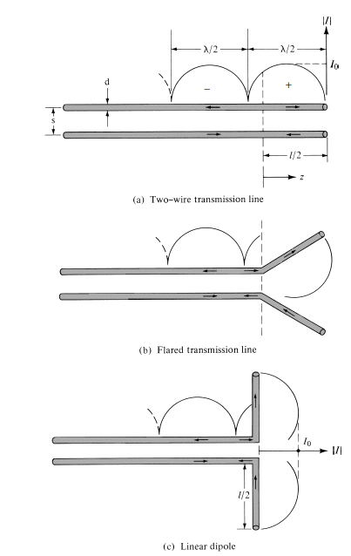
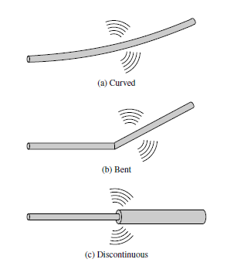
Discontinuities and radiation
Discontinuities accelerate charges and accelerated charges generate radiation
Analyze small current filament

Slide 11
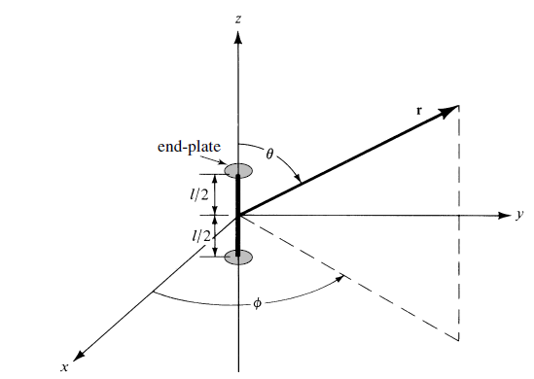
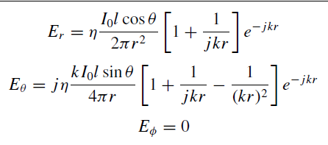





Spherical coordinates (r, $θ, φ)$
Analysis of dipole is done using retarded vector potential (A)
P(r, $θ, φ)$
Once A is obtained, we have $B=∇×A$
Without going much intro details, the fields at the point P(r, $θ, φ)$ is given as:
Small dipole l<<λ
Placed symmetrically around origin
Uniform current I(z) = I₀a_{z}
Where k = $β=$propagation constant

Slide 12
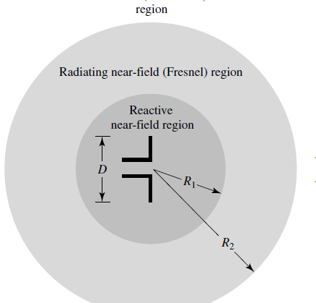



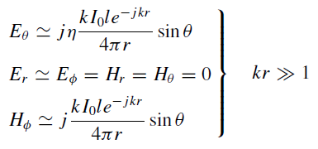
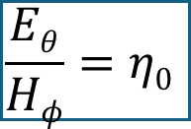


Near-field and far-field regions
k = propagation constant
Reactive energy stored around
Transitions from reactive to radiative
Radiated fields in far away region
$$Eθ ⊥Hφ$$
$$\frac{Eθ}{Hφ}=η0$$
Like uniform plane waves

Slide 13


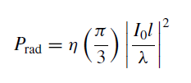
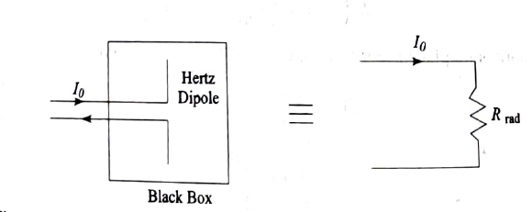
Radiated power and radiation resistance
I₀ represents the maximum current in the antenna
The radiation resistance of an antenna is the electrical resistance that represents the power radiated into space by the antenna if same current is excited into the antenna

Slide 14

Example: A small dipole of length 0.1 λ is excited with peak current of 5A. How much power will be radiated by the antenna.
Solution:
Answer: Radiation resistance = 0.8$π2 Ω and Prad=98.67 Watts$

Slide 15
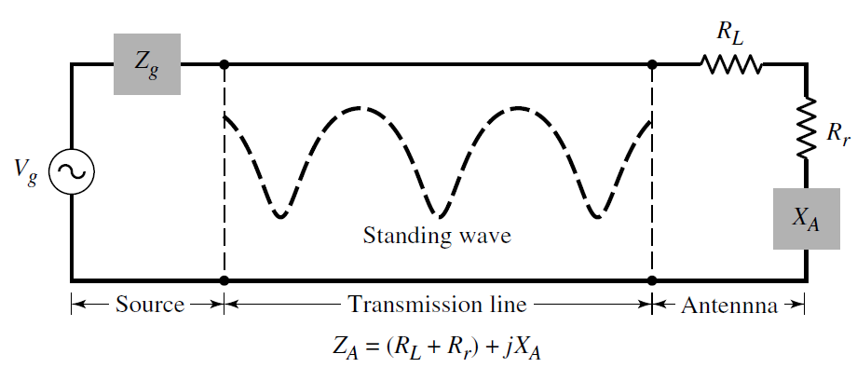
Antenna Impedance
It may be purely resistive, or resistive with a reactive (inductive or capacitive) component.
An antenna is said to be resonant if it displays no reactive component. That is, its impedance is purely resistive.
The resistive portion of the impedance, is made up of a radiation resistance and a loss resistance.
The radiation resistance is an imaginary resistance. The power “dissipated” in this resistance is the power actually radiated from the antenna.
The loss resistance is made up of resistances of the conductors used to make the antenna and other losses in the antenna system. The power dissipated in these resistances is lost, wasted as heat.
At resonance
R = R_{r} +R_{L}

