Slide 1
Smith Chart and Impedance Matching
Engineering Electromagnetics

Slide 2
Smith Chart (Mizuhashi–Smith chart):
Transmission line chart
Reflection chart
Circle diagram of impedance
Smith chart in the 1940s
Z-plane chart
Smith chart as a name does not reflect anything about the plot itself.
Other names do!
Western world by 1950 adopted the name after P. H. Smith
Smith chart: Graphical method to solve for input impedance, reflection coefficient, load impedance etc.
https://en.wikipedia.org/wiki/Smith_chart#:~:text=While%20Smith%20had%20originally%20called,the%201940s%2C%20a%20name%20generally

Slide 3
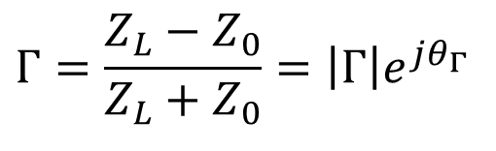
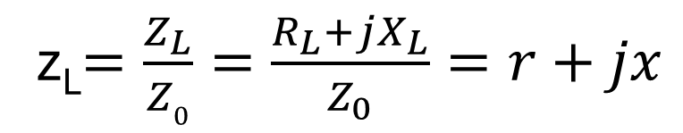
Smith Chart (Mizuhashi–Smith chart):
Assuming a lossless (Z₀ = R₀) transmission line, the voltage reflection coefficient is defined as
$$Γ=\frac{Z_{L}−Z_{0}}{Z_{L}+Z_{0}}=\left|Γ\right|e^{jθ_{Γ}}$$
If we normalize load impedance to characteristic impedance of TL, we have:
z_{L}$=\frac{Z_{L}}{Z0}=\frac{R_{L}+jX_{L}}{Z_{0}}=r+jx$
Where z_{L} is used to denote the normalized quantity load impedance
Where as, normalized resistance and reactance are denoted as r and x

Slide 4
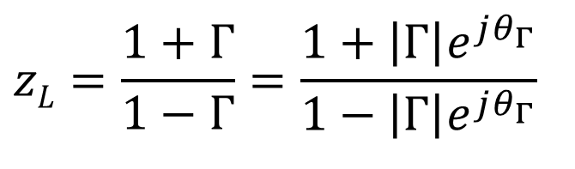
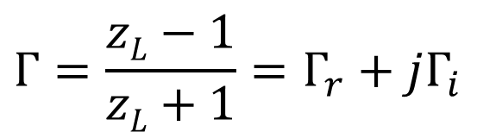
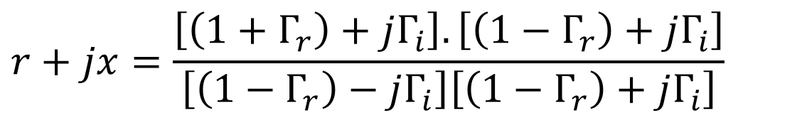
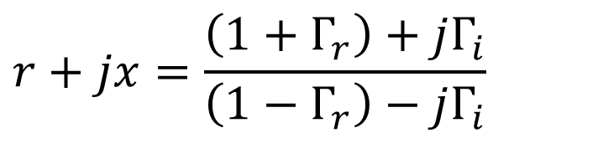
$$Γ=\frac{zL−1}{zL+1}=Γ_{r}+jΓ_{i}$$
where Γ_{i} and Γ_{r} denote the real and imaginary parts of complex Γ
$$zL=\frac{1+Γ}{1−Γ}=\frac{1+\left|Γ\right|e^{jθ_{Γ}}}{1−\left|Γ\right|e^{jθ_{Γ}}}$$
Separating real and imaginary parts
$$r+jx=\frac{\left(1+Γ_{r}\right)+jΓ_{i}}{\left(1−Γ_{r}\right)−jΓ_{i}}$$
Rationalize, we get
$$r+jx=\frac{\left[\left(1+Γ_{r}\right)+jΓ_{i}\right].\left[\left(1−Γ_{r}\right)+jΓ_{i}\right]}{\left[\left(1−Γ_{r}\right)−jΓ_{i}\right]\left[\left(1−Γ_{r}\right)+jΓ_{i}\right]}$$

Slide 5
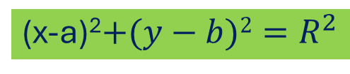
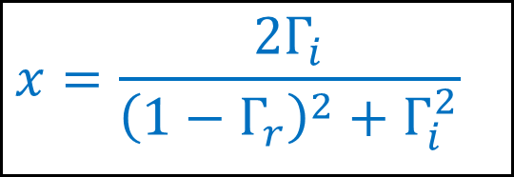
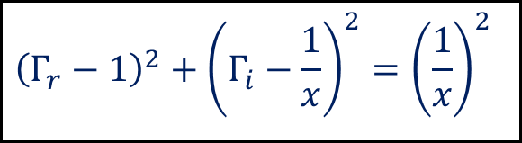
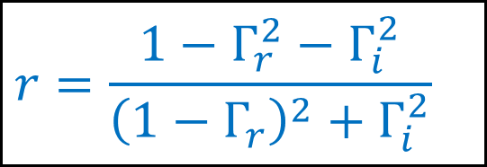
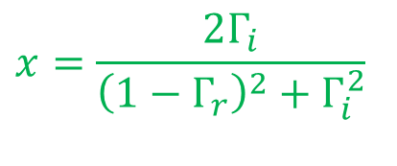
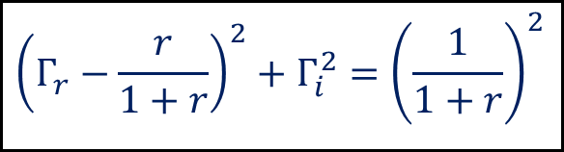
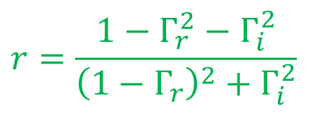
On extracting real and imaginary parts
$$r=\frac{1−Γ_{r}^{2}−Γ_{i}^{2}}{{\left(1−Γ_{r}\right)}^{2}+Γ_{i}^{2}}$$
$$x=\frac{2Γ_{i}}{{\left(1−Γ_{r}\right)}^{2}+Γ_{i}^{2}}$$
Perform manipulations to obtain equations of circles
$$r=\frac{1−Γ_{r}^{2}−Γ_{i}^{2}}{{\left(1−Γ_{r}\right)}^{2}+Γ_{i}^{2}}$$
$${\left(Γ_{r}−\frac{r}{1+r}\right)}^{2}+Γ_{i}^{2}={\left(\frac{1}{1+r}\right)}^{2}$$
(x-a)²$+(y−b)2=R^{2}$
$$x=\frac{2Γ_{i}}{{\left(1−Γ_{r}\right)}^{2}+Γ_{i}^{2}}$$
$${\left(Γ_{r}−1\right)}^{2}+{\left(Γ_{i}−\frac{1}{x}\right)}^{2}={\left(\frac{1}{x}\right)}^{2}$$

Slide 6

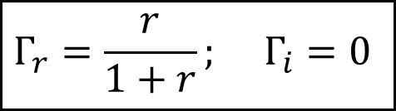


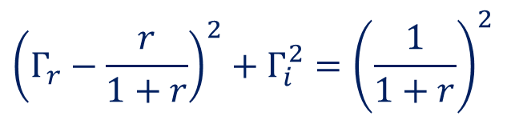




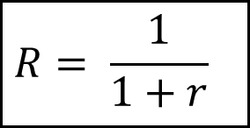

Constant Resistance Circles
$${\left(Γ_{r}−\frac{r}{1+r}\right)}^{2}+Γ_{i}^{2}={\left(\frac{1}{1+r}\right)}^{2}$$
Therefore, we get a family of circles with Eq:
Center
Radius
$$Γ_{r}=\frac{r}{1+r}; Γ_{i}=0$$
$$R= \frac{1}{1+r}$$
Different values of r yield circles with different radii and shifting centers:
$$Γ_{i}$$
$$r=0$$
$$r=1$$
$$r<1$$
$$r>1$$
$$Γ_{r}$$
$$\left|Γ\right|∠θΓ$$
$$r=∞$$

Slide 7



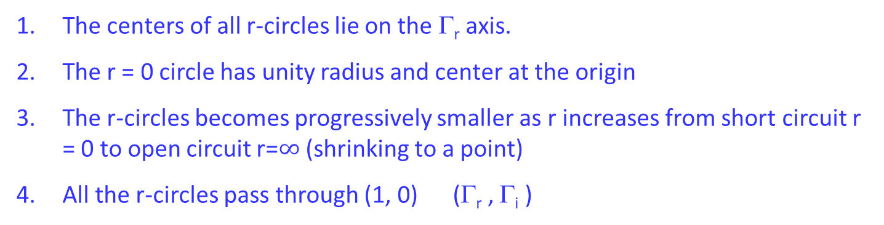






Constant $r$ Circles properties
The centers of all r-circles lie on the Γ_{r} axis.
The r = 0 circle has unity radius and center at the origin
The r-circles becomes progressively smaller as r increases from short circuit r = 0 to open circuit r=$∞$ (shrinking to a point)
All the r-circles pass through (1, 0) (Γ_{r} , Γ_{i} )
$$Γ_{i}$$
$$r=0$$
$$r=1$$
$$r<1$$
$$r>1$$
$$Γ_{r}$$
$$\left|Γ\right|∠θΓ$$
$$r=∞$$

Slide 8

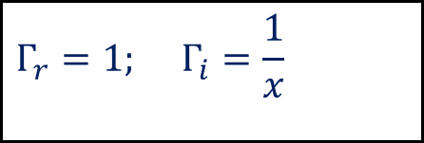


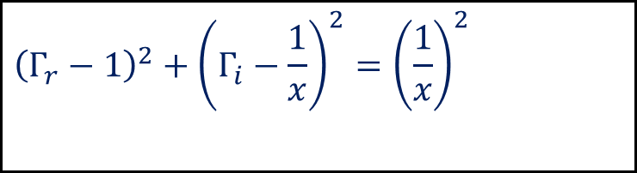






Constant Reactance Circles
$${\left(Γ_{r}−1\right)}^{2}+{\left(Γ_{i}−\frac{1}{x}\right)}^{2}={\left(\frac{1}{x}\right)}^{2}$$
Center
Radius
$$Γ_{r}=1; Γ_{i}=\frac{1}{x}$$
$$\frac{1}{\left|x\right|}$$
$$Γ_{i}$$
$$x=1$$
$$x<1$$
$$x>1$$
$$Γ_{r}$$
$$x=0$$
Take image about the y-axis for negative values of $x$
$$x=±∞$$

Slide 9
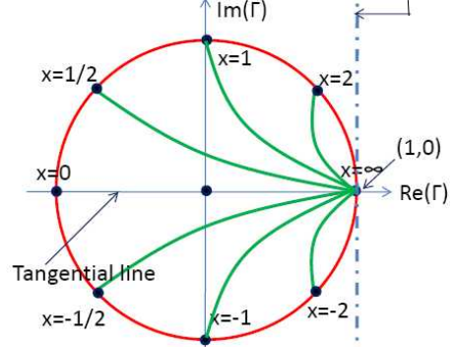

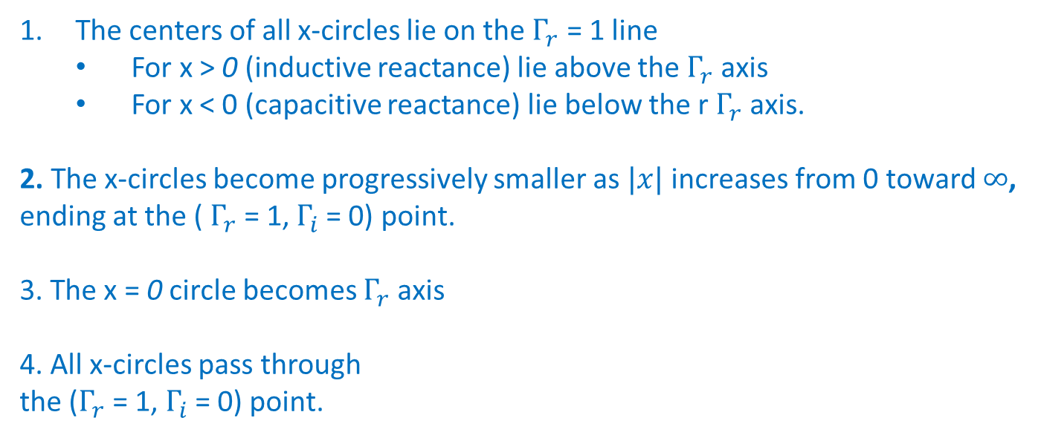


Constant $x$ Circles properties
The centers of all x-circles lie on the $Γ_{r}$ = 1 line
For x > 0 (inductive reactance) lie above the $Γ_{r}$axis
For x < 0 (capacitive reactance) lie below the r $Γ_{r}$axis.
2. The x-circles become progressively smaller as $|x|$ increases from 0 toward $∞$,
ending at the ( $Γ_{r}$ = 1, $Γ_{i}$= 0) point.
3. The x = 0 circle becomes $Γ_{r}$axis
4. All x-circles pass through
the ($Γ_{r}$= 1, $Γ_{i}$= 0) point.
$$Γ_{i}$$
$$Γ_{r}$$
Combining constant r and x circles gives the smith chart that we use.

Slide 10
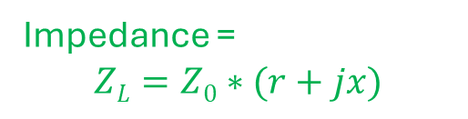






Smith chart properties
|Γ|≤ 1
r and circles $at 90o$
I$ntersection denotes$
$$zL=r+jx$$
Impedance =
$$ZL=Z0∗(r+jx)$$
$$SC$$
$$OC$$
$$Γ_{OC}=1$$
$$Γ_{SC}=−1$$
We can work directly with polar coordinates

Slide 11





Smith chart properties
circle intersect the real axis at
P_{MAX} on positive real axis (voltage maxima)
P_{MIN} on negative real axis (voltage minima)
R_{L} > R₀ (r > 1) : P_{MAX}
R_{L} > R₀ (r < 1) : P_{MIN}
$$\left|Γ\right|∠θΓ$$
$$if RL<R0$$
$$S=1/r$$
$$if RL>R0$$
$$S=r$$
$$PMIN$$
$$PMAX$$

Slide 12

$$\text{Constant} \left|Γ\right| \text{Circle}$$
All the Γ circles are centered at the origin and their radii vary from 0 to 1.
The angle measured from the positive real axis of the line drawn from the origin through the point representing z_{L} equals θ_{Γ}.
The value of the r-circle passing through the intersection of the Γ circle and the positive real axis (P_{MIN} and P_{MAX} points) equals the standing wave ratio as per the conditions provided in next slide.

Slide 13
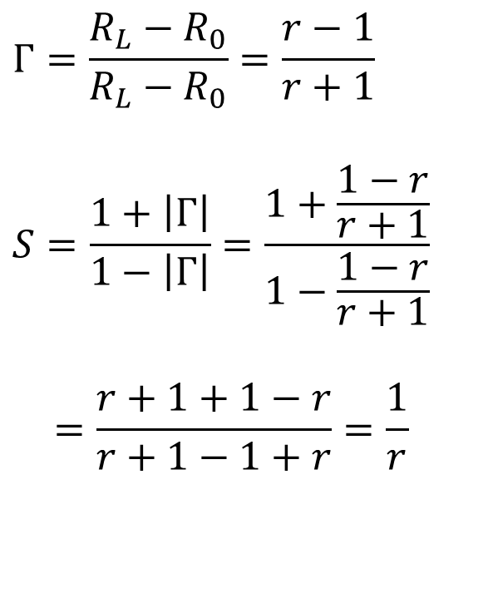

SWR calculations
$$if R_{L}<R_{0}$$
$$Γ=\frac{R_{L}−R_{0}}{R_{L}−R_{0}}=\frac{r−1}{r+1}$$
$$S=\frac{1+\left|Γ\right|}{1−\left|Γ\right|}=\frac{1+\frac{1−r}{r+1}}{1−\frac{1−r}{r+1}}$$
$$=\frac{r+1+1−r}{r+1−1+r}=\frac{1}{r}$$

Slide 14
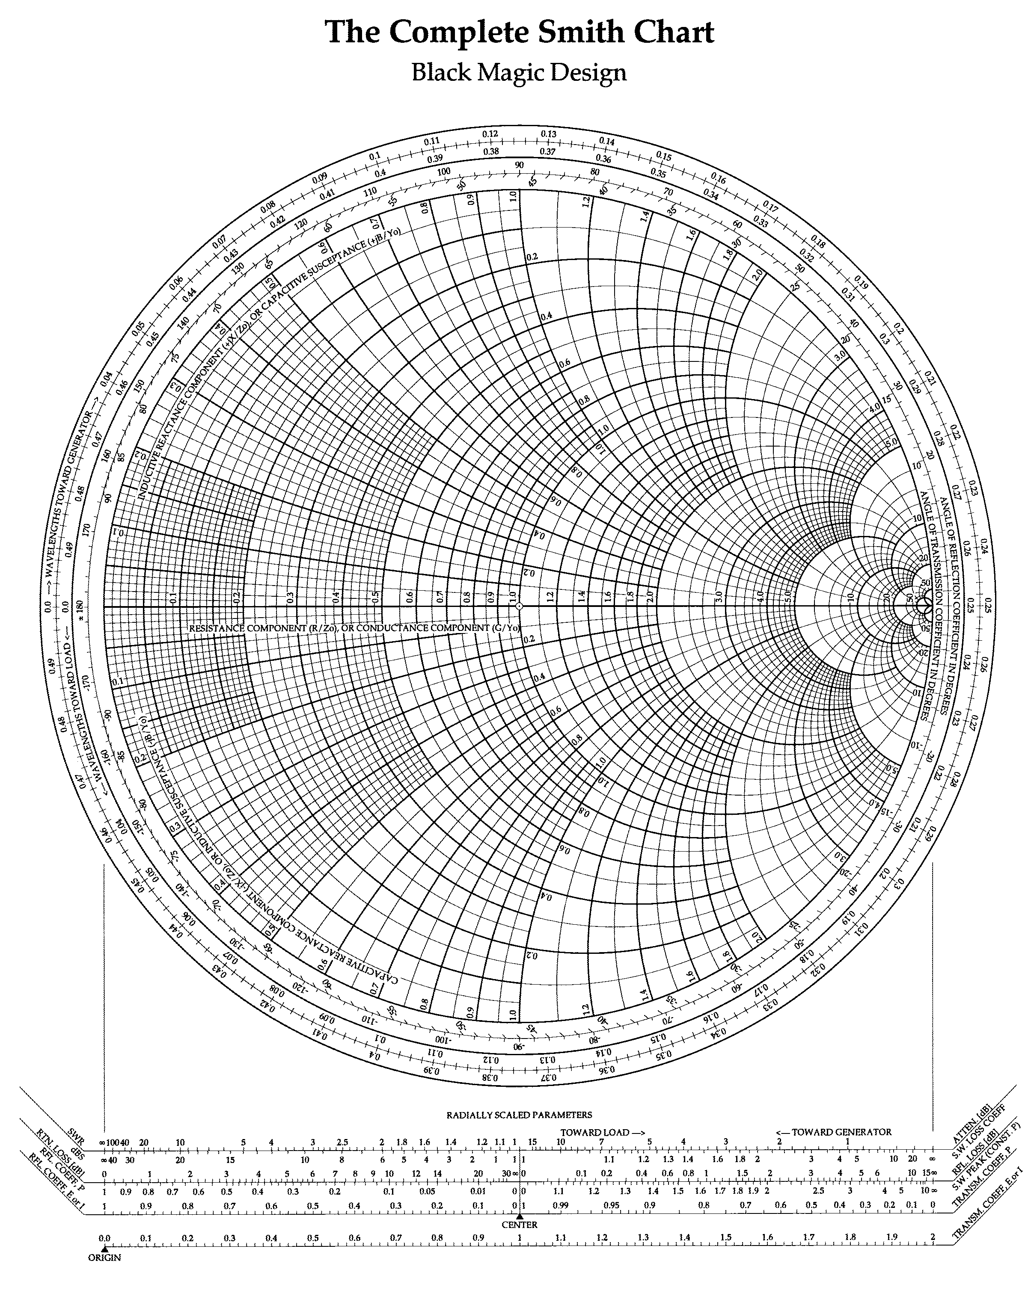
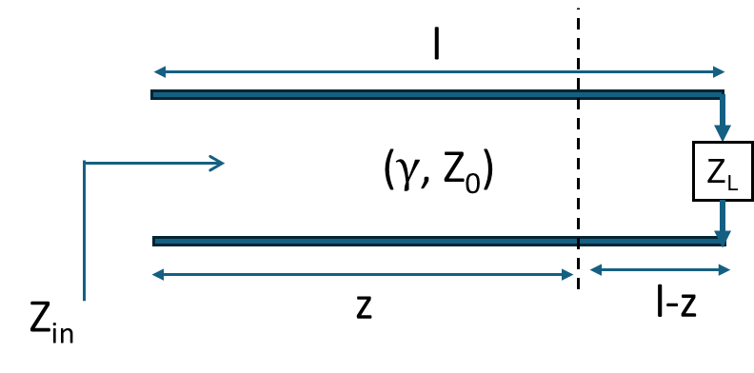


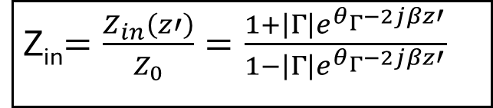
Moving along $\text{Constant} \left|Γ\right| \text{Circle}$
The outer scale on smith chart is marked “wavelength toward generator” in clockwise direction (increasing z’)
The inner scale is marked “wavelength toward load” in counter-clockwise direction (decreasing z’)
toward generator
toward load
Z_{in}$=\frac{Z_{in}\left(z′\right)}{Z_{0}}=\frac{1+\left|Γ\right|e^{θ_{Γ}−2jβz′}}{1−\left|Γ\right|e^{θ_{Γ}−2jβz′}}$
$$z′$$

Slide 15
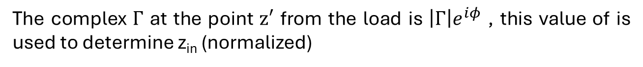
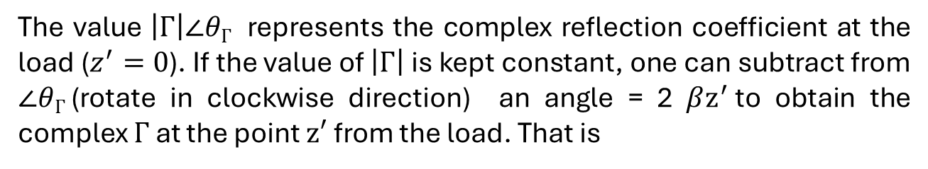
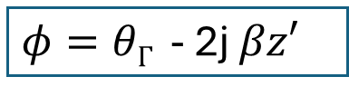
The value $\left|Γ\right|∠θΓ$ represents the complex reflection coefficient at the load ($z^{′}=0$). If the value of $\left|Γ\right|$ is kept constant, one can subtract from $∠θΓ$(rotate in clockwise direction) an angle = 2 $βz^{′}$to obtain the complex $Γ$ at the point $z′$ from the load. That is
The complex $Γ$ at the point $z′$ from the load is $\left|Γ\right|e^{iφ}$ , this value of is used to determine z_{in} (normalized)
$φ=θΓ$ - 2j $βz′$
Therefore, complete revolution gives the z’ of λ/2
The outermost scale on the Smith chart is labelled as “wavelength towards generator (TWG)” in the clockwise direction (increasing z’)
The last but one scale on the Smith chart is labelled as “wavelength towards load (TWG)” in the counter-clockwise direction (decreasing z’)

Slide 16



Example:1 Find Γ_{L} if the load impedance Z_{L} is 25+j150 Ω and characteristic impedance of transmission line is 50 Ω
$$\overline{z_{L}}=0.5+j3.0$$
$$\left|Γ\right|∠θΓ$$
$$zL$$

Slide 17





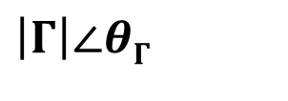
$$zL$$
$$\left|Γ\right|∠θΓ$$
$$S$$
Chart not to scale
$$S$$
$$VSWR=10.4$$
|$Γ|=0.8246$

Slide 18
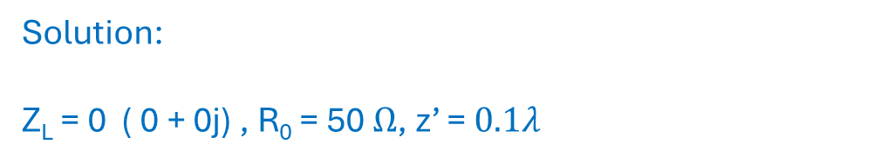
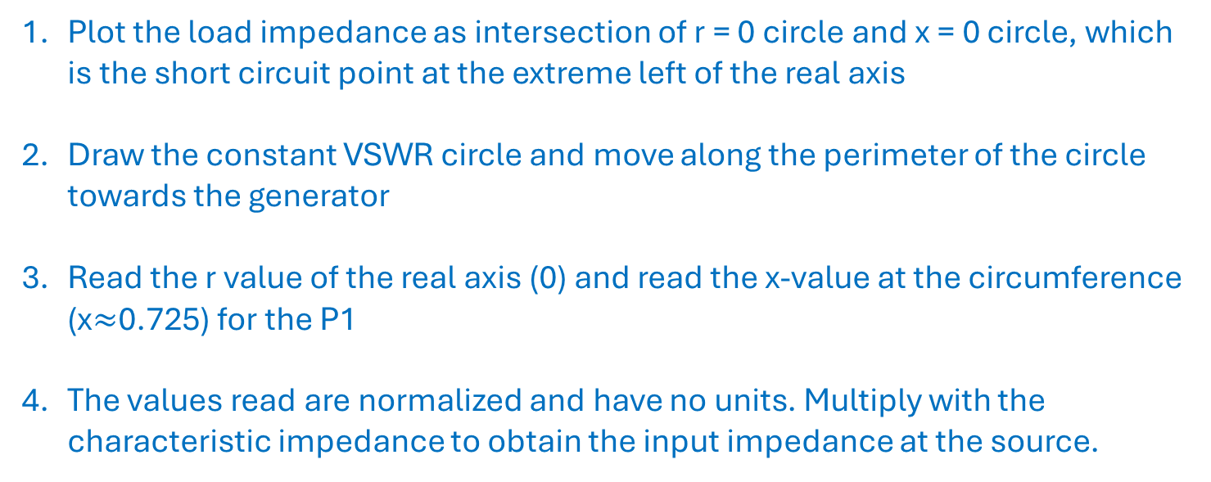
Example: Use the smith chart to find the input impedance of a section of 50 $Ω$ lossless Transmission line which is $0.1λ$ long and is terminated in a short circuit
Solution:
Z_{L} = 0 ( 0 + 0j) , R₀ = 50 $Ω$, z’ = $0.1λ$
Plot the load impedance as intersection of r = 0 circle and x = 0 circle, which is the short circuit point at the extreme left of the real axis
Draw the constant VSWR circle and move along the perimeter of the circle towards the generator
Read the r value of the real axis (0) and read the x-value at the circumference (x$≈$0.725) for the P1
The values read are normalized and have no units. Multiply with the characteristic impedance to obtain the input impedance at the source.

Slide 19
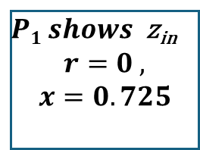

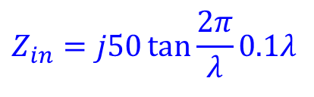

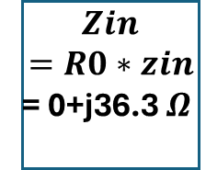
P’1
$$0.1λ$$
Read the outer most scale for the difference in length from Z_{L} to P1
P1
$P1 shows$ z_{in}
$$r=0 ,$$
$$x=0.725$$
Move toward the generator
$$Zin$$
$$=R0∗zin$$
= 0+j36.3 $Ω$
Z_{L}
Alternatively,
$$Z_{in}=jR_{0}\tan{β}l$$
$$Z_{in}=j50\tan{\frac{2π}{λ}0.1λ}$$

Slide 20
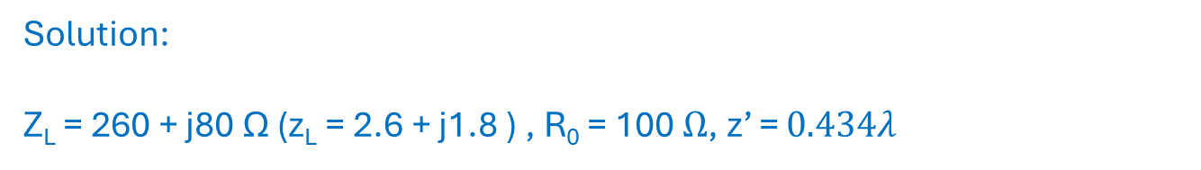
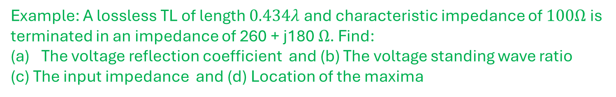
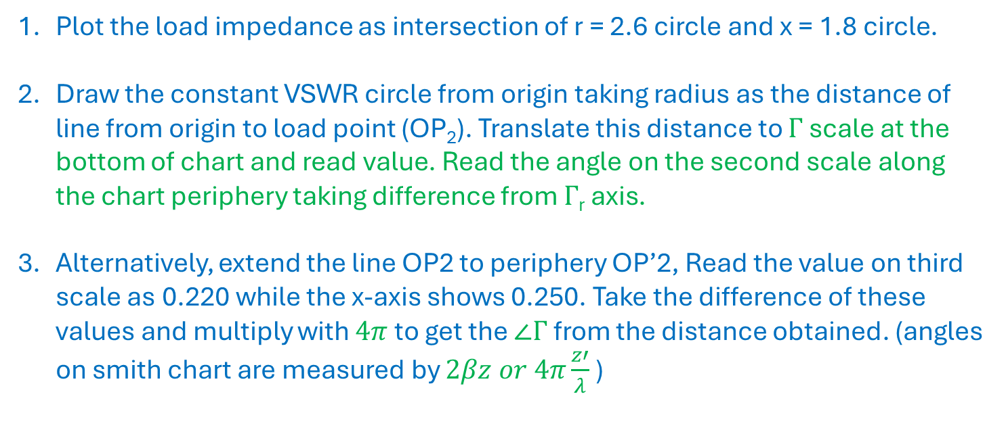
Example: A lossless TL of length $0.434λ$ and characteristic impedance of $100Ω$ is terminated in an impedance of 260 + j180 $Ω$. Find:
The voltage reflection coefficient and (b) The voltage standing wave ratio
(c) The input impedance and (d) Location of the maxima
Solution:
Z_{L} = 260 + j80 Ω (z_{L} = 2.6 + j1.8 ) , R₀ = 100 $Ω$, z’ = $0.434λ$
Plot the load impedance as intersection of r = 2.6 circle and x = 1.8 circle.
Draw the constant VSWR circle from origin taking radius as the distance of line from origin to load point (OP₂). Translate this distance to $Γ$ scale at the bottom of chart and read value. Read the angle on the second scale along the chart periphery taking difference from $Γ$_{r} axis.
Alternatively, extend the line OP2 to periphery OP’2, Read the value on third scale as 0.220 while the x-axis shows 0.250. Take the difference of these values and multiply with $4π$ to get the $∠Γ$ from the distance obtained. (angles on smith chart are measured by $2βz or 4π\frac{z′}{λ}$)

Slide 21

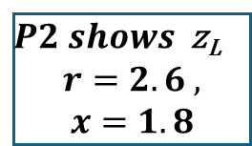




$P2 shows$ z_{L}
$$r=2.6 ,$$
$$x=1.8$$
P’2
P2
Z_{L}
$$|Γ|$$
$$∠Γ$$
$$Γ=0.60 ∠21o$$
P_{MIN}
O
P_{MAX}
$$S=r$$
$$S=r=4 at PMAX$$

Slide 22
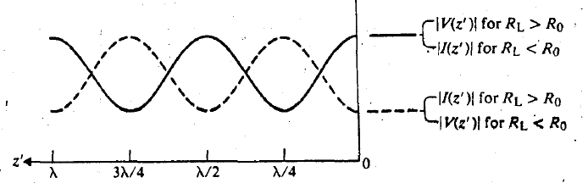
l
I_{L}
Z_{L}
Z_{in}
l_{MAX}
z’ =0
z =0
Dashed line shows voltage
l_{MAX}

Slide 23
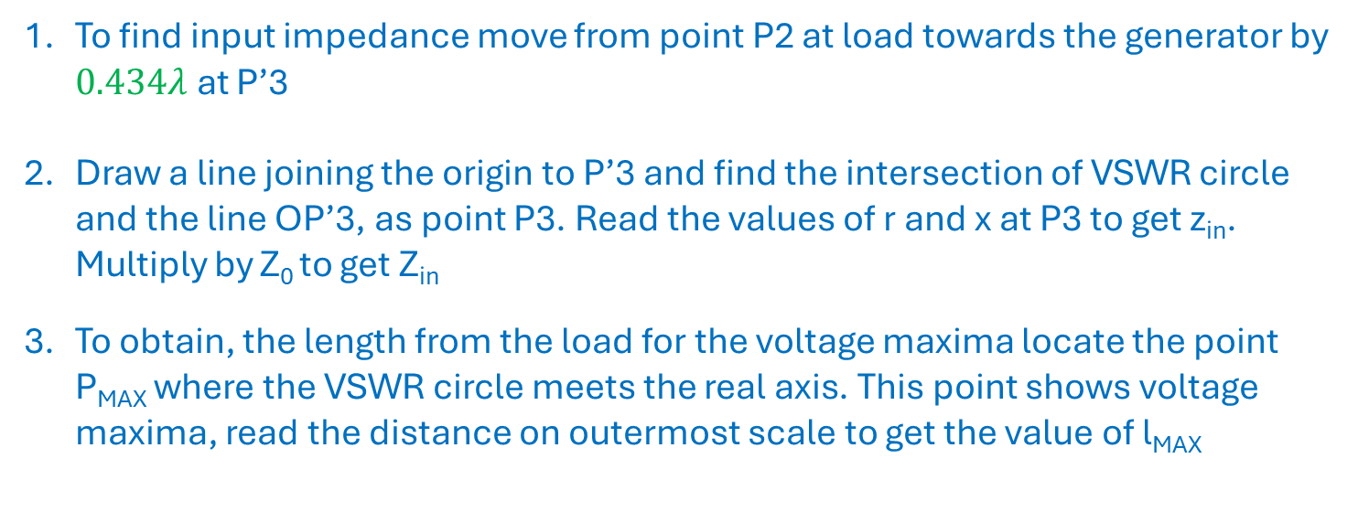
To find input impedance move from point P2 at load towards the generator by $0.434λ$ at P’3
Draw a line joining the origin to P’3 and find the intersection of VSWR circle and the line OP’3, as point P3. Read the values of r and x at P3 to get z_{in}. Multiply by Z₀ to get Z_{in}
To obtain, the length from the load for the voltage maxima locate the point P_{MAX} where the VSWR circle meets the real axis. This point shows voltage maxima, read the distance on outermost scale to get the value of l_{MAX}

Slide 24
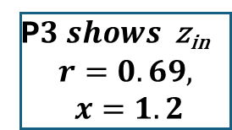


P’3
Due to cyclic nature, subtract (move CCL) from P’2 (0.5 -0.434 = 0.066)
P3
P’2
Z_{L}
P2
l_{MAX}
P_{MIN}
O
P_{MAX}
P$3 shows$ z_{in}
$$r=0.69,$$
$$x=1.2$$
$Zin$= 69+j120$Ω$
$$lMAX= 0.030λ$$

Slide 25
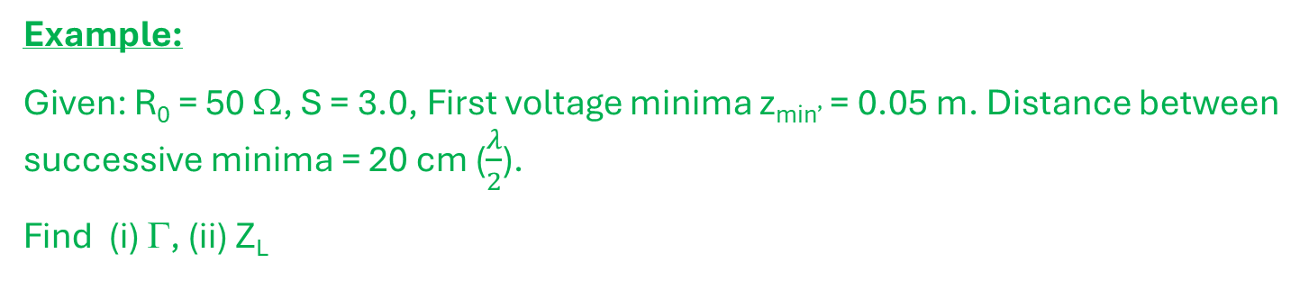
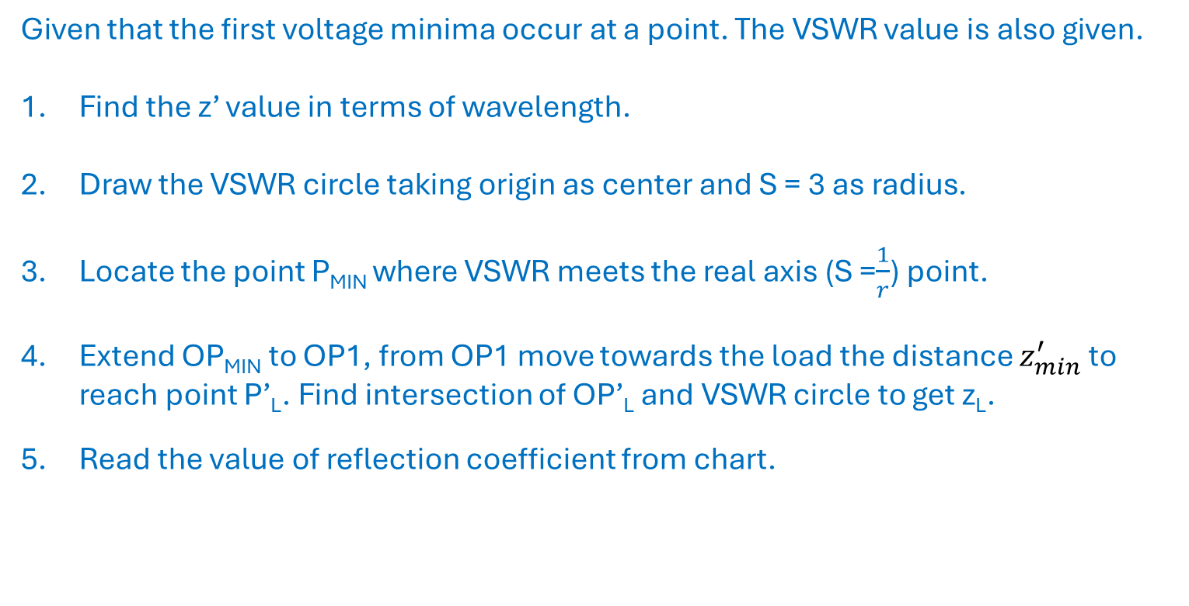

Example:
Given: R₀ = 50 Ω, S = 3.0, First voltage minima z_{min’} = 0.05 m. Distance between successive minima = 20 cm ($\frac{λ}{2}$).
Find (i) Γ, (ii) Z_{L}
Given that the first voltage minima occur at a point. The VSWR value is also given.
Find the z’ value in terms of wavelength.
Draw the VSWR circle taking origin as center and S = 3 as radius.
Locate the point P_{MIN} where VSWR meets the real axis (S =$\frac{1}{r}$) point.
Extend OP_{MIN} to OP1, from OP1 move towards the load the distance $z_{min}^{′}$ to reach point P’_{L}. Find intersection of OP’_{L} and VSWR circle to get z_{L}.
Read the value of reflection coefficient from chart.
$$\frac{Z_{min}^{′}}{λ}=\frac{0.05}{0.4}=0.125$$

Slide 26






Given P_{MIN} is 0.125 λ from the load towards generator. Find load z_{L}?
VSWR =3
P_{L}$shows$ z_{L}
$$r=0.6,$$
$$x=−0.8$$
$$∠Γ$$
P1
P_{MIN}
O
P_{MAX}
$$|Γ|$$
P_{L}
Z_{L}
$ZL$= 30-j$40Ω$
$|Γ|$= 0.5
$∠Γ$= 270º
Move towards load to find the load position
P’_{L}

Slide 27




Converting from impedance to admittance in smith chart
$$Γ\left(d\right)=\left|Γ\right|e^{jθ_{Γ}}$$
$$Γ\left(d+λ/4\right)=\left|Γ\right|e^{j\left(θ_{Γ}−2βλ/4\right)}=\left|Γ\right|e^{jθ_{Γ}}e^{−jπ}=−Γ\left(d\right)$$
Also, we know
$$z_{n}\left(d\right)=\frac{1+Γ\left(d\right)}{1−Γ\left(d\right)}; y_{n}\left(d\right)=\frac{1−Γ\left(d\right)}{1+Γ\left(d\right)}$$
$$z_{n}\left(d+\frac{λ}{4}\right)=\frac{1+Γ\left(d+\frac{λ}{4}\right)}{1−Γ\left(d+\frac{λ}{4}\right)}=\frac{1−Γ\left(d\right)}{1+Γ\left(d\right)}=y_{n}\left(d\right)$$
$$z_{n}\left(d+\frac{λ}{4}\right)=y_{n}\left(d\right)$$
Thus, moving 0.25$λ$ on constant VSWR circle along smith chart coverts given impedance to admittance and vice-versa. This corresponds to $θΓ=$180º .

Slide 28





$$Z\left(d+\frac{λ}{4}\right)=Z_{0}.z_{n}\left(d+\frac{λ}{4}\right)$$
$$Y\left(d\right)=Y_{0}.y_{n}\left(d\right)$$
Actual Impedance
Actual Admittance
Where,
$$Y_{0}=1/Z_{0}$$
Alternatively, for a quarter-wave long line ,
$$Z_{in}=Z_{0}\frac{Z_{L}+jZ_{0}\tan{β}l}{Z_{0}+jZ_{L}\tan{β}l}$$
$$\frac{Z_{in}}{Z_{0}}=\frac{Z_{0}}{Z_{L}}$$
For l = λ/4
$$\overline{z_{in}}=\frac{1}{\overline{z_{L}}}=\overline{y_{L}}$$
Thus, moving 0.25$λ$ on constant VSWR circle along smith chart coverts given impedance to admittance and vice-versa. This corresponds to $θΓ=$180º .

Slide 29
Example: Impedance Z_{L} = 25 + j 50 Ω and Z0 = 50 Ω ; Find the admittance Y_{L}
z_{L} = 0.50 + j(1)
P_{L}
z_{L}
Note:
When working with impedance we add in series (impedances)
Once we convert to admittance, we must add in parallel since admittances directly add in parallel.
180º
Add here
y_{L}
y_{L} = 0.40 – j(0.8)
Add here

Slide 30



Transmission Line Impedance Matching:
Quarter Wave Transformer for purely resistive loads
$$\frac{λ}{4}$$
$$R_{0}=\sqrt{R_{in}R_{RL}}$$
R_{L}
R_{in} = 50$Ω$
z’ =0
z =0
From the load, connect a quarter wave transmission line of characteristic impedance of R₀ as defined in the figure above.

Slide 31



Transmission Line Impedance Matching:
Quarter Wave Transformer for complex loads
$$\frac{λ}{4}$$
d
$$R_{0}=\sqrt{Z_{in}Z_{RL}}$$
Z_{RL}
Z_{L}
Z₀ = 50$Ω$
Z_{in} = 50$Ω$
z’ =0
z =0
Z_{L} may be complex load
Quarter Wave Transformer method is only valid when Z_{RL} is purely real. When Z_{L} is complex, d must be adjusted to make Z_{RL} purely resistive.

Slide 32



Procedure for quarter wave matching for complex load.
Plot the complex normalized load impedance using Z₀ = 50$Ω$ (any value)
Draw the VSWR corresponding to load point.
Move towards the generator along constant VSWR Circle to intersect real axis. Mark this impedance as z_{RL}. Multiply with Z₀ to obtain Z_{RL} (purely resistive)
Use the equation to obtain characteristic impedance of quarter wave transformer
Quarter-wave matching techniques are generally effective, but they can produce large structures so alternatives may be required such as single-stub matching.
$$R_{0}=\sqrt{Z_{in}Z_{RL}}$$
Example:
Use the Quarter wave transformer to match the complex load Z_{L} = 50 + j 70 $Ω$
Solution: Since load is complex, first transform into purely resistive using TL of impedance of Z₀ = 50 $Ω$ ; z_{L} = 1+j(1.4)$Ω$

Slide 33



Z_{L}
Z_{RL}
Z_{RL} is purely resistive,
Use quarter-wave matching
$ZRL$= $3.6×50 Ω=180 Ω$
$$R_{0}=\sqrt{50×180}$$
$$R_{0}≈95Ω$$

Slide 34
Admittance Smith chart
Constant g and b circles

Slide 35




Constant $g$ Circles and b Circles : Admittance Smith Chart
$$Γ=\frac{zL−1}{zL+1}=Γ_{r}+jΓ_{i}$$
$$use yL=\frac{1}{zL}$$
where Γ_{i} and Γ_{r} denote the real and imaginary parts of complex Γ
$$yL=\frac{1−Γ}{1+Γ}=\frac{1−\left|Γ\right|e^{jθ_{Γ}}}{1+\left|Γ\right|e^{jθ_{Γ}}}$$
y_{L}$=g+jb=\frac{\left(1−Γ_{r}\right)−jΓ_{i}}{\left(1+Γ_{r}\right)+jΓ_{i}}$
Separating real and imaginary parts and rationalizing we get:

Slide 36






On extracting real and imaginary parts
$$g=\frac{1−Γ_{r}^{2}−Γ_{i}^{2}}{{\left(1+Γ_{r}\right)}^{2}+Γ_{i}^{2}}$$
$$b=\frac{−2Γ_{i}}{{\left(1+Γ_{r}\right)}^{2}+Γ_{i}^{2}}$$
Perform manipulations to obtain equations of circles
$$g=\frac{1−Γ_{r}^{2}−Γ_{i}^{2}}{{\left(1+Γ_{r}\right)}^{2}+Γ_{i}^{2}}$$
$${\left(Γ_{r}+\frac{g}{1+g}\right)}^{2}+Γ_{i}^{2}={\left(\frac{1}{1+g}\right)}^{2}$$
(x-a)²$+(y−b)2=R^{2}$
$$b=\frac{−2Γ_{i}}{{\left(1−Γ_{r}\right)}^{2}+Γ_{i}^{2}}$$
$${\left(Γ_{r}+1\right)}^{2}+{\left(Γ_{i}+\frac{1}{b}\right)}^{2}={\left(\frac{1}{b}\right)}^{2}$$

Slide 37









Constant Conductance Circles
$${\left(Γ_{r}+\frac{g}{1+g}\right)}^{2}+Γ_{i}^{2}={\left(\frac{1}{1+g}\right)}^{2}$$
Therefore, we get a family of circles with Eq:
Center
Radius
$$Γ_{r}=−\frac{g}{1+g}; Γ_{i}=0$$
$$R= \frac{1}{1+g}$$
Different values of r yield circles with different radii and shifting centers:
$$Γ_{i}$$
$$g=0$$
Mirror image of constant r circles about the center
$$g<1$$
$$g=1$$
$$Γ_{r}$$
$$g>1$$
$$g=∞$$
$g=$0

Slide 38










Constant Susceptance Circles
$${\left(Γ_{r}+1\right)}^{2}+{\left(Γ_{i}+\frac{1}{b}\right)}^{2}={\left(\frac{1}{b}\right)}^{2}$$
Center
Radius
$$Γ_{r}=−1; Γ_{i}=−\frac{1}{b}$$
$$\frac{1}{\left|b\right|}$$
$$b=−1$$
$$Γ_{i}$$
$$\left|b\right|>1$$
$$\left|b\right|<1$$
Mirror image of constant x circles about the center
$$Γ_{r}$$
$$|b|=∞$$
Take image about the y-axis for positive values of $b$
$|b|=$0

Slide 39





















$$Γ_{i}$$
Mirror
$$Γ_{i}$$
$$r=0$$
$$g=0$$
$$r=∞$$
$$g=∞$$
$$Γ_{r}$$
$$Γ_{r}$$
$$r=1$$
$$g=1$$
$g=$0
$$Γ_{i}$$
$$b=−1$$
$$x=1$$
$$Γ_{i}$$
$$b=0$$
$$Γ_{r}$$
$$b=±∞$$
$$Γ_{r}$$
$$x=0$$
$$x=±∞$$
Since g and b circles are mirror images of r and x circles, we can simply invert our (impedance) smith chart to work with g and b circles (admittances)

Slide 40








Impedance to admittance chart conversion
Impedance Smith Chart
admittance Smith Chart
Inductive reactance (+jx)
Inductive susceptance -jb_{L}
$$z=0$$
$$z=∞$$
$$y=∞$$
$$y=0$$
$$y=∞$$
$$z=0$$
$$z=∞$$
$$y=0$$
Capacitive reactance (-jx)
Capacitive susceptance (+jb)
Constant r and x circles
Constant g and b circles
Rotate the impedance chart 180º

Slide 41

There is another smith chart that has overlapping impedance and admittance Smith Charts. But we will work only with impedance Smith chart and keep converting from impedance to admittance when working series or parallel connection respectively. We will take g=1 circle for reference use.
https://www.microwaves101.com/encyclopedias/smith-chart-basics

Slide 42

Previous example: Impedance Z_{L} = 25 + j 50 Ω and Z0 = 50 Ω ; Find admittance Y_{L}
Note: If we do not flip the chart, we can read r and x values directly as done for impedance (as in class), but we must remember that they represent g and b values.
Inductive susceptance -jb_{L}
b= 0.8 circle
g= 0.4 circle
Capacitive susceptance (+jb)
Once converted from impedance to admittance, we should ideally flip the impedance Smith chart to visualize g and r circles where, the constant radius circles represent g circles and arcs represent b circles.
Note: Once converted to admittance, we move along constant g and b circles, so flip the chart for better clarity when it is required to move along Smith chart.

Slide 43








Single Stub Matching:
Using admittances for parallel connections
_{B}
$$d$$
Y_{B}
Y_{i}
Z_{L}
Z₀ =R₀
Y_{s}
_{B’}
Matching condition:
$$Y_{i}=Y_{B}+Y_{S}$$
(admittances directly add in parallel circuits)
$$ls$$
Z_{sc} = 0$Ω$
$$Y_{i}=Y_{0}$$
$$\frac{Y_{i}}{Y_{0}}=\frac{Y_{B}}{Y_{0}}+\frac{Y_{S}}{Y_{0}}$$
$$y_{i}=y_{B}+y_{S}$$
(normalized)
$$1=y_{B}+y_{S}$$

Slide 44



Since we are using short circuited stub, the impedance looking into the stub is purely reactive, therefore the admittance is purely susceptive (Imaginary)
$$y_{s}=−jb_{B}$$
Since,
$$y_{B}+y_{S} =1$$
Matching condition:
$$y_{B}=1+jb_{B}$$
We can transform (by moving along constant VSWR circle towards generator) the value Y_{B} such that it has g=1, whereas the remaining imaginary part can be compensated using stub admittance.

Slide 45


Single Stub Matching: Procedure
Using the Smith chart as an admittance chart, we proceed as follows:
Enter the point representing the normalized load admittance, y_{L}
Draw the $Γ$-circle for y_{L}, which will intersect the g = 1 circle at two points. At these points y_{B1} = 1 + jb₁, and у_{B2} = 1 + jb₂. Both are possible solutions.
Determine load-section lengths d₁ and d₂ from the angles between the point representing y_{L} and the points representing y_{B1} and y_{B2}.
Determine stub lengths l_{B1} and l_{B2} from the angles between the short-circuit point on the extreme right of the chart to the points representing -jb₁ and -jb₂ respectively.
Example: Use single stub matching using shorted stub to match the complex load Z_{L} = 35 - j 47.5 $Ω.$ Find position and length of stub. Z₀ = 50 $Ω$
Solution: z_{L} = 0.7 - j(0.95)$Ω$. Follow the procedure as above.

Slide 46




P’2
d1
_{P’3}
$zL$= 0.7-j95$Ω$
$yL≈$ 0.5+j68$Ω$
d2
P2
y_{L}
_{P3}
_{g=1}
O
Z_{oc}
Y_{sc}
Position:
P3 = Y_{B1} =1+j1.2
_{P4}
P4 = Y_{B2} =1-j1.2
P1
Z_{L}
d₁= (0.168-0.109) $λ$
d₂= (0.332-0.109) $λ$
_{P’4}
_{P5}

Slide 47



_{P6}
l_{B2}
Both solutions (d₁, l_{B1}) and (d₂, l_{B2}) are valid.
After adding stub, points P3 and P4 shift to origin ($|Γ|=0,∠Γ=0$)
_{P3}
_{g=1}
O
Z_{oc}
Length:
Y_{sc}
-jb₁ = -j1.2
_{P4}
l_{B1}= (0.361-0.25) $λ$
l_{B1}
-jb₂= j1.2
l_{B2}= (0.139+0.25) $λ$
_{P5}

Slide 48
Impedance Matching with lumped components
Use of reactive components for lossless matching

Slide 49







Impedance matching with lumped elements
Action: Adding resistance in series
_{Reaction on smith chart:}
Movement along constant reactance circles in Smith Chart where resistance increases
$$R$$
Z_{L}
$z$= $\frac{R}{Z0}$
Action: Adding inductance in series
_{Reaction on smith chart:}
Movement along constant resistance circles in impedance Smith Chart where reactance increases (upward)
$$jωL$$
Z_{L}
$z$= j($\frac{XL}{Z0}$)
Action: Adding capacitance in series
$\frac{1}{jωC}$ =
$$\frac{−j}{ωC}$$
_{Reaction on smith chart:}
Movement along constant resistance circles in impedance Smith Chart where reactance decreases (downward)
Z_{L}
$z$= -j($\frac{Xc}{Z0}$)

Slide 50






Impedance matching with lumped elements
Note the use of admittance, so first convert to admittance if it is not.
Action: Adding resistance in parallel
_{Reaction on smith chart:}
Movement along constant susceptance circles in admittance Smith Chart where resistance decreases
$$G= \frac{1}{R}$$
Y_{L}
$Y$= $\frac{G}{Y0}$
_{Movement along flipped chart}
Action: Adding inductance in parallel
_{Reaction on smith chart:}
Movement along constant conductance circles in admittance Smith Chart where susceptance value subtracts
B_{L} = $\frac{1}{jωL }$
Y_{L}
$Y$= -j($\frac{BL}{Y0}$)
Movement along flipped chart (upward)
Action: Adding capacitance in parallel
_{Reaction on smith chart:}
Movement along constant conductance circles in admittance Smith Chart where susceptance adds up
B_{C} = $jωC$
Y_{L}
Y = j($\frac{Bc}{Y0}$)
Movement along flipped chart (downward)

Slide 51
Q2. Consider an impedance Z = R + jX marked with point P in an impedance Smith chart as shown in below figure. The movement from point P along a constant resistance circle in the clockwise direction by an angle 45 deg is equivalent to……..
We are working on impedance chart
Load is capacitive since x is negative on impedance chart
Moving 45 deg. clockwise in constant resistance circle increases the reactance.
It is equivalent to adding an inductance in series with Z.
(i) Moving in clockwise direction along constant resistance circle is same as adding inductance in series.
(ii) Moving in anti-clockwise direction along constant resistance circle is same as adding capacitor in series.

Slide 52


Exercise: Matching with Lumped elements
Match the 100 $Ω$load to 50 $Ω$ at f = 100 MHz
If we simply add 100 $Ω$resistor to the load side, we can get a perfect match.
But that resistor will dissipate power making our matching network lossy.
Thus, we require reactive components to match the load without dissipating any power in the matching circuits. These matching sections are often in shape of L network or inverted L network.

Slide 53
Points to remember:
Our aim is to reach the center of smith chart for perfect match.
We need to go from z_{L} = 2 + j(0) to z_{in} = 1 + j(0) to get to the sweet spot
But we would not go any closer by adding series impedance so we must add things in parallel
When we want to circuit components in parallel, we should work with admittances and hence we need to flip over our Smith chart
So first convert the load impedance to admittance chart.
Since, we are working with impedance Smith chart, it is helpful to add g=1 circle for reference. Simply take the mirror image of r=1 circle on your chart.

Slide 54
Since, we are working with impedance Smith chart, it is helpful to add g=1 circle for reference. Simply take the mirror image of r=1 circle on your chart.
Since, we need parallel components, we switch to admittance. Draw VSWR circle and mirror load about the origin on VSWR Circle
Add capacitance such that we intersect g=1 circle, Xc = 0.5. Notice that the movement is along g= 0.5 circle (since it is admittance we should invert the chart to look at g circles)
Now add series inductance, first change to impedance.
Now add series inductance to cancel the reactive part.

Slide 55









Z_{in} = 1+ j0
Z_{L} = 2+ j0
Capacitance value
Inductance value
$$jb=j(0.5)$$
$$jx=j(1)$$
$B=$bY₀ = b/Z₀
$$X=x×Z=50 Ω$$
$$\frac{0.5}{50}=2π\left(100MHz\right)C$$
$$50 Ω=2π\left(100MHz\right)L$$
$$C=16 pF$$
$$C=80 nH$$

Slide 56
We could have found another solution if we moved downward using parallel inductance, find that solution

