Slide 1
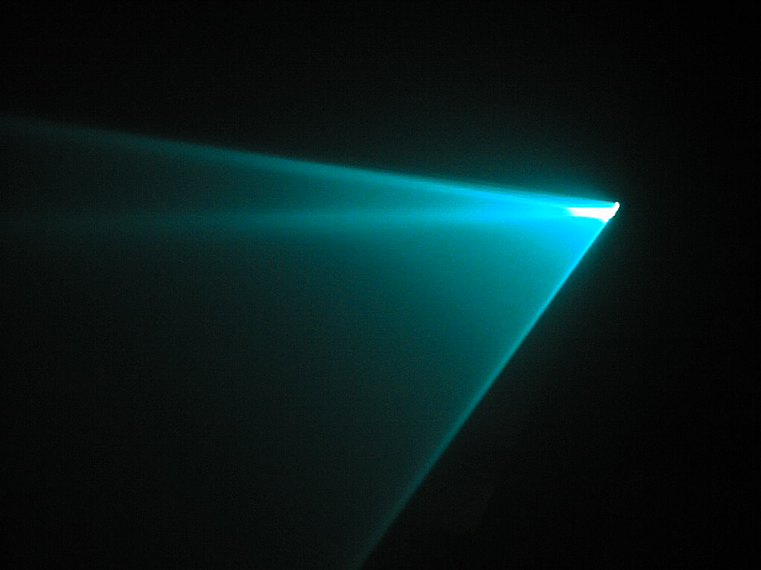
LASER
CUTTING
ISE

Slide 2

WHAT IS A LASER CUTTER?
Laser stands for Light Amplification by the Stimulated Emission of Radiation
The laser is a monochromatic beam of light created by the light amplification process
A Laser cutters uses a gas laser to cut holes or lines into a workpiece

Slide 3
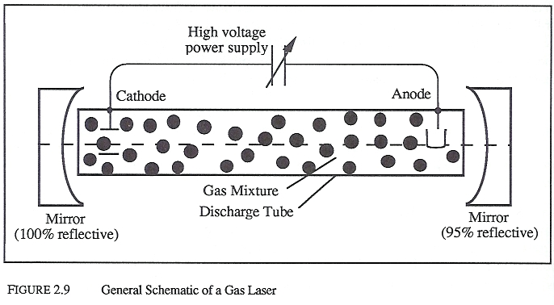
HOW A LASER WORKS
Gas mixture (active medium)
Totally reflecting mirror
Partially reflecting mirror
Power supply (pump)

Slide 4
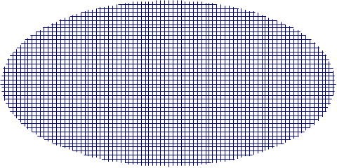
HOW A LASER WORKS
Chamber is filled with an active medium
Pump
+
-
Active medium
Totally
reflecting mirror
Partially
reflecting mirror

Slide 5
HOW A LASER WORKS
The pump provides energy to gas
Atoms in active medium become excited
Pump
+
-
Active medium
Totally
reflecting mirror
Partially
reflecting mirror

Slide 6
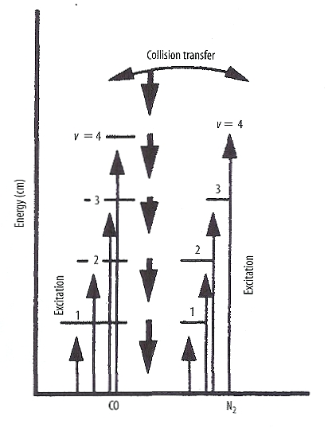
HOW A LASER WORKS
Atoms absorb energy from the pump, which causes them to leave the ground state
This means electrons jump to a higher energy level
When an atom de-excites, it gives off energy in the form of a photon

Slide 7
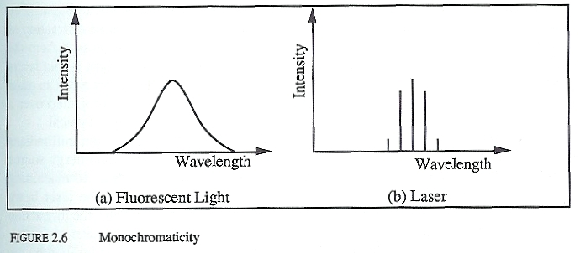
HOW A LASER WORKS
Energy level jumps are the same for a single gas
Light given off is all the same wavelength, or monochromatic

Slide 8
HOW A LASER WORKS
Atoms de-excite and photons are given off
Pump
+
-
Active medium
Totally
reflecting mirror
Partially
reflecting mirror

Slide 9
HOW A LASER WORKS
Photons oscillate between two mirrors
Photons collide with other excited atoms which give off more photons
Pump
+
-
Active medium
Totally
reflecting mirror
Partially
reflecting mirror

Slide 10
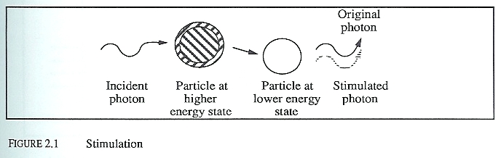
HOW A LASER WORKS
When a photon collides with an excited atom, it causes it to drop to a lower energy state, giving off another photon
This is called the stimulated emission phenomenon

Slide 11
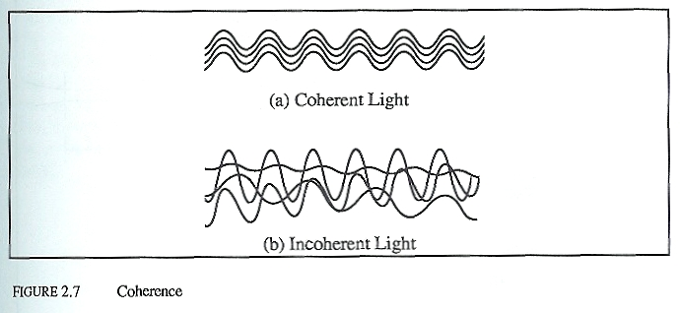
HOW A LASER WORKS
The stimulated photons have the same direction and phase as the incident photon

Slide 12
HOW A LASER WORKS
Photons pass through partially reflecting mirror and create a beam
Pump
+
-
Active medium
Totally
reflecting mirror
Partially
reflecting mirror

Slide 13
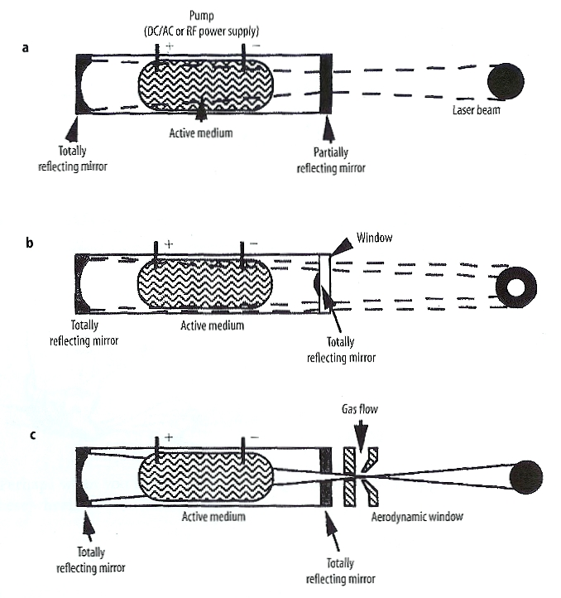
HOW A LASER WORKS

Slide 14
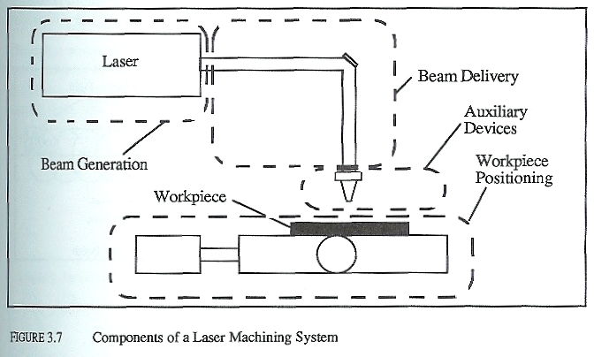
HOW A LASER CUTTER WORKS
Laser
Beam delivery system
Auxiliary devices
Worktable

Slide 15
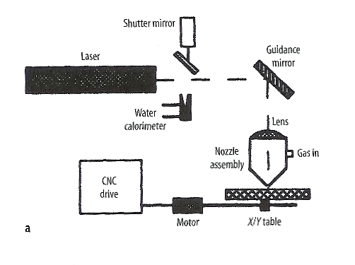
HOW A LASER CUTTER WORKS
A shutter mirror allows the laser into the guidance system

Slide 16
HOW A LASER CUTTER WORKS
The guidance mirror reflects the beam to the lens

Slide 17
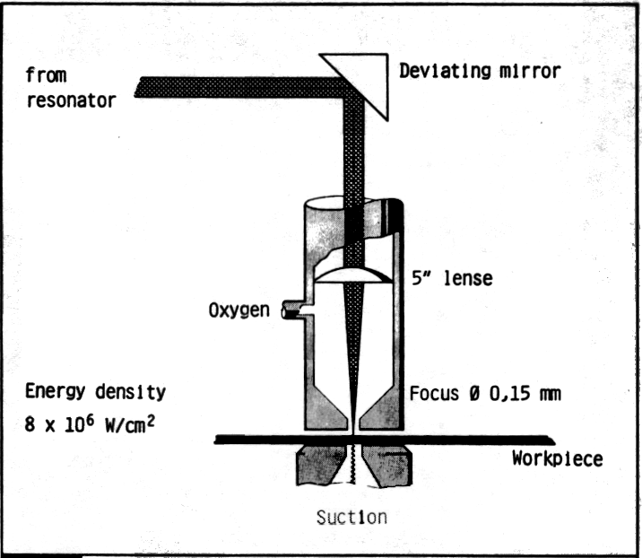
HOW A LASER CUTTER WORKS
The lens focuses the beam on the workpiece through a nozzle
Pressurized gas prevents scrap from the workpiece from damaging the lens or from reflecting the beam

Slide 18
HOW A LASER CUTTER WORKS
Molten metal is either allowed to fall off, is removed by the pressurized gas, or is suctioned out

Slide 19
HOW A LASER CUTTER WORKS
A CNC drive controls the table which moves the workpiece being cut

Slide 20
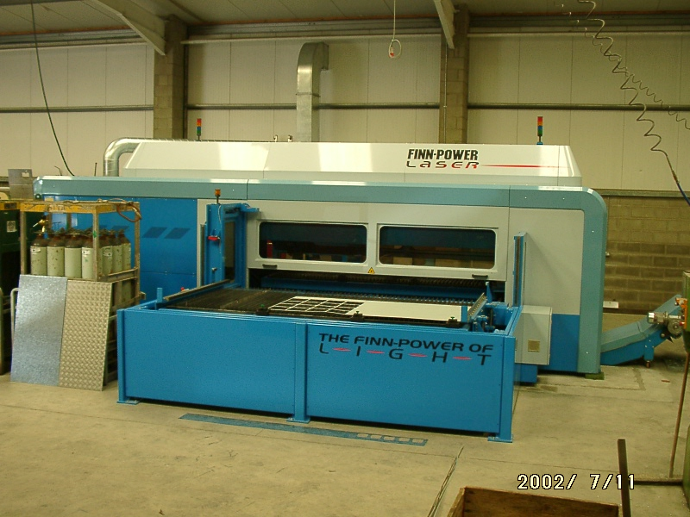
LASER CUTTERS

Slide 21
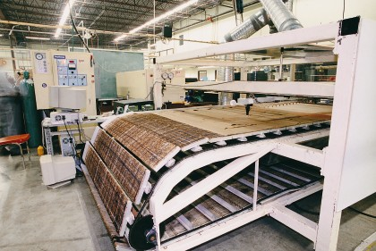
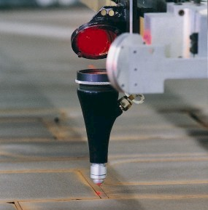
LASER CUTTERS

Slide 22
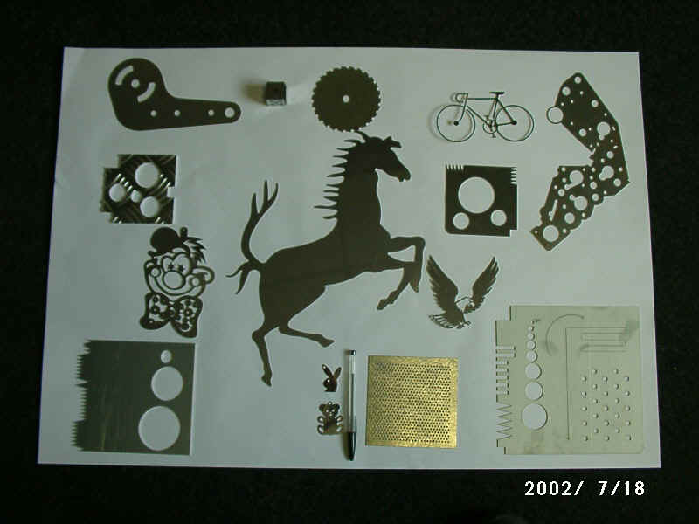
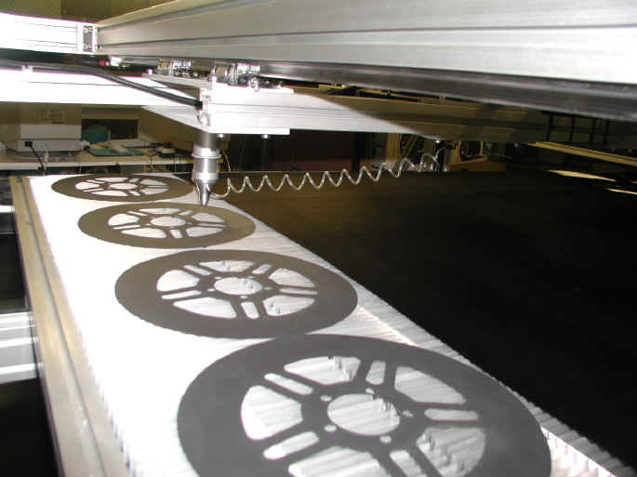
LASER CUTTERS

Slide 23
TYPES OF LASER CUTTING
Vaporisation
Fusion cutting
Reactive fusion cutting
Controlled fracture
Scribing
Cold Cutting
Laser Assisted Oxygen Cutting

Slide 24
VAPORISATION
Laser heats up the surface to boiling which creates a small hole
Laser is rapidly reflected by boiled material which deepens the hole
Material is ejected from bottom of workpiece
Pulsating laser is used
Good for non-melting materials

Slide 25
FUSION CUTTING
Melt and blow
Hole is made at edge of workpiece
Gas jet blows away molten material
Worktable moves the material under the laser is is constantly cut

Slide 26
REACTIVE FUSION CUTTING
Melt, burn, and blow
Similar to fusion cutting
Gas reacts with material causing it to melt

Slide 27
CONTROLLED FRACTURE
Thermal stress cracking
Good for brittle materials
Laser creates a controlled crack in the material

Slide 28
SCRIBING
Laser makes a groove in the workpiece
Workpiece is then broken at the groove line
Creates little debris

Slide 29
COLD CUTTING
Groundbreaking technique
Uses a ultraviolet laser with 4.9 eV photons
The bond energy for most organic materials is around this value
Photons hitting these bonds will cause the bonds to break

Slide 30
LASER ASSISTED OXYGEN CUTTING
LASOX Process
Laser ignites oxygen stream
Material is cut by burning oxygen
Low power

Slide 31
ADVANTAGES
Smooth edge
Much faster than many similar techniques
Extremely accurate with high repeatability
Fully automated

Slide 32
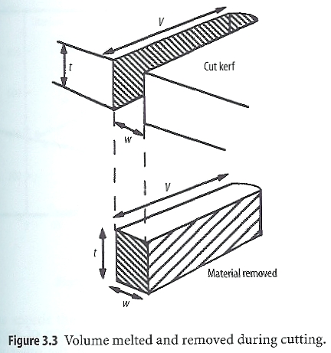
ADVANTAGES
Narrow kerf width

Slide 33
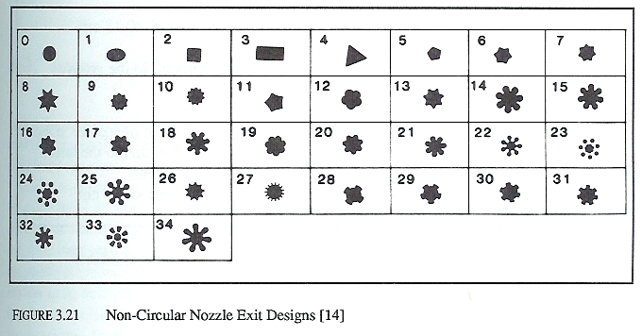
ADVANTAGES
Shape of cut can be controlled

Slide 34
ADVANTAGES
No tooling to replace
Cost to operate less than many similar processes
Can be used for almost any type of material
Virtually silent

Slide 35
DISADVANTAGES
Depth of material is limited
Certain reflective metals cannot be cut
Cut edge is brittle
Difficult to cut stacks of workpieces
Material can become warped
Initial investment is high

Slide 36
