Slide 1
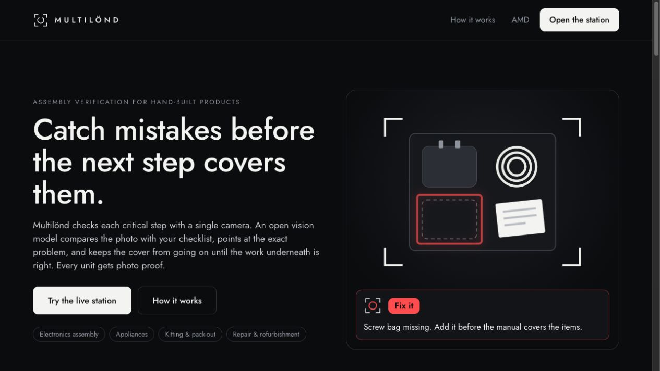
LABLAB.AI · AMD DEVELOPER HACKATHON: ACT III
INTELLIGENT INDUSTRY
MULTILÖND AI
Catch mistakes before the next step covers them.
TEAM MULTILÖND AI
OCT 2026
Notes:
0:00–0:12. Multilönd AI checks manual assembly and packing while the work is still visible. A missing accessory is easy to add when the box is open. After the lid closes, it becomes rework or a customer return.

Slide 2
MULTILÖND AI
01 / 03
01
THE PROBLEM
Notes:
0:12–0:15. The problem is the moment a later step hides earlier work.

Slide 3
MULTILÖND AI
THE PROBLEM
A missing accessory disappears when the lid closes.
01 · STEP
02 · HIDDEN
03 · FAILURE
A worker packs the kit but leaves out the charger.
The next step closes the box and hides its contents.
The customer opens an incomplete kit.
Notes:
0:15–0:27. Our main example is an accessory box. A worker leaves out a charger. Closing the lid hides the contents, and the customer receives an incomplete kit. This is an illustrative scenario, not a measured customer incident.

Slide 4
MULTILÖND AI
THE PROBLEM
The 1–10–100 rule
1
10
100+
At the workstation, while still visible
At the final factory test
At the customer: repair, warranty, reputation
RULE OF THUMB / ILLUSTRATIVE MULTIPLIERS, NOT MEASURED SAVINGS
Notes:
0:27–0:41. The 1-10-100 rule of thumb explains why timing matters. Fixing a mistake at the station is simpler than finding it at final test or after delivery. These multipliers illustrate the principle. We have not measured savings.

Slide 5
MULTILÖND AI
02 / 03
02
HOW IT WORKS
Notes:
0:41–0:44. The camera checks the contents before the workflow reaches the closing step.

Slide 6
MULTILÖND AI
HOW IT WORKS
Packing-box inspection
PRODUCT PAGE / ILLUSTRATION
Notes:
0:44–1:14. This is the product page, with an accessory-box illustration. In the live packing demo, the worker shows the contents to the camera. Fix it marks a problem area. Pass advances the workflow. Retake asks for a clearer view. The software keeps the lid step locked until required checks pass or a person provides an override reason. Physical interlocks are future work. Replace this illustrative product-page screenshot with real packing-station footage when the recording owner supplies it.

Slide 7
MULTILÖND AI
HOW IT WORKS
One check, step by step
01
02
03
04
05
Capture
Filter
Ask
Ground
Decide
Worker captures or uploads a photo
OpenCV checks photo quality
Question describes the correct state
DeepSeek V4.1 Flash returns verdict + box
Rules control progress and save visual attempts
Notes:
1:14–1:26. The worker captures a photo. OpenCV checks image quality locally. A checklist question describes what correct looks like. The model returns a verdict and, for a visible problem, a box. Fixed rules decide what happens next and save visual inspection attempts.

Slide 8
MULTILÖND AI
HOW IT WORKS
Open vision on AMD
DeepSeek V4.1 Flash (open-weight) on AMD Token Factory
FACTORY WORKSTATION
AMD TOKEN FACTORY
Laptop + camera
Radeon Cloud GPUs
PHOTO
Web worker station
RESULT
Open-weight model
OpenCV photo check
HTTPS API
OpenAI-compatible API
Python + YAML step rules
DeepSeek V4.1 Flash
SQLite evidence log
Structured JSON output
Production plan: the same open model runs on the factory’s own AMD GPU.
Notes:
1:26–1:44. The current demo uses DeepSeek V4.1 Flash (open-weight) on AMD Token Factory through an OpenAI-compatible API. The 14/24 cable benchmark and its roughly six-second checks were measured with Gemma 4. Those figures do not establish DeepSeek performance. In production, the same open model runs on the factory’s own AMD GPU. That deployment is planned, not demonstrated here.

Slide 9
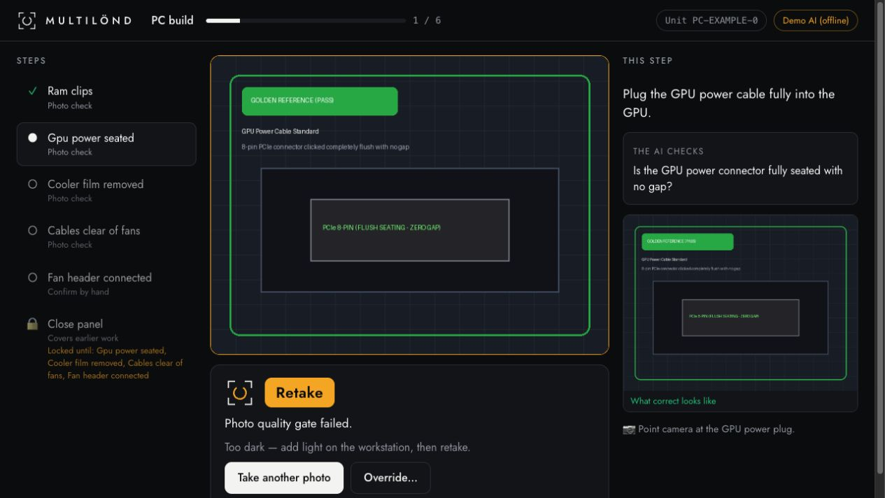
MULTILÖND AI
HOW IT WORKS
Same engine, new checklist
PC build example
RAM clips and GPU power before the panel closes.
Photo evidence per unit
Visual attempts save a photo, timestamp, check ID and result.
PC EXAMPLE / LOCAL DEMO MODE
Notes:
1:44–2:02. A new product uses a new checklist. This screenshot shows the existing PC-build workflow in local demo mode. The image-quality gate requested a retake, and the panel step remains locked. Visual attempts save photo evidence by unit with a timestamp, check ID and checker result. Override reasons remain in the active session. Durable override records need further work.

Slide 10
MULTILÖND AI
03 / 03
03
THE RESULTS
Notes:
2:02–2:05. The historical cable benchmark was measured with Gemma 4, comparing generic and targeted questions on the same photo set.

Slide 11
MULTILÖND AI
THE RESULTS
2/24 to 14/24 defects caught
Same 34 cable photos: 24 defective, 10 clean / measured with Gemma 4
METRIC | GENERIC | TARGETED
Defects caught | 2/24 (8.3%) | 14/24 (58.3%)
False alarms | 0/10 | 0/10
Mean box IoU* | 0.8554 | 0.62
Average check time | 5.71 s | 5.65 s
7× as many caught. 10/24 defects still missed.
Measured with Gemma 4 / AMD Token Factory (Radeon Cloud GPUs)
Generic IoU: recalculated from 2 detected boxes. Targeted: 14 detected boxes.
*Positive-overlap detections only. Misses and zero-overlap boxes excluded. Small sample, not factory validation.
Notes:
2:05–2:45. In the historical benchmark measured with Gemma 4 (Gemma-4-31B-IT) on the same 34 MVTec AD cable photos, the generic checklist caught two of 24 defects. It passed almost everything, so zero false alarms alone was misleading. Describing a correct cable raised the catch count to 14, seven times as many. Both runs had zero false alarms on ten clean photos. Targeted checks averaged 5.65 seconds. Generic mean box IoU is 0.8554, recalculated from its two detected boxes. Targeted mean box IoU is 0.6211 across fourteen detected boxes, shown rounded to 0.62. Both means use positive-overlap detections only. Ten defects still escaped. This small cable experiment does not establish packing-box or factory reliability. The targeted run caught 3/3 cable swaps and 3/3 missing cables in this set; these are subtype catch counts, not precision. The earlier 91.3% IoU and 97.1% mask coverage were from one photo, not sample averages. Sources: team rerun report supplied by the user; https://github.com/acagliol/amdactiii/commit/ad0c66e88bdd35f602c00ffaa5f11fc87b0c9439 ; evaluator averaging behavior in eval/evaluate.py. Both per-image CSVs are now available in PR #9 and have been checked for matching image paths and labels. Counts, latency averages and box IoU were recalculated from those records; this is not an independent model rerun. The generic CSV and scorecard store 0.75, but their saved boxes yield 0.8160 and 0.8948, averaging 0.8554. The original CSV and scorecard remain unchanged. Source: https://github.com/acagliol/amdactiii/tree/7b9e5baaf56b1d8d30acccf876d91235f606c098/docs/results . Pixel-mask coverage and endpoint/model settings have not been independently verified.

Slide 12
LABLAB.AI · AMD DEVELOPER HACKATHON: ACT III
Check the packing box before the lid closes. Keep photo evidence for each visual attempt.
THANK YOU
github.com/acagliol/amdactiii
Notes:
2:45–3:00. Multilönd AI helps catch mistakes while the work is still visible. Next we want broader validation and deployment on a factory AMD GPU. The packing box is our main demo. PC build shows how the same engine uses another checklist. Thank you.

