Slide 1
RxJS
ou les streams

Slide 2
 | Une seule valeur | Plusieurs valeurs
Pull / Interactif
Push / Reactif

Slide 3



 | Une seule valeur | Plusieurs valeurs
Pull / Interactif | variable, function
Push / Reactif

Slide 4
 | Une seule valeur | Plusieurs valeurs
Pull / Interactif | variable, function | iterable (array, set, map, object)
Push / Reactif

Slide 5


 | Une seule valeur | Plusieurs valeurs
Pull / Interactif | variable, function | iterable (array, set, map, object)
Push / Reactif | promise

Slide 6
 | Une seule valeur | Plusieurs valeurs
Pull / Interactif | variable, function | iterable (array, set, map, object)
Push / Reactif | promise | observable

Slide 7
 | Une seule valeur | Plusieurs valeurs
Pull / Interactif | variable, function | iterable (array, set, map, object)
Push / Reactif | promise | observable
getArray()
.filter (s => s % 2 === 0)
.map(s => s + 1)
.forEach(s => console.log(s))
// Array : [0, 1, 2, 3]
1
3
5

Slide 8
 | Une seule valeur | Plusieurs valeurs
Pull / Interactif | variable, function | iterable (array, set, map, object)
Push / Reactif | promise | observable
getArray()
.filter (s => s % 2 === 0)
.map(s => s + 1)
.forEach(s => console.log(s))
getObservable().pipe(
filter (s => s % 2 === 0),
map(s => s + 1),
tap(s => console.log(s))
)
// Array : [0, 1, 2, 3]
1
3
5

Slide 9
 | Une seule valeur | Plusieurs valeurs
Pull / Interactif | variable, function | iterable (array, set, map, object)
Push / Reactif | promise | observable
getArray()
.filter (s => s % 2 === 0)
.map(s => s + 1)
.forEach(s => console.log(s))
getObservable().pipe(
filter (s => s % 2 === 0),
map(s => s + 1),
tap(s => console.log(s))
)
.subscribe()
// Array : [0, 1, 2, 3]
1
3
5
// Observable : -0--1--2--3-
1
3
5

Slide 10
const subscription = getObservable().pipe(
filter (s => s % 2 === 0),
map(s => s + 1),
tap(s => console.log(s))
)
.subscribe()

Slide 11
const subscription = getObservable().pipe(
filter (s => s % 2 === 0),
map(s => s + 1),
tap(s => console.log(s))
)
.subscribe()
Observable
filter
map
tap
Souscription
const { interval } = Rx;
const { filter, map, tap } = RxOperators;
interval(1000).pipe(
filter (s => s %2 === 0),
map(s => s + 1),
tap(s => console.log(s))
)

Slide 12
const subscription = getObservable().pipe(
filter (s => s % 2 === 0),
map(s => s + 1),
tap(s => console.log(s))
)
.subscribe()
Les observables
Observable
filter
map
tap
Souscription
const { interval } = Rx;
const { filter, map, tap } = RxOperators;
interval(1000).pipe(
filter (s => s %2 === 0),
map(s => s + 1),
tap(s => console.log(s))
)

Slide 13
const subscription = getObservable().pipe(
filter (s => s % 2 === 0),
map(s => s + 1),
tap(s => console.log(s))
)
.subscribe()
Les opérateurs
Observable
filter
map
tap
Souscription
const { interval } = Rx;
const { filter, map, tap } = RxOperators;
interval(1000).pipe(
filter (s => s %2 === 0),
map(s => s + 1),
tap(s => console.log(s))
)

Slide 14
const subscription = getObservable().pipe(
filter (s => s % 2 === 0),
map(s => s + 1),
tap(s => console.log(s))
)
.subscribe()
Les souscriptions
Observable
filter
map
tap
Souscription
const { interval } = Rx;
const { filter, map, tap } = RxOperators;
interval(1000).pipe(
filter (s => s %2 === 0),
map(s => s + 1),
tap(s => console.log(s))
)

Slide 15
Les observables
const subscription = getObservable().pipe(
filter (s => s % 2 === 0),
map(s => s + 1),
tap(s => console.log(s))
)
.subscribe()

Slide 16



const { from, of, timer, interval, fromEvent } = Rx;
const { map } = RxOperators;
interval(1000)
timer(1000)
from([0,1,2,3,4])
of([0,1,2,3,4])
of(0,1,2,3,4)
fromEvent(document, 'mousemove').pipe(
map(event => event.clientX)
)

Slide 17
Les opérateurs
const subscription = getObservable().pipe(
filter (s => s % 2 === 0),
map(s => s + 1),
tap(s => console.log(s))
)
.subscribe()

Slide 18
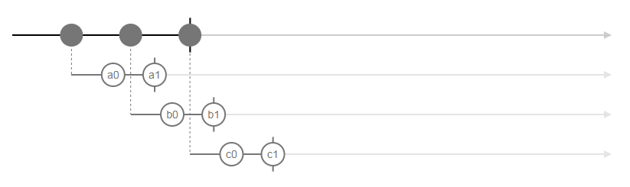

const { from, of, timer, interval, fromEvent } = Rx;
const { take, mergeMap, switchMap, concatMap, map } = RxOperators;
const letters = ['a', 'b', 'c']
interval(1000).pipe(take(3),
map(l => letters[l])
)
interval(1000).pipe(take(3),
map(l => interval(700).pipe(map(i => letters[l] + i), take(2)))
)
interval(1000).pipe(take(3),
mergeMap(l => interval(700).pipe(map(i => letters[l] + i), take(2)))
)
interval(1000).pipe(take(3),
switchMap(l => interval(700).pipe(map(i => letters[l] + i), take(2)))
)
interval(1000).pipe(take(3),
concatMap(l => interval(700).pipe(map(i => letters[l] + i), take(2)))
)
TRANSFORMER

Slide 19


const { from, of, timer, interval, fromEvent } = Rx;
const { map, filter, take, skip, distinctUntilChanged, last } = RxOperators;
interval(1000).pipe(
filter(v => v % 2 === 0)
)
interval(1000).pipe(
take(3)
)
interval(1000).pipe(
take(3),
last()
)
interval(1000).pipe(
skip(2)
)
interval(1000).pipe(
map(v => v < 3 ? "T" : "F"),
distinctUntilChanged()
)
FILTRER

Slide 20
const { from, of, timer, interval, fromEvent } = Rx;
const { count, max, reduce, scan, take } = RxOperators;
interval(1000).pipe(
take(5),
scan((acc, v) => acc + v)
)
interval(1000).pipe(
take(5),
reduce((acc, v) => acc + v)
)
interval(1000).pipe(
take(5),
max()
)
interval(1000).pipe(
take(5),
count()
)
AGGREGER

Slide 21



const { from, of, timer, interval, fromEvent } = Rx;
const { startWith, endWith, concat, take } = RxOperators;
interval(1000).pipe(
startWith(42)
)
interval(1000).pipe(
take(5),
endWith(42)
)
interval(1000).pipe(
take(5),
concat(interval(200))
)
CONCATENER

Slide 22
const { from, of, timer, interval, fromEvent } = Rx;
const { delay, delayWhen, debounceTime, throttleTime } = RxOperators;
interval(1000).pipe(
delay(1000)
)
interval(1000).pipe(
delayWhen(v => timer((v % 2) * 500))
)
interval(1000).pipe(
delayWhen(v => timer((v % 2) * 500)),
debounceTime(1000)
)
interval(1000).pipe(
delayWhen(v => timer((v % 2) * 500)),
throttleTime(1000)
)
GERER LE TEMPS

Slide 23
const { from, of, timer, interval, fromEvent, merge, combineLatest, zip } = Rx;
const { map } = RxOperators;
merge(
interval(1000).pipe(map(() => 'a')),
interval(2250).pipe(map(() => 'b'))
)
combineLatest(
interval(1000),
interval(2250)
)
zip(
interval(1000),
interval(2250)
)
COMBINER

Slide 24
const { from, of, timer, interval, fromEvent, throwError } = Rx;
const { map, catchError, finalize } = RxOperators;
interval(1000).pipe(
map(v => {
if(v === 3) throw new Error('oops')
return v
})
)
interval(1000).pipe(
map(v => {
if(v === 3) throw new Error('oops')
return v
}),
catchError(err => of('E'))
)
interval(1000).pipe(
map(v => {
if(v === 3) throw new Error('oops')
return v
}),
catchError(err => throwError('Error!'))
)
GERER LES ERREURS (1/2)

Slide 25
const { from, of, timer, interval, fromEvent, throwError } = Rx;
const { map, catchError, finalize } = RxOperators;
interval(1000).pipe(
map(v => {
if(v === 3) throw new Error('oops')
return v
}),
catchError((err, caught) => caught)
)
interval(1000).pipe(
map(v => {
if(v === 3) throw new Error('oops')
return v
}),
finalize(() => console.log('Log in console'))
)
GERER LES ERREURS (2/2)

Slide 26
Les souscriptions
const subscription = getObservable().pipe(
filter (s => s % 2 === 0),
map(s => s + 1),
tap(s => console.log(s))
)
.subscribe()

Slide 27
interval(1000).pipe(
filter (s => s % 2 === 0),
map(s => s + 1),
tap(s => console.log(s))
)

Slide 28
interval(1000).pipe(
filter (s => s % 2 === 0),
map(s => s + 1),
tap(s => console.log(s))
)
.subscribe(
next => console.log(next)
)

Slide 29
interval(1000).pipe(
filter (s => s % 2 === 0),
map(s => s + 1),
tap(s => console.log(s))
)
.subscribe(
next => console.log(next),
error => console.error(error),
() => console.log("Completed")
)

Slide 30
const subscription = interval(1000).pipe(
filter (s => s % 2 === 0),
map(s => s + 1),
tap(s => console.log(s))
)
.subscribe(
next => console.log(next),
error => console.error(error),
() => console.log("Completed")
)
subscription.unsubscribe();

Slide 31
Hot vs Cold
Unicast vs Multicast

Slide 32
Hot vs Cold
Unicast vs Multicast
La source de données est indépendante de la souscription

Slide 33
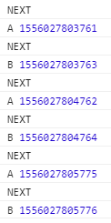
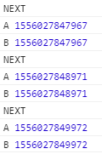
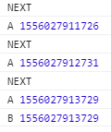
const { from, of, timer, interval, fromEvent } = Rx;
const { share, shareReplay, tap, take, mergeMap, switchMap, concatMap, map, mergeAll } = RxOperators;
const source$ = interval(1000).pipe(
take(3),
map(() => Date.now()),
tap(() => console.log("NEXT"))
)
source$.subscribe(v => console.log("A", v))
source$.subscribe(v => console.log("B", v))
const shared$ = source$.pipe(
share()
)
shared$.subscribe(v => console.log("A", v))
shared$.subscribe(v => console.log("B", v))
shared$.subscribe(v => console.log("A", v))
setTimeout(() => shared$.subscribe(v => console.log("B", v)), 2500)
MULTICAST (1/2)

Slide 34
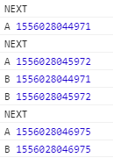
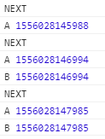
const { from, of, timer, interval, fromEvent } = Rx;
const { share, shareReplay, tap, take, mergeMap, switchMap, concatMap, map, mergeAll } = RxOperators;
const source$ = interval(1000).pipe(
take(3),
map(() => Date.now()),
tap(() => console.log("NEXT"))
)
const sharedReplay$ = source$.pipe(
shareReplay()
)
sharedReplay$.subscribe(v => console.log("A", v))
setTimeout(() => sharedReplay$.subscribe(v => console.log("B", v)), 2500)
const sharedReplayLast$ = source$.pipe(
shareReplay(1)
)
sharedReplayLast$.subscribe(v => console.log("A", v))
setTimeout(() => sharedReplayLast$.subscribe(v => console.log("B", v)), 2500)
MULTICAST (2/2)

Slide 35
Observable + Observer =
Subject

Slide 36
const { from, of, timer, interval, fromEvent, Subject, ReplaySubject, BehaviorSubject } = Rx;
const { tap, take, map } = RxOperators;
const source$ = interval(1000).pipe(
take(3),
map(() => Date.now()),
tap(() => console.log("NEXT"))
)
source$.subscribe(v => console.log("A", v))
source$.subscribe(v => console.log("B", v))
const shared$ = new Subject()
source$.subscribe(shared$)
shared$.subscribe(v => console.log("A", v))
shared$.subscribe(v => console.log("B", v))
shared$.subscribe(v => console.log("A", v))
setTimeout(() => shared$.subscribe(v => console.log("B", v)), 2500)
SUBJECT (1/2)

Slide 37
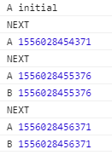
const { from, of, timer, interval, fromEvent, Subject, ReplaySubject, BehaviorSubject } = Rx;
const { tap, take, map } = RxOperators;
const source$ = interval(1000).pipe(
take(3),
map(() => Date.now()),
tap(() => console.log("NEXT"))
)
const sharedReplay$ = new ReplaySubject()
source$.subscribe(sharedReplay$)
sharedReplay$.subscribe(v => console.log("A", v))
setTimeout(() => sharedReplay$.subscribe(v => console.log("B", v)), 2500)
const sharedReplayLast$ = new BehaviorSubject('initial')
source$.subscribe(sharedReplayLast$)
sharedReplayLast$.subscribe(v => console.log("A", v))
setTimeout(() => sharedReplayLast$.subscribe(v => console.log("B", v)), 2500)
SUBJECT (2/2)

Slide 38
Exemple courant
Type Ahead

Slide 39
search(): Observable<string[]> {
return this.champRecherche.valueChanges.pipe(
startWith(""),
debounceTime(500),
switchMap(nom =>
this.clients.searchByNom(nom).pipe(
startWith([
"Chargement..."
]),
catchError(err => of([]))
)
)
);
}

Slide 40
search(): Observable<string[]> {
return this.champRecherche.valueChanges.pipe(
startWith(""),
debounceTime(500),
map(nom =>
this.clients.searchByNom(nom).pipe(
startWith([
"Chargement..."
]),
catchError(err => of([]))
)
)
);
}

Slide 42
search(): Observable<string[]> {
return this.champRecherche.valueChanges.pipe(
startWith(""),
debounceTime(500),
mergeMap(nom =>
this.clients.searchByNom(nom).pipe(
startWith([
"Chargement..."
]),
catchError(err => of([]))
)
)
);
}

Slide 44
search(): Observable<string[]> {
return this.champRecherche.valueChanges.pipe(
startWith(""),
debounceTime(500),
switchMap(nom =>
this.clients.searchByNom(nom).pipe(
startWith([
"Chargement..."
]),
catchError(err => of([]))
)
)
);
}

Slide 46
search(): Observable<string[]> {
return this.champRecherche.valueChanges.pipe(
startWith(""),
debounceTime(500),
switchMap(nom =>
this.clients.searchByNom(nom).pipe(
startWith([
"Chargement..."
]),
catchError(err => of([]))
)
)
);
}

Slide 47
search(): Observable<string[]> {
return this.champRecherche.valueChanges.pipe(
startWith(""),
debounceTime(500),
switchMap(nom =>
this.clients.searchByNom(nom).pipe(
startWith([
"Chargement..."
]),
catchError(err => of([]))
)
)
);
}

Slide 48
search(): Observable<string[]> {
return this.champRecherche.valueChanges.pipe(
startWith(""),
debounceTime(500),
switchMap(nom =>
this.clients.searchByNom(nom).pipe(
startWith([
"Chargement..."
]),
catchError(err => of([]))
)
)
);
}

Slide 49
search(): Observable<string[]> {
return this.champRecherche.valueChanges.pipe(
startWith(""),
debounceTime(500),
switchMap(nom =>
this.clients.searchByNom(nom).pipe(
startWith([
"Chargement..."
]),
catchError(err => of([]))
)
)
);
}

Slide 50
T’as oublié le unsubscribe() !
x | async

Slide 51
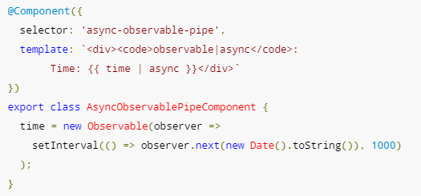

Slide 52
Et les EventEmitter ?
= Subject avec @Output devant

Slide 53
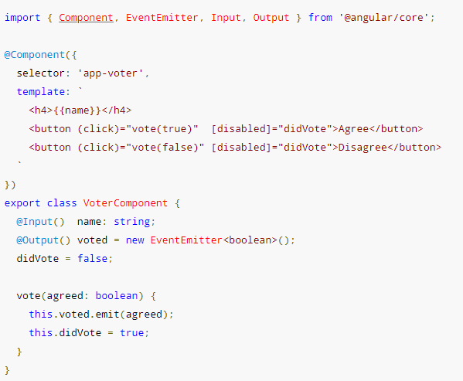

Slide 54
Ressources utiles
Concepts et opérateurs les plus courants : https://www.learnrxjs.io/
Autre façon de présenter les concepts : https://rxjs-dev.firebaseapp.com/
Catalogue des opérateurs : https://rxjs-dev.firebaseapp.com/api
Arbre de décision : https://rxjs-dev.firebaseapp.com/operator-decision-tree
Visualisateur graphique de streams : https://rxviz.com/examples/chess-game

