Slide 1

Brève introduction à

Slide 2
Au commencement,
les composants...

Slide 3
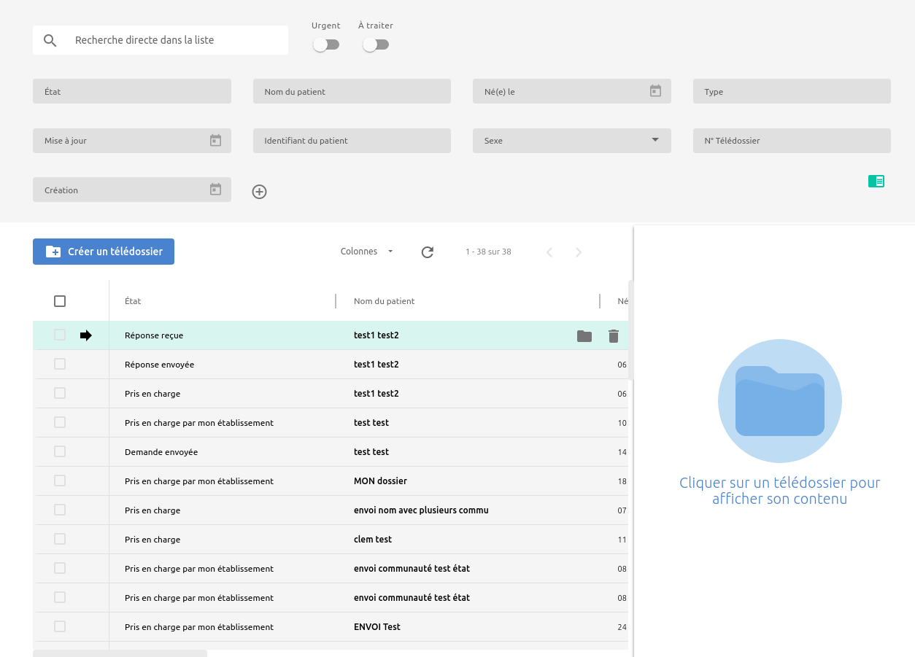

Slide 6
Component
.ts
LOGIQUE
.scss
STYLE
.html
TEMPLATE

Slide 7
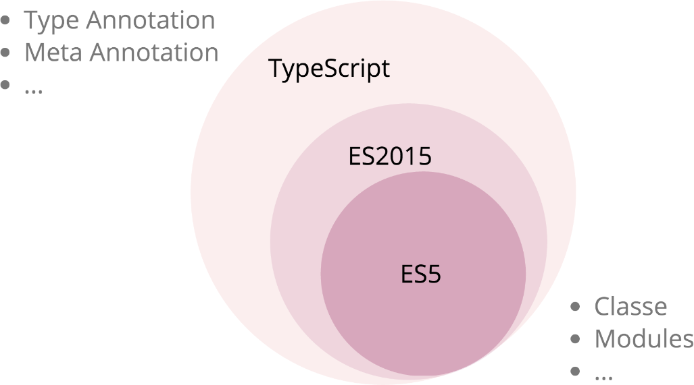

Slide 8
Component
.ts
LOGIQUE
.scss
STYLE
.html
TEMPLATE

Slide 9
Component
.ts
LOGIQUE
.scss
STYLE
@Component
.scss
selector
styleUrls
.html
TEMPLATE
templateUrl

Slide 10
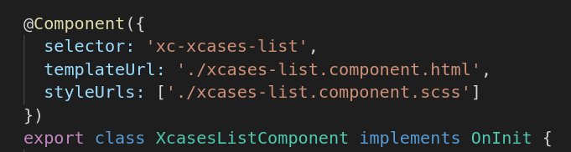

Slide 11
Component
.ts
LOGIQUE
.scss
STYLE
@Component
.scss
selector
styleUrls
.html
TEMPLATE
templateUrl

Slide 12
Parent component
@Input
@Output
Component
.ts
LOGIQUE
.scss
STYLE
@Component
.scss
selector
styleUrls
.html
TEMPLATE
templateUrl

Slide 13
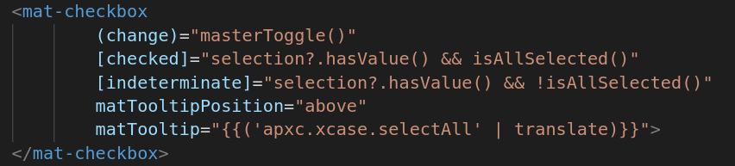
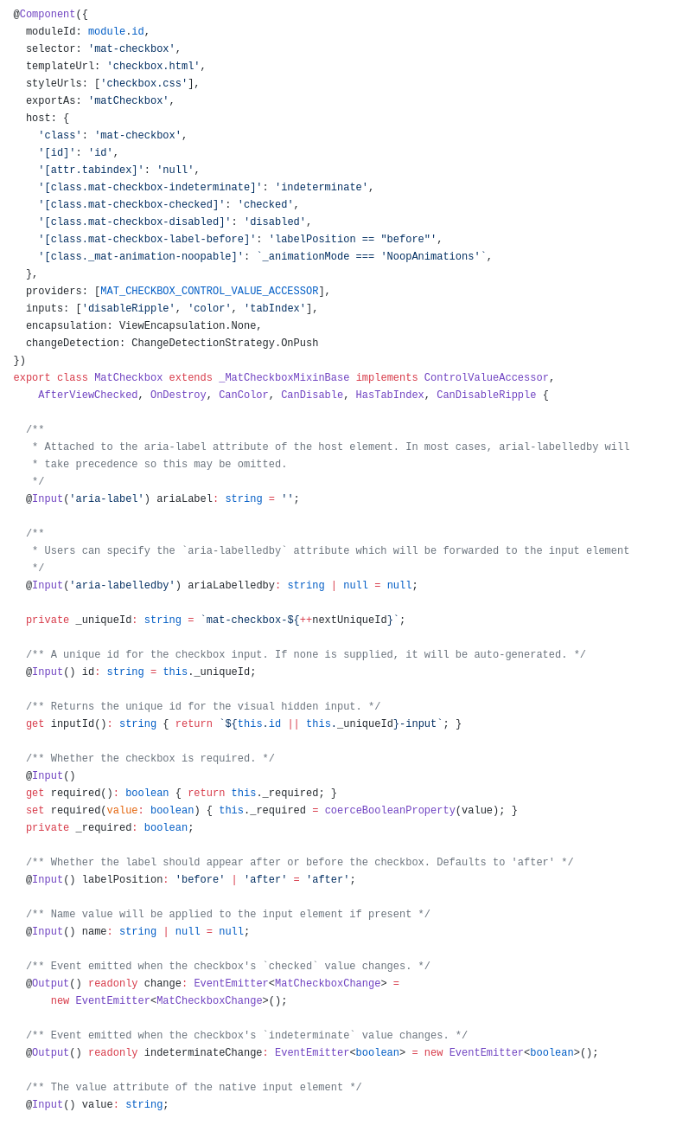
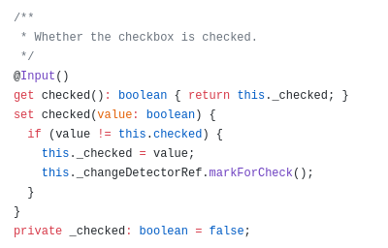

Slide 14
Parent component
@Input
@Output
Component
.ts
LOGIQUE
.scss
STYLE
@Component
.scss
selector
styleUrls
.html
TEMPLATE
templateUrl

Slide 15
Parent component
@Input
@Output
Component
.ts
LOGIQUE
.scss
STYLE
@Component
.scss
selector
styleUrls
.html
TEMPLATE
templateUrl
this.myValue=...
[value]=”myValue”
save(){...}
(click)=”save()”

Slide 16
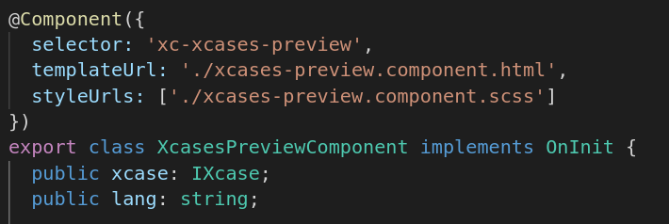
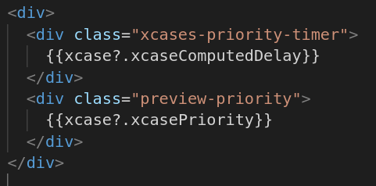

Slide 17
Parent component
@Input
@Output
Component
.ts
LOGIQUE
.scss
STYLE
@Component
.scss
selector
styleUrls
.html
TEMPLATE
templateUrl
this.myValue=...
[value]=”myValue”
save(){...}
(click)=”save()”

Slide 18
Parent component
@ViewChild
@Input
@Output
Component
.ts
LOGIQUE
.scss
STYLE
@Component
.scss
selector
styleUrls
.html
TEMPLATE
templateUrl
this.myValue=...
[value]=”myValue”
save(){...}
(click)=”save()”

Slide 19
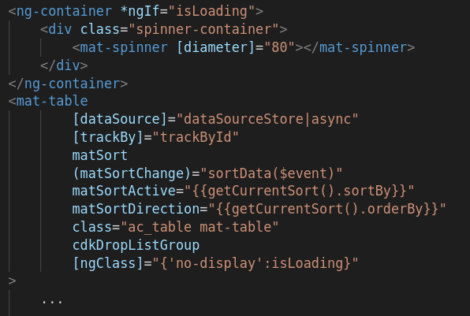
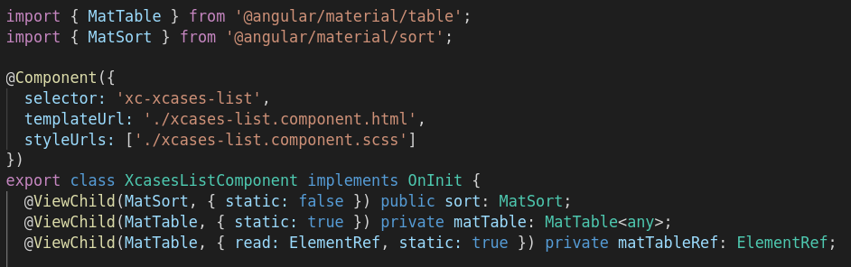

Slide 20
Parent component
@ViewChild
@Input
@Output
Component
.ts
LOGIQUE
.scss
STYLE
@Component
.scss
selector
styleUrls
.html
TEMPLATE
templateUrl
this.myValue=...
[value]=”myValue”
save(){...}
(click)=”save()”

Slide 21
Parent component
@ViewChild
@Input
@Output
Component
.ts
LOGIQUE
.scss
STYLE
@Component
.scss
selector
styleUrls
.html
TEMPLATE
templateUrl
this.myValue=...
[value]=”myValue”
save(){...}
(click)=”save()”
Module
@NgModule
providers
declarations
imports
exports

Slide 22
Parent component
@ViewChild
@Input
@Output
Component
.ts
LOGIQUE
.scss
STYLE
@Component
.scss
selector
styleUrls
.html
TEMPLATE
templateUrl
this.myValue=...
[value]=”myValue”
save(){...}
(click)=”save()”
Module
@NgModule
providers
declarations
imports
exports
Other module

Slide 23
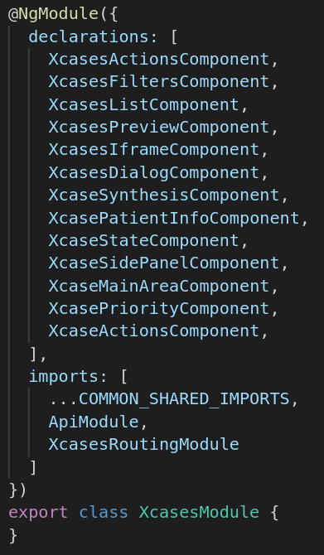

Slide 24
Parent component
@ViewChild
@Input
@Output
Component
.ts
LOGIQUE
.scss
STYLE
@Component
.scss
selector
styleUrls
.html
TEMPLATE
templateUrl
this.myValue=...
[value]=”myValue”
save(){...}
(click)=”save()”
Module
@NgModule
providers
declarations
imports
exports
Other module

Slide 25
Parent component
@ViewChild
@Input
@Output
Component
.ts
LOGIQUE
.scss
STYLE
@Component
.scss
selector
Injector
styleUrls
.html
TEMPLATE
service
templateUrl
service
this.myValue=...
[value]=”myValue”
save(){...}
(click)=”save()”
Module
@NgModule
providers
declarations
imports
exports
Other module

Slide 26
Parent component
@ViewChild
@Input
@Output
Component
.ts
LOGIQUE
.scss
STYLE
@Component
.scss
selector
Injector
styleUrls
.html
TEMPLATE
service
templateUrl
service
this.myValue=...
[value]=”myValue”
save(){...}
(click)=”save()”
Module
@NgModule
providers
declarations
imports
exports
Other module
Other module

Slide 27
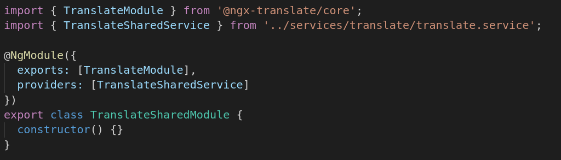

Slide 28
Parent component
@ViewChild
@Input
@Output
Component
.ts
LOGIQUE
.scss
STYLE
@Component
.scss
selector
Injector
styleUrls
.html
TEMPLATE
service
templateUrl
service
this.myValue=...
[value]=”myValue”
save(){...}
(click)=”save()”
Module
@NgModule
providers
declarations
imports
exports
Other module
Other module

Slide 29
Parent component
@ViewChild
@Input
@Output
Component
.ts
LOGIQUE
.scss
STYLE
@Component
.scss
selector
Injector
styleUrls
.html
TEMPLATE
service
templateUrl
service
this.myValue=...
[value]=”myValue”
save(){...}
(click)=”save()”
Module
@NgModule
providers
declarations
imports
exports
Extension
Other module
Other module

Slide 30
Parent component
EventsService
@EventInput
@ViewChild
@Input
@Output
@EventOutput
Component
.ts
LOGIQUE
.scss
STYLE
@Component
.scss
selector
Injector
styleUrls
.html
TEMPLATE
service
templateUrl
service
this.myValue=...
[value]=”myValue”
save(){...}
(click)=”save()”
Module
@NgModule
providers
declarations
imports
exports
Extension
Other module
Other module

Slide 31
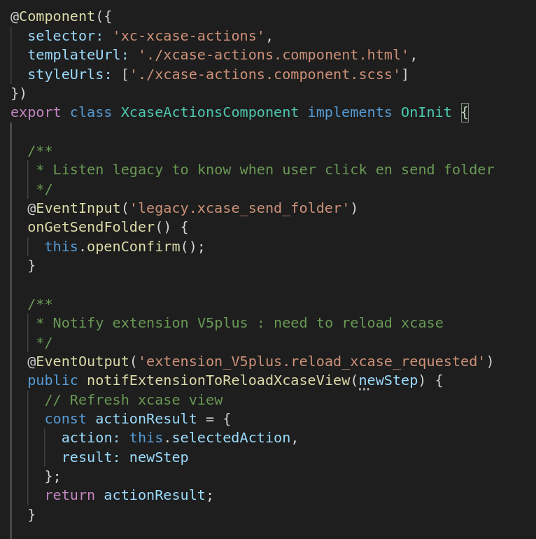

Slide 32
ET AUSSI ...

Slide 33
*ngIf
&
pipe

Slide 34
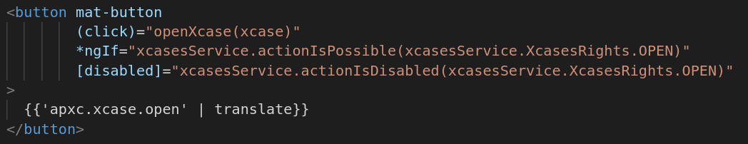

Slide 35
*ngFor

Slide 36
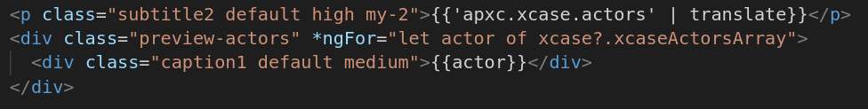

Slide 37
Lifecycle Hooks

Slide 38
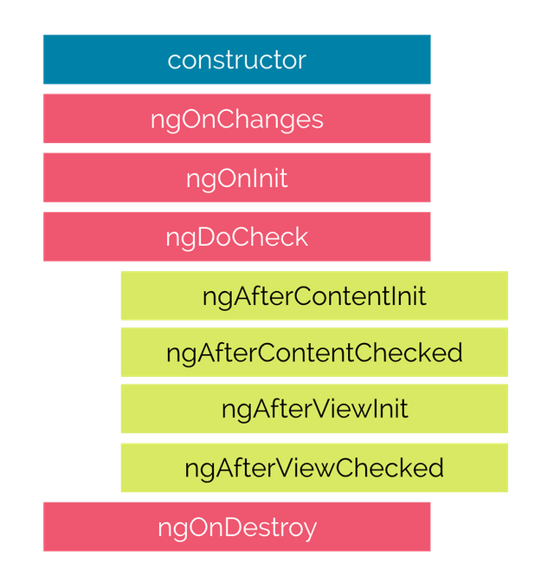

Slide 39
Et les observables ?

Slide 40
Introduction
https://www.coursepixel.com/blogs/rxjs-basics
Quelques opérateurs
https://reactive.how/
https://player.vimeo.com/video/239108249?title=0&autopause=0&autoplay=0
https://player.vimeo.com/video/240131697?title=0&autopause=0&autoplay=0
API
https://rxjs-dev.firebaseapp.com/api

