Slide 1
Towards a
Connect Monitoring Infrastructure
Antonino Sabetta
CNR (Pisa,Italy)

Slide 2
Outline
General goals

Slide 3
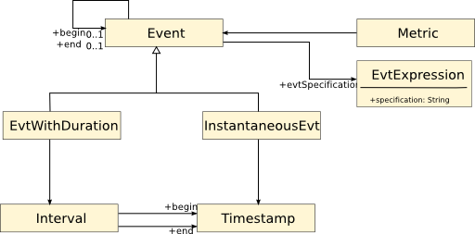
Event Metamodel

Slide 4
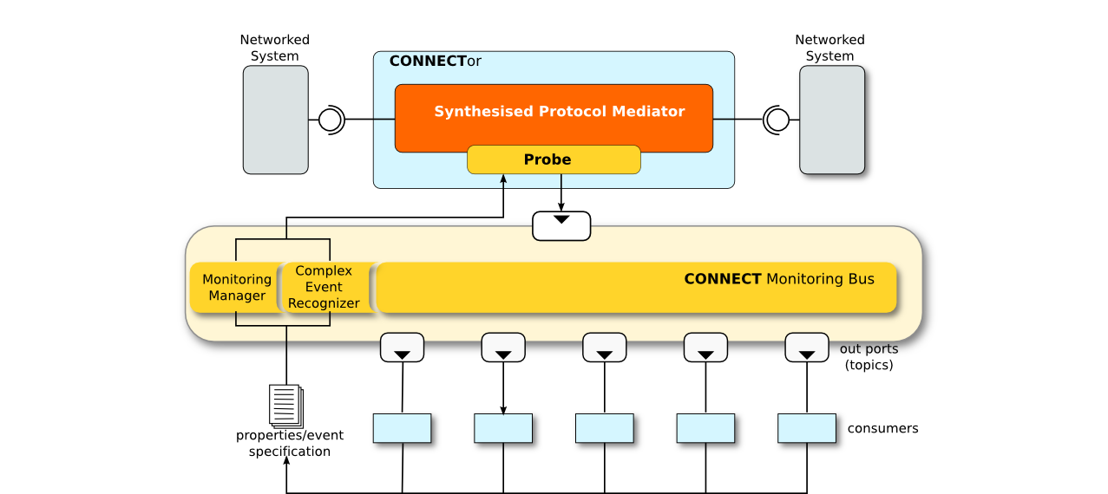
Architecture Overview

Slide 5
Ongoing work
Investigate the idea of composing
  Domain model + Connect model
  Metrics generic model
Survey of the literature
  Ongoing
  We found approaches that
    compose domain models and metrics (but not for dependability metrics) [jezequel 2008]
    others have a sophisticated and detailed generic model [omg-marte] but the domain is fixed (rt-embedded systems)

Slide 6
General Goals
Provide support for
  Dependability assessment
  (Re-)learning
  Connector operation
Relationships with the rest of the CONNECT infrastructure (in terms of input/output)

Slide 7
Architecture elements
Monitoring Bus (MB)
  Topics used to disseminate measures/observations related to a given metric/property
Monitoring Manager
  Gets requests from clients (e.g., “I need response time for interactions involving X and Y” or “raise an alarm every time a response to message X has not been sent within Y seconds”)
  Turns requests into dedicated probes (if not already available/deployed)
  Create topic: probes are producers, clients are consumers
Probes
  Implemented by connector instrumentation
  (connector synthesis and connector themselves are supposed to be easily instrumentable; should work on this with WP3)

Slide 8
Monitoring and Metrics Definition
Connect Metrics Definition Language
  A metamodel for expressing QoS metrics tailored for connect and/or a specific application
Monitoring manager
  To convert conditions/events into detailed models that can be used to manage the MB
    Topics
    Probes

Slide 9
Mid-term goals (Y2)
Work on how to bridge the gap between high-level monitoring goals specification and the realization of a monitor configuration that achieve those goals
Early integration: working prototype with reduced functionality, but meaningful as a proof-of-concept
  Minimal clients will be developed as samples for partners to extend
Non-functional properties
  Performance:
    response time, throughput
  Metamodel for metrics used to specify inputs to the monitoring (and partly outputs)
Functional properties
  Support basic monitoring needs of learning and synthesis
    Monitoring of connector (Networkes Systems not addressed for now)

Slide 10
Technology
Apache ActiveMQ (JMS compliant implementation)
    Supports many transports (REST, NIO, Streaming Text Orientated Messaging Protocol)
      we will strive for simplicity
Model-driven code generation (Eclipse EMF, Acceleo and the like)
    To generate the probes
Properties and events specified using a dedicated metamodel (Ecore/EMF)
Model transformation languages (ATL) may be used

Slide 11
Model-driven Metrics Framework
Elaborate on the current state of the Connect Metrics Framework
We need a practical way to express metrics in a simple by precise (i.e., machine-processable) way
Devise a dedicated language to express metrics in Connect
Language defined as a metamodel

Slide 12
Domain concepts and generic metric patterns
Metrics fundamental concepts and patterns
  Elementary metrics
  Composition operators, modifiers
Domain specific metamodel
  A representation of the domain
  Contains concepts that can be used in combination with generic metric patterns and operators
Concepts from the latter can be used to specialize/instanciate patterns from the former

Slide 13
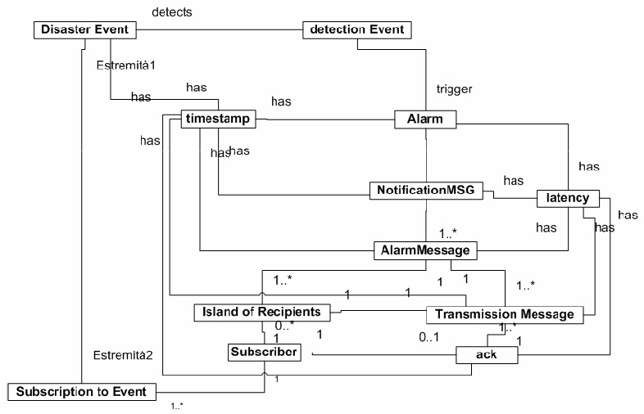
A model of the domain (first iteration)

Slide 14
A model of the domain (2nd iteration)

Slide 15
A model of the domain (3rd iteration)

Slide 16
Factoring out fundamental concepts
Time (T)
  Timestamp (a point in time)
  Interval
  .....
Event
  Simple event (atomic occurrence)
  Complex event (event modifiers and composition operators)
Duration
Operators
  count(x)
  count(x)/T
  .......

Slide 17
Achieving Connect's goals
Assuring dependability of CONNECTed systems is an intrinsically difficult problem
  Is it realistic to expect that users rely on a system that is built in a CONNECTed fashion?
Connect-specific challenges
  Usual challenges of complex dynamic systems pushed to the extreme by having learned models to guide the synthesis of emergent connectors
A gap to be closed:
  Existing approaches to learning, synthesis, analysis are quite good at tackling a static setting

Slide 18
Extra slides

Slide 19
A practical research agenda
Which of the existing techniques can be used in a connected setting, taking into account:
    Heterogeneity
    Run-time learning of component behaviour
    Uncontrolled evolution
Off-line techniques adapted to an on-line context
Monitoring as a core enabling function of a connected system

Slide 20
A monitoring-centric architectural view
Existing techniques (normally used off-line)
  Extended to accommodate change/dynamism
  Combined with an on-line monitoring infrastructure
A simple but effective pattern:
  “Elaboration” phase
  Monitoring phase
  Feedback

Slide 21
Example 1: Monitoring and Dependability Analysis
Performability as a dependability/QoS indicator
  How well a system performs in a given time interval (or instant of time), taking into account behaviour due to the occurrence of faults.
It generalizes the notion of dependability in two ways:
  It includes performance-related impairments to proper service
  It considers multiple levels of service in specification
Performability: a useful dependability metric in Connect
  It can actually represent a variety of Dependability/QoS indicators
  Allows reasoning about important trade-offs both from a system developer and user perspectives

Slide 22
Example 1: Monitoring and Dependability Analysis
Setting up and solving the model
Fault Model
  Accidental and/or Malicious faults, at HW and/or SW level
Measures of interest
  Classical dependability attributes, such as reliability and availability
  Performability measures, combining performance and dependability
  Both system and user oriented views in defining the measures
Formalisms/Tools
  Petri nets like formalisms (GSPN, DSPN, SAN)
  Mobius (Univ. of Illinois) and DEEM (ISTI and Univ. of Florence)
Solution Methods
  Analytical and/or simulation

Slide 23
Example 1: Monitoring and Dependability Analysis
Key challenges for stochastic model-based analysis related to:
  on-the-fly generation of the models that are used for evaluating dependability
    REAL-TIME concerns
  adaptation/identification/formalization of (possibly new) metrics to represent (accomplishment grades of) dependability/security/QoS of connectors

Slide 24
Example 1: Monitoring and Dependability Analysis
Towards on-line evaluation:
  Exploring approaches for on-line evaluation to support evolution and on-line decisions (e.g., trigger new connector synthesis)
As a starting point:
  incremental off-line exploration of a number of possible system scenarios, and
  on-line selection of the pre-computed analysis on the basis of matching scenarios,
  Rely on dynamic/adaptive monitoring to get feedback on the real conditions of systems and services
Strict interaction with dynamic monitoring to correctly apply analysis results

Slide 25
Example 2: Monitoring and Learning
Assumptions:
  Incremental building of a model that justifies observed reactions to purposely selected stimuli
  No moving target!
How to accommodate change?
  Again: Learning, monitoring, feedback
Monitoring to discover:
  Changes in the components
    Should trigger revision of learned model
  Unexpected behaviours
    ......

Slide 26
Example 3: Connector Synthesis
Connector synthesis based on assumptions
  Input models (as inferred by learning) represent real behaviour faithfully
Monitoring can efficiently observe whether these assumptions actually hold during system operation
  Update connector to work around problems (e.g. to include fault tolerance or performance-enhancing mechanisms)
  Trigger new synthesis phase

Slide 27
Example 4: User Preferences and Reactions
Capturing intention
Turning user preferences (wrt QoS and extra-functional properties) into monitoring directives that:
  Can be efficiently implemented
  Can give useful feedback to the learning/synthesis/analysis modules of Connect

Slide 28
Inputs to the monitoring infrastructure
Learned models of individual components
(Models of) synthesised connectors
Intention, semantic information from ontologies, user goals/preferences/reactions
Need for a smart way to use this information

Slide 29
Naïve monitoring doesn't cut it (I)
Monitoring should be efficient
  Don't want the system to slow down just because you're checking whether the system is slow
  You don't want to just keep checking whether each single piece of information holds at runtime
Monitoring should be application-specific
  Need expressive ways to say what the monitoring should reveal, in order to have meaningful feedback

Slide 30
Naïve monitoring doesn't cut it (II)
Monitoring should be adaptive
  Use a broad range of technical solutions as appropriate, addressing:
    Event-data collection (code/bytecode instrumentation, proxy-based interception)
    Data transmission, aggregation (prioritisation of observation, opportunistic approaches to ensure timely/efficient notification)
    Correlation (to detect and make sense of application-specific non-local events)
Monitoring might use dynamically generated components, in order to adapt to unforeseen/changed conditions

Slide 31
Conclusions
Partial solutions that need substantial improvement/extension/integration
Some promising directions
  Research on more sophisticated approaches (e.g. faster algorithms, better metrics,...)
  Pursue integration (to leverage in a dynamic on-line setting what we already have that works well off-line)
A simple pattern that combines static/off-line techniques with on-line monitoring

Slide 32
In the context of CONNECT
Dependability analysis could be useful in CONNECT to assess the whole connected system, as well as system components
  Connectors, which compose and coordinate interaction protocols of networked systems
  Connect-Enablers, which enable cooperative reasoning / learning about interactions among networked systems
  the Connected system, which describes the continuous composition of networked systems

