Slide 1
Connect Monitoring Framework
Architecture Overview

Slide 2
Goals
Matched with the synthesis process
  Monitoring probes inserted in the connector during connector synthesis
    Abstract level: LTS model for reasoning about synthesis of probes and deployment plan
    Concrete level: code (bytecode?) instrumentation
To support both functional and non-functional properties
Flexibile generic infrastructure
Tunable overhead

Slide 3
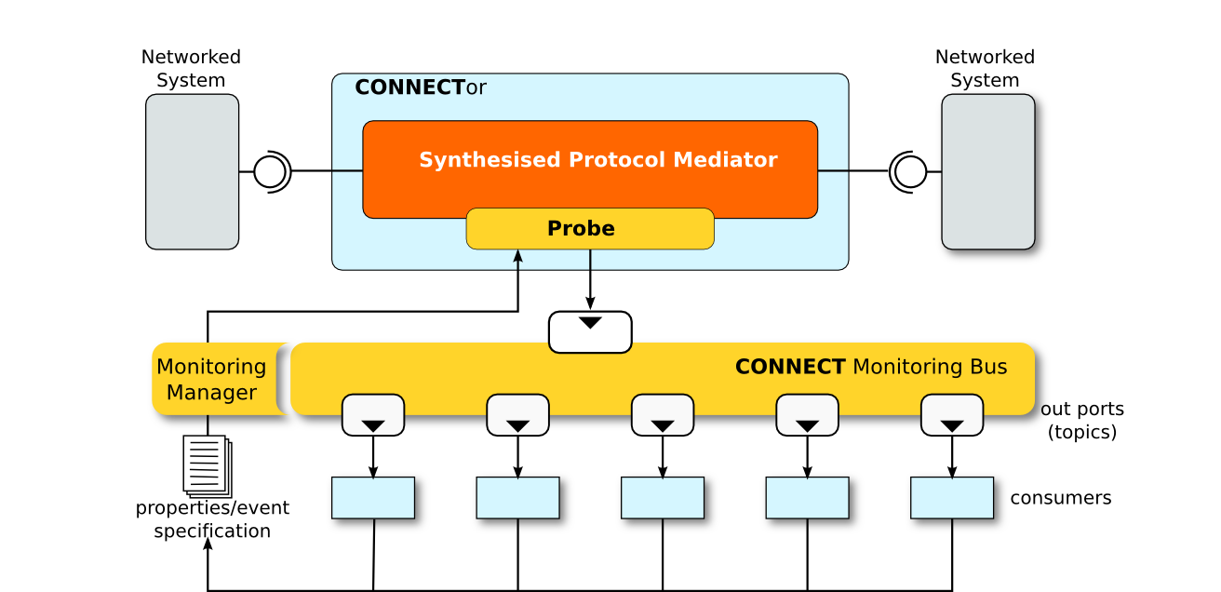
High-level architecture

Slide 4
Architecture elements
Monitoring Bus (MB)
  Topics used to disseminate measures/observations related to a given metric/property
Monitoring Manager
  Gets requests from clients (e.g., “I need response time for interactions involving X and Y” or “raise an alarm every time a response to message X has not been sent within Y seconds”)
  Turns requests into dedicated probes (if not already available/deployed)
  Create topic: probes are producers, clients are consumers
Probes
  Implemented by connector instrumentation
  (connector synthesis and connector themselves are supposed to be easily instrumentable; should work on this with WP3)

Slide 5
Monitoring and Metrics Definition
Connect Metrics Definition Language
  A metamodel for expressing QoS metrics tailored for connect and/or a specific application
Monitoring manager
  To convert conditions/events into detailed models that can be used to manage the MB
    Topics
    Probes

Slide 6
Mid-term goals (Y2)
Work on how to bridge the gap between high-level monitoring goals specification and the realization of a monitor configuration that achieve those goals
Early integration: working prototype with reduced functionality, but meaningful as a proof-of-concept
  Minimal clients will be developed as samples for partners to extend
Non-functional properties
  Performance:
    response time, throughput
  Metamodel for metrics used to specify inputs to the monitoring (and partly outputs)
Functional properties
  Support basic monitoring needs of learning and synthesis
    Monitoring of connector (Networkes Systems not addressed for now)

Slide 7
Technology
Apache ActiveMQ (JMS compliant implementation)
    Supports many transports (REST, NIO, Streaming Text Orientated Messaging Protocol)
      we will strive for simplicity
Model-driven code generation (Eclipse EMF, Acceleo and the like)
    To generate the probes
Properties and events specified using a dedicated metamodel (Ecore/EMF)
Model transformation languages (ATL) may be used

Slide 8
Model-driven Metrics Framework
Elaborate on the current state of the Connect Metrics Framework
We need a practical way to express metrics in a simple by precise (i.e., machine-processable) way
Devise a dedicated language to express metrics in Connect
Language defined as a metamodel

Slide 9
Domain concepts and generic metric patterns
Metrics fundamental concepts and patterns
  Elementary metrics
  Composition operators, modifiers
Domain specific metamodel
  A representation of the domain
  Contains concepts that can be used in combination with generic metric patterns and operators
Concepts from the latter can be used to specialize/instanciate patterns from the former

Slide 10
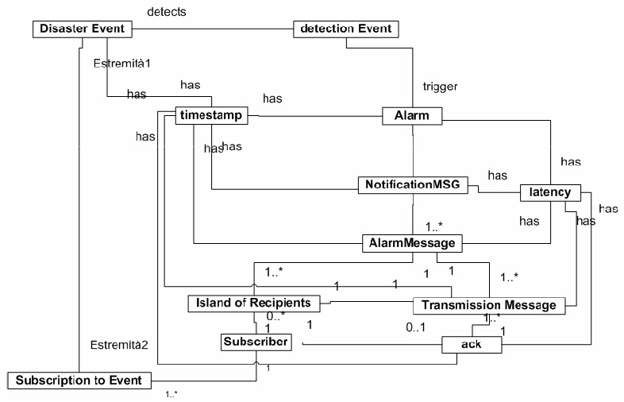
A model of the domain (first iteration)

Slide 11
A model of the domain (2nd iteration)

Slide 12
A model of the domain (3rd iteration)

Slide 13
Factoring out fundamental concepts
Time (T)
  Timestamp (a point in time)
  Interval
  .....
Event
  Simple event (atomic occurrence)
  Complex event (event modifiers and composition operators)
Duration
Operators
  count(x)
  count(x)/T
  .......

Slide 14
Ongoing work
Investigate the idea of composing
  Domain model + Connect model
  Metrics generic model
Survey of the literature
  Ongoing
  We found approaches that
    compose domain models and metrics (but not for dependability metrics) [jezequel 2008]
    others have a sophisticated and detailed generic model [omg-marte] but the domain is fixed (rt-embedded systems)

Slide 16
Taking inspiration fro

