Slide 1

Collections Framework in Java
@Author
#TechieMit
Like ,Comment and Subscribe to #TechieMit

Slide 2
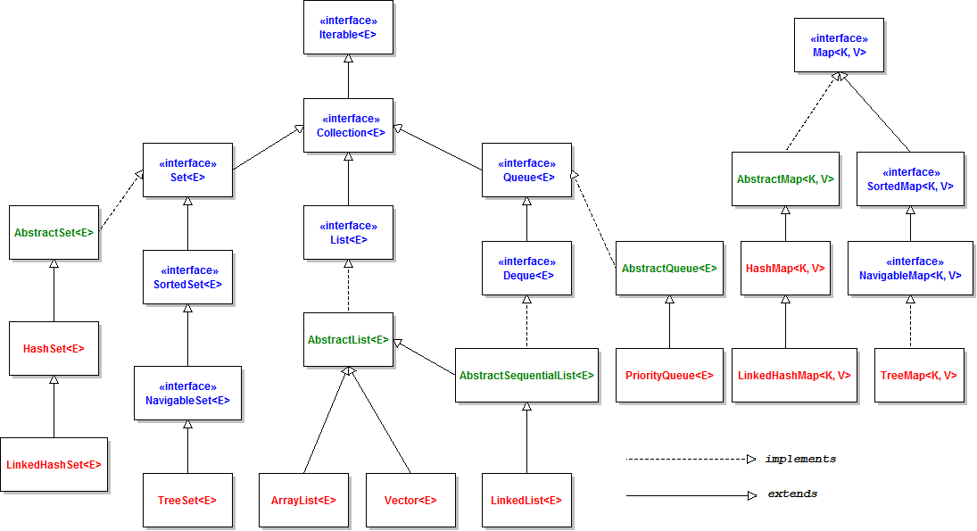
Collection Framework Hierarchy

Slide 3
public interface Collection<E>extends Iterable<E>
public interface Collection<E> extends Iterable<E> {
// Basic operations
int size();
boolean isEmpty();
boolean contains(Object element);
boolean add(E element); //optional
boolean remove(Object element); //optional
Iterator<E> iterator();
// Bulk operations
boolean containsAll(Collection<?> c);
boolean addAll(Collection<? extends E> c); //optional
boolean removeAll(Collection<?> c); //optional
boolean retainAll(Collection<?> c); //optional
void clear(); //optional
// Array operations
Object[] toArray();
<T> T[] toArray(T[] a);
}

Slide 4
Set Interface in Java
Set is an interface in collections framework that cannot contain duplicate elements
They can be represented by mathematical set abstraction used to represent sets comprising unique elements like Set of Unique employee Identity Cards,Set of Cards from Card Set etc
HashSet,LinkedHashSet and TreeSet are the major implementations of Set interface

Slide 5
public interface Set<E>extends Collection<E>
public interface Set<E> extends Collection<E> {
// Basic operations
int size();
boolean isEmpty();
boolean contains(Object element);
boolean add(E element); //optional
boolean remove(Object element); //optional
Iterator<E> iterator();
// Bulk operations
boolean containsAll(Collection<?> c);
boolean addAll(Collection<? extends E> c); //optional
boolean removeAll(Collection<?> c); //optional
boolean retainAll(Collection<?> c); //optional
void clear(); //optional
// Array Operations
Object[] toArray();
<T> T[] toArray(T[] a);
}

Slide 6
List Interface in Java
List is an interface in collections framework that can contain duplicate elements as well unique elements
They can be represented by list of user defined objects like list of Employee Address,List of Shopping Cards,List of Phone Numbers
ArrayList,LinkedList and Vector are the major implementations of List interface

Slide 7
public interface List<E>extends Collection<E>
public interface List<E> extends Collection<E> {
// Positional access
E get(int index);
E set(int index, E element); //optional
boolean add(E element); //optional
void add(int index, E element); //optional
E remove(int index); //optional
boolean addAll(int index,
Collection<? extends E> c); //optional
// Search
int indexOf(Object o);
int lastIndexOf(Object o);
// Iteration
ListIterator<E> listIterator();
ListIterator<E> listIterator(int index);
// Range-view
List<E> subList(int from, int to);
}

Slide 8
public interface ListIterator<E>extends Iterator<E>
public interface ListIterator<E> extends Iterator<E> {
boolean hasNext();
E next();
boolean hasPrevious();
E previous();
int nextIndex();
int previousIndex();
void remove(); //optional
void set(E e); //optional
void add(E e); //optional
}

Slide 9
Queue Interface in Java
Queue as per the english meaning indicates sequence of elements on the basis of First in first Out(FIFO)
As per the data structure any element added in the queue first will be removed first after the completion of its tasks
Example Queue of People Paying bill at shopping mall
Besides Insertion and Deletion Queue also provides some additional operations like extraction and inspection operations

Slide 10
public interface Queue<E> extends Collection<E>
public interface Queue<E> extends Collection<E> {
E element(); //Returns the head of the queue throws exception if list is empty
E add(); //Adds new element to the last inserted element returns true if successfully added otherwise throws exception
E peek(); //Returns the head of the queue throws exception if list is empty
boolean offer (E e);//Adds element into queue returns true if successfully added else return false
E remove();// Returns and removes the head of the queue
E poll(); //Returns null if queue is empty
}

Slide 11
Map Interface in Java
Map interface stores elements in the form of key value pairs (key being the unique identifier for particular value) (Value can be of any valid datatypes) like Short,Integer,String,Float,Boolean etc
Map cannot contain duplicate keys and each key can store at most 1 value
HashMap ,LinkedHashMap and TreeMap are major implementations of map interface

Slide 12
public interface Map<k,v>
public interface Map<K,V> {
// Basic operations
V put(K key, V value);
V get(Object key);
V remove(Object key);
boolean containsKey(Object key);
boolean containsValue(Object value);
int size();
boolean isEmpty();
// Bulk operations
void putAll(Map<? extends K, ? extends V> m);
void clear();
// Collection Views
public Set<K> keySet();
public Collection<V> values();
public Set<Map.Entry<K,V>> entrySet();
// Interface for entrySet elements
public interface Entry {
K getKey();
V getValue();
V setValue(V value);
}
}

Slide 13
Iterator interface in Java
Iterator is an interface that enables us to traverse through the collection
It contains methods such as next(),hasNext(),previous() to check whether collection has elements or not
You can get iterator for collection by calling the iterator() method
For Example consider following code snippet : -
List<String> mobilePhones=new ArrayList<>();
mobilePhones.add("Apple Iphone 11");
mobilePhones.add("Samsung M30 S");
Iterator<String> getIterator=mobilePhones.iterator();
System.out.println("The iterator elements are::");
while(getIterator.hasNext())
{
System.out.println(getIterator.next());
}

Slide 14
Iterator built-in methods
public interface Iterator<E> {
boolean hasNext();
E next();
void remove(); //optional
}

