Slide 1
METASPACE JAVA 8 Case Study
@Author
#TechieMit
Like ,Comment and Subscribe to #TechieMit

Slide 2
Metaspace definition and key aspects
In Java 8 Perm Gen area method area replaced with Metaspace
Its specialized memory space in Native OS called as Metaspace
It allows for improvements over PermGen space in Garbage collection, auto tuning, concurrent de-allocation of metadata
MetaspaceSize and MaxMetaspaceSize – we can set the Metaspace upper bounds
MinMetaspaceFreeRatio – is the minimum percentage of class metadata capacity free after garbage collection
MaxMetaspaceFreeRatio – is the maximum percentage of class metadata capacity free after garbage collection to avoid reduction in amount of space

Slide 3
Difference between Metaspace and PermGenSpace
PermGenSpace | Metaspace
PermGen always has a fixed maximum size. | Metaspace by default auto increases its size depending on the underlying OS.
Memory in form of contiguous heap memory | Native memory provided by underlying OS
Frequently GC pauses and no concurrent de-allocation of memory | Deallocate class data concurrently and not during GC pause.
Its removed from Java 8 and above versions | Its included in Java 8 and above versions

Slide 4
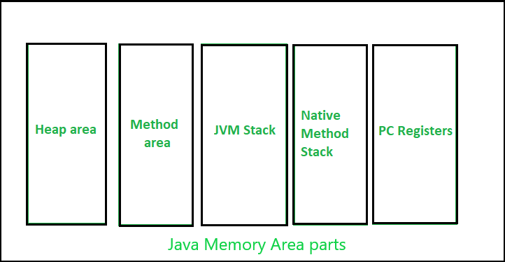
JVM Memory Structure
JVM defines various run-time areas is divided into multiple memory area like heap area, stack area, method area, PC Registers etc

Slide 5
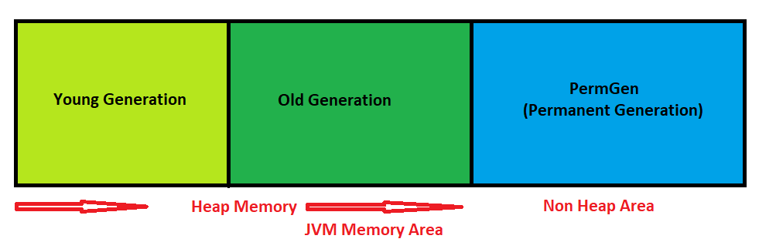
Heap Memory
Young Generation(Nursery): All the new objects are allocated in this memory. Whenever this memory gets filled, the garbage collection is performed. This is called as Minor Garbage Collection.
Old Generation:All the long lived objects which have survived many rounds of Garbage Collection are stored here. This is called as Minor Garbage Collection

Slide 6
Issue in PermGen Memory
This is a special space in java heap which is separated from the main memory where all the static content is stored in this section. Apart from that, this memory also stores the application metadata required by the JVM. Metadata is a data which is used to describe the data
The biggest disadvantage of PermGen is that it contains a limited size which leads to an OutOfMemoryError.
The default size of PermGen memory is 64 MB on 32-bit JVM and 82 MB on the 64-bit version. Due to this, JVM had to change the size of this memory by frequently performing Garbage collection which is a costly operation
The above issues led to generation of Metaspace

