Slide 1


(de)constructing health news: a transdisciplinary investigation into news media coverage of elderly-related health issues
Sarah van leuven, stijn joye, daniël biltereyst &
karin raeymaeckers
Etmaal van de communicatiewetenschap - 3 february 2015

Slide 2
Context of the PROJECT
Important societal changes
  Healthism, medicalization
  Ageing of the population
  Digitalization
Enormous increase of health related information
  Through the mass media
  Through different channels and stakeholders
Central research question
  Patient empowerment ↔ Influence of stakeholders?
  Construction and deconstruction of health news/information?
  Focus on the elderly (50+)

Slide 3
Start-to-end perspective
Construction and deconstruction of health news
STAKEHOLDERS
MEDIA
AUDIENCE (ELDERLY)

Slide 4

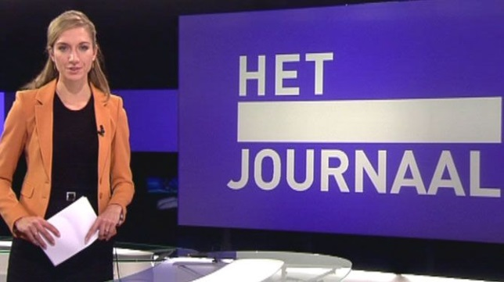



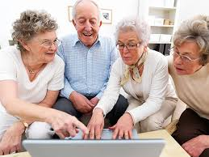

Stakeholders

Slide 5
Transdisciplinary research
a “particular form of interdisciplinary research which does not simply bring together different disciplines and theoretical-analytical frameworks. It also initiates a dialogue between two disciplines and frameworks, which may lead to a development of both through a process of each internally appropriating the logic of the other as a resource for its own development.”
Chiapello and Fairclough (2002: 206)

Slide 6
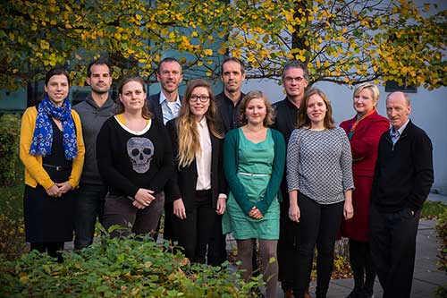

Health, Media & Society
  6 Supervisors: Daniël Biltereyst (communication), Piet Bracke (sociology), Thierry Christiaens (medical & health), Geert Jacobs (sociolinguistics), Stijn Joye (communication), Karin Raeymaeckers (communication)
  1 postdoc researcher: Sarah Van Leuven (communication)
  4 PhD researchers: Violetta Jitomirskaya (communication), Sarah Van den Bogaert (sociology), Jana Declercq (sociolinguistics), Joyce Stroobant (communication)

Slide 7
Research design
WP1: STAKEHOLDER ANALYSIS
WP2: NEWS STORY LIFECYCLE ANALYSIS
WP3: NEWS SOURCING, FRAME AND DISCOURSE ANALYSIS
WP4: NEWS MEDIA UPTAKE ANALYSIS AND AUDIENCE RESEARCH

Slide 8
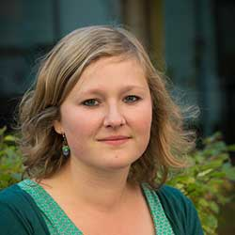


WP1: Stakeholder analysis
SOCIOLOGY
PhD Student: Sarah van den bogaert
SUPERVISOR: piet bracke

Slide 9
WP1: Stakeholder analysis
GOAL: Stakeholder mapping
  Relations and interests
  Discourse of stakeholders
METHOD
  Two waves of in-depth interviews
    9 categories of stakeholders
    Stakeholders who communicate about pharmaceuticals
  Respondents: key persons per stakeholder category
    administration/management level
    operational level (in charge of communication)

Slide 10
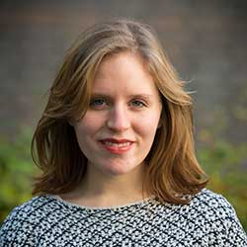
WP2: production processes
Linguistic ethnography
PhD student: Jana declercq
supervisor: geert jacobs

Slide 11
Research Question: backstage production processes of elderly-related health news?
linguistic ethnography
sites
online blog or website
pr-department pharmaceutical company
General newspaper
Production process
Magazine for the elderly
fieldwork
Observations
Interviews
Cognitive
Material
Social

Slide 12
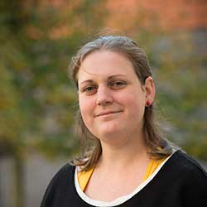
WP3: news content
Communication sciences
Phd student: Joyce Stroobant
supervisor: Karin raeymaeckers

Slide 13
Share of elderly-related health news
Sourcing practices
Role of the media
Frame analysis
Quantitative content analysis
(2015)
Newspapers
Magazines
Television
Online news
Discourse analysis
Issue Attention Cycle

Slide 14
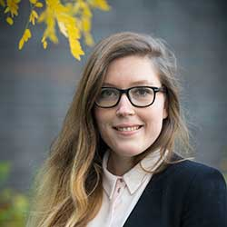
WP4: audience research
Communication sciences
Phd student: Violetta jitomirskaya
supervisors: stijn joye and daniël biltereyst

Slide 15
WP4: audience research
GOAL
  Investigate how elderly people perceive, interpret, trust and use health information
  Brought to them by news media and other stakeholders
METHOD
  Exploratory analysis: media use (Digimeter)
  In-depth interviews with members of the audience
  Focus groups with members of the audience

Slide 16
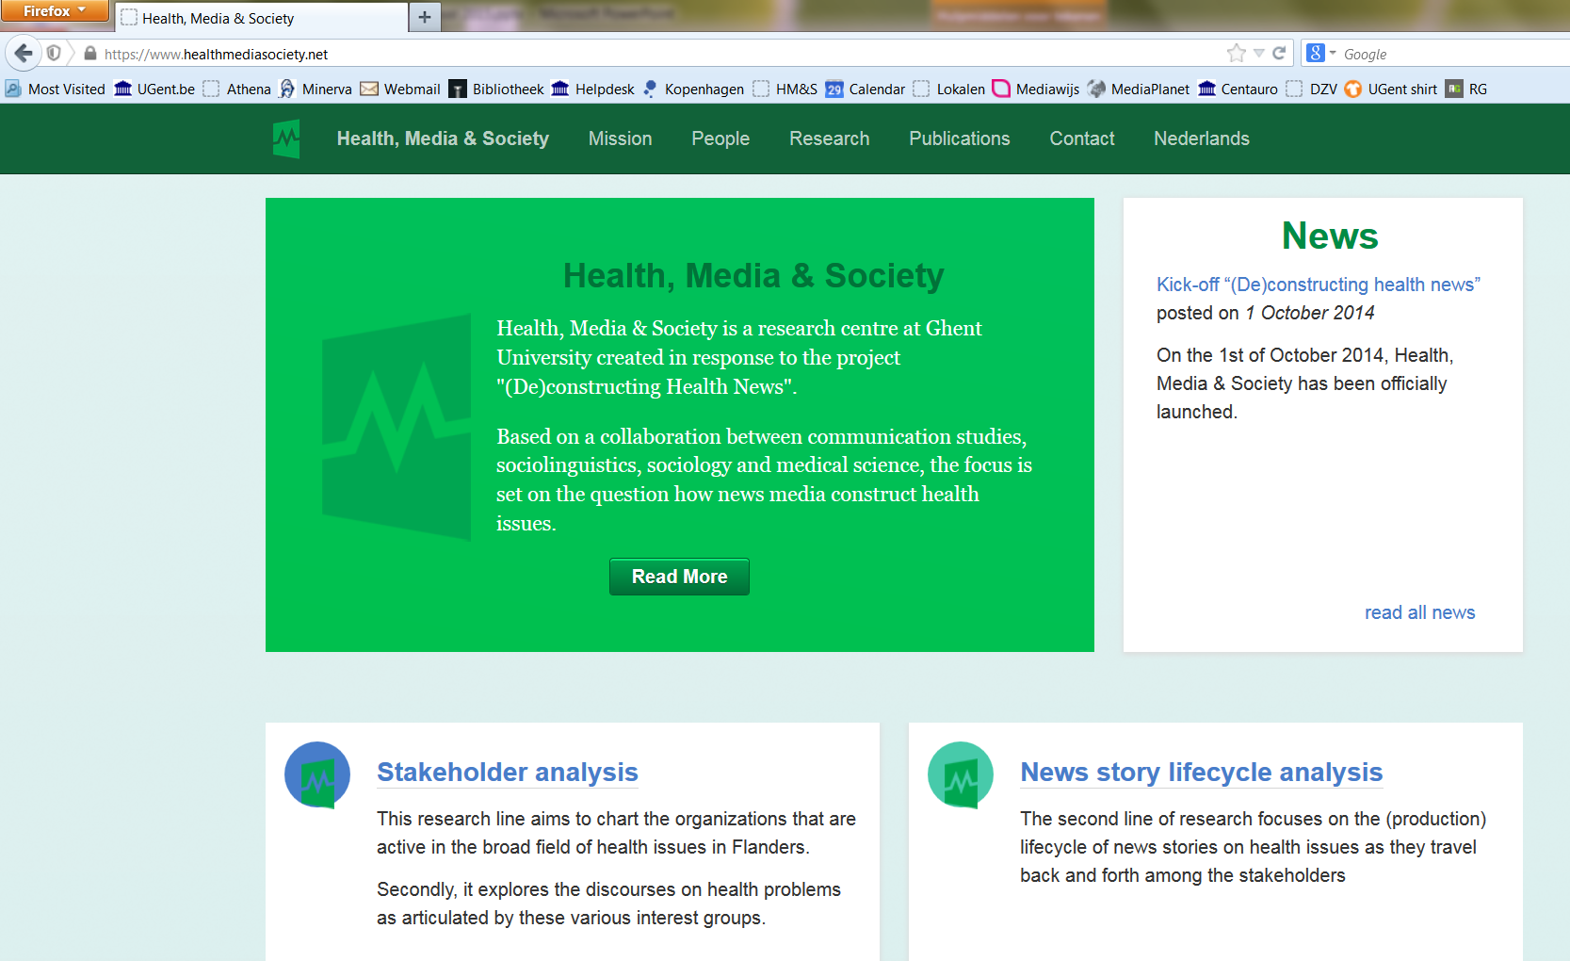
Want to know more?
www.healthmediasociety.net

