Slide 1
IFCO Data science challenge
Functional- Business oriented presentation

Slide 2

INDEX
Problem features
Data Generation
The estimation of the shrinking rate
Estimation of number of available containers
Difference between the scenario 1 and 2
Technical Appendix

Slide 3
1. Problem features
The definition of a “Lost” container
Threshold to define mínimum trip duration expected
RGB: 12.35.64
RGB: 218.41.28
A description the major challenges of this problem and the solutions proposed
Transp. 10%
Transp. 10%
Challenge
Solution proposed
Transp. 20%
Transp. 20%
Different trips starting date
Focusing on trip duration
Transp. 30%
Transp. 30%
The case of study is panel data where the event we are intrested in ( losing the container) is not directly observable.
If we adress all the containers at the end of the observation period as lost we might include the ones that recently started a new trip and they are likley not to be lost, misclassifiing those container could inflate out estimate for the shrinking rate
The user has the possibility of defining a threshold that should represent the minimum amount of days expected for a trip
The containers that have not been seen in that time span will not be consider as lost even if there was no recollection event associated with the container.
A container is defined lo if this 2 conditions are met:
1. The container has not been recollected in the observed time span.
2. The trip duration exceeds the user-defined threshold.
The dashoboard include a set of KPI that help the user to understand if the value chosen is reasonable.
Transp. 40%
Transp. 40%
Circular structure
Assuming constant risk of loss
RGB: 143.170.220
RGB:
112.48.160
RGB:
180.199.231
RGB:
197.224.180
Every RPCs can start a trip in an any given date so all the container have potenitially a different risk to be lost in the time Interval, moreover when calculating the shrinking risk we are intrested just in the container there are in a trip and therefore exposed to the risk of being lost.
The granularity we need to observe is the trip so each pair (container trip ) is used to estimate the shrinking risk
For calculating the shrinking risk we focus just on the days that the container have been travelling in order to have a more accurate estimation.
When estimating the number of container in a limited time span we have to consider that every container have been exposed to different risk of being lost depending on how many days the RPCs have been traveling and how many trips the container had.
Assuming the mean risk of being lost in equally distributed in the observed time span can help us to estimate what is the average number of container that we expect to lose in the interval
The risk of losing the container should be corrected considering the probability of the container to be in a trip, and therefore exposed to he risk.
Notes:
Technical note : This case of studies contains both casuistic of data left and right censored. Because the container can be lost but we dont’ know exacly when (left censored). On the other hand due to the circular structure we have containers that can start a trip just before the observation period and that could lead to a right censored Group of data.

Slide 4
2. Data Generation
RGB: 12.35.64
RGB: 218.41.28
Data The main characteristics and process to generate the data
Transp. 10%
Transp. 10%
Transp. 20%
Transp. 20%
Characteristic of data
Process
Transp. 30%
Transp. 30%
Panel data : every container is repeated for n times
The starting date of a trip can have a value or remain null, indicating that the container is not in a trip.
When the recollecting date have a value it means that the container has returned
From the day after of the container return the container might start another trip so we assume that the time needed to sanitize the container it’s at least one day. The case that this container can be broken has not been taken into account for simplicity
There is a statistical distribution (log-norm function) that model the probability of the container to be recollected.
The main difference between scenario 1 and scenario 2 are the parameter of the distribution that generated the recollecting event. In scenario 2 it’s likely to observe the recollecting event in a bigger time span than in scenario 1.
As mentioned before a minimum days expected for the trip threshold should be insert by the user, some metrics about the trip duration can guide the user to establish the value.
This value can be changed in the streamlit front end in an easy and interactive way
Additional metrics are calulated in the data generation like the amount of days where a container has been uncorrectly classified as lost and the actual total available container number, field that is meant to be used for validation.
Transp. 40%
Transp. 40%
User input
Data generation
RGB: 143.170.220
RGB:
112.48.160
RGB:
180.199.231
RGB:
197.224.180
Metrics review

Slide 5
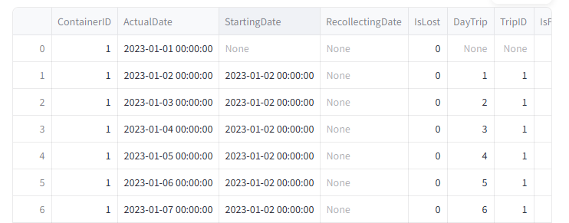
2. Data Generation
RGB: 12.35.64
RGB: 218.41.28
Description of main operations and structure of the data that have been generated
Transp. 10%
Transp. 10%
Transp. 20%
Transp. 20%
Output Variable
Descripción
Input Variable
Descripción
Transp. 30%
Transp. 30%
Start date
Represent the date that the date when the RPCs starts a new trip from a SC
Number of containers
How many RPCs Will be generated
Transp. 40%
Transp. 40%
Actual date
Represent the current date of the generatel interval
days
How many days Will be considered in the analysis
Recollecting date
Represent the date of the RPC comes back to the SC and ends it’s trip
Min recollect offset
The mínimum value expected for a container to end a trip
RGB: 143.170.220
RGB:
112.48.160
Container ID
ID of the RPCs
RGB:
180.199.231
RGB:
197.224.180
Is Lost
Dummy variable that indicate while the container has been lost during the trip based on the max tollerance input
Trip ID
Id of the trip it resets it’s value for every RPCs
Day trip
Represent the number of days that the specific container is in a specific trip
Is Fake Lost
Dummy variable that indicate whether the container has been misclassified given the treshold chosen to define a missing container
Total Stock
The sum of all the container that are not been classified as lost in any given moment

Slide 6
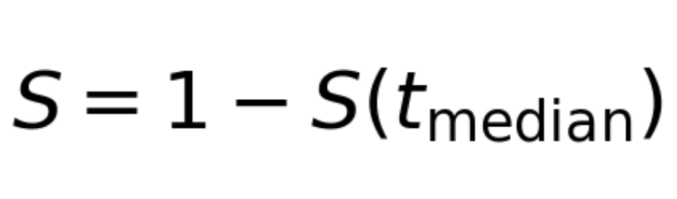
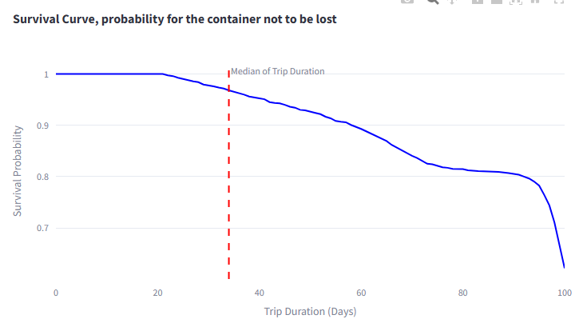

3. The estimation of the shrinking rate
Data Generation input
Why kaplan-meier model?
RGB: 12.35.64
RGB: 218.41.28
To estimate the shrinking rate we take into account the distribution of trip durations and estimate a Kaplan-Meier survival curve to estimate the los risk in any day of trip duration, then we consider the median trip duration value of the curve.
Transp. 10%
Transp. 10%
The model
Transp. 20%
Transp. 20%
Data Generation input
Considerations
Transp. 30%
Transp. 30%
As mentioned before for estimating the risk the granularity of the observation is the trip itself
Every couple Container- trip id represent the granularity for the analysis
It have been considered just the days where the containers were in a trip
The data passed to the model include just the time duration of each trip and a variable that indicates wheter the container has been lost in the specific trip or not
Easy and intuitive explanation of the risk over time supported by the survival curve graphics.
Flexibility he Kaplan-Meier model is non-parametric, meaning it does not rely on any assumptions about the underlying probability distribution of survival. Instead, it calculates survival probabilities directly from the observed data, making it highly adaptable.
Some parametric model can be used to estimate the survival curve (Like Weibull or others), but they do asume that the loss probability is following some specific distribution, and we would need to test the data in order to veryfy that assumption (running for example some kolmogorov smirnov test) and that goes beyond the scope of this Project.
Transp. 40%
Transp. 40%
Risks
RGB: 143.170.220
RGB:
112.48.160
RGB:
180.199.231
RGB:
197.224.180
For estimate the risk of losing a container over time the kaplan-meier survival curve has been estimated
The shrinking ratio is
Where S(t) is the value of the survival function estimated and t median de median trip duration
The Kaplan- Meier survival curve depends as well on the value of the threshold that the user input, in fact as you can check on the graph on the right the risk until thetrip duration threshold is met is equal to 0, that could lead to a sub estimation of the risk in the 1st part
On the other hand if we set a very small value of the threshold we Will classify as lost containers that likley are not lost and that would inflate the rate.

Slide 7
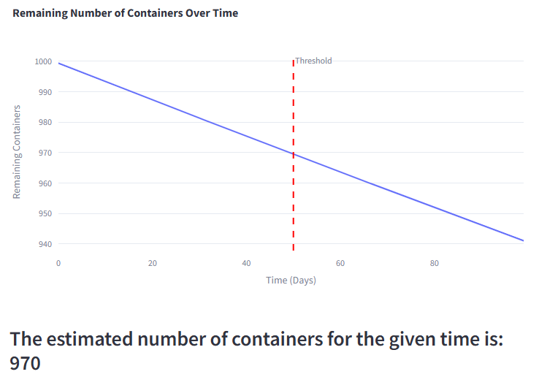


4. Estimation of number of available containers
Data Needed
Assumptions
RGB: 12.35.64
RGB: 218.41.28
For estimating number of available containers in a given time, it has been used the shrinking rate calculated in the previous step, divided for the time interval and adjusted for the probability of the container to be in a trip.
Transp. 10%
Transp. 10%
The Formulas
Transp. 20%
Transp. 20%
Methodology
Considerations
Transp. 30%
Transp. 30%
The shrinking rate: S
The probability of being in a trip calculated as the amount of days that all the containers were in a trip divided for the total days observed: Ptrip
The number of days to be considered for the estimation
The number of containers available in a specific day : N(t). In the t0 It will be initial container number
The constant risk of losing a container in every day of the Interval : H it would be the Shrinking rate divided for the number of days in the time interval
Since multiple trips can happen within the same time span, we are using assuming that the risk it's a constant value for each day in the time span.
We are assuming that the probability for a container to be or not to be in a trip it’s constant for the observed time span.
For the shrinking rate since the observed distribution is not symmetrical we assume that the median value of trip is an adequate measure to estimate the median risk in the interval.
Transp. 40%
Transp. 40%
Risks
RGB: 143.170.220
RGB:
112.48.160
RGB:
180.199.231
RGB:
197.224.180
Where H is the daily probability of losing a container
The constant shrinking rate for the interval implies a on overestimated risk value for the short trips and an underestimated for the longest one, so the assumption is that this two biases are compensating themselves but if the long trip class or the short one is bigger we might have bigger biases.

Slide 8
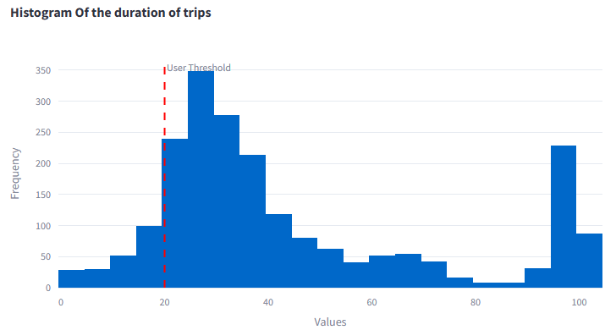
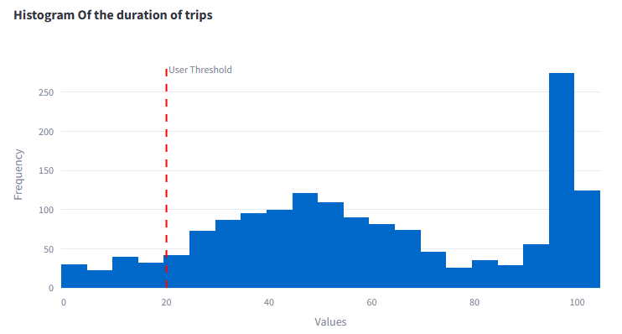


5. Difference between the scenario 1 and 2
Trip duration distribution scenario 1
Data Generation input
Difference in the trip duration
RGB: 12.35.64
RGB: 218.41.28
The main difference between the 2 scenarios is the probability of experiment a recollection event therefore we expect the distribution of the trip duration to change and to have bigger higher values
Transp. 10%
Transp. 10%
Transp. 20%
Transp. 20%
Data Generation input
Trip duration distribution scenario 2
Transp. 30%
Transp. 30%
In the case of the second scenario the user has to imput an additional parametrer that represent the expected percentage of observable trip.
Transp. 40%
Transp. 40%
Difference in results
The graphs in the right shows the different time duration of trip in the two scenarios, in the second scenario we are supposing that just the 50% of trips are observables.
This difference is the consequence of the smaller probability of recollecting the container in a reduced time span
Another consequence is the higher number of containers classified as lost as you can observe by the difference in the right peak of the distributions
For a correct use of the tolos this element should be taken into account by the user and the value of the threshold should be bigger in scenario 2 for avoiding the overstimation of lost containers.
An example of this over-estimation can be seen in the different shrinking rate estimated
RGB: 143.170.220
RGB:
112.48.160
RGB:
180.199.231
RGB:
197.224.180
Shrinking rate Scenario 1
Shrinking rate Scenario 2

Slide 9
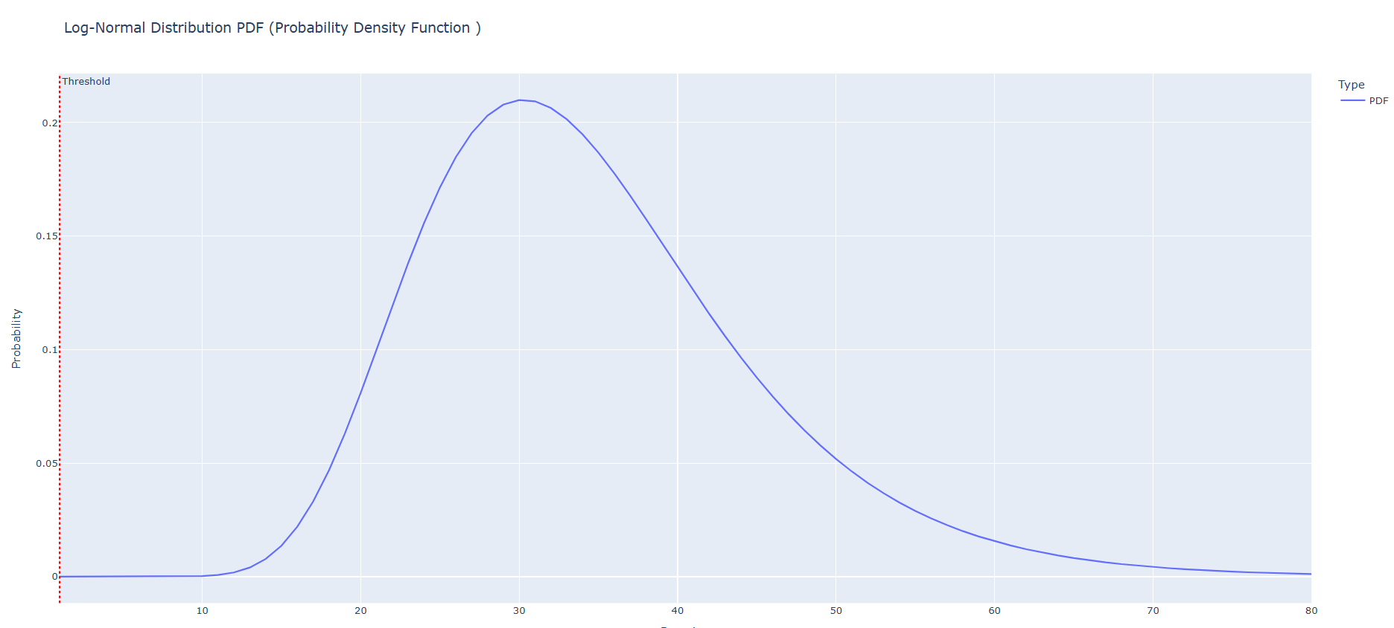
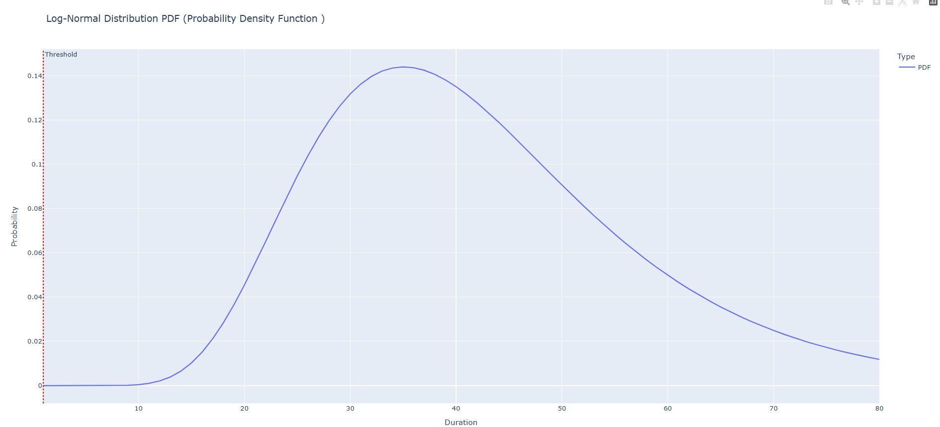
6. Technical Appendix
Data generation Scenario 1 and 2
Recollecting probability density function scenario 1 and 2
RGB: 12.35.64
RGB: 218.41.28
Mapping of survival probability
Transp. 10%
Transp. 10%
In-depth explanation of some technical topics
Transp. 20%
Transp. 20%
When the percentage of the expected observed trip is input by the user there is a function that map this value in order to change the 2 main parameters of the log- norm function use to model the recollecting probability.
This function affect both the mean and the variance of the underlying normal distribution making the recollecton evento more likley to happen in a posterior time and the distribution more disperse, to the right the example of the function generated for the two scenarios.
Transp. 30%
Transp. 30%
Transp. 40%
Transp. 40%
Calculating precision for the initial threshold
RGB: 143.170.220
RGB:
112.48.160
The Kaplan meier curve, as the other survival models, map the probability in between a space included into 1 and 0 assuming that no observation will survive the end of the Interval (considered right censored).
In order to model the risk into the domain needed and use the risk function : (1- S(t) ) domium of the function have been mapped in a space in between 1 and p where p represents the observed percentage of container lost in the period.
RGB:
180.199.231
RGB:
197.224.180
Even if generally the precisión is calculated in the model validation test, in this case this metric have been included in the data generation section in order to give additional informations about the potential fake positive bias setting the threshold.
As improvement point further validations of the model should be done as for instance compared the estimated number of containers at a time t with the actual number. This part have not been implemented because it’s out of the Project scope.

