Slide 1
BLDC ESC HARDWARE DESIGN
Ahmet can yulaf

Slide 2
Contents
Brushless DC Motor
  Structure & Operation
  Control Methods
  Applications
Hardware Design
  System Block Diagram & Operation
  Components Chosen
  PCB & 3D Models
Conclusion and Q&A

Slide 3

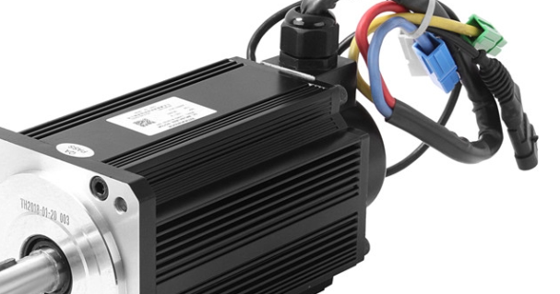
Brushless DC Motor

Slide 4
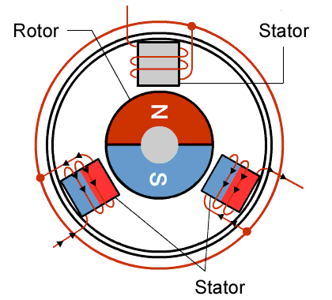
Working Principle

Slide 5
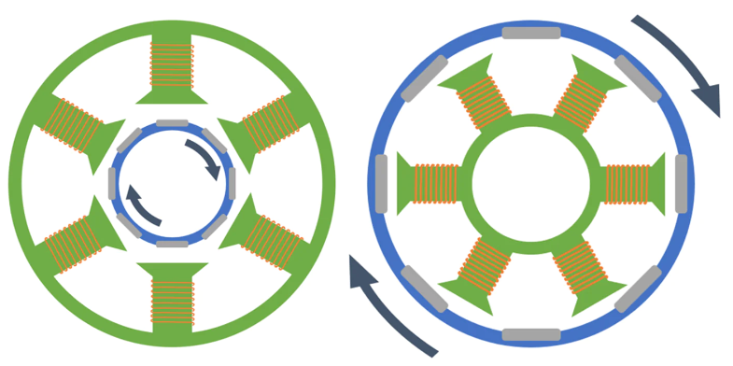
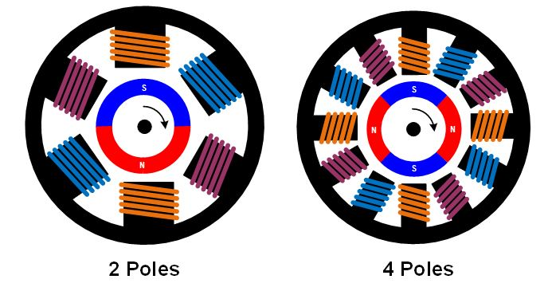
Structure

Slide 6
Control Methods
Trapezoidal Control
Sinusoidal Control
Field-Oriented Control

Slide 7
Applications
Automotive
Automation
Aerospace
Military & Defense
Consumer Electronics

Slide 8
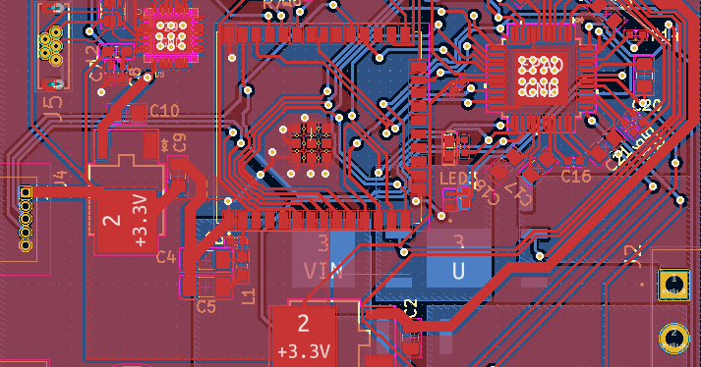
Hardware Design

Slide 9
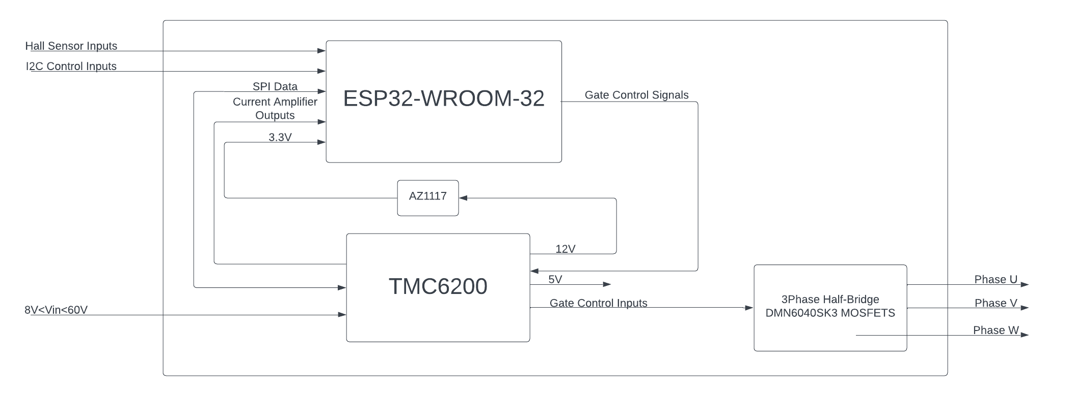
System Block Diagram

Slide 10
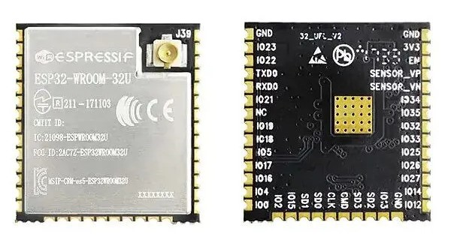
Controller

Slide 11
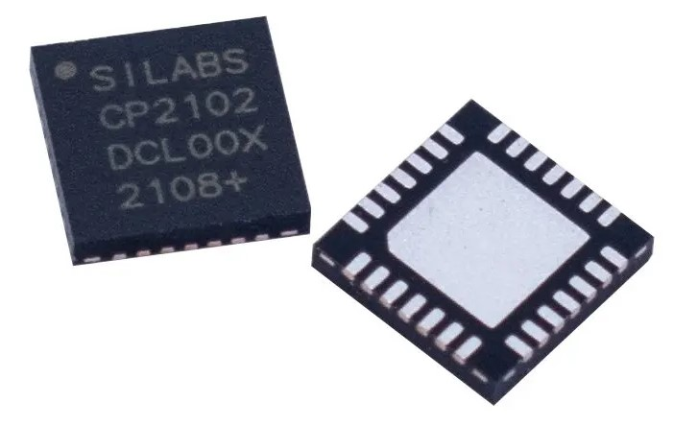
Programming Interface-UART Bridge

Slide 12
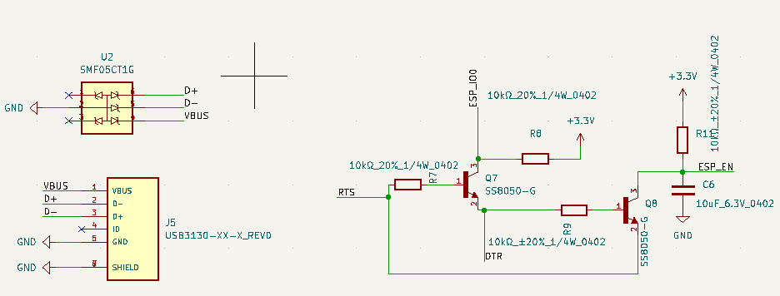
Programming Interface-USB Connector

Slide 13
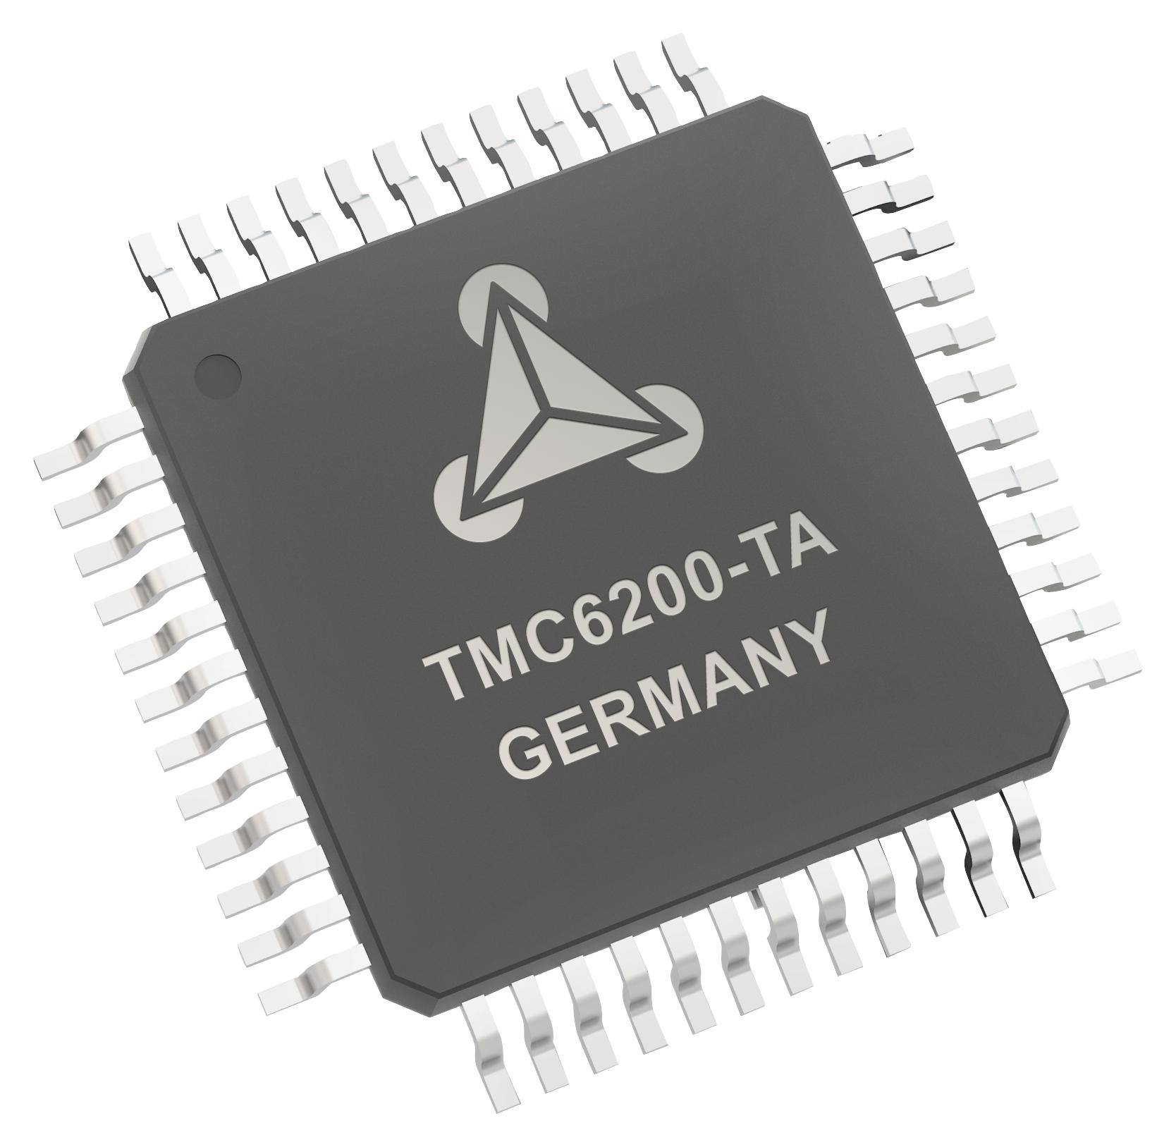
Gate Driver

Slide 14
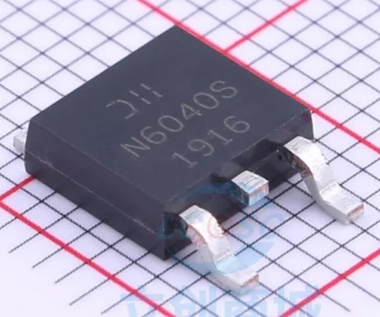
Inverter MOSFETs

Slide 15
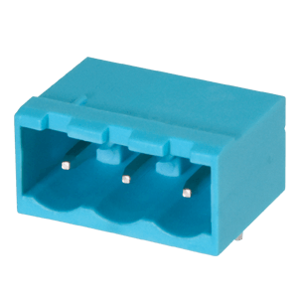
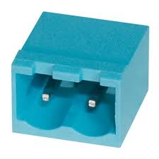
Connectors-Power I/O

Slide 16
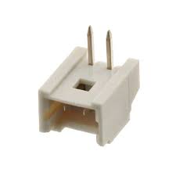
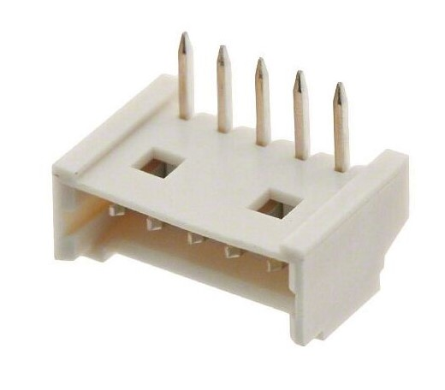
Connectors-Signals

Slide 17
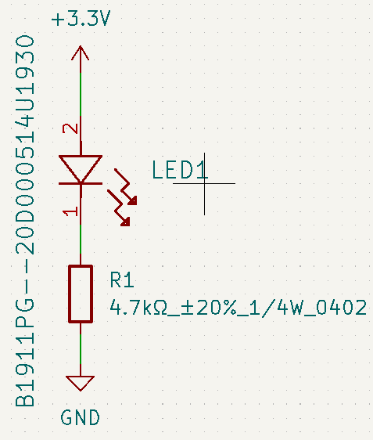
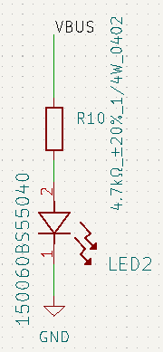
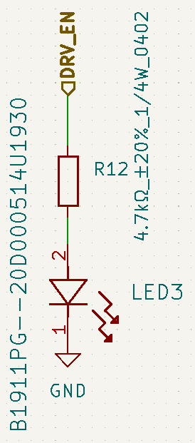
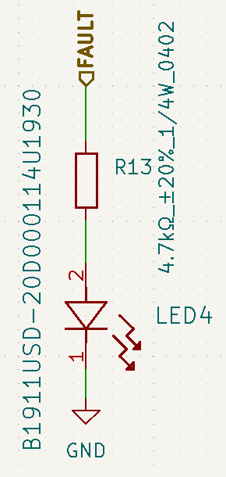
LEDs

Slide 18
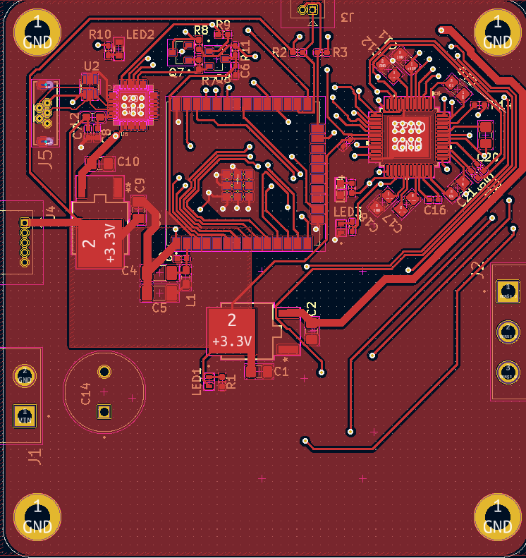
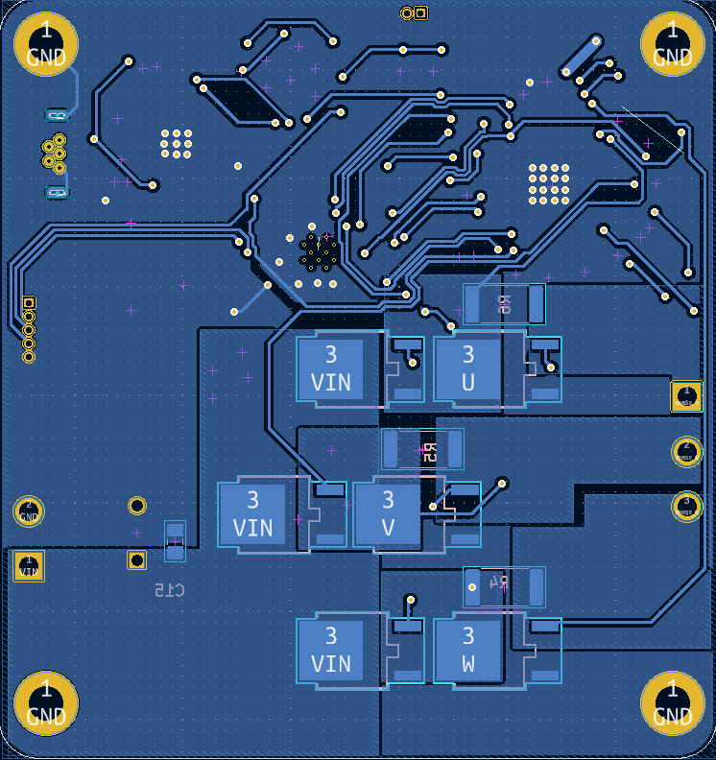
PCB

Slide 19
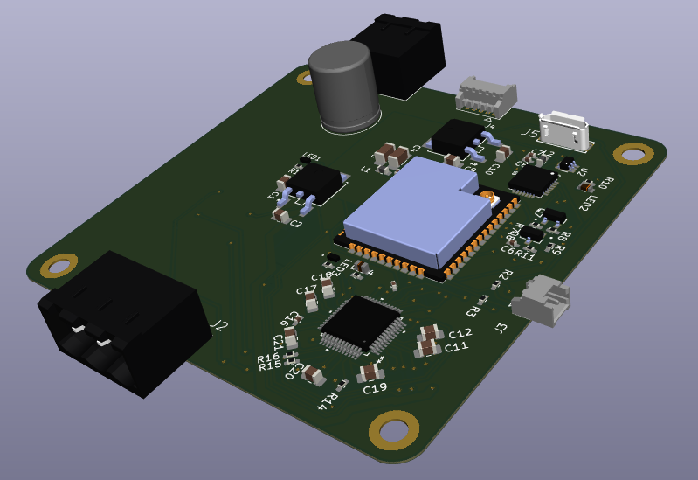
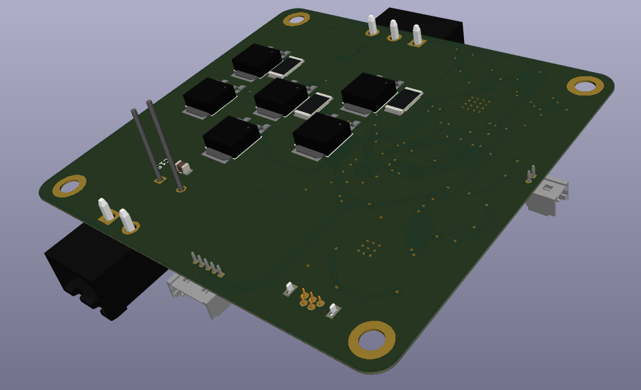
3D Model

Slide 20
Q&A
Thanks for your attention!

