Slide 1

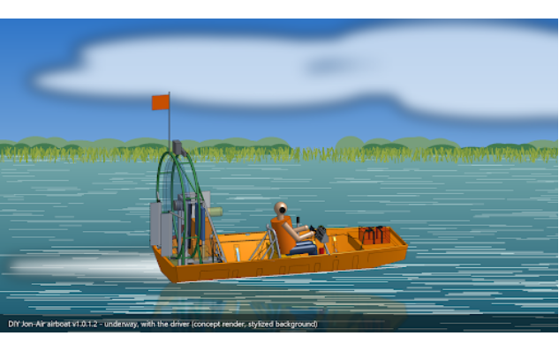

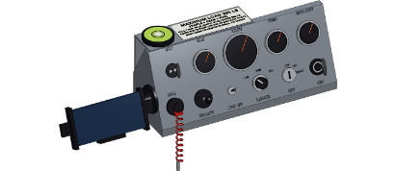
MISSION OVERVIEW
•
High-Performance Everglades Workboat
JON-AIR rev8: Built for Everglades Night Hunting
165 HP ROTAX 850 E-TEC
Full Armor UHMW Plastic Bottom for Zero-Stick Sliding
Ergonomic Helm Control Box
Integrated lanyard kill switch, searchlight joystick, USB charging, and dual temperature/gas gauges.
3.5s Hole Shot & Water-Level Eye Line
Low engine placement unlocks visibility under overhanging sawgrass banks where pythons nest.

Slide 2
The Collaborative Build Model & Economics
COOPERATIVE MODEL
By pooling sweat equity and buying materials directly, builders acquire military-grade workboats at half retail cost.
~$16K
~200 hrs
GoFundMe
$35K+
MATERIAL COST / HULL
DIY BUILD LABOR
OVERHEAD SUBSIDIES
COMMERCIAL VALUE
Equity Through Efficiency
Pooled Overhead Protection
Volunteers and founders combine baseline hardware purchasing with ~200 DIY build hours. No commercial manufacturer markups or corporate margins.
GoFundMe proceeds absorb legal entity formation, D&O governance protection, and workshop Commercial General Liability (CGL) insurance policies.

Slide 3

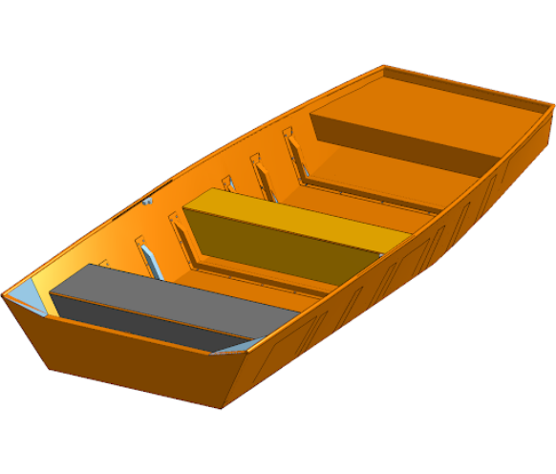

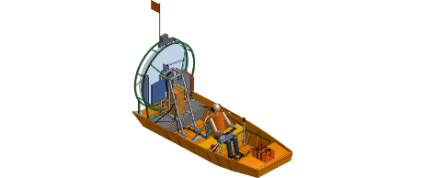
Build Origin: Starting with a Used 1448 Jonboat Hull
STEP 01 FABRICATION
Target Outcome: rev8 Airboat
Baseline Aluminum Shell
Adding 6061 aluminum stringers, Rotax 850 engine stand, stick steering, and UHMW armor bottom.
Purchased used to keep initial capital low before stripping for stringer and armor integration.

Slide 4

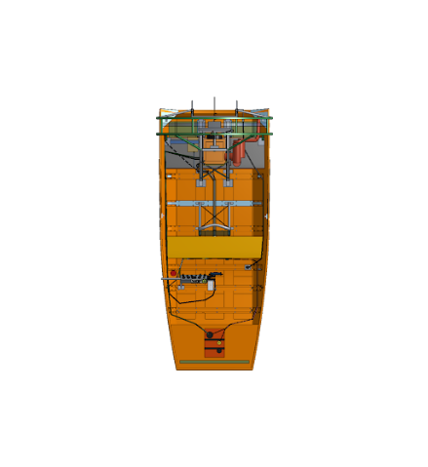
Tracking Labor & Money: Guaranteed Returns
MASTER LEDGER SYSTEM
Fixed-estimate task valuations guarantee fair title allocation or Batch 2 credit rollover.
1. Fixed-Estimate Task Valuation
Build hours are pre-set by task complexity (e.g., 50 hrs for stringer welding). Fast completion is rewarded; slow work yields zero extra credit.
2. Full Vessel Ownership vs. Rollover
Anchor builders (~200 DIY hrs + material deposit) receive refined production hulls (#2, #3, #4). Micro-contributors roll credits into Batch 2 or gear/fleet days.
3. Outsource Option
Participants may satisfy any task module by submitting receipts for approved professional vendor work.
Top-Down Layout Blueprint
Internal stringer grid & tank placement driving task estimates.

Slide 5
JOIN THE INITIATIVE
Help Build the Everglades Fleet
Sign the Operating Agreement, claim a shop build slot, or back the GoFundMe campaign to fund baseline hardware.
Join Build Crew
Back GoFundMe

Slide 6
Questions?
Jon-Air rev8 Enterprise LLC
Everglades Invasive Species Management & Python Hunting Cooperative Build Program

