Slide 1
Novel structural MS-based elucidation methods for the analysis of complex environmental samples
Paolo Benigni
Research Mentor: Dr. Francisco Fernandez-Lima
Dept. Chemistry and Biochemistry

Slide 2
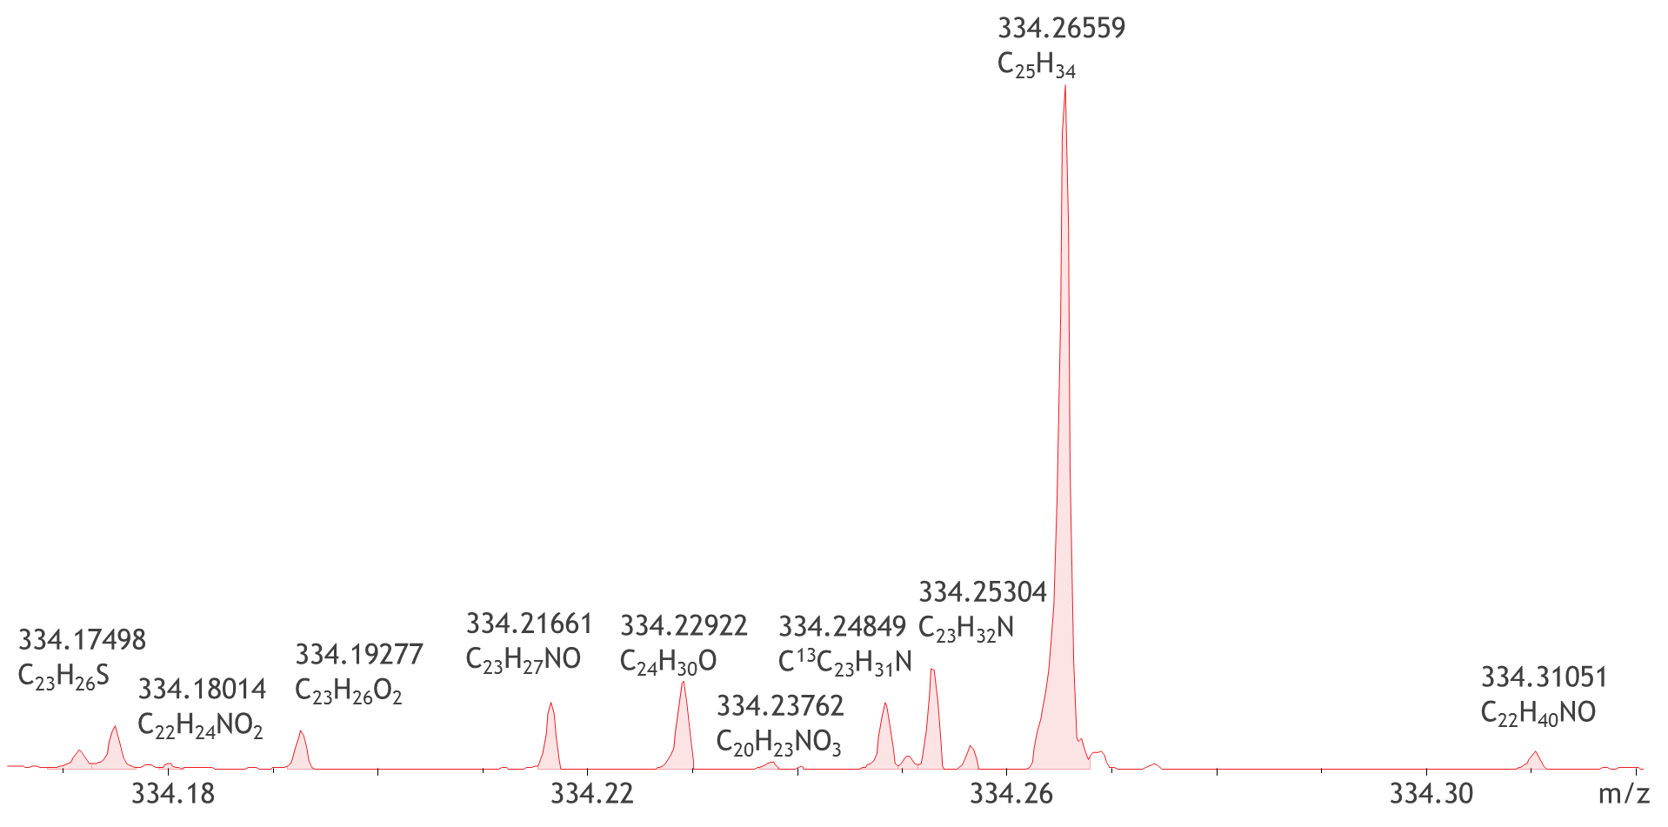
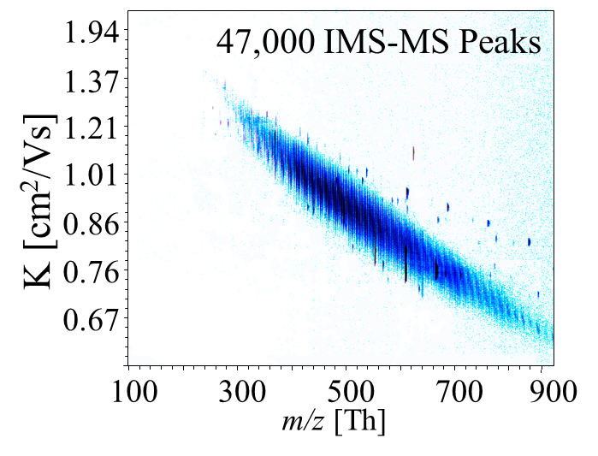
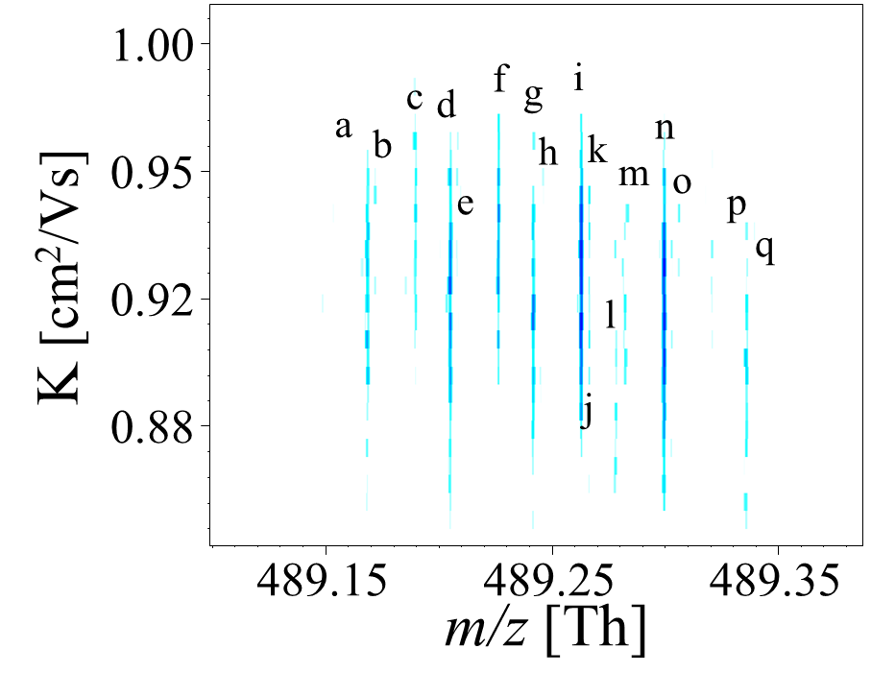
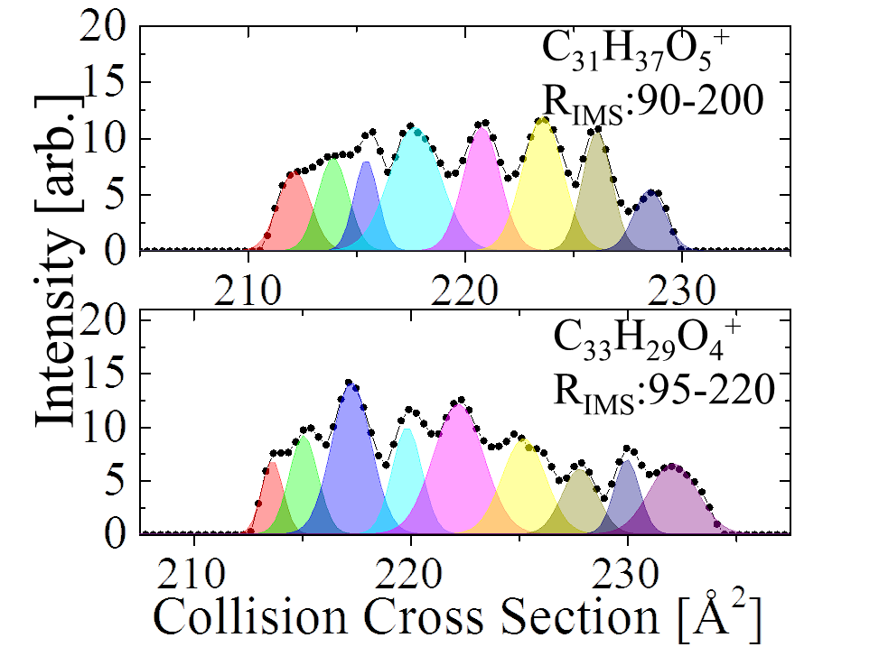
Trapped Ion Mobility Spectrometry coupled to Ultrahigh resolution MS
TIMS Analyzer
+
+
+
+
Combine the isomeric separation of TIMS to the isobaric separation of FT-ICR MS in order to resolve complex environmental samples.

