Slide 1

ACM-476-DATA MINING
Ege Acaroğlu
20191308020

Slide 2
Data Description
The dataset utilized in this analysis comprises various parameters related to the energy efficiency of buildings, simulated using the Ecotect software. Each entry in the dataset represents a distinct building configuration, characterized by twelve different attributes. These attributes encompass factors such as the building's relative compactness, surface area, wall area, roof area, overall height, orientation, glazing area, glazing area distribution, and the corresponding heating and cooling load requirements. The dataset aims to explore how these attributes influence a building's energy efficiency, particularly in terms of heating and cooling requirements.

Slide 3
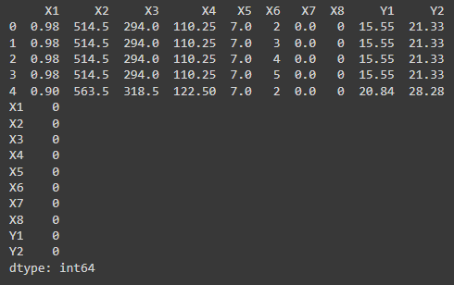
EDA
As you can see from the right dataset has 8 features and 2 target values.
Features are listed below:
Relative Compactness
Surface Area
Wall Area
Roof Area
Overall Height
Orientation
Glazing Area
Glazing Area Distribution
Targets are listed below:
Heating Load
Cooling Load

Slide 4
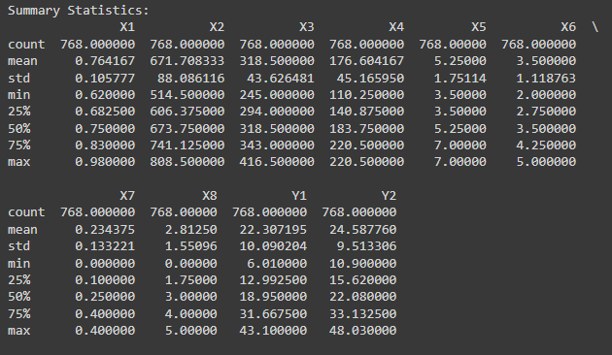
Summary Statistics

Slide 5
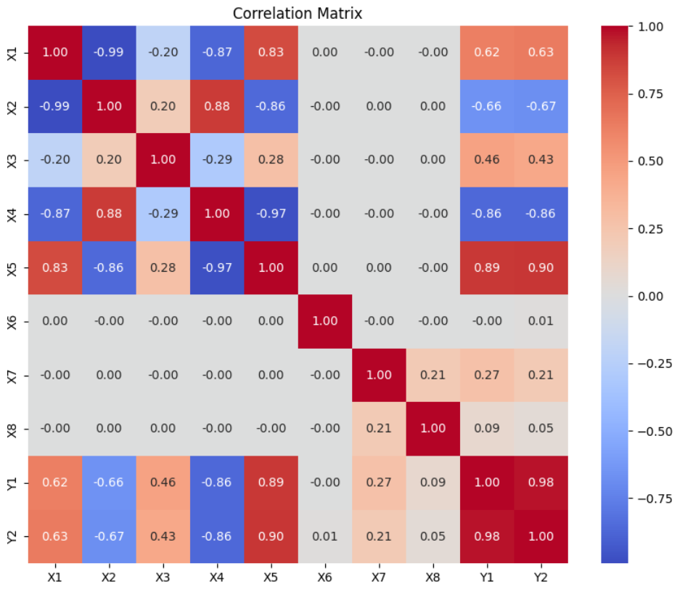
Correlation Matrix

Slide 6
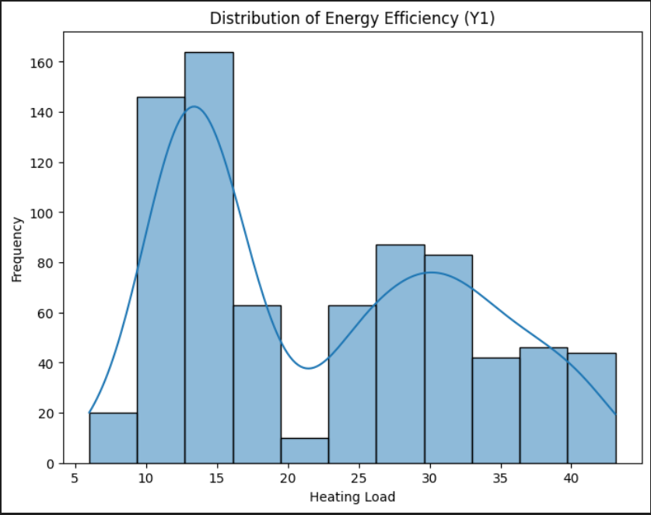
Distribution of Energy Efficiency
This graphic shows the relationship between frequency and heating load.

Slide 7
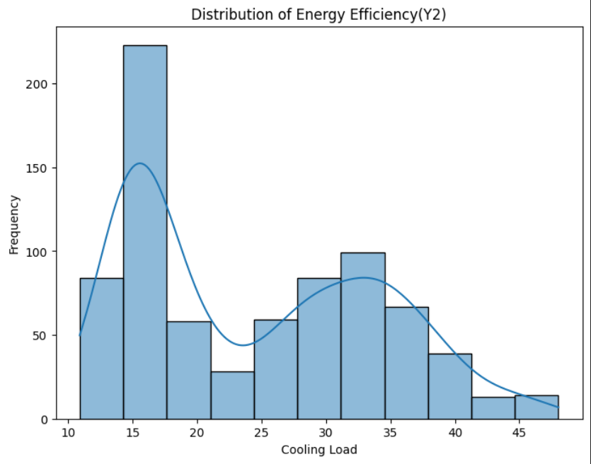
Distrubiton of Energy Efficiency
This grapich shows the relationship between frequency and cooling load.

Slide 8
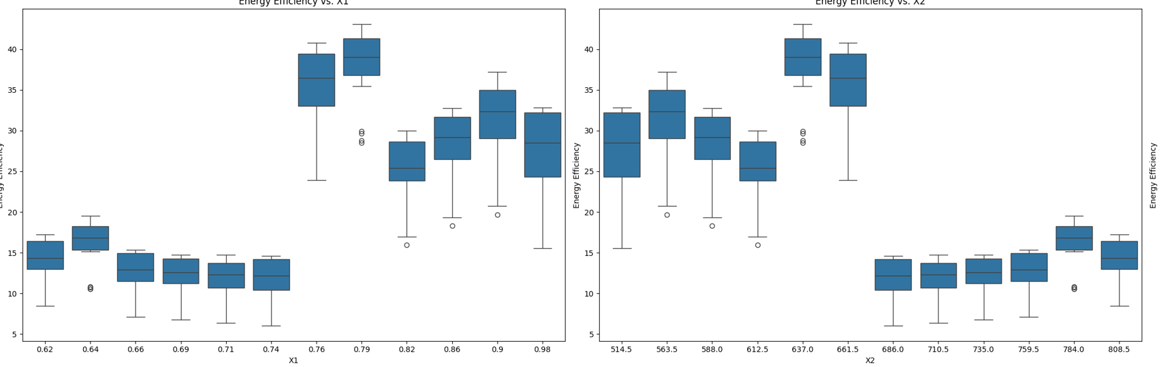
Relative Compactness(X1)-Surface Are(X2)

Slide 9
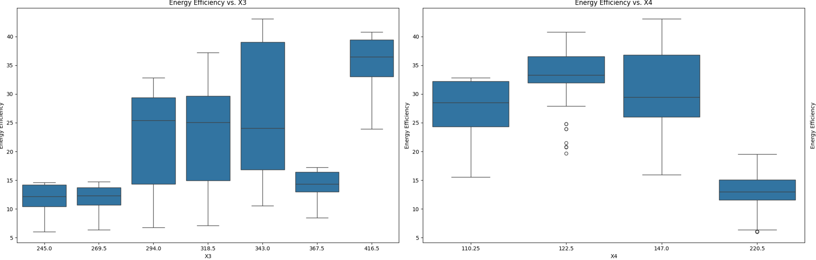
Wall Area(X3)-Roof Area(X4)

Slide 10
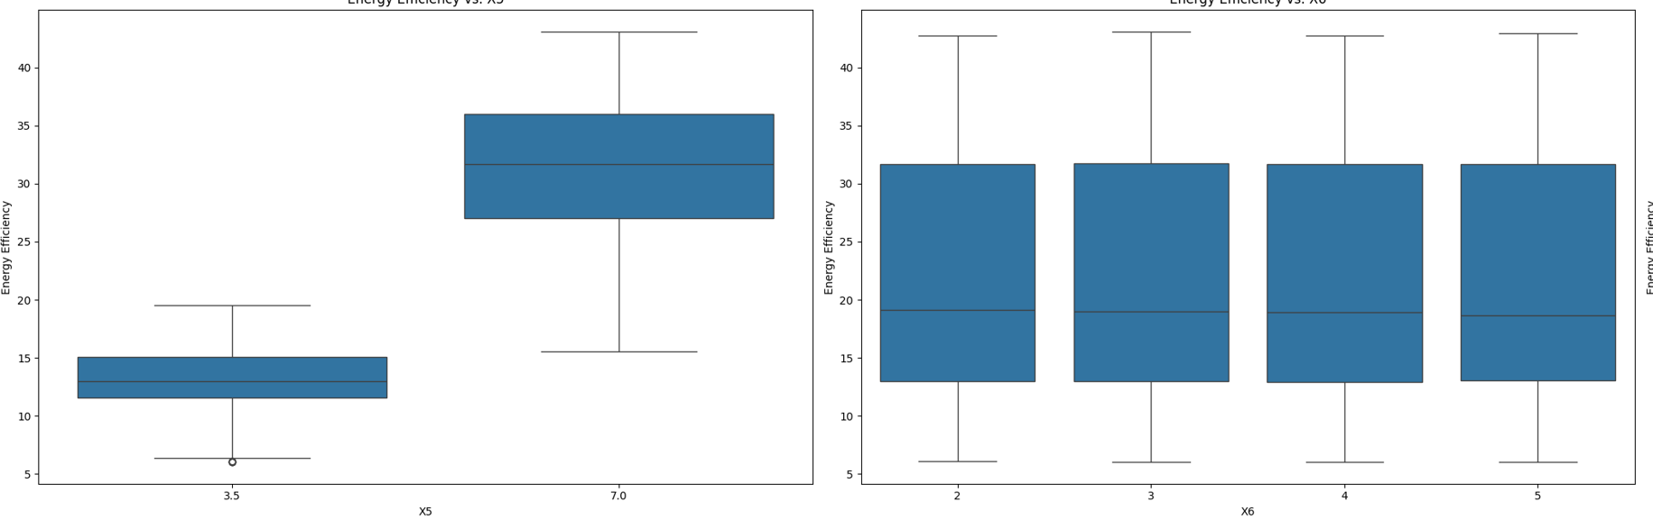
Overall Height(X5)-Orientation(X6)

Slide 11
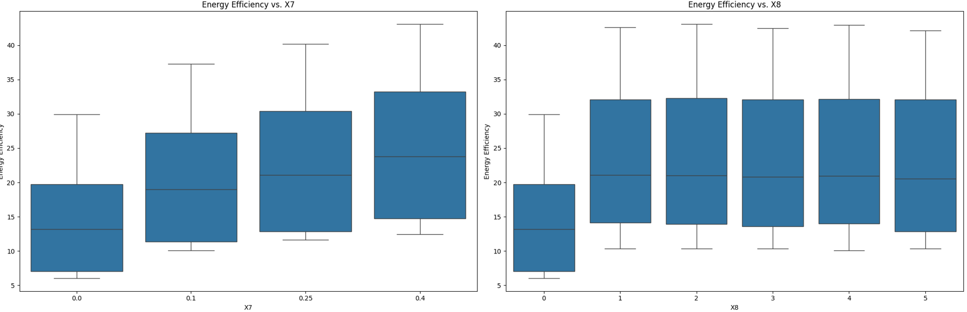
Glazing Area(X7)-Glazing Area Distribution(X8)

Slide 12
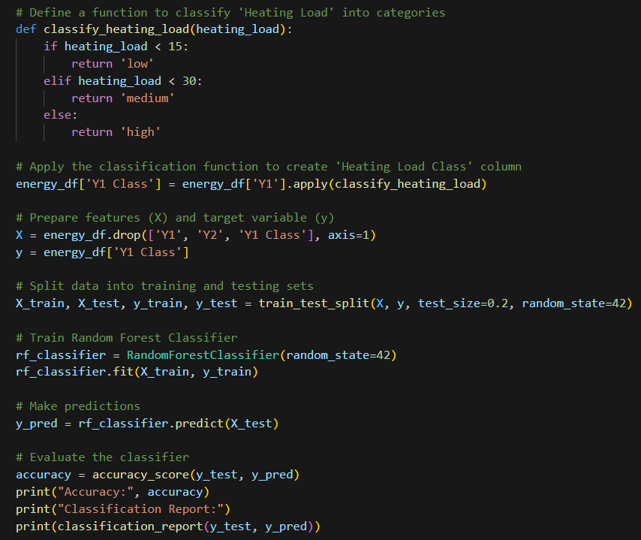
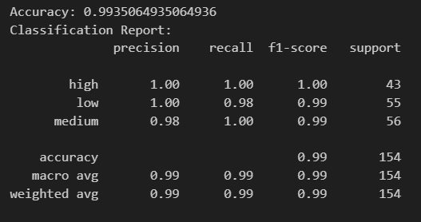
Random Forest Classification
Random Forest is chosen for its ability to handle non-linear relationships, its robustness to overfitting, and its capability to estimate feature importance. Random Forest is an ensemble learning method that combines the predictions of multiple decision trees to improve predictive accuracy and generalization performance.

Slide 13
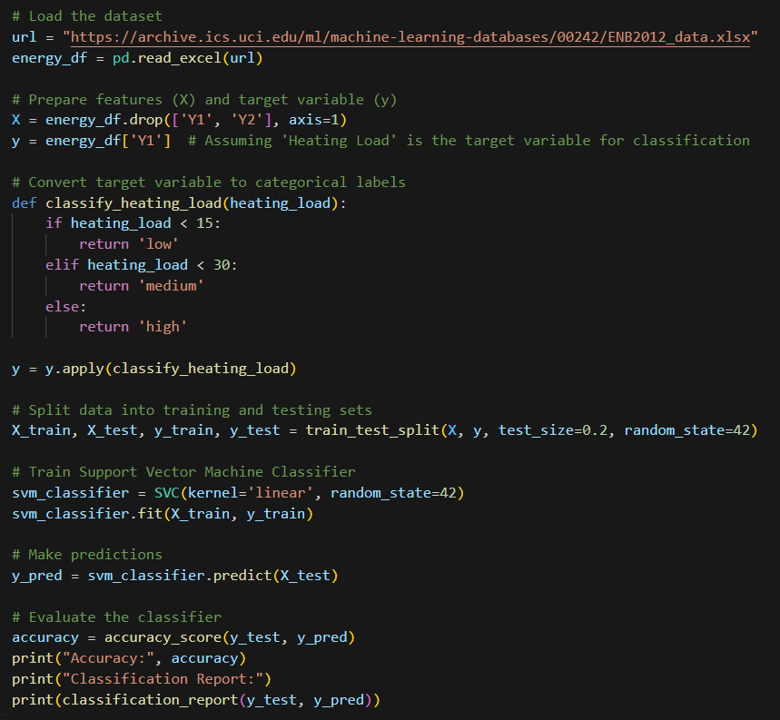
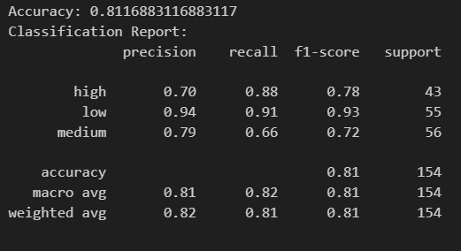
Support Vector Machine
Support Vector Machine (SVM) is chosen for its ability to handle both linear and non-linear relationships, its effectiveness in high-dimensional spaces, and its robustness to overfitting. SVM is a supervised learning algorithm that is widely used for classification and regression tasks.

Slide 14
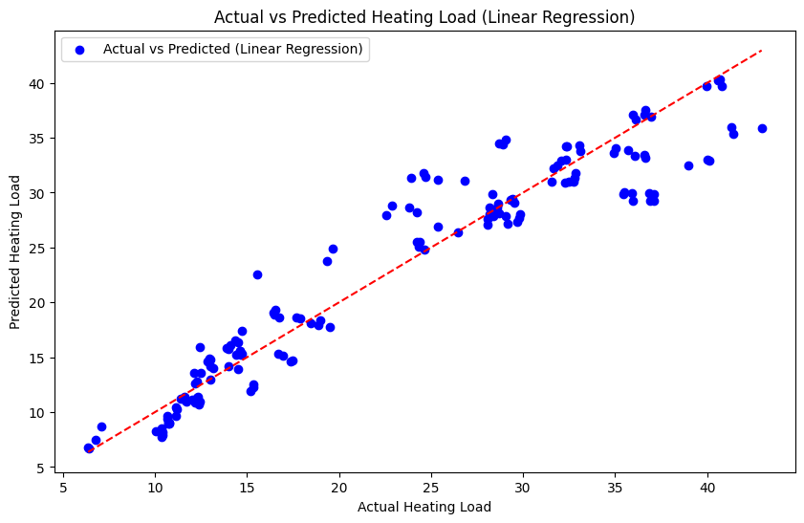
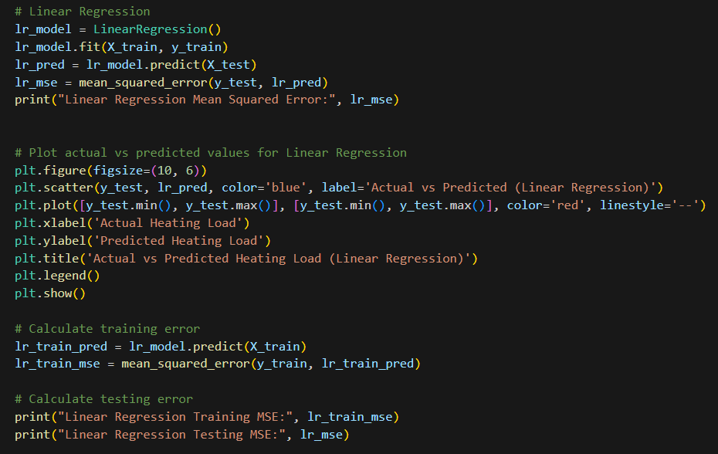
Linear Regression
Linear Regression Training MSE: 8.37778940979849
Linear Regression Testing MSE: 9.151736165801019
In the analysis of energy efficiency data, we chose regression methods to model the relationship between independent variables (such as building characteristics) and dependent variables (such as heating and cooling loads). Regression analysis allows us to understand how changes in the independent variables affect the dependent variables and make predictions about the dependent variable based on the values of the independent variables.
Linear Regression Mean Squared Error: 9.151736165801019

Slide 15
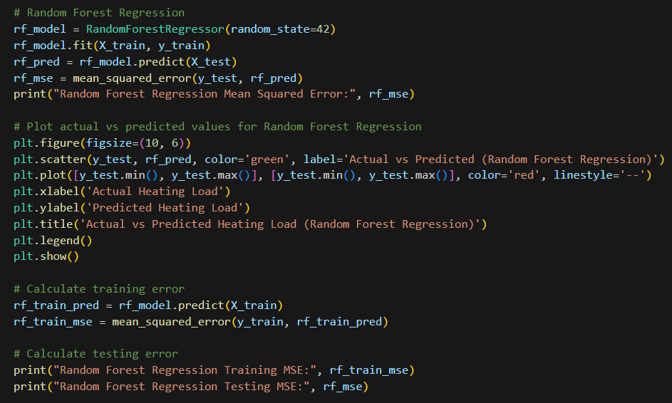
Random Forest Regression
Random Forest Regression Mean Squared Error: 0.24088314337662134

Slide 16
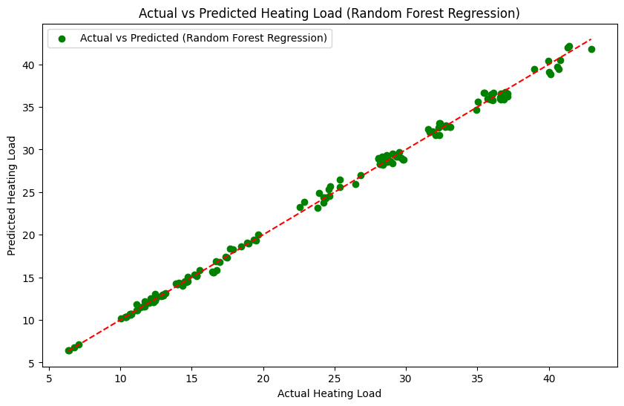
Random Forest Regression
Random Forest Regression Training MSE: 0.030351020977198658
Random Forest Regression Testing MSE: 0.24088314337662134

