Slide 1
JavaScript : it sucks
abby
stupid

Slide 2
Why does JS Suck?
It was not thoroughly explained enough (I have no idea what's happening.)
I will reiterate the fact that I did not want to learn JavaScript
I only picked this class because of Python and machines run by Python

Slide 3
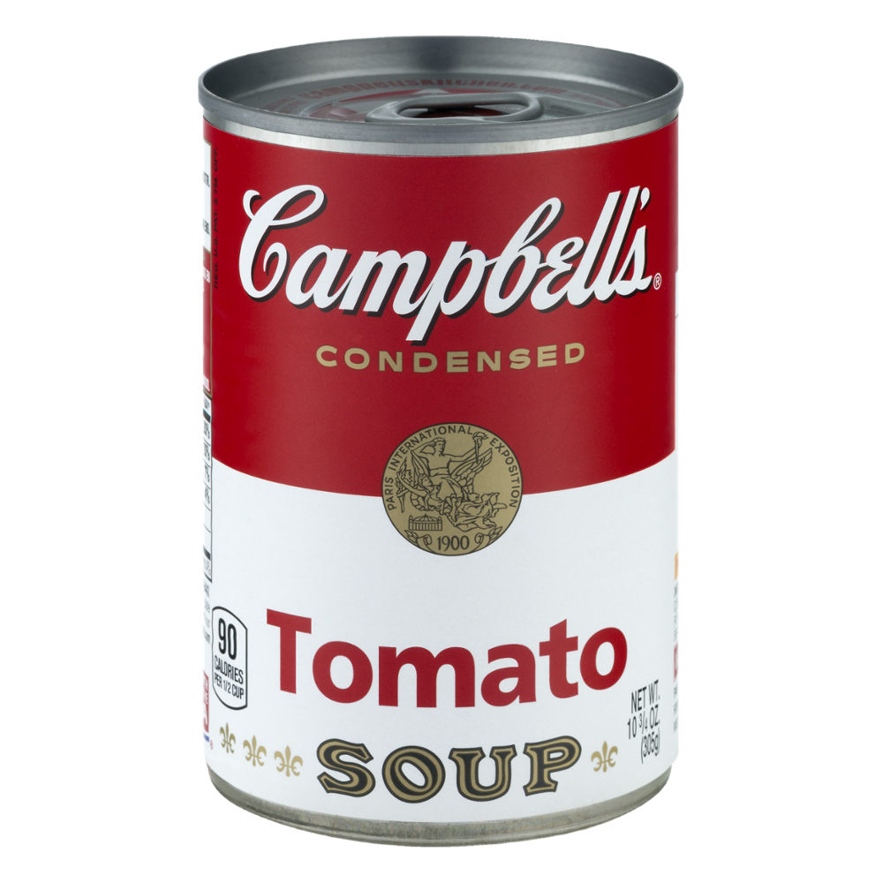
How can we fix it?
Petition to get the Nocti changed to something more practical.
No one likes JavaScript because it is too complicated and terrible.
Python is superior because it is way better no questions asked.
If you like JS you are a terrible person.

Slide 4
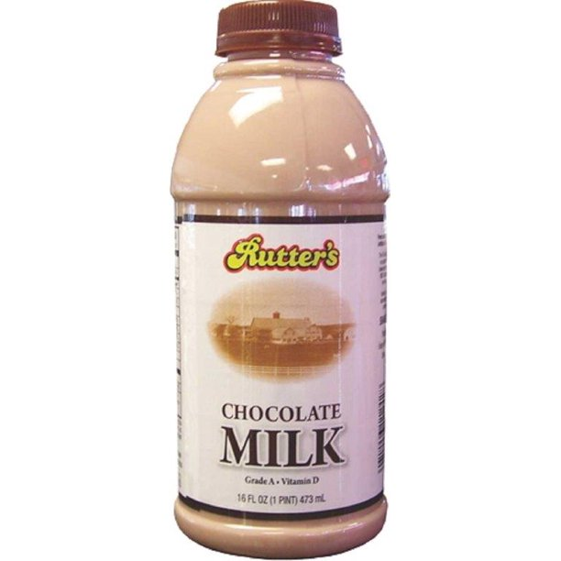
What should we do instead?
Maybe learn what I actually came here to learn
That being, programming robots or telling a machine (that doesn’t require me to make a dumb website) to do what I want.

Slide 5

Cons of JS (because there are no pros)
Its too complicated
Code is complicated as is and JS just makes it worse
While knowing how to setup a webserver and site might be appealing to employers, JS is the worst and I can pretty much guarantee that its not what most of us came here to learn.
JS is just the worst

Slide 6
END
I hate this assignment. Please grade my stuff.
Note: I am going on a trip in about a month and if my grade looks the way it does I’m not going to be allowed to got and I’ll be pissed if I can’t.

