Slide 1
Schema2Script
GROUP G2
Kaucic Nik, Jakopovic Robert, Gobin Frane, Kosar Yigit, Ozbahceci Acar

Slide 2
OUTLINE
Project Overview
Demonstration
Abstracted Input
Abstracted Output
SonarQube Analysis
Reflection

Slide 3
Project Overview
Java tool converting JSON/XML schemas into SQL DDL scripts
Supports MySQL, PostgreSQL, Oracle
Factory-based parser + generator architecture
Swing GUI for file upload, schema visualization, and live editing
Real-time SQL generation + automatic saving to project directory
Notes:
Schema2Script is our end-to-end tool that takes JSON or XML schemas and turns them into SQL DDL scripts. We support three major DBMS systems. The whole project is built around a unified SchemaModel and factories for both parsers and SQL generators, which makes the architecture easy to extend.
In Milestone 3, we introduced the GUI — users can upload a file, visually inspect and edit the schema, and then instantly generate SQL based on those changes. The output updates in real time and also gets saved automatically inside the project directory.

Slide 4
Demonstration

Slide 5
Abstracted Input
JSON and XML supported through unified parser interface
SchemaParser defines the contract for all parsers
ParserFactory selects correct parser based on file type
Both parsers produce a unified SchemaModel
Controller handles file loading and triggers parsing
Model passed to GUI for visualization & editing
Notes:
For the input side, our system uses a shared SchemaParser interface that both XML and JSON parsers implement.
When the user uploads a file, the controller sends the file type to the ParserFactory, which selects the correct parser automatically. Both parsers output the same SchemaModel, which standardizes the schema no matter the input format.
The controller then returns this model to the GUI, where the user can visually inspect and edit the schema. This keeps the parsing logic clean, extendable, and fully separated from the UI.

Slide 6
Abstracted Output
SQL generation handled through SqlGenerator interface
Factory selects MySQL, PostgreSQL, or Oracle generator
Generators transform the unified SchemaModel into DDL
GUI triggers generation based on selected DBMS
Output displayed in UI + saved to target/generated/schema.sql
Consistent, extensible architecture for adding new DBMS types
Notes:
On the output side, SQL generation is abstracted through the SqlGenerator interface.
When the user picks a target DBMS in the GUI, the controller uses the SqlGeneratorFactory to select the correct generator — MySQL, PostgreSQL, or Oracle.
Each generator takes the unified SchemaModel and converts it into valid DDL statements. The SQL script appears instantly in the interface, and we also save it automatically to target/generated/schema.sql.
This output architecture is extremely flexible; adding a new database type only requires writing a new generator implementation.

Slide 7
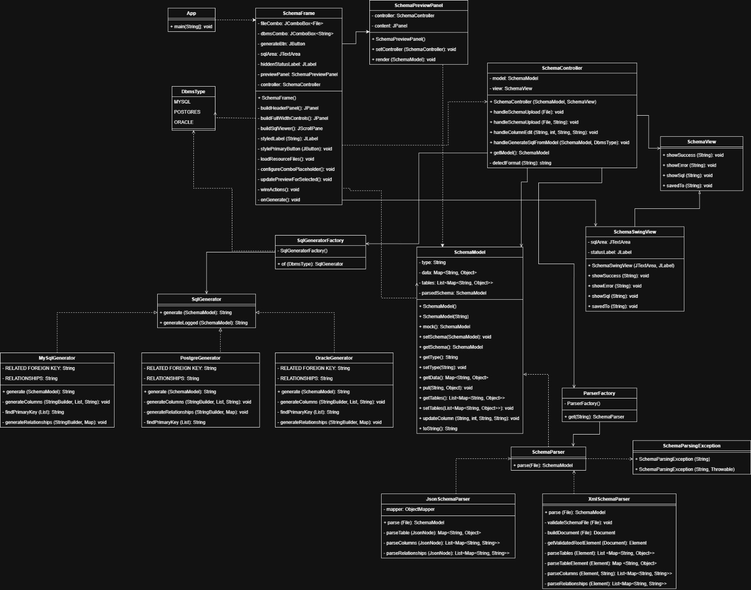
Class Diagram
Notes:
This class diagram shows the full architecture of the Schema2Script application, covering both the input and output sides of the system.
At the center we have the SchemaController, which coordinates all major operations. It communicates with the view layer, manages the SchemaModel, and delegates parsing and SQL generation to their respective factories.
On the input side, we have the SchemaParser interface with two implementations: JsonSchemaParser and XmlSchemaParser. These classes are selected using the ParserFactory, and both produce the unified SchemaModel, which stores tables, columns, data types, and relationships.
On the output side, the SqlGenerator interface defines how SQL scripts are produced. The SqlGeneratorFactory selects the correct concrete generator — MySQL, PostgreSQL, or Oracle. Each generator converts the same SchemaModel into valid DDL syntax for its target database.
The diagram also includes the full Swing GUI layer: SchemaFrame, SchemaSwingView, and SchemaPreviewPanel. These components handle file uploads, schema visualization, user edits, DBMS selection, and displaying the final SQL output.
Overall, the diagram highlights a clean separation of concerns: parsers handle input, generators handle output, the controller coordinates the logic, and the view manages user interaction. The architecture is highly modular and easy to extend — adding a new parser or a new database type only requires creating another implementation of the corresponding interface.

Slide 8
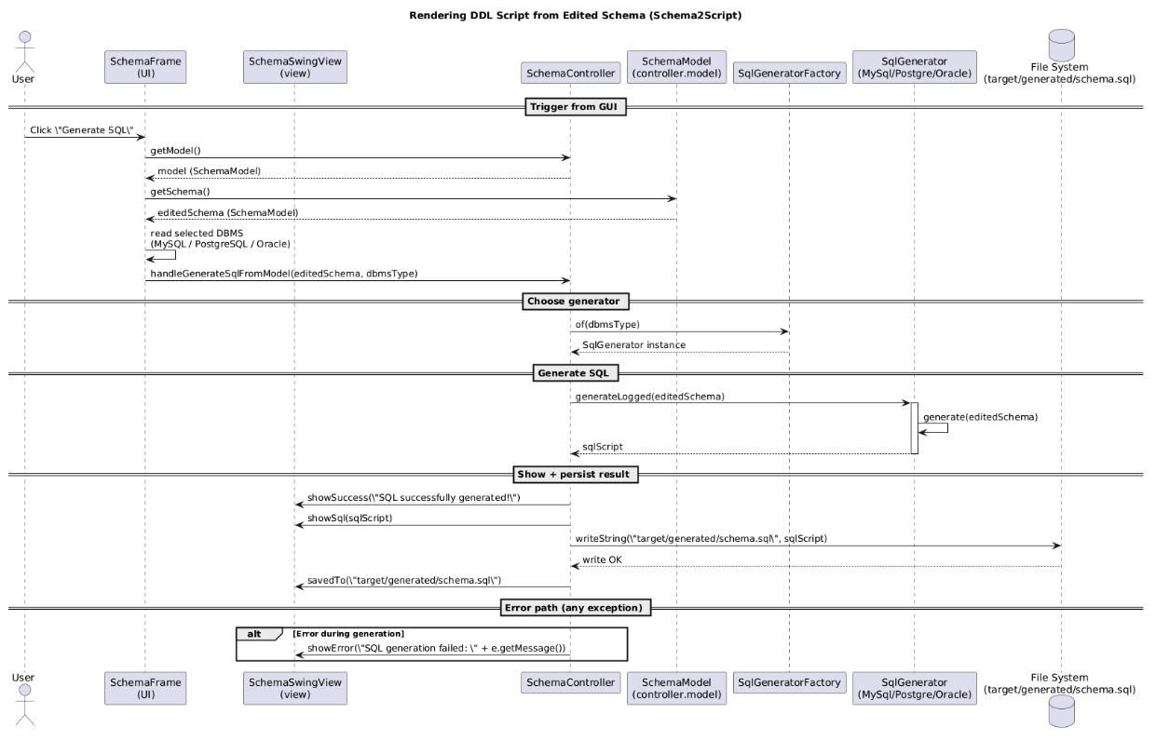
Sequence Diagram
Notes:
This sequence diagram shows the full workflow of generating the SQL script after the user edits the schema in the GUI.
It starts when the user clicks Generate SQL in the Swing interface. The SchemaFrame asks the controller for the current SchemaModel, which already contains all visual edits made by the user. Once it retrieves the edited schema, the GUI also reads the selected database type, such as MySQL, PostgreSQL, or Oracle.
This information is passed to the controller through handleGenerateSqlFromModel. The controller then calls the SqlGeneratorFactory, which returns the correct generator implementation for the chosen DBMS.
After that, the controller invokes generateLogged on the generator. The generator converts the unified SchemaModel into the final SQL DDL script. When the script is ready, it’s returned to the controller.
The controller then updates the GUI by showing a success message and displaying the generated SQL. It also writes the script to target/generated/schema.sql so the user has a saved version.
Finally, if anything fails during generation or saving, the process switches into the error path, and the GUI shows an error message to the user.

Slide 9
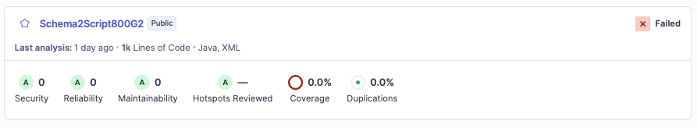
SonarQube Analysis
Notes:
Here is our final SonarQube analysis for the Schema2Script project.
All three key quality categories — Security, Reliability, and Maintainability — received an A rating, with zero issues reported in each of these areas. This means our codebase has no security vulnerabilities, no reliability problems, and no maintainability concerns according to SonarQube’s ruleset.
We also have zero hotspots, zero duplications, and SonarQube confirmed that the project contains no duplicated logic across the codebase.

Slide 10
Reflection – What Is Missing
Relationship visualization in the GUI
Drag-and-drop schema editing
Undo/redo functionality
Exporting edited schema back into JSON/XML
More advanced SQL formatting options
Configurable output file location
Additional DBMS generators (e.g., SQL Server, SQLite)
Notes:
Here are the features we didn’t manage to implement within the milestone scope.
We weren’t able to add full relationship visualization or drag-and-drop editing, and undo/redo was a larger UI task than expected.
We also didn’t build schema export or extra DBMS generators due to time limitations. These are all realistic next steps for extending the project.

Slide 11
Reflection – What We Are Most Proud Of
Fully working end-to-end pipeline (parse → edit → generate SQL)
Clean modular architecture with factories and interfaces
Unified SchemaModel enabling consistent processing
Stable Swing-based editor with real-time updates
Reliable SQL generation for three DBMS systems
Strong team collaboration and consistent communication
Notes:
The part we’re most proud of is that the system now works completely from start to finish.
We have a clean architecture, a unified model, and a functional GUI that lets the user edit schemas visually and instantly generate SQL.
Our team stayed consistent and cooperative throughout the project, which made the whole development process smooth.

Slide 12
Reflection – What Could Have Been Done Better
More advanced GUI design and layout improvements
Better error handling and user feedback in the editor
Additional unit tests and test coverage reporting
More detailed input validation in parsers and GUI
Clearer separation between UI and controller logic
Improved time management for optional features
Notes:
If we had more time, we would improve our GUI layout, add stronger validation, and expand our test coverage.
We’d also refine the separation between the UI and controller to reduce responsibility overlap.
And finally, we’d allocate more time for optional features like schema export and better relationship editing.

