Slide 1


Slide 2
The problem
Sometimes you need to debug an issue that requires checking what has changed in a configuration file stored in b:hive
Or you forget what is the naming convention for your project file structure

Slide 3
Typical workflow
Go to http://bhive.bazaarvoice.com/<proj>/doc/?path=<filePath>
Copy the previous revision number
Go to http://bhive.bazaarvoice.com/<proj>/doc/<filePath>?v=<version>
Download that file (and the head revision)
jsonpp + diff in command line

Slide 4
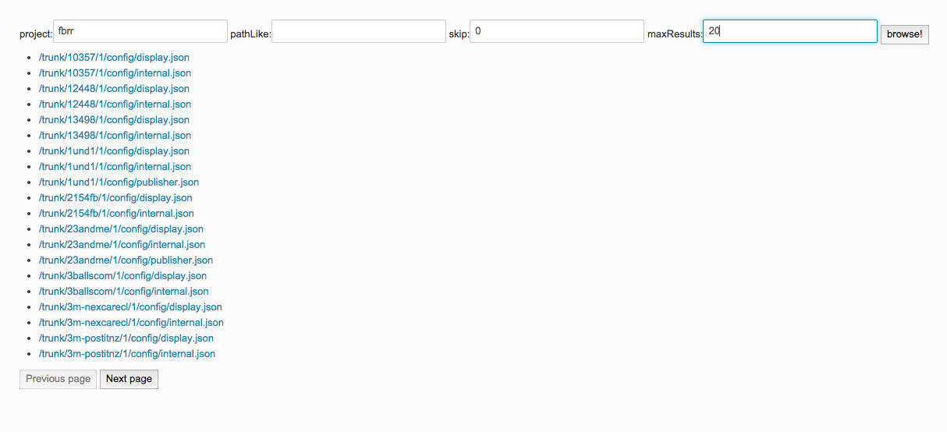
This is it
browse and paginate

Slide 5
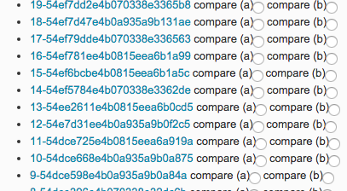
Examine revisions

Slide 6
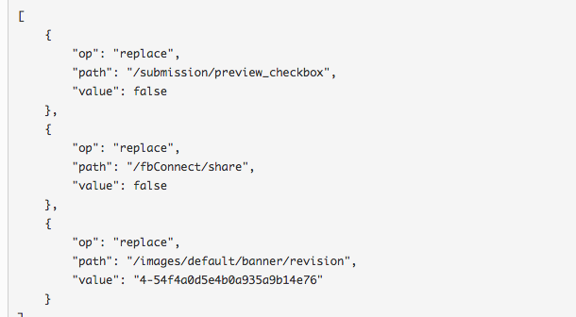
Compare

Slide 7
Technology
Mostly client-side with Angular.js
Only needs a tiny node.js server to add jsonp to b:hive requests (using the mashery endpoint would remove that dependency)
Please don’t look at the code, it’s rubbish

Slide 8
Lessons learnt
Coffee makes me more annoying than alcohol
You really need a designer in your team
Low hanging fruit is as delicious as the higher hanging fruit
Praveen can only withstand 2 hours of movie soundtracks looping in the background
Gamble’s beard should be in some currency

