Slide 1
Automatic Image Curation
Can a computer model predict the usefulness of a review image?

Slide 2

Preparing the data
Filter reviews with images and user feedback
Fetch all the images!

Slide 3
We need to digest the images
Pixel RGB values are a lot of numbers that do not tell us much
We need a few numbers that tell us a lot

Slide 4
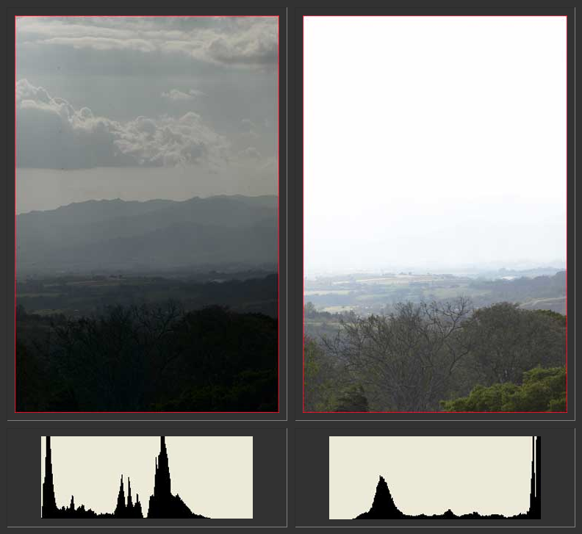
What photographers do
They look at the histogram
It tells if an image is overexposed or underexposed
And how contrasty it is

Slide 5

Going a little bit further
We can do multilevel analysis
If we downscale the image and get the new histogram, we get information about microcontrast: the histogram goes flatter.
That is what makes an image “pop”

Slide 6

An Artificial Neural Network
They are good to do regression on multidimensional data
They can discover hidden relations between inputs and outputs

Slide 7
Our data set and network topology
Input:
Histogram quantized for 8 levels of gray
For 4 different resolution images
Output:
The number of positive feedback the review had
Topology
Backpropagation 1 hidden layer with 128 nodes, full connectivity

Slide 8
The results
The ANN is very good at predicting…

Slide 9
Wait for it…

Slide 10
NOTHING
But it is very good giving us a value around the median feedback for almost all the reviews
That kept the error low

Slide 11
Some more insights
By manually inspecting the images I found
Useful reviews often have poor images
The most beautiful images were for cameras
I blame my University teachers for giving me unrealistic expectations on AI

