Slide 1

ASIC design: approach 1
01/08/2021

Slide 2
AES algorithm’s steps

Slide 3
Substitution according to table
Shifting
Multiplication matrix x matrix
XOR between matrix (3) and round key
Upwards shift
Substitution (step 1)
XOR between matrix column and corresponding rc constant
Key
Generation

Slide 4
Encoding
Key Gen.
ROM
(Rijndael
S-box)
ROM
(rc cons)
Subs
(16 blocks)
Shifters
(16 sfts, 4 blks of 4-serial shts)
Key_{i} storage
(4x4 matrix)
Shifters
(16 sfts, 4 blks of 4-serial sfts)
Multipl.
(16 muls, 4 sums)
Galinois’ check
(…)
Subs
(16 blocks)
XOR
(16 blocks)
XOR
(16 blocks)
AXI 4 (bus)

Slide 5
Extra notes
The ASIC schematic is divided into two parts since the key generation process and the encryption of the data can be done in parallel.
Since the shifters are used simultaneously and in different directions (sidewards vs upwards), I decided to implement two modules
Problem: Galinois’ multiplication
Further investigation should be carried in order to merge the data extracted from the AES’ code and the gates/schematic that will be implemented in the ASIC.

Slide 6
Multiplicator (enc, submódul)
8
8
8
8
8
8
8
8
8-bit number
8-bit number
8-bit number
8-bit number
8-bit number
8-bit number
8-bit number
8-bit number
Comp_mul_2to1.sv
16-bit number
16-bit number
16-bit number
16-bit number
C
16-bit number
Comp_sum_4to1.sv
16-bit number

Slide 7
Multiplicator (enc)
1
2
16
8
8
8
8
8
8
8
8
8-bit number
8-bit number
8-bit number
8-bit number
8-bit number
8-bit number
8-bit number
8-bit number
16-bit number
16-bit number
16-bit number
16-bit number
…
C
16-bit number
16-bit number
P₀₀ (16-bit)
P₀₁ (16-bit)
P₃₃ (16-bit)

Slide 8
tb:

Slide 9
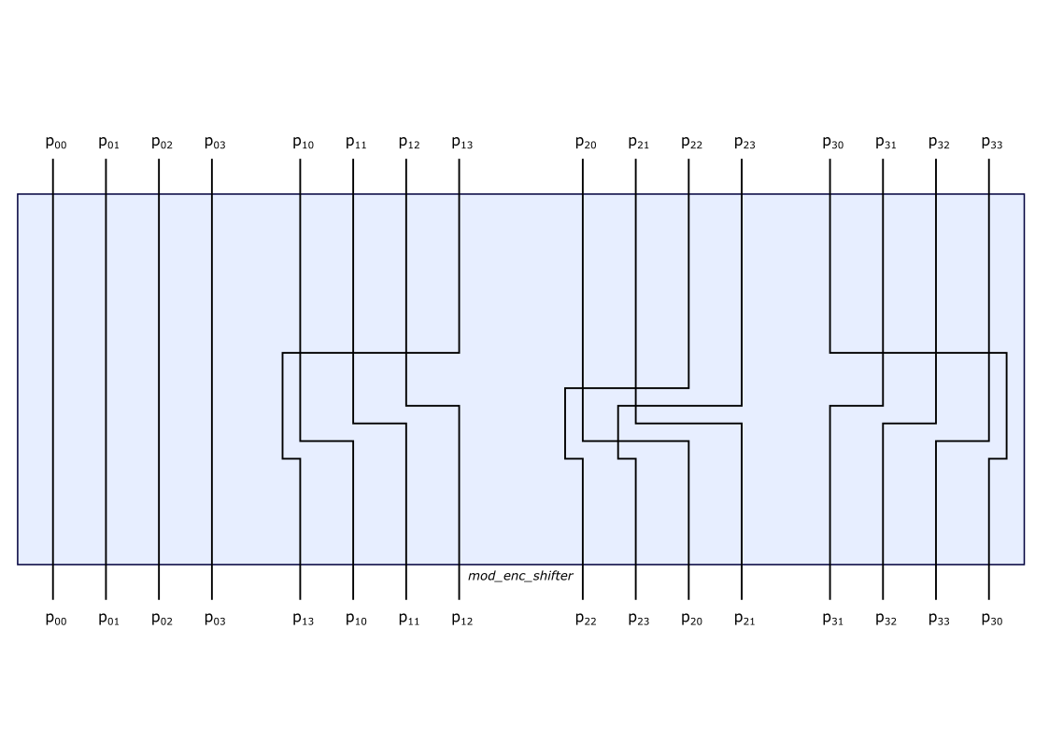
Shifter (enc)

Slide 10
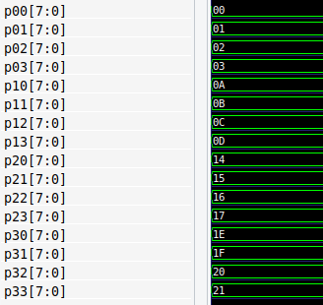
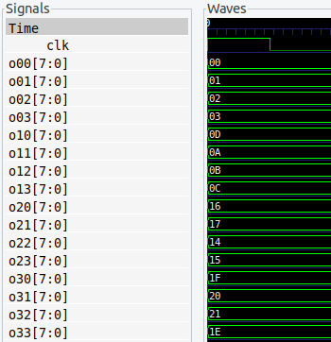
tb: SUCCESSFUL
p00 | 00 | o00 | 00
p01 | 01 | o01 | 01
p02 | 02 | o02 | 02
p03 | 03 | o03 | 03
p10 | 0A | o10 | 0D
p11 | 0B | o11 | 0A
p12 | 0C | o12 | 0B
p13 | 0D | o13 | 0C
p20 | 14 | o20 | 16
p21 | 15 | o21 | 17
p22 | 16 | o22 | 14
p23 | 17 | o23 | 15
p30 | 1E | o30 | 1F
p31 | 1F | o31 | 20
p32 | 20 | o32 | 21
p33 | 21 | o33 | 1E

Slide 11
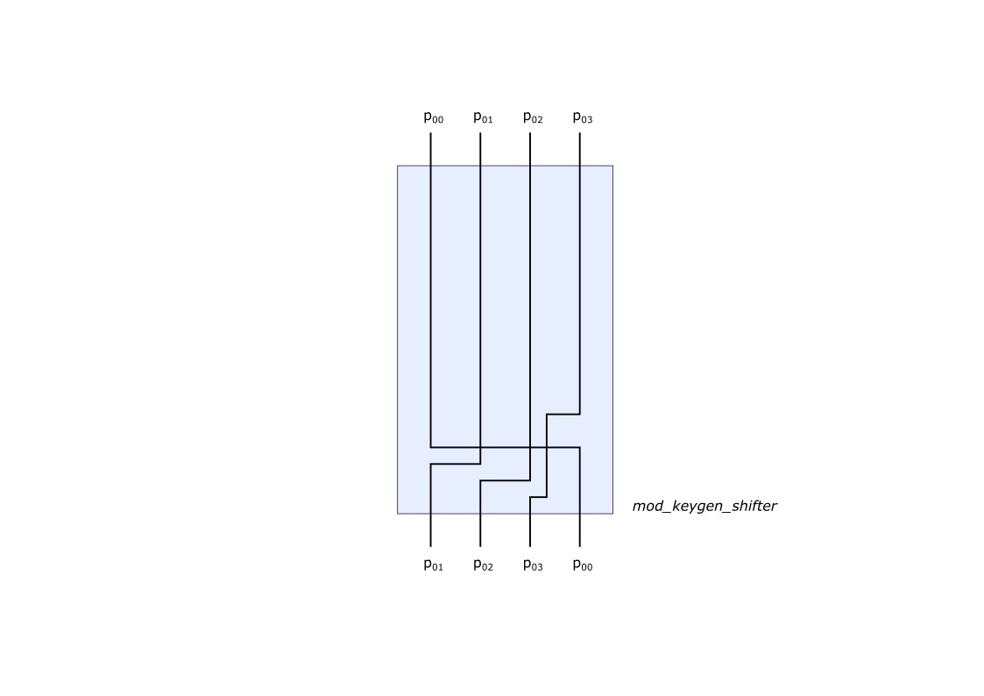
Shifter (keygen)

Slide 12
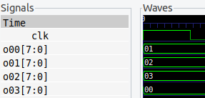

tb: SUCCESSFUL
p00 | 00 | o00 | 01
p01 | 01 | o01 | 02
p02 | 02 | o02 | 03
p03 | 03 | o03 | 00

