Slide 1

ASIC design: approach 1
01/08/2021

Slide 2
AES algorithm’s steps

Slide 3
Substitution according to table
Shifting
Multiplication matrix x matrix
XOR between matrix (3) and round key
Upwards shift
Substitution (step 1)
XOR between matrix column and corresponding rc constant
Key
Generation

Slide 4
Encoding
Key Gen.
ROM
(Rijndael
S-box)
ROM
(rc cons)
Subs
(16 blocks)
Shifters
(16 sfts, 4 blks of 4-serial shts)
Key_{i} storage
(4x4 matrix)
Shifters
(16 sfts, 4 blks of 4-serial sfts)
Multipl.
(16 muls, 4 sums)
Galinois’ check
(…)
Comp_mul_2to1.sv
Subs
(16 blocks)
AddRoundKey (XOR)
(16 blocks)
XOR
(16 blocks)
AXI 4 (bus)
Notes:
NOTE: Maybe the “Upward shift” step is only performed with the first column and we only perform and XOR with the rest of the key’s column (check https://towardsdatascience.com/aes-encryption-256-bit-a9ae49cde0b6 for more details).

Slide 5
Extra notes
The ASIC schematic is divided into two parts since the key generation process and the encryption of the data can be done in parallel.
Since the shifters are used simultaneously and in different directions (sidewards vs upwards), I decided to implement two modules
Problem: Galinois’ multiplication
Further investigation should be carried in order to merge the data extracted from the AES’ code and the gates/schematic that will be implemented in the ASIC.

Slide 6
List of components
Overall | .sv done | tb | Use of matrices
Device | - | -
reg16 | OK | OK | OK
Encryption side (enc) | .sv done | tb | Use of matrices
Subsitution (module) | OK | -
Shifter (module) | OK | OK | OK
MixColumns (module) | - | -
Multiplicator (module) | OK | -
Multiplicator (component) | OK | -
Adder (component) | OK | - | OK
Galois operator (module) | - | -
AddRoundKey (module) | OK | OK | OK
ROM | OK | OK | OK
Keygen side (keygen) | .sv done | tb | Use of matrices
Shifter (module) | OK | Done but not working | OK
Substitution (module) | OK | -
XOR (module) | - | -

Slide 7
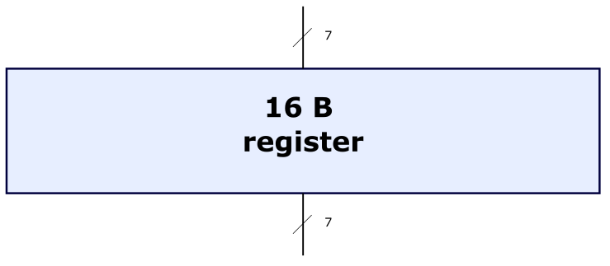
16-byte register
Notes:
Creating a ROM verilog:
https://vlsiworld-asic.blogspot.com/2012/02/verilog-code-for-ram-rom.html
https://github.com/Obijuan/open-fpga-verilog-tutorial/wiki/Cap%C3%ADtulo-26:-Memoria-ROM

Slide 8
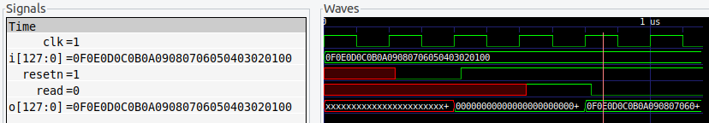
tb: successful

Slide 9
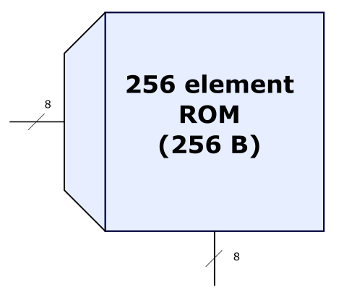
ROM (module)
Notes:
Creating a ROM verilog:
https://vlsiworld-asic.blogspot.com/2012/02/verilog-code-for-ram-rom.html
https://github.com/Obijuan/open-fpga-verilog-tutorial/wiki/Cap%C3%ADtulo-26:-Memoria-ROM

Slide 10
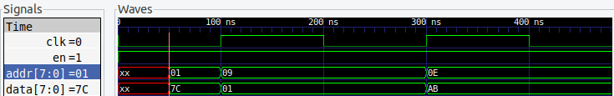
Tb: successful
ROM v1.0 (reading from file)

Slide 11
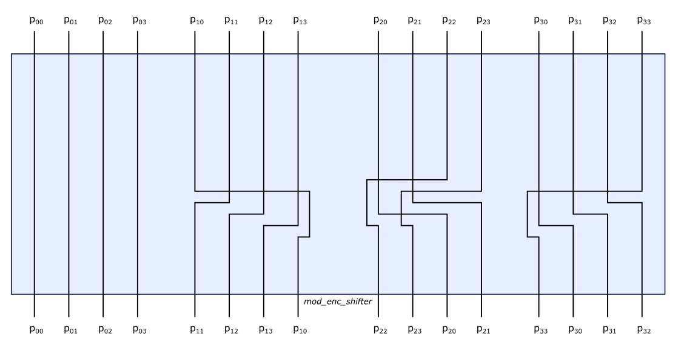
Shifter (enc)

Slide 12
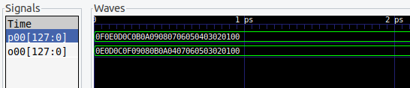
tb: SUCCESSFUL
p00 | 00 | o00 | 00
p01 | 01 | o01 | 01
p02 | 02 | o02 | 02
p03 | 03 | o03 | 03
p10 | 04 | o10 | 05
p11 | 05 | o11 | 06
p12 | 06 | o12 | 07
p13 | 07 | o13 | 04
p20 | 08 | o20 | 10
p21 | 09 | o21 | 11
p22 | 10 | o22 | 08
p23 | 11 | o23 | 09
p30 | 12 | o30 | 15
p31 | 13 | o31 | 12
p32 | 14 | o32 | 13
p33 | 15 | o33 | 14

Slide 13
Multiplicator (submodule, enc)
8
8
8
8
8
8
8
8
8-bit number
8-bit number
8-bit number
8-bit number
8-bit number
8-bit number
8-bit number
8-bit number
Comp_mul_2to1.sv
16-bit number
16-bit number
16-bit number
16-bit number
C
16-bit number
Comp_sum_4to1.sv
16-bit number

Slide 14
Multiplicator (module, enc)
1
2
16
8
8
8
8
8
8
8
8
8-bit
8-bit
8-bit
8-bit
8-bit
8-bit
8-bit
8-bit
16-bit
16-bit
16-bit
16-bit
…
C
16-bit
16-bit
P₀₀ (16-bit)
P₀₁ (16-bit)
P₃₃ (16-bit)

Slide 15
tb:

Slide 16
AddRoundKey (enc)
8
8
8
8
8
8
8
8
8
8
8
8
8
8
8
8
8
8
8
8
8
8
8
8
8
8
8
8
8
8
8
8
8-bit
8-bit
8-bit
8-bit
8-bit
8-bit
8-bit
8-bit
8-bit
8-bit
8-bit
8-bit
8-bit
8-bit
8-bit
8-bit
8-bit
8-bit
8-bit
8-bit
8-bit
8-bit
8-bit
8-bit
8-bit
8-bit
8-bit
8-bit
8-bit
8-bit
8-bit
8-bit
8-bit
8-bit
8-bit
8-bit
8-bit
8-bit
8-bit
8-bit
8-bit
8-bit
8-bit
8-bit
8-bit
8-bit
8-bit
8-bit
Notes:
Doubt 1: The output for the XOR modules, having an input of two 8-bit numbers, will be 8-bit or 16-bit?

Slide 17
tb: SUCCESSFUL
Position | P_{xy} hex (dec) | K_{xy} hex (dec) | o_{xy}
00 | 00 (00) | 0A (10) | 0A
01 | 01 (01) | 0A (10) | 0B
02 | 02 (02) | 0A (10) | 08
03 | 03 (03) | 0A (10) | 09
10 | 0A (10) | 0F (15) | 05
11 | 0B (11) | 0F (15) | 04
12 | 0C (12) | 0F (15) | 03
13 | 0D (13) | 0F (15) | 02
20 | 14 (20) | 14 (20) | 00
21 | 15 (21) | 14 (20) | 01
22 | 16 (22) | 14 (20) | 02
23 | 17 (23) | 14 (20) | 03
30 | 1E (30) | 28 (40) | 36
31 | 1F (31) | 28 (40) | 37
32 | 20 (32) | 28 (40) | 08
33 | 21 (33) | 28 (40) | 09
Notes:
Website for manual verification: https://xor.pw/#
Hexadecimal to decimal conversion and vice versa: https://www.rapidtables.com/convert/number/hex-to-decimal.html

Slide 18
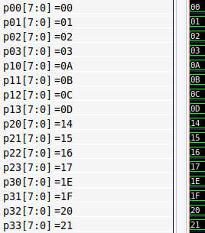
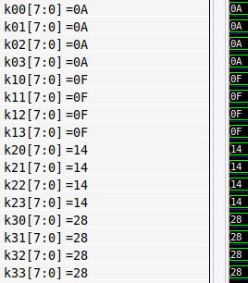
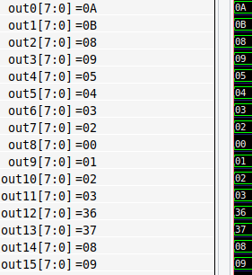
=
XOR

Slide 19
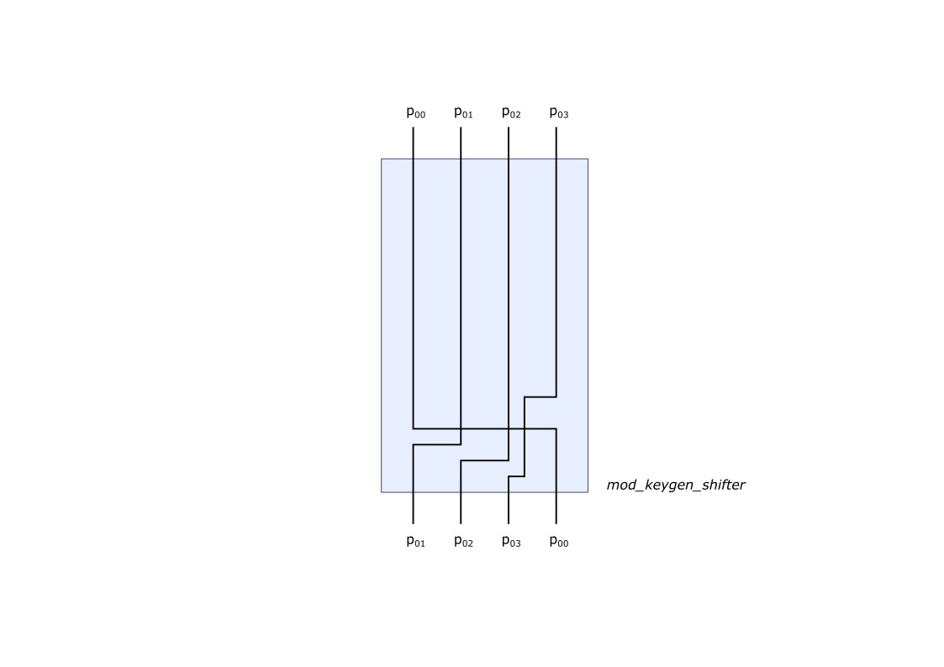
Shifter (keygen)

Slide 20
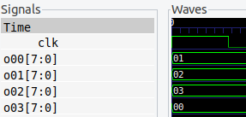

tb: SUCCESSFUL
p00 | 00 | o00 | 01
p01 | 01 | o01 | 02
p02 | 02 | o02 | 03
p03 | 03 | o03 | 00

