Slide 1
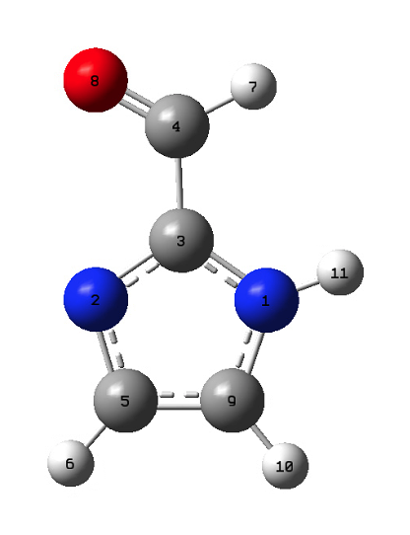
Imidazolate-2-carboxyaldehyde
o
hc
c
cc
hn
nc
nc
cd
cd
h4
h4

Slide 2
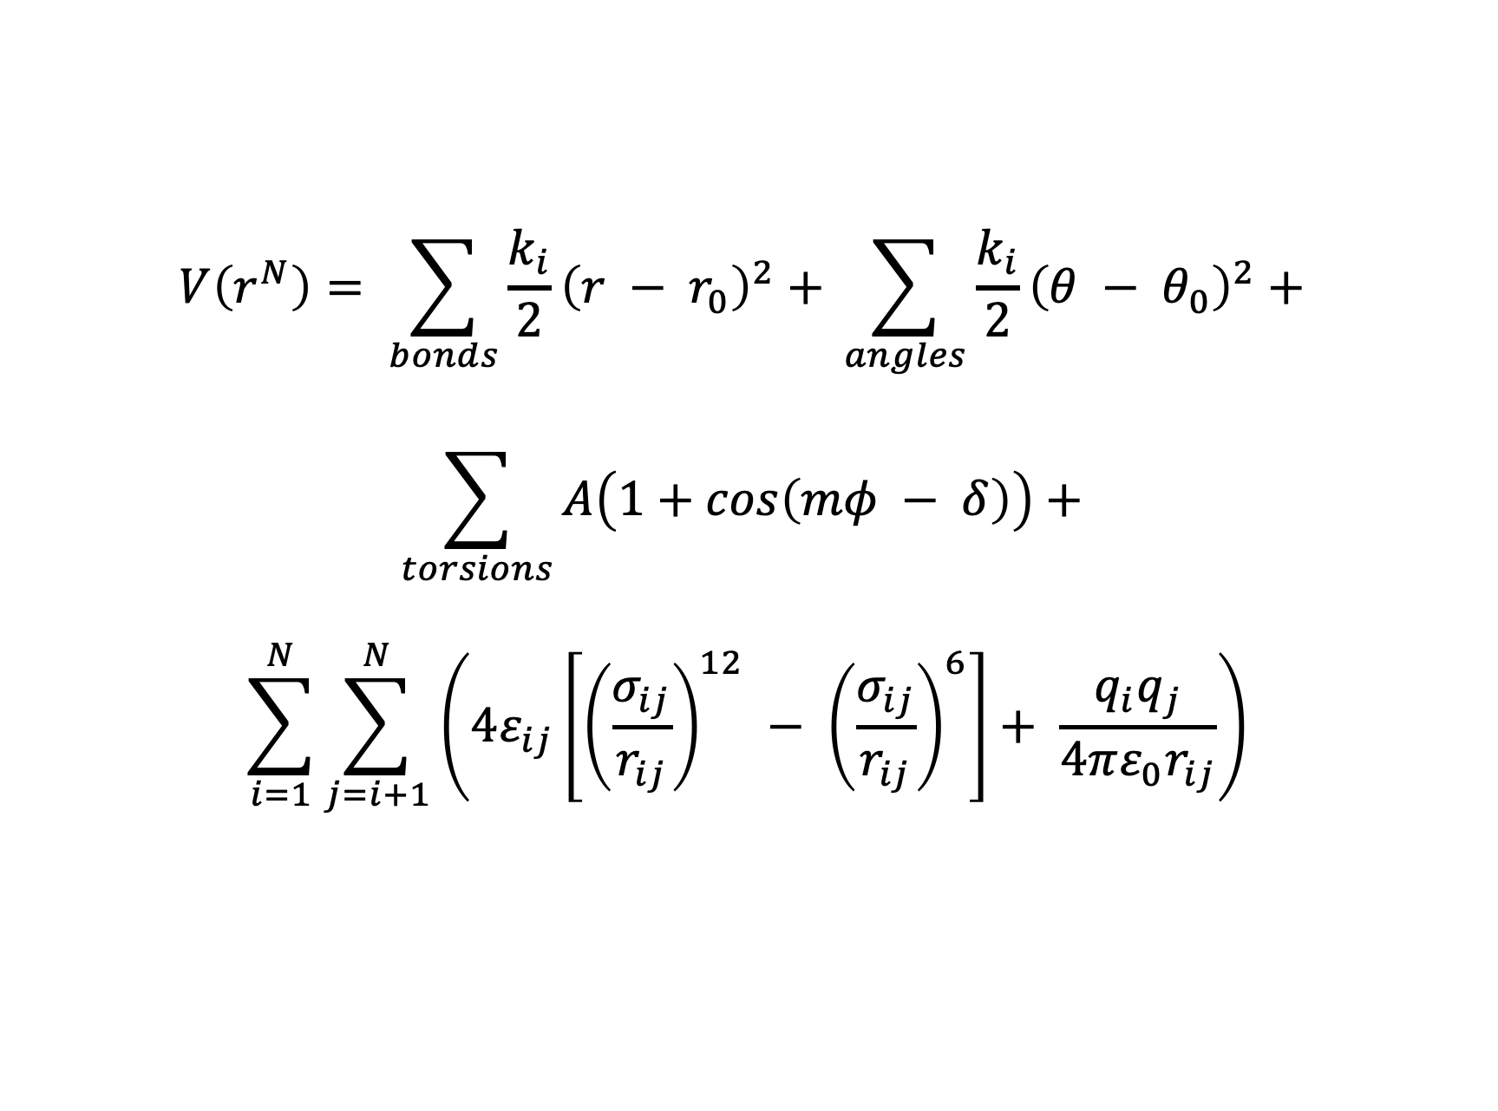
Functional form
$$V\left(r^{N}\right)= \sum_{bonds}{\frac{k_{i}}{2}{\left(r − r_{0}\right)}^{2}+ }\sum_{angles}{\frac{k_{i}}{2}{\left(θ − θ_{0}\right)}^{2}+ }$$
$$\sum_{torsions}{A\left(1+cos\left(mφ − δ\right)\right)}+$$
$$\sum_{i=1}^{N}{\sum_{j=i+1}^{N}{\left(4ε_{ij}\left[{\left(\frac{σ_{ij}}{r_{ij}}\right)}^{12} − {\left(\frac{σ_{ij}}{r_{ij}}\right)}^{6}\right]+ \frac{q_{i}q_{j}}{4πε_{0}r_{ij}}\right)}}$$

Slide 3
Scaling for 1—4 non-bonded interactions
Dihedrals:
1—4 electrostactic interaction scale factor: 0.833333
1—4 van der Waals interaction scale factor: 0.500000
Impropers:
1—4 electrostactic interaction scale factor: 0.000000
1—4 van der Waals interaction scale factor: 0.000000
Note that in both force_field.dat and FIELD, the central atom in the improper is the first one listed

Slide 4
Energy contributions
Term | Energy contribution (kcal/mol)
Chemical bond energy | 5.482052
Valence angle/3-body potential energy | 11.93073
Dihedral/inversion/four body energy | 0.009797326
Electrostatic energy | 12.19756
VdW/metal/Tersoff energy | 0.789953

